Slide 1
Project NYLS
SCHWAB Lucas
NICOLAS Maxime
LANUEL Charlotte
YVOZ Stéphane

Slide 2
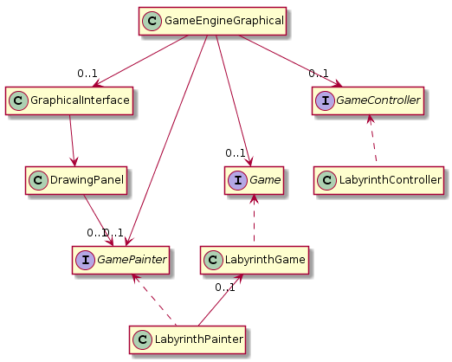

Slide 3
Sprint 1
Setting up project structure and git
Map generated from a file
Hero is able to move

Slide 4
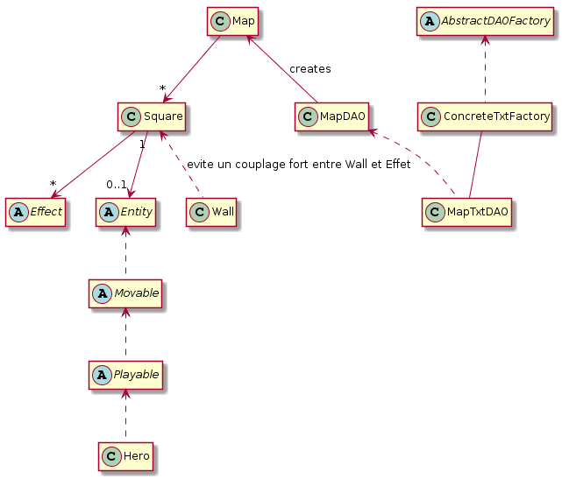

Slide 5
Sprint 2
Treasure and teleportation portals
monsters
Basic attack system

Slide 6
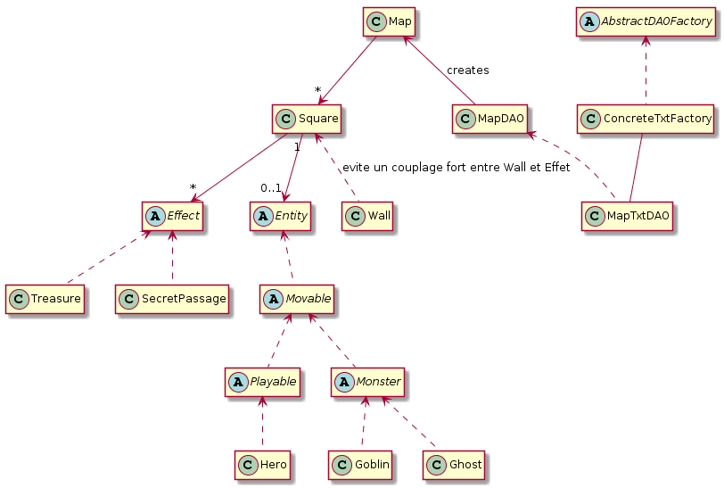

Slide 7
Sprint 3
Textures
Healing/Trap
Random monster’s movements
Changing level

Slide 8
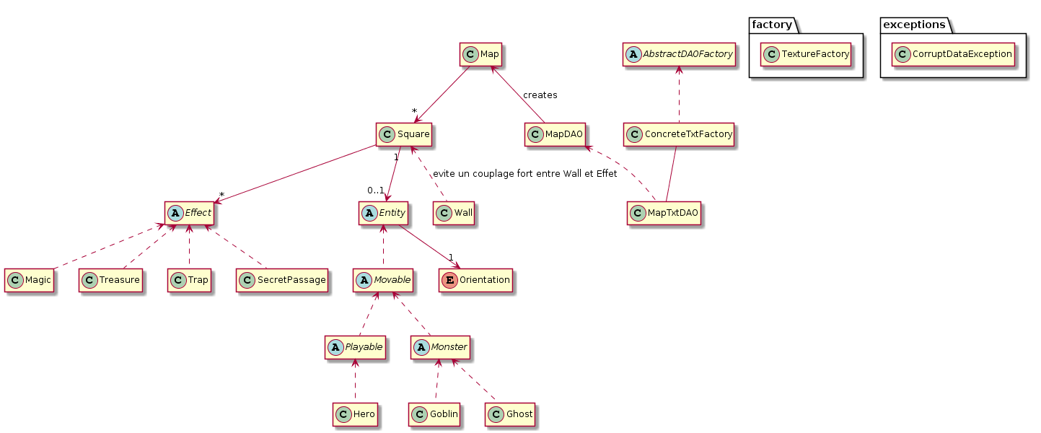

Slide 9
Sprint 4
Option menu (Save, Load, …)
Manual attacks
IA for monsters
GameOver
Graphical enhancements
Possibilities for random positionning

Slide 10
