Slide 1
xFuzz: Machine Learning Guided Cross-Contract Fuzzing
Yinxing Xue, Jiaming Ye, Wei Zhang, Jun Sun, Lei Ma, Haijun Wang, and Jianjun Zhao
TDSC 2022

Slide 2
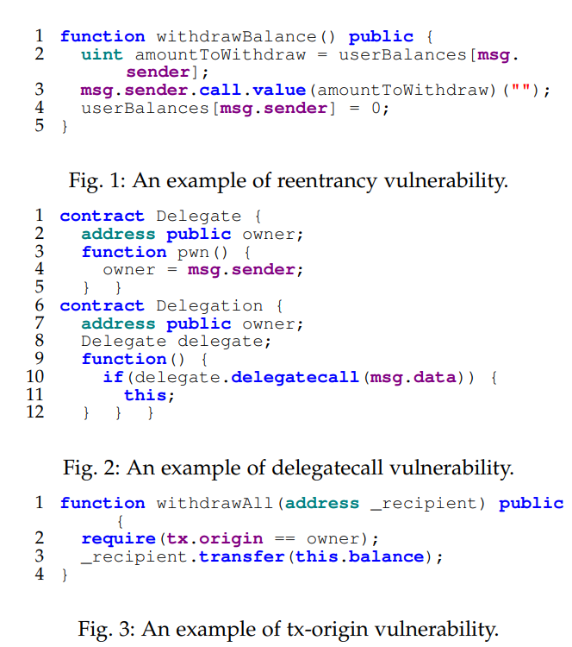
Motivation
1. Common drawback of static and dynamic tools: detection rules are built-in and predefined by developers
2. Applying machine learning -> improving fuzzing efficiency in C/C++ programs
[ICSE 2019] Leopard: Identifying vulnerable code for vulnerability assessment through program metrics
[ASE 2017] Learn&fuzz: Machine learning for input fuzzing
3. Existing works focus on intra-contract scope
Guide the fuzzing via the aid of ML models

Slide 3
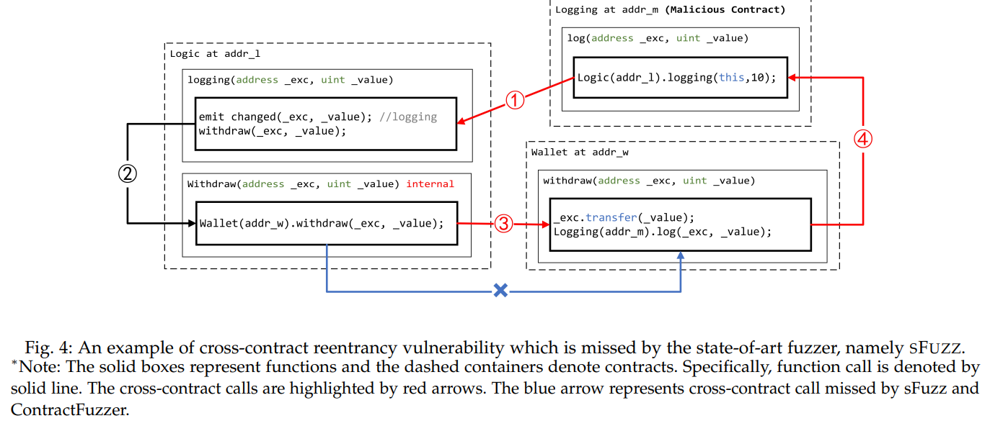
Motivation

Slide 4
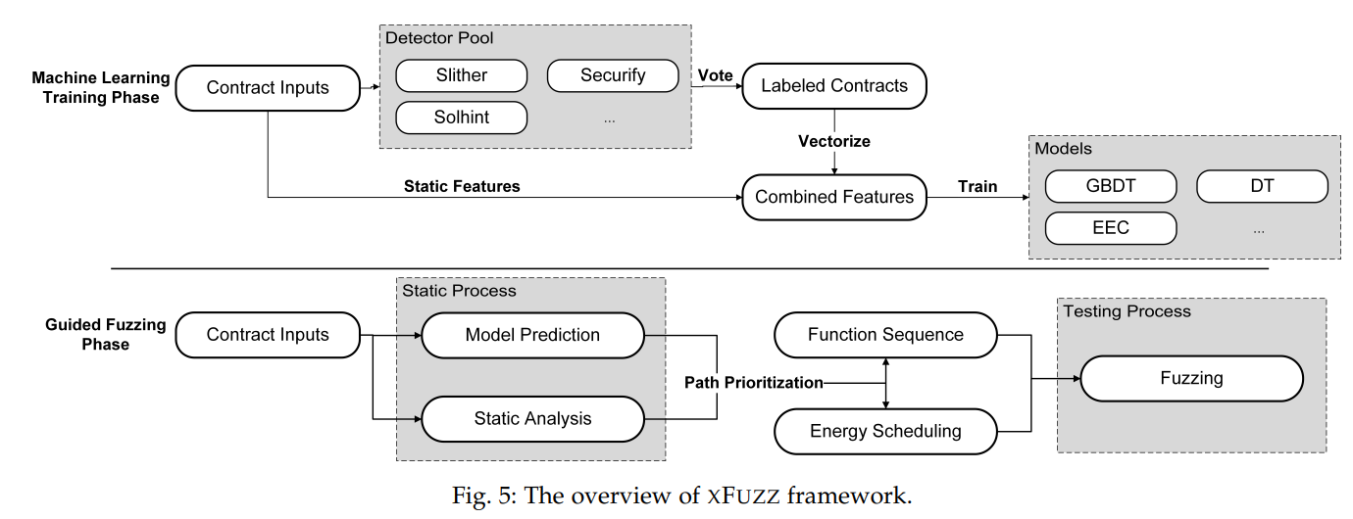
Overview

Slide 5
Research Questions
How to train the machine learning model and achieve satisfactory precision and recall?
How to combine trained model with fuzzer to reduce search space towards efficient fuzzing?
How to empower the guided fuzzer the support of effective cross-contract vulnerability detection?

Slide 6
ML Guidance Preparation
Dataset
Vuln benchmark: scarce, insufficient
Use voting result of Solhint, Slither and Securify
Etherscan 100139 contracts -> 788 reentrancy, 40 delegatecall and 334 tx-origin, manually confirm
Feature Engineering
Slither source->bytecode, Word2Vec->20-d vector
7 static features: has_modifier, has_call, has_balance, callee_external, can_send_eth; has_delegate, has_tx_origin
Model Selection
Imbalanced dataset: 1162 vuln vs 98977 benign, use tree-based models

Slide 7
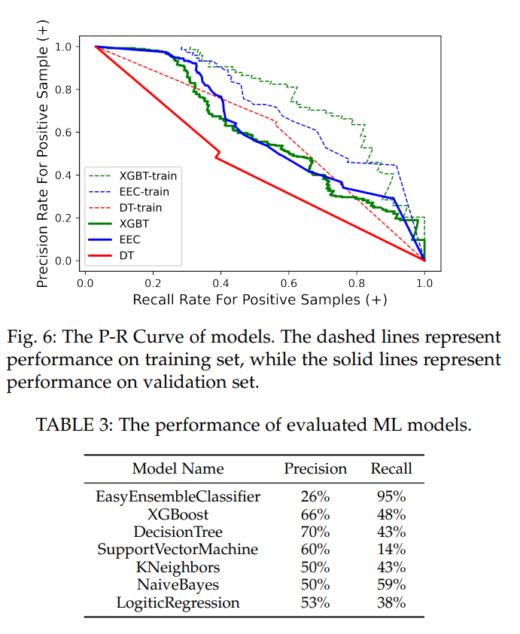
Model Selection

Slide 8
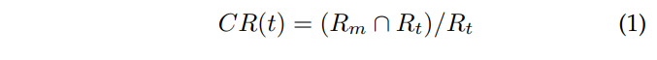
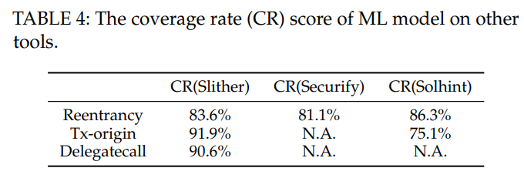
Model Robustness Evaluation
Evaluation dataset:
https://github.com/tintinweb/smart-contract-sanctuary
Filter majority versions: 0.4.24 and 0.4.25
Coverage Rate of ML Model on Another Tool:

Slide 9
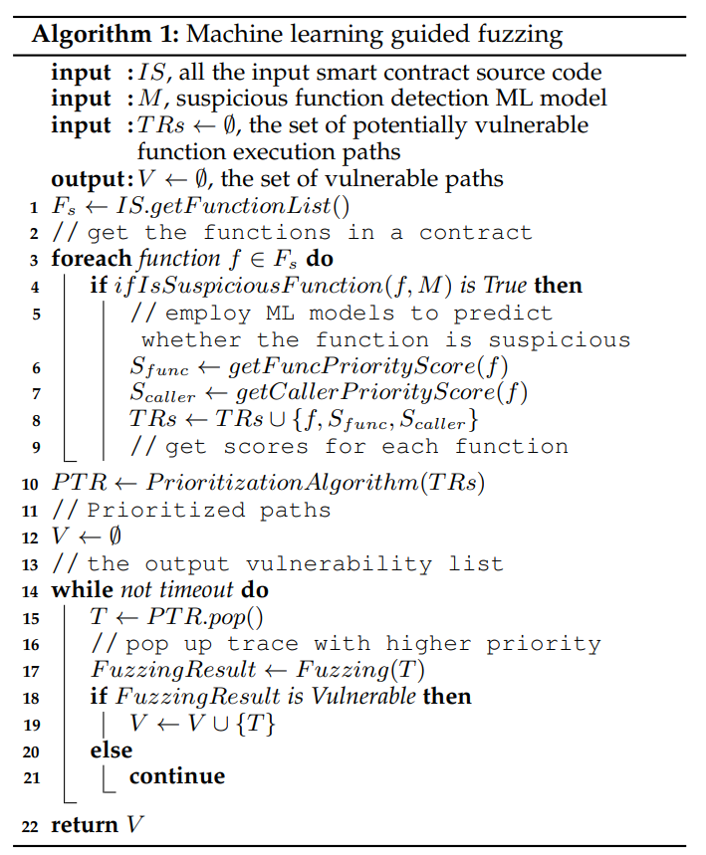
Guided Cross-Contract Fuzzing

Slide 10
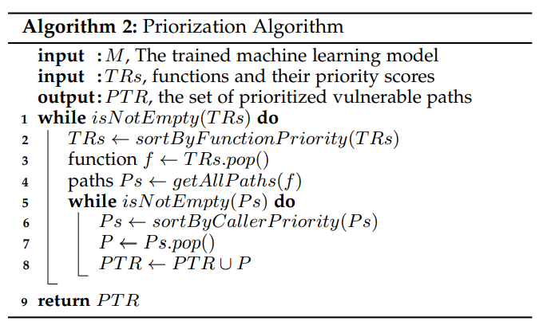
Guided Cross-Contract Fuzzing
Guidance Algorithm
Locate suspicious functions
Combine with static information for path prioritization

Slide 11
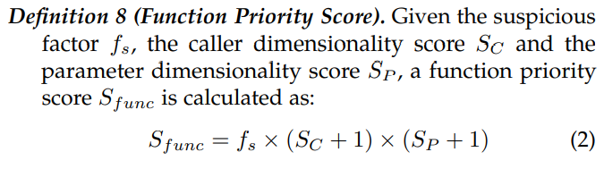
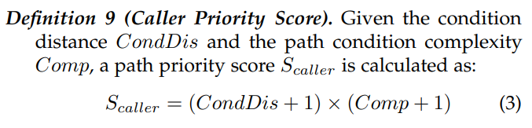
Priority Score
fs: 0.5 for suspicious, 1 for benign
Sc: number of callers
Sp: complexity of parameters
CondDis: #statements from entry to condition
Comp: #branch statements

Slide 12
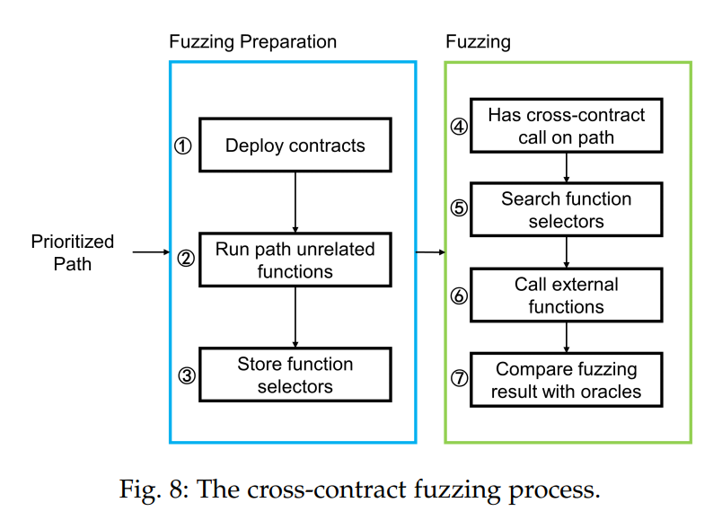
Cross-contract Fuzzing

Slide 13
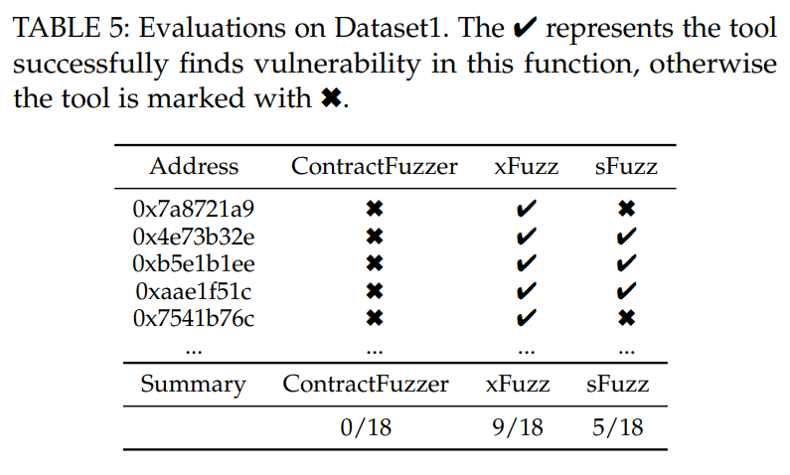
Evaluation: Vuln Detection Effectiveness
Dataset1: previous work, famous websites
18 labeled reentrancy vulnerabilities, no cross-contract ones
Difficult branch conditions blocking fuzzer to traverse vulnerable branches

Slide 14
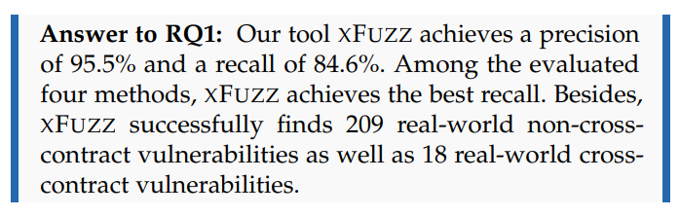
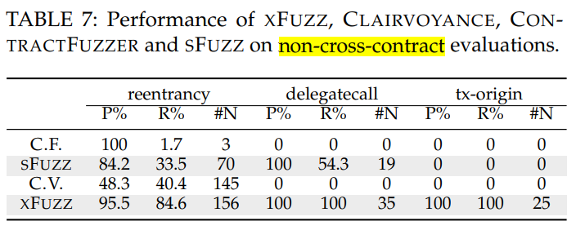
Evaluation: Vuln Detection Effectiveness
Dataset2: Etherscan 7391 contracts

Slide 15
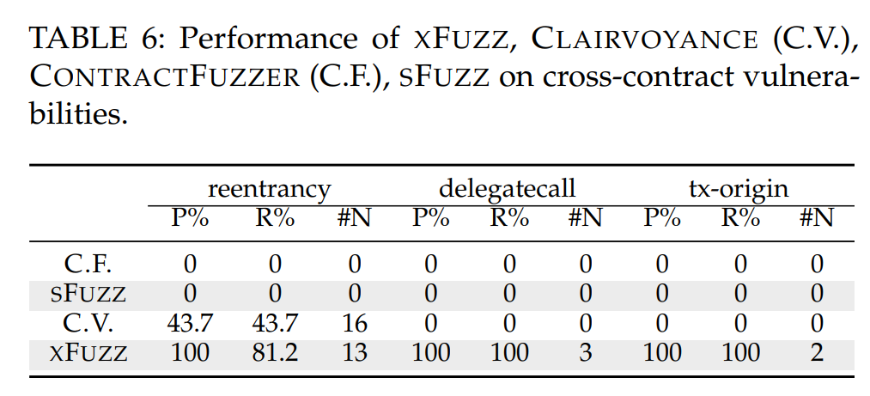
Evaluation: Vuln Detection Effectiveness
Dataset2: Etherscan 7391 contracts

Slide 16
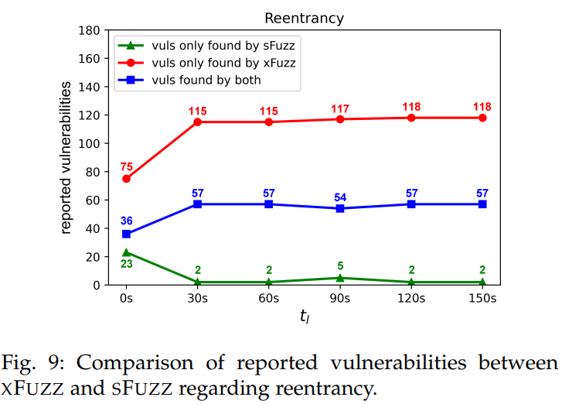
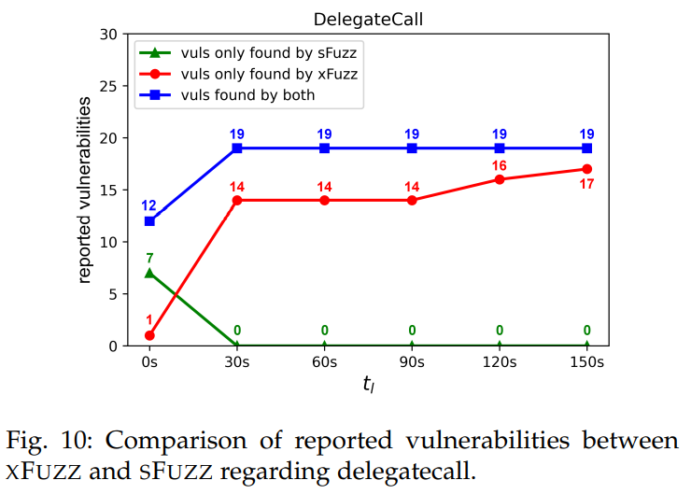
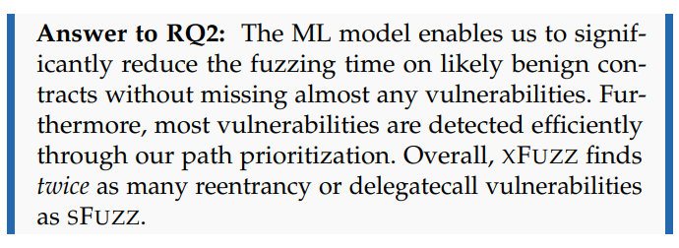
Evaluation: Effectiveness of Guided Fuzzing
sFuzz vs xFuzz-only-ML (no focus on cross-contract vuln)
Whether reducing time spent on benign contracts?
If predicted as benign, only fuzz t_{l} , else 180s

Slide 17
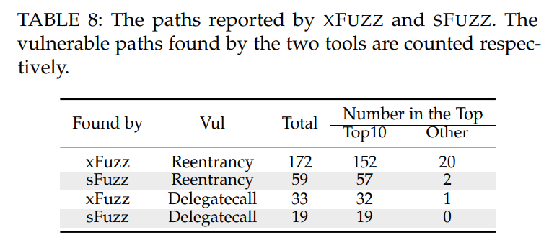
Evaluation: Effectiveness of Guided Fuzzing
Effectiveness of Path Prioritization

Slide 18
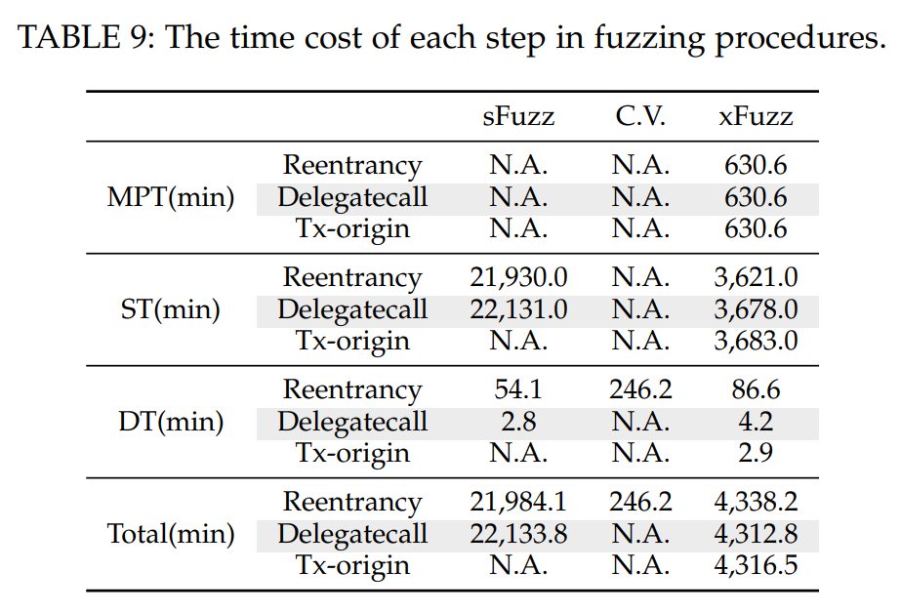
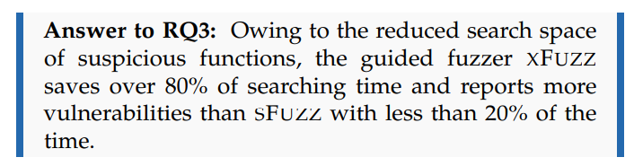
Evaluation: Detection Efficiency
Model prediction time
Search time for vulnerable paths
Detection time / Fuzzing time

Slide 19
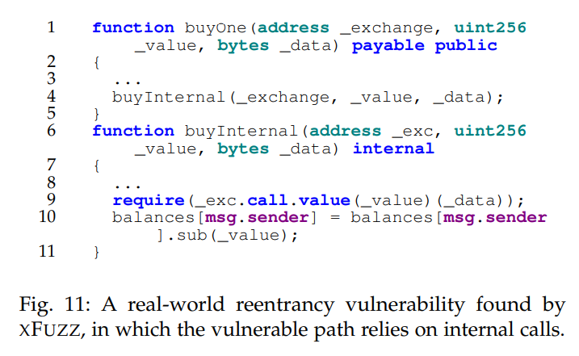
Real-world Case Studies

Slide 20
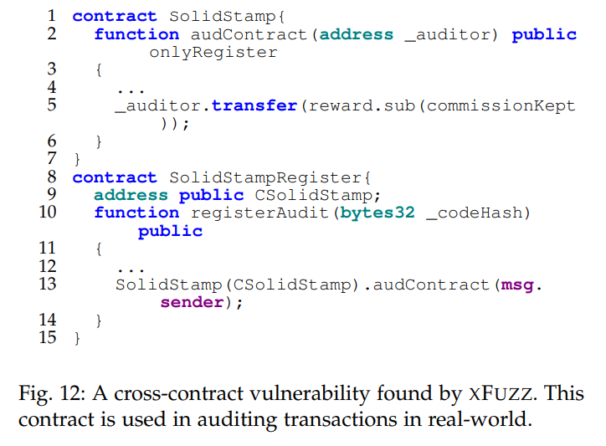
Real-world Case Studies

Slide 21
Conclusion
Novel ML guided fuzzing framework
Focus on cross-contract vulnerabilities
Address two key challenges:
Reducing search space
Completing cross-contract fuzzing
Faster than existing fuzzers and detectors

Slide 22
Questions
tx-origin漏洞: 与cross-contract并不相关
函数级别的ML是否站得住脚
为什么用静态分析工具投票来训练ML？
重入漏洞的检测规则
为什么要在字节码层面做word2vec 不使用源码
为什么不做成完全字节码 逆向提取那些静态特征
路径优先选择容易触发的有无必要 sFuzz也是top10发现大部分漏洞
数据集Dataset2的ground truth是啥 不可能人工打标签啊
Fuzzing的时间为什么这么短？
具体参数的选择 比如为什么预测有问题用0.5

