Slide 1
PROYEK AKHIR AI Dosen Pengampu : H. M. Faisal Amin, M.Kom
Melatih Jaringan Syaraf Dengan Backpropagation Untuk Melakukan Pembelajaran Terhadap Data Kebangkrutan Perusahaan
Oleh : Adi Darmana
NIM : 310125023966
Sekolah Tinggi Manajemen Informatika dan Komputer Banjarbaru 2026

Slide 2
NIM : 310125023966 | 4 digit: 3966 Multiplier : 0.3966 DATA Learning : 1.0 LEARNING RATE : 0.01 Konstanta e : 2.71828183 DATA TRAINING (sebelum skalasi): Data 1: x1=0.9, x2=0.4, t=1 Data 2: x1=0.73, x2=0.85, t=0 ↳ [Hasil setelah dikalikan 0.3966] target tetap: DATA TRAINING (setelah skalasi): Data 1: x1 = 0.356940, x2 = 0.158640, t = 1 Data 2: x1 = 0.289518, x2 = 0.337110, t = 0
DATA AWAL

Slide 3
• Bobot input ke hidden (Acak Mentah):
v11=0.9562 v12=0.7762 v13=0.1623 v14=0.2886
v21=0.1962 v22=0.6133 v23=0.0311 v24=0.9711
↳ [Hasil setelah dikalikan 0.3966]:
v11=0.379229 v12=0.307841 v13=0.064368 v14=0.114459
v21=0.077813 v22=0.243235 v23=0.012334 v24=0.385138
------------------------------------------------------------------
• Bobot bias ke hidden (Acak Mentah):
V01=0.7496 V02=0.3796 V03=0.7256 V04=0.1628
↳ [Hasil setelah dikalikan 0.3966]:
v01=0.297291 v02=0.150549 v03=0.287773 v04=0.064566
------------------------------------------------------------------
• Bobot hidden ke output (Acak Mentah):
w1=0.2280 w2=0.9585 w3=0.6799 w4=0.0550
↳ [Hasil setelah dikalikan 0.3966]:
w1 =0.090425 w2 =0.380141 w3 =0.269648 w4 =0.021813
------------------------------------------------------------------
• Bobot bias ke output (Acak Mentah):
w0=0.9505
↳ [Hasil setelah dikalikan 0.3966]: w0=0.376968

Slide 4
EPOCH 1 - DATA 1
OPERASI PADA HIDDEN LAYER

Slide 5
Rumus Penjumlahan Terbobot (z_in_{i}) z_in_{i} = v0_{i} + (v1_{i} * x1)+(v2_{i} * x2)
Diketahui :
v01= 0.297291 v02 = 0.150549 v03 = 0.287773 v04 = 0.064566
v11= 0.379229 v12 = 0.307841 v13 = 0.064368 v14 = 0.114459
v21= 0.077813 v22 = 0.243235 v23 = 0.012334 v24 = 0.385138
X1 = 0.356940, x2 = 0.158640
z_in1 = 0.297291 + (0.379229 x 0.356940) + (0.077813 x 0.158640) = 0.297291 + 0.135362 + 0.012344 = 0.444998
z_In2 = 0.150549 + (0.307841 x 0.356940) + (0.243235 x 0.158640) = 0.150549 + 0.109881 + 0.038587 = 0.299017
z_in3 = 0.287773 + (0.064368 x 0.356940 ) + ( 0.012334 x 0.158640) = 0.287773 + 0.022976 + 0.001957 = 0.312705
z_in4 = 0.064566 + (0.114459 x 0.356940) + ( 0.385138 x 0.158640) = 0.064566 + 0.040855 + 0.061098 = 0.166520

Slide 6



Rumus pengaktifan (z) z_{i} = $\frac{1}{1+e^{−{z_}_{ini}}}$
Diketahui :
z_in1 = 0.444998 z_in2 = 0.299017 z_in3 = 0.312705 z_in4 = 0.166520
z₁ = $\frac{1}{1+{2.71828183}^{−0.444998}}$
z₁ = $\frac{1}{0.609450}$
z₁ = 0.609449
z₂ = $\frac{1}{1+{2.71828183}^{−0.299017 }}$
z₂ = $\frac{1}{1.741547}$
z₂ = 0.574202
z₃ = $\frac{1}{1+{2.71828183}^{−0.312705 }}$
z₃ = $\frac{1}{1.731466}$
z₃ = 0.577545
z₄ = $\frac{1}{1+{2.71828183}^{−0.166520 }}$
z₄ = $\frac{1}{1.846605}$
z₄ = 0.541534

Slide 7
EPOCH 1 - DATA 1
OPERASI PADA OUTPUT LAYER

Slide 8
Rumus perkalian linier Combiner y_in = w0 + (w1*z1) + (w2 * z2) + (w3*z3) + (w4 * z4)
Diketahui :
z₁ = 0.609449 z₂ = 0.574202 z₃ = 0.577545 z₄ = 0.541534
w0 = 0.376968 w1 =0.090425 w2 =0.380141 w3 =0.269648 w4 =0.021813
y_in = 0.376968 + (0.090425 * 0.609449) + (0.380141 * 0.574202) + (0.269648 * 0.577545) + (0.021813 * 0.541534) = 0.817902

Slide 9


Rumus pengaktifkan (y) y = $\frac{1}{1+e^{−y_in}}$
Diketahui :
y_in = 0.817902 e = $2.71828183$
y = $\frac{1}{1+{2.71828183}^{−0.817902}}$ = $\frac{1}{1+0.441355}$ = $\frac{1}{1.441355}$ = 0.693791
Rumus error
error = t – y
error = 1- 0.693791 = 0.306209
error² (mse) = (0.306209)² = 0.093764
Apa itu MSE ?
(Mean Squared Error) adalah metrik evaluasi dalam statistik dan machine learning untuk mengukur seberapa jauh tebakan (prediksi) model dari data sebenarnya

Slide 10

Rumus delta (δ) δ = (t- y) * ($\frac{1}{1+e^{−y_in}}$) * [1 - ($\frac{1}{1+e^{−y_in}}$)] atau bisa disederhanakan δ = (t- y) * y * (1-y)
Diketahui :
t=1 y = 0.693791
δ = (1- 0.693791) * 0.693791 * (1-0.693791)
δ = (0.306209) * 0.693791 * (0.306209)
δ = (0.306209) * 0.212445 = 0.065053

Slide 11
Update Bobot Hidden
Rumus (Δwi)
Δwi = ά * δ * zi
Diketahui :
ά = 1.0 δ = 0.065053
Δw1 = 1.0 x 0.065053 x 0.609449 = 0.039646
Δw2 = 1.0 x 0.065053 x 0.574202 = 0.037353
Δw3 = 1.0 x 0.065053 x 0.577545 = 0.037571
Δw4 = 1.0 x 0.065053 x 0.541534 = 0.035228
Δw0 = 1.0 x 0.065053 = 0.065053

Slide 12
Rumus (δ_in_{i}) δ_in_{i} = δ * wi
Diketahui :
w1 = 0.090425 w2 = 0.380141 w3 = 0.269648 w4 = 0.021813
δ = 0.065053
δ_in₁ = 0.065053 x 0.090425 = 0.005882
δ_in₂ = 0.065053 x 0.380141 = 0.024729
δ_in₃ = 0.065053 x 0.269648 = 0.017541
δ_in₄ = 0.065053 x 0.021813 = 0.001419

Slide 13

Rumus (δi) δ_{i} = δ_in_{i}* ($\frac{1}{1+e^{−z_in}}$) * [1 - ($\frac{1}{1+e^{−zin}}$)] atau bisa disederhanakan δi = δ_in_{i} * zi * (1-zi)
Diketahui :
δ_in₁ = 0.005882 δ_in₂ = 0.024729 δ_in₃ = 0.017541 δ_in₄ = 0.001419
z₁ = 0.609449 z₂ = 0.574202 z₃ = 0.577545 z₄ = 0.541534
δ₁ = 0.005882 x 0.609449 x (1- 0.609449)
δ₁ = 0.005882 x 0.609449 0.390551= 0.001400
δ₂ = 0.024729 x 0.574202 x (1- 0.574202)
δ₂ = 0.024729 x 0.574202 x 0.425798 = 0.006046
δ₃ = 0.017541 x 0.577545 x (1- 0.577545)
δ₃ = 0.017541 x 0.577545 x 0.422455 = 0.004280
δ₄ = 0.001419 x 0.541534 x (1- 0.541534)
δ₄ = 0.001419 x 0.541534 x 0.458466 = 0.000352

Slide 14
Update Bobot Input Rumus w_{i} w_{i} (baru) = w_{i} + Δw_{i}
_{Diketahui :}
Δw0 = 0.065053 Δw1 = 0.039646 Δw2 = 0.037353 Δw3 = 0.037571 Δw4 = 0.035228
w0 = 0.376968 w1 =0.090425 w2 =0.380141 w3 =0.269648 w4 =0.021813
w₀ = 0.376968 + 0.065053 = 0.442021
w₁ = 0.090425 + 0.039646 = 0.130071
w₂ = 0.380141 + 0.037353 = 0.417494
w₃ = 0.269648 + 0.037571 = 0.307219
w₄ = 0.021813 + 0.035228 = 0.057041

Slide 15
Rumus (v₁₁) Δv_{1i} = ά * δ * x1
Diketahui :
ά = 1.0 x1= 0.356940
δ₁ = 0.001400 δ₂ = 0.006046 δ₃ = 0.004280 δ₄ = 0.000352
Δv₁₁ = 1.0 x 0.001400 x 0.356940 = 0.000500
Δv₁₂ = 1.0 x 0.006046 x 0.356940 = 0.002158
Δv₁₃ = 1.0 x 0.004280 x 0.356940 = 0.001528
Δv₁₄ = 1.0 x 0.000352 x 0.356940 = 0.000126

Slide 16
Rumus (v_{i}) v_{1i} (baru) = v_{1i}+ Δv_{1i}
Diketahui :
Δv₁₁ = 0.000500 Δv₁₂ = 0.002158 Δv₁₃ = 0.001528 Δv₁₄ = 0.000126
v11= 0.379229 v12 = 0.307841 v13 = 0.064368 v14 = 0.114459
v₁₁ = 0.379229 + 0.000500 = 0.379729
v₁₂ = 0.307841 + 0.002158 = 0.309999
v₁₃ = 0.064368 + 0.001528 = 0.065896
v₁₄ = 0.114459 + 0.000126 = 0.114585

Slide 17
Rumus (v₁₁) Δv_{2i} = ά * δ * x2
Diketahui :
ά = 1.0 x2 = 0.158640
δ₁ = 0.001400 δ₂ = 0.006046 δ₃ = 0.004280 δ₄ = 0.000352
Δv₂₁ = 1.0 x 0.001400 x 0.158640 = 0.000222
Δv₂₂ = 1.0 x 0.006046 x 0.158640 = 0.000959
Δv₂₃ = 1.0 x 0.004280 x 0.158640 = 0.000679
Δv₂₄ = 1.0 x 0.000352 x 0.158640 = 0.000056

Slide 18
Rumus (v_{i}) v_{2i} (baru) = v_{2i}+ Δv_{2i}
Diketahui :
v21=0.077813 v22=0.243235 v23=0.012334 v24=0.385138
Δv₂₁ = 0.000222 Δv₂₂ = 0.000959 Δv₂₃ = 0.000679 Δv₂₄ = 0.000056
v₂₁ = 0.077813 + 0.000222 = 0.078035
v₂₂ = 0.243235 + 0.000959 = 0.244194
v₂₃ = 0.012334 + 0.000679 = 0.013013
v₂₄ = 0.385138 + 0.000056 = 0.385194

Slide 19
Rumus (v₁₁) Δv_{0i} = ά * δ
Diketahui :
ά = 1.0
δ₁ = 0.001400 δ₂ = 0.006046 δ₃ = 0.004280 δ₄ = 0.000352
Δv₀₁ = 1.0 x 0.001400 = 0.001400
Δv₀₂ = 1.0 x 0.006046 = 0.006046
Δv₀₃ = 1.0 x 0.004280 = 0.004280
Δv₀₄ = 1.0 x 0.000352 = 0.000352

Slide 20
Rumus (v_{i}) v_{0i} (baru) = v_{0i}+ Δv_{0i}
Diketahui :
v01=0.297291 v02=0.150549 v03=0.287773 v04=0.064566
Δv₀₁ = 0.001400 Δv₀₂ = 0.006046 Δv₀₃ = 0.004280 Δv₀₄ = 0.0003526
v₀₁ = 0.297291 + 0.001400 = 0.298691
v₀₂ = 0.150549 + 0.006046 = 0.156595
v₀₃ = 0.287773 + 0.004280 = 0.292053
v₀₄ = 0.064566 + 0.000352 = 0.064919

Slide 21
Nilai (v_{1i},v_{2i},v_{0i},w_{i}) Baru
Bobot input ke hidden
v₁₁ = 0.379729 v₁₂ = 0.309999 v₁₃ = 0.065896 v₁₄ = 0.114585
v₂₁ = 0.078035 v₂₂ = 0.244194 v₂₃ = 0.013013 v₂₄ = 0.385194
Bobot bias ke hidden
v₀₁ = 0.298691 v₀₂ = 0.156595 v₀₃ = 0.292053 v₀₄ = 0.064919
Bobot hidden ke output
w₁ = 0.130071 w₂ = 0.417494 w₃ = 0.307219 w₄ = 0.057041
Bobot bias ke output
w₀ = 0.442021

Slide 22
Dari Bobot Baru tadi lalu dilanjutkan ke Epoch 1 Data 2 dengan cara yang sama, sampai kemudian di dapat Target error = 0.01, pada multiplier 3966 target error dapat dicapai dengan 1054 Epoch. Ini dapat dibuktikan dengan melakukan perhitungan menggunakan aplikasi yang saya buat dengan bahasa pemrograman py sebagai berikut.

Slide 23
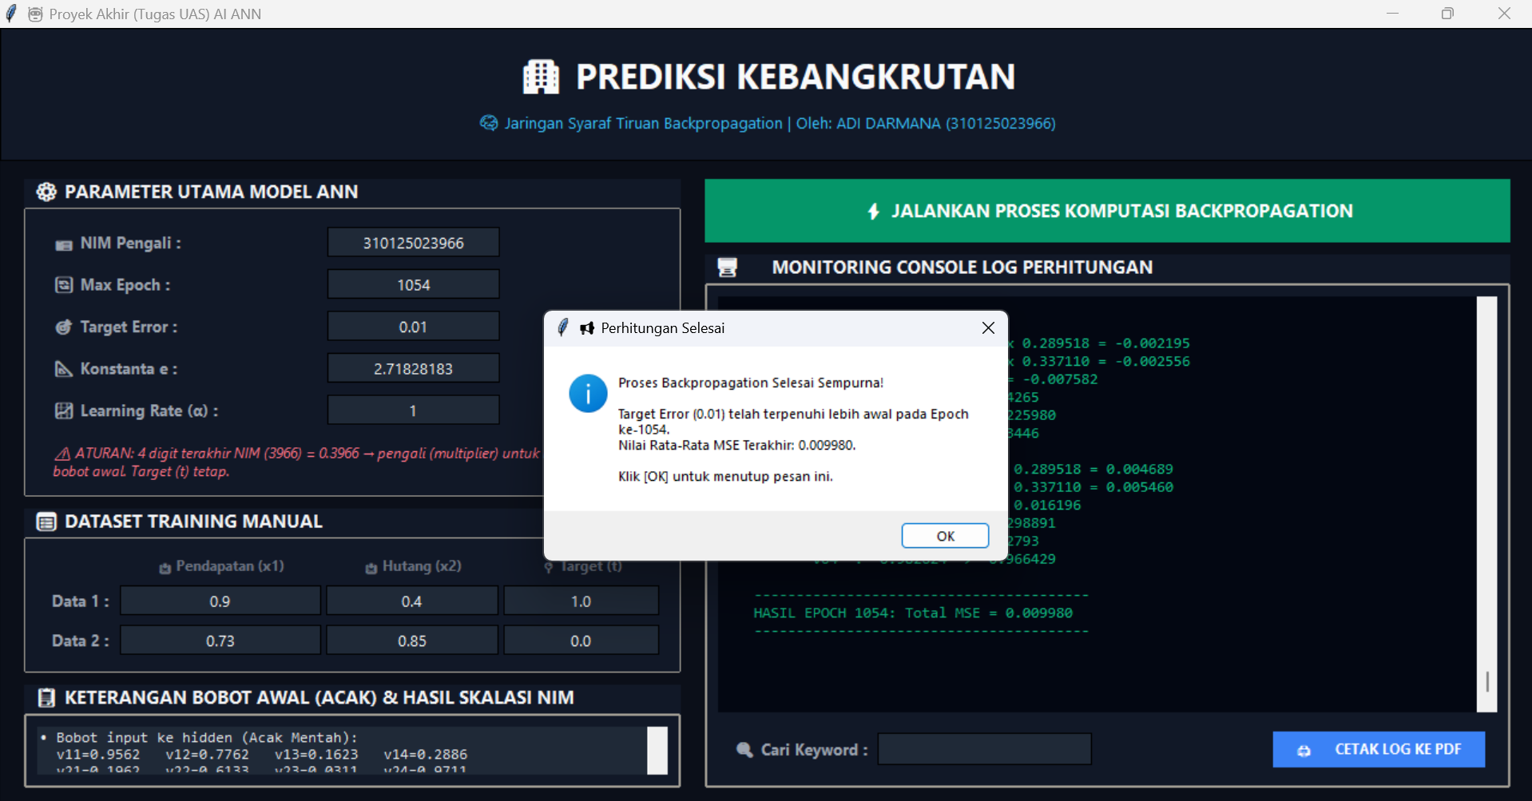

Slide 24
TERIMAKASIH

