Slide 1
The Learning Curve to Implementing a Just Culture
Lindsey Yin
CSD 380
Assignment 9.2
8 July 2024

Slide 2
Introduction
Definition: Just culture is an organizational culture that promotes accountability and a learning environment by balancing the need for open reporting and learning with appropriate accountability.
Objective: To explore the learning curve involved in implementing a just culture in organizations.

Slide 3
What is a Just Culture?
Principles: Fairness, transparency, learning, and accountability.
Goal: Improve safety and performance by fostering an environment where employees feel safe to report mistakes without fear of unfair punishment.

Slide 4
Initial Challenges
Resistance to Change: Employees and managers may resist changes due to fear of the unknown and existing punitive cultures.
Trust Issues: Building trust takes time, especially in environments where fear of blame is ingrained.
Misunderstanding Just Culture: Misinterpretation of just culture principles can lead to either over-punishment or lack of accountability.

Slide 5
Steps to Implementing a Just Culture
Leadership Commitment: Strong leadership support and commitment to just culture principles.
Education and Training: Comprehensive training programs for all employees on just culture principles and practices.
Policy Development: Establish clear policies and procedures that reflect just culture values.
Communication: Continuous communication and dialogue about the importance and benefits of just culture.
Feedback Mechanisms: Develop systems for reporting, analyzing, and learning from incidents.

Slide 6
Learning Curve
Timeframe: Implementing a just culture typically takes 1-3 years.
Stages:
Awareness and Training: Initial 6-12 months focused on education and training.
Policy and Practice Changes: Next 6-12 months dedicated to revising policies and integrating just culture practices.
Sustaining and Improving: Ongoing efforts to sustain and improve the culture, with continuous learning and adaptation.

Slide 7
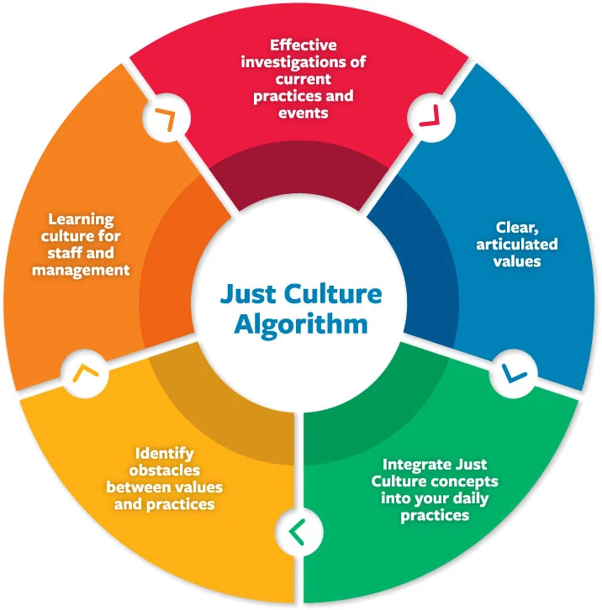
Implementing a Just Culture

Slide 8
Benefits of a Just Culture
Enhanced Safety: Reduction in incidents and near misses.
Improved Morale: Higher employee satisfaction and engagement.
Better Reporting: Increased reporting of errors and near misses, leading to more opportunities for improvement.
Organizational Learning: Continuous improvement and learning from incidents.

Slide 9
Case Studies
Example 1: Healthcare industry case study showing reduced error rates.
Example 2: Aviation industry case study demonstrating improved safety and reporting.
References:
Agency for Healthcare Research and Quality (AHRQ). (2019). Just Culture and Safety.
International Air Transport Association (IATA). (2020). Just Culture in Aviation.

Slide 10
Conclusion
Implementing a just culture requires a significant learning curve, involving stages of awareness, policy changes, and sustained effort.
While challenging, the benefits of a just culture—improved safety, better reporting, and enhanced organizational learning—make it a worthwhile investment for any organization.

Slide 11
References
Dekker, S. (2012). Just Culture: Balancing Safety and Accountability.
Marx, D. (2001). Patient Safety and the "Just Culture": A Primer for Health Care Executives.
Reason, J. (1997). Managing the Risks of Organizational Accidents.

