Slide 1
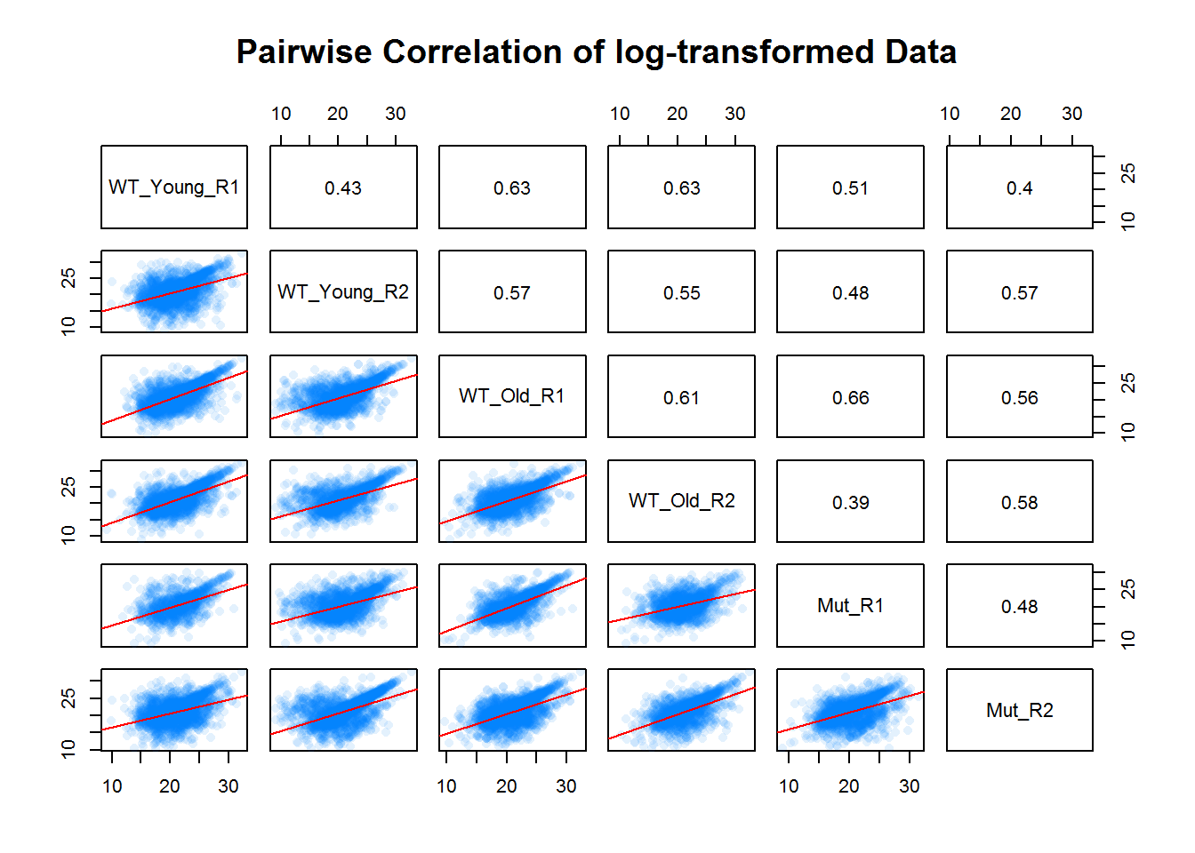
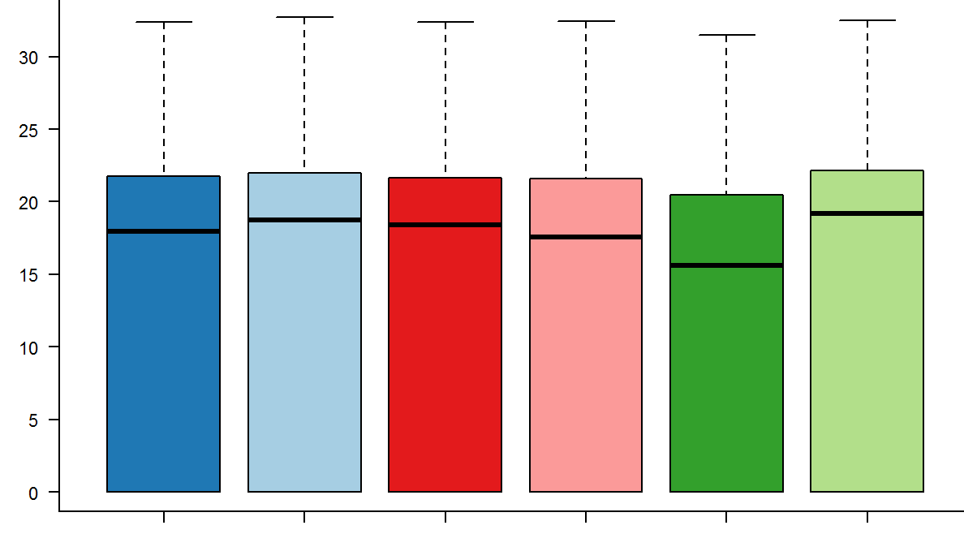
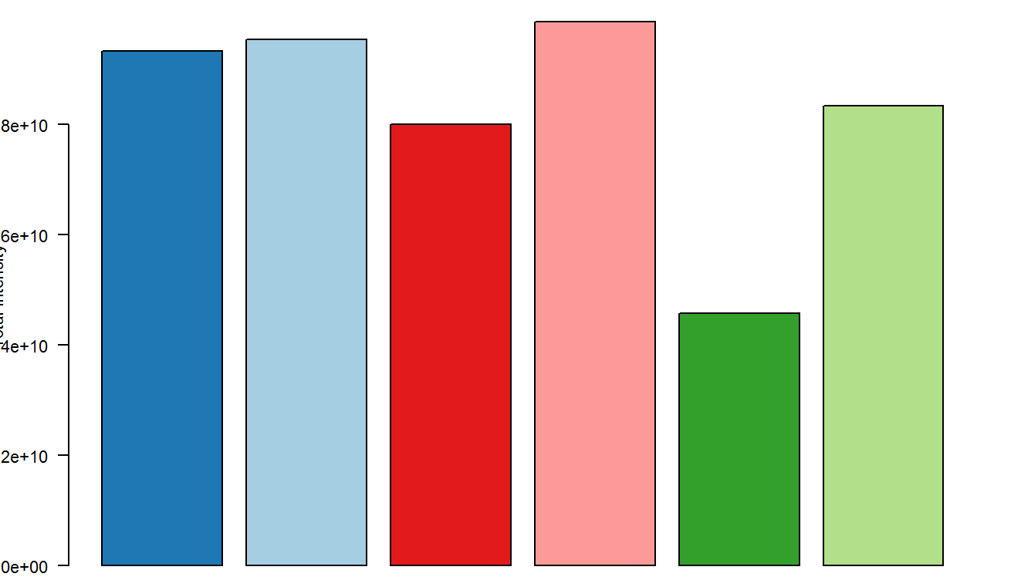
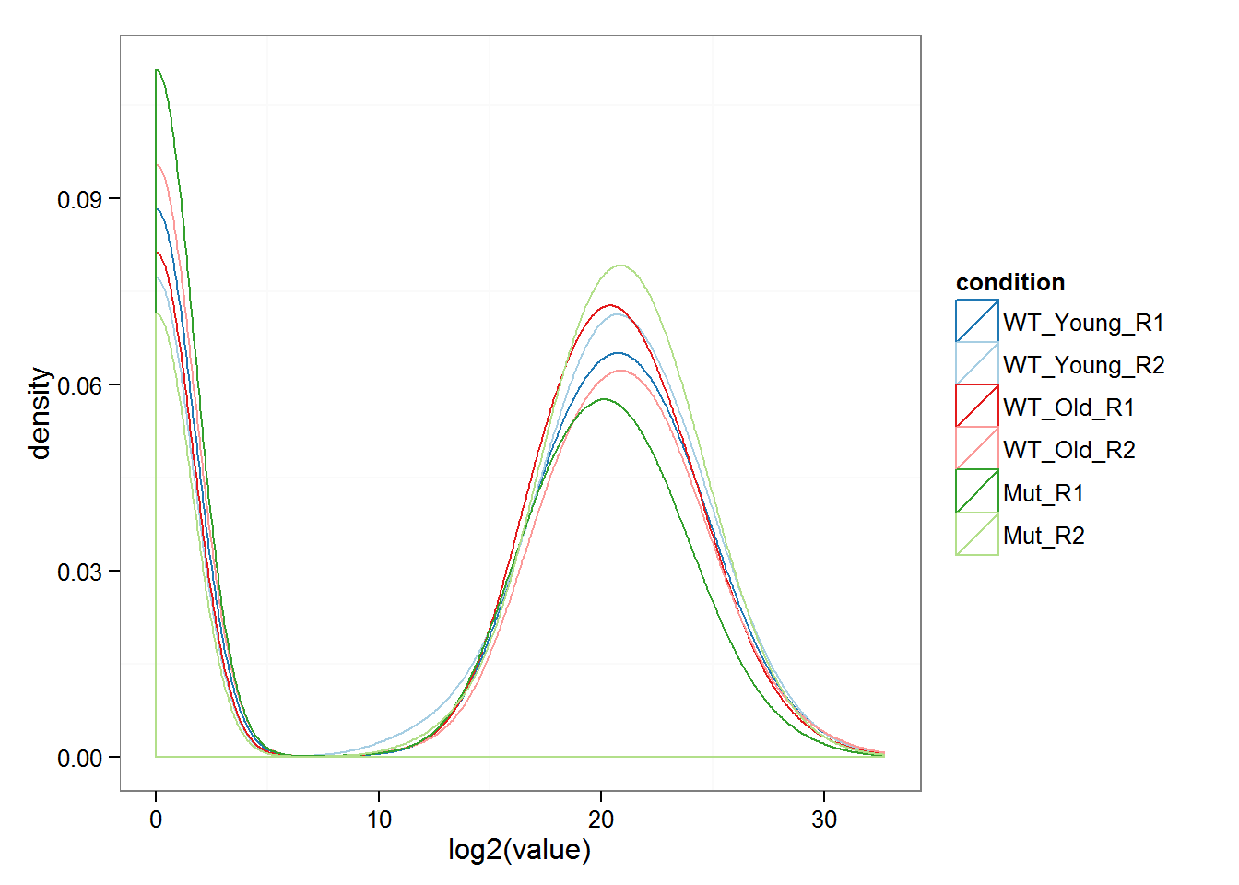
Distribution of expression level
log₂ expression
Distribution of expression level
Sum of expression
Density
WT_Young_R2
WT_Old_R2
WT_Old_R1
Mut_R1
WT_Young_R1
Mut_R2
log₂ expression

