Slide 1
BOOSTING ALGORITHMS

Slide 2
Overview of boosting algorithms
Boosting is an Ensemble technique that combines multiple weak learners to create a strong learner
Applications: Used in classification, regression, ranking, and more.
Gradient boosting decision tree(GBDT) is one of the top choices for kagglers and machine learning practitioners.
Most of the best kernels and winning solutions on kaggle end up using one of the gradient boosting algorithm.
It can be AdaBoost, XGBoost, LightGBM or maybe some other optimized gradient boosting algorithm.

Slide 3
ADA BOOST
Boosting is sequential training of models whereas bagging involves parallel training of models. Boosting algorithm is designed in such a way that the its improves the errors of the previous learners in sequence.
Adaboost = Adaptive Boosting. This algorithm is the very first algorithm in boosting techniques
AdaBoost is best used to boost the performance of decision trees on binary classification problems.
AdaBoost can be used to boost the performance of any machine learning algorithm.
It is best used with weak learners. These are models that achieve accuracy just above random chance on a classification problem.

Slide 4
Ada-boost
retrains the algorithm iteratively by choosing the training set based on accuracy of previous training.
The weight-age of each trained classifier at any iteration depends on the accuracy achieved.

Slide 5
AdaBoost – Advantages, Disadvantages & Applications
Advantages:
Simplicity: Easy to implement.
Versatility: Works with various base learners.
Improved Accuracy: Focuses on hard-to-classify instances.
Disadvantages:
Sensitivity to Noisy Data: Can be negatively affected by outliers.
Overfitting Risk: May overfit if the base learner is too complex.
Computational Cost: Can be slower with large datasets.
Sample Applications:
Finance: Fraud detection.
Healthcare: Early disease detection.
Marketing: Customer churn prediction.

Slide 6
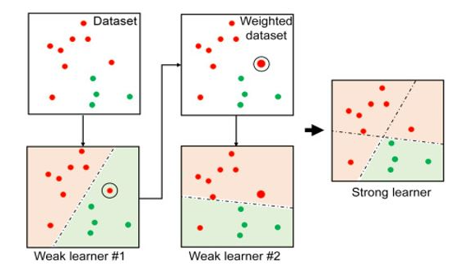
Pic source - https://www.analyticsvidhya.com/blog/2022/01/introduction-to-adaboost-for-absolute-beginners/

Slide 7
XG BOOST
XGBoost, short for eXtreme Gradient Boosting, is an optimized and highly efficient implementation of gradient boosting.
XGBoost is focused on computational speed and model performance
Key Features: Tree pruning, parallel processing, and regularization

Slide 8
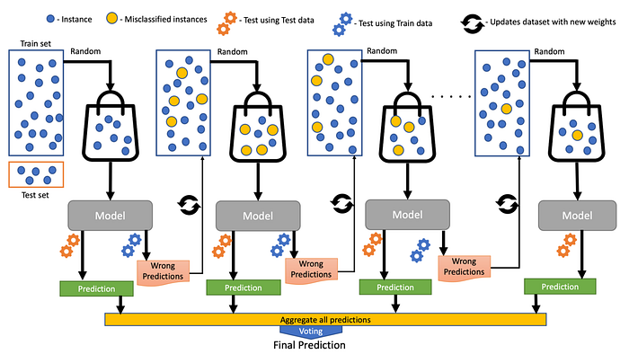
Looking at CART and Gradient Boosting to understand the mechanics of boosting algorithm
Source - https://medium.com/sfu-cspmp/xgboost-a-deep-dive-into-boosting-f06c9c41349

Slide 9
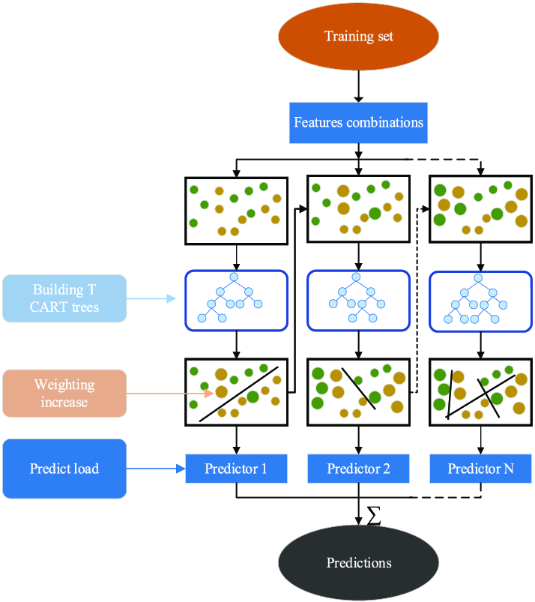
XG boost illustration
Source: https://www.researchgate.net/figure/Schematic-illustration-of-the-XGboost-model_fig2_362100649

Slide 10
XGBoost – Advantages, Disadvantages & Applications
Advantages:
High Performance: Optimized for speed and performance.
Scalability: Handles large datasets efficiently.
Flexibility: Supports various objective functions and custom evaluation metrics.
Disadvantages:
Complexity: More complex to tune compared to simpler models.
Memory Usage: Can be memory-intensive with large datasets.
Interpretability: Models can be harder to interpret.
Sample Applications:
Finance: Credit scoring.
Healthcare: Predicting patient outcomes.
E-commerce: Product recommendation systems.

Slide 11
LG BOOST
Light Gradient Boosting Machine (LightGBM)
Advantages: Faster training speed, lower memory usage
Key Features: Leaf-wise growth, histogram-based decision tree learning

Slide 12
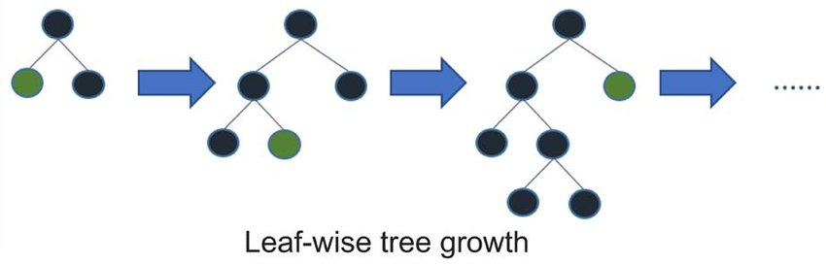

Slide 13
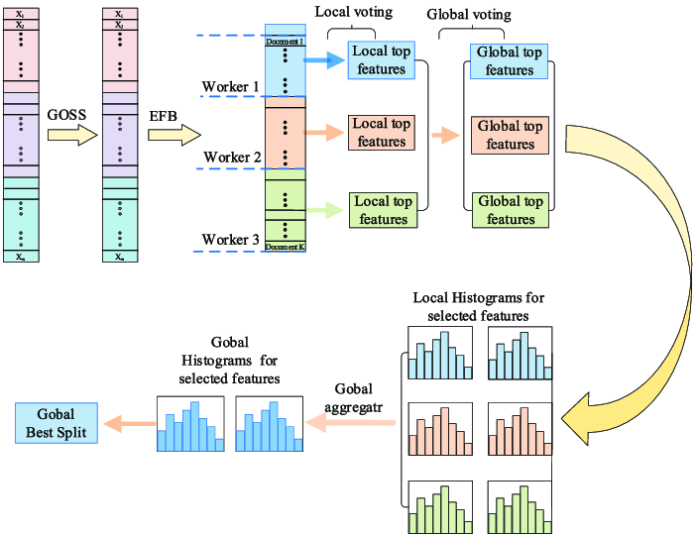
lightGBM illustration
Pic source - https://www.researchgate.net/figure/Schematic-illustration-of-the-LightGBM-model_fig1_362100649

Slide 14
LG Boost – Advantages, Disadvantages & Applications
Advantages:
Speed: Faster training compared to other boosting algorithms.
Efficiency: Lower memory usage.
Accuracy: Maintains high accuracy with large datasets.
Disadvantages:
Sensitivity to Data Quality: Performance can drop with poor data quality.
Complexity: Requires careful parameter tuning.
Small Datasets: May not perform as well on very small datasets.
Applications:
Finance: Risk assessment.
Healthcare: Medical diagnosis prediction.
E-commerce: Customer segmentation.

Slide 15
Comparison of LightGBM vs XGBoost vs AdaBoost
Speed: LightGBM > XGBoost > AdaBoost
Accuracy: Comparable performance
Use Case:
LightGBM for large datasets
XGBoost for small to medium datasets
AdaBoost for simpler models, sensitive to noisy data

