Slide 1
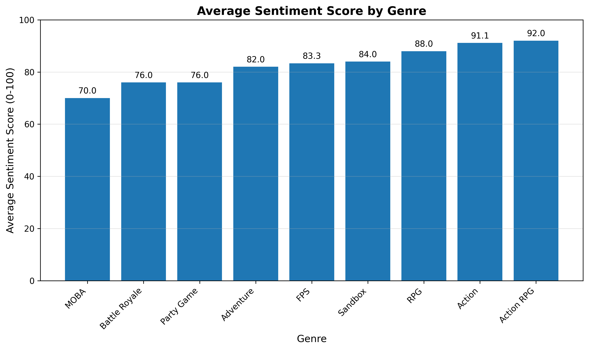
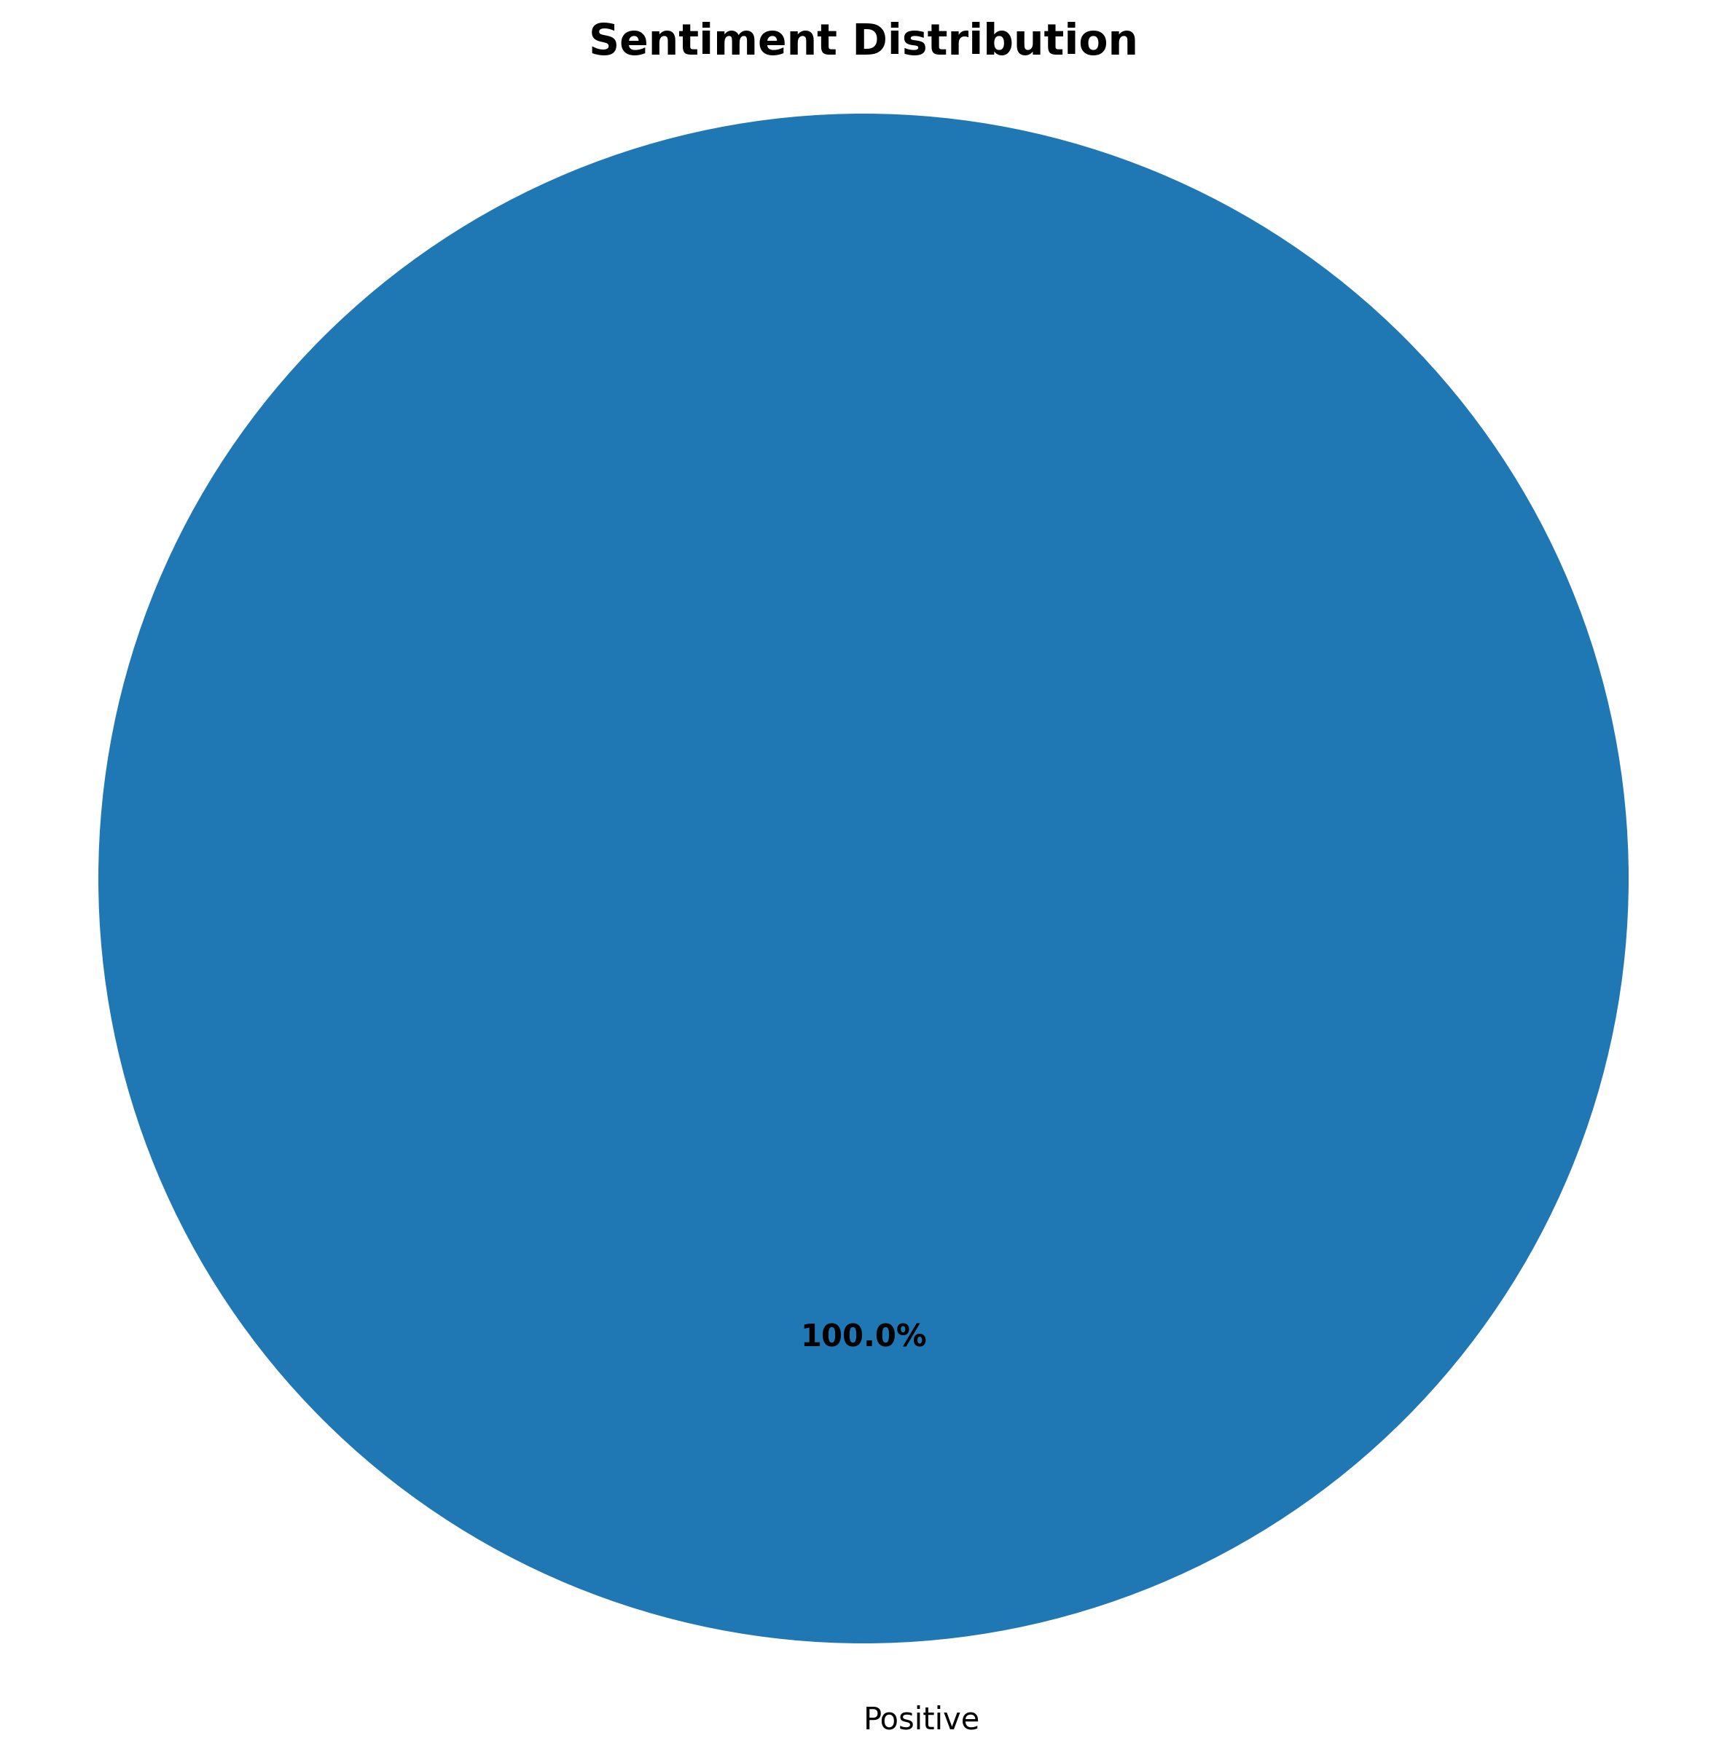
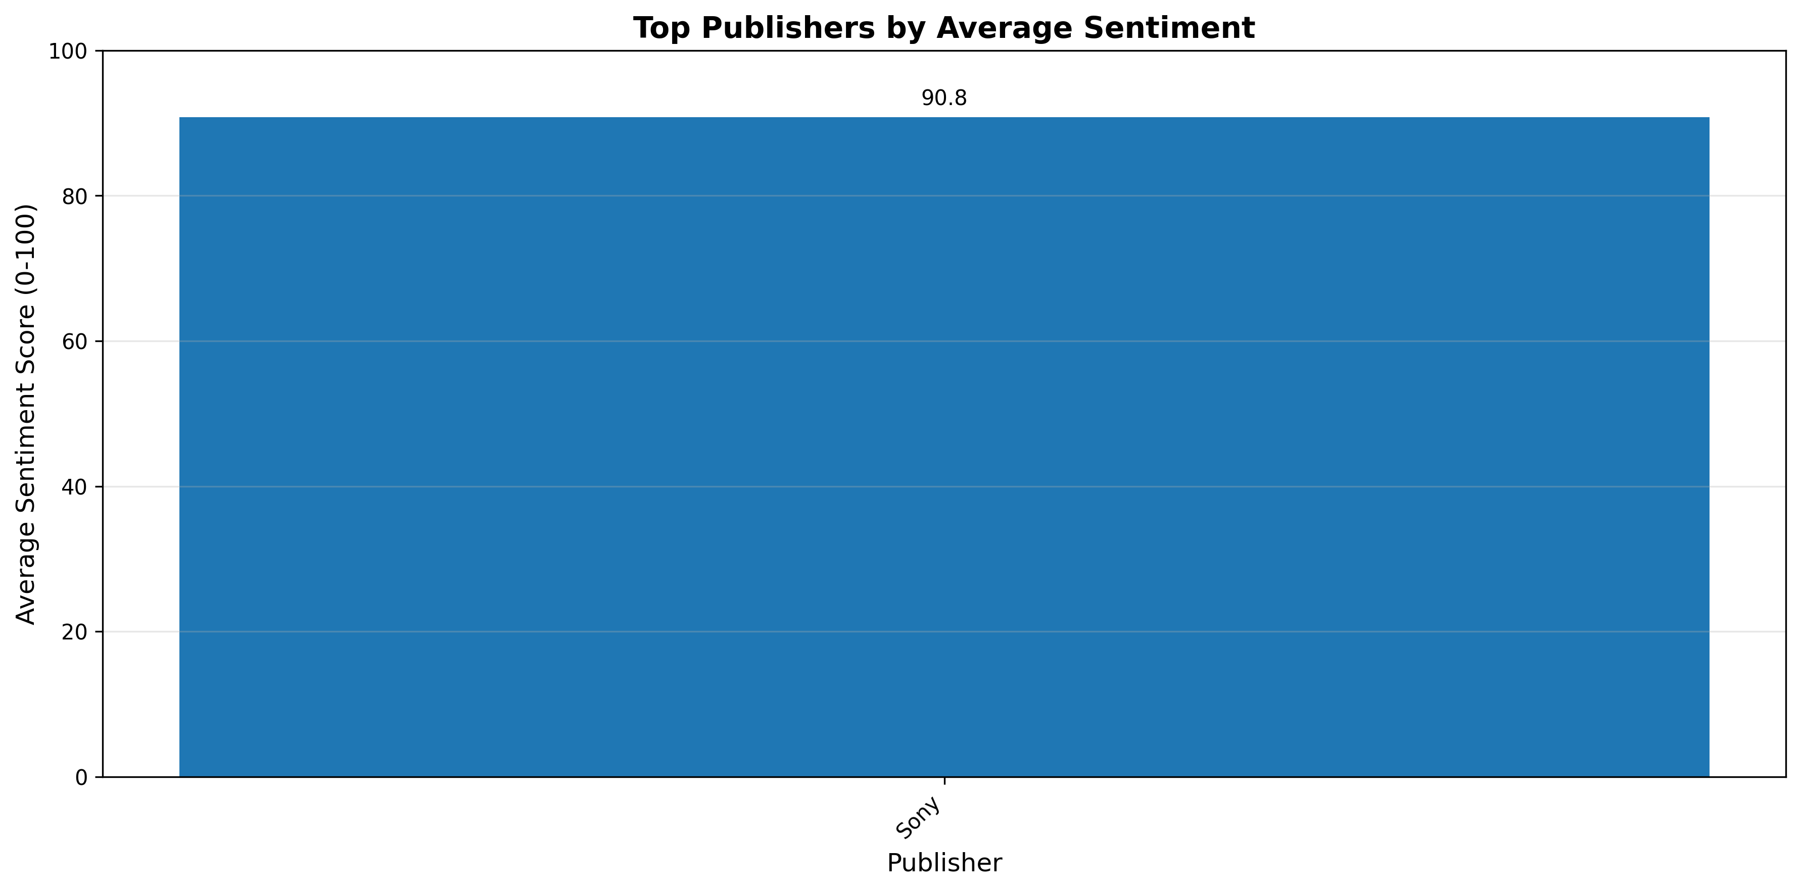
Game Review Sentiment — One-Day Dashboard
Key Insights:
• Overall sentiment is positive with 100.0% positive reviews
• Action RPG games have the highest average sentiment (92.0/100)
• Sony leads with 90.8/100 sentiment across 5 reviews
• Significant sentiment variation across genres (22.0 point spread)

