Slide 1


WEB DEVELOPMENT · FINAL PROJECT
Lulu Bakery
A custom cake ordering website
for a local bakery in Chino Hills
Next.js · React · lulubakerychinohills.com
Lulu Bakery 1 / 12

Slide 2

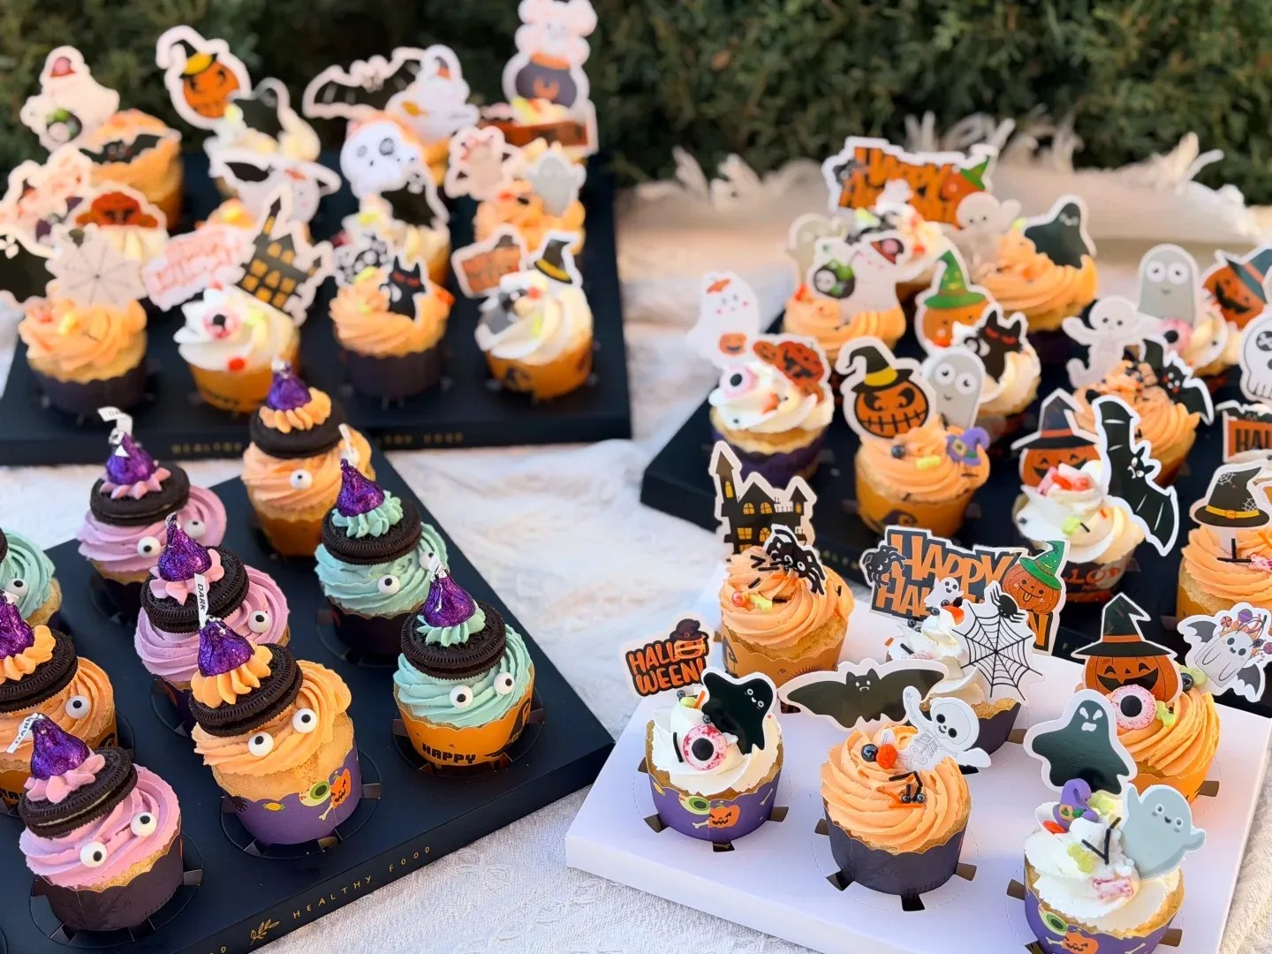
OVERVIEW
What this project is
– This site is for Lulu Bakery in Chino Hills.
– They make custom cakes. People need to see styles and place an order online.
– Most visitors are probably parents planning a birthday or family event.
– They browse on the phone first, then finish the form later.
– So the flow stays simple: look, choose, submit.
Lulu Bakery 2 / 12

Slide 3

ARCHITECTURE
Site structure
– Home — cake gallery and order form
– Category pages — men / women / kids / other
– Sweet — dessert menu, then a photos page
– About — who they are and pickup info
– Privacy — required before someone submits an order
– The main nav stays short on purpose.
Lulu Bakery 3 / 12

Slide 4
DESIGN
Look and feel
– Warm brown on cream — quiet, not loud.
– I checked contrast so body text stays readable.
– Same buttons and cards across pages.
– Geist Sans through next/font on the site.
– Spacing comes from a small set of CSS variables.
Lulu Bakery 4 / 12

Slide 5
CSS
How the layout is built
– box-sizing: border-box everywhere.
– Header and filter chips use Flexbox.
– The cake grid and order form use CSS Grid.
– Nav is sticky. The success popup is fixed.
– There’s a basic print stylesheet too.
Lulu Bakery 5 / 12

Slide 6
RESPONSIVE
How it adapts
– Mobile first, then sm / md / lg breakpoints.
– Phone: one column. Desktop: three cake cards.
– The form goes to two columns on wider screens.
– Images use lazy loading and sizes.
– I’ll resize the browser in the demo.
Lulu Bakery 6 / 12

Slide 7
JAVASCRIPT
Interactivity
– Gallery search waits 300ms before filtering.
– Category buttons also update the URL.
– The form checks email, pickup time, and privacy.
– After submit, a dialog appears. Esc closes it.
– Native HTML required still helps if JS is slow.
Lulu Bakery 7 / 12

Slide 8
ACCESSIBILITY
What I paid attention to
– Skip link to jump past the header.
– Real <nav>, plus breadcrumbs on deeper pages.
– Focus outline shows when you tab.
– Dialog uses role="dialog" and labels.
– Tests include axe; I’ll also show Lighthouse / WAVE.
Lulu Bakery 8 / 12

Slide 9
BUILD
Stack and performance
– Next.js, React, TypeScript, Tailwind.
– Products and images live in Supabase.
– Orders go out by SMTP email.
– WebP where I can; uploads compressed with sharp.
– Deployed on Vercel.
Lulu Bakery 9 / 12

Slide 10
PROCESS
Testing and docs
– npm test — 13 tests.
– Search, form checks, skip link, breadcrumbs, axe smoke.
– design-dossier.md for the design write-up.
– accessibility-report.md for the checklist.
– README has setup and where the docs are.
Lulu Bakery 10 / 12

Slide 11
REFLECTION
What was hard / what I learned
– The shop already worked — the class still needed clearer a11y and tests.
– The success popup looked fine, but needed proper dialog markup.
– Pulling search into a plain function made testing easier.
– One shared header beat copying the same nav three times.
– Landmarks are easier if you set them up early.
Lulu Bakery 11 / 12

Slide 12
Thank you
Live demo next — layout, search, form, keyboard nav
lulubakerychinohills.com
Questions are welcome
Lulu Bakery 12 / 12

