Slide 1

Demonstration of Utility Managed Smart Charging for Multiple Benefit Streams
For Argonne-Exelon Biweekly
Argonne National Laboratory
February 3rd, 2022

Slide 2
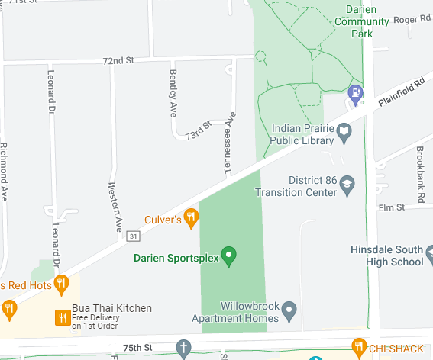
Basic power flow
Input data (Exelon): topology (coordinate); line impedance; loads; transformers
Example inputs from ATEAM: EVSE type; Coordinate; Capacity; Charging Profile
Node
Circuit
EVCS
Line
Power Flow
Substation
Impedance
Undervoltage that cannot be measured

Slide 3
Basic power flow
Voltage Profile
Voltage constraint violation
Penalty
High losses
Low power quality
Potential voltage instability
Branch Current Profile
Line overloading
Transformer overloading
Time Series Power Flow Study
Different EV Penetration Level
*Contingency analysis and reconfiguration
Power Flow

Slide 4
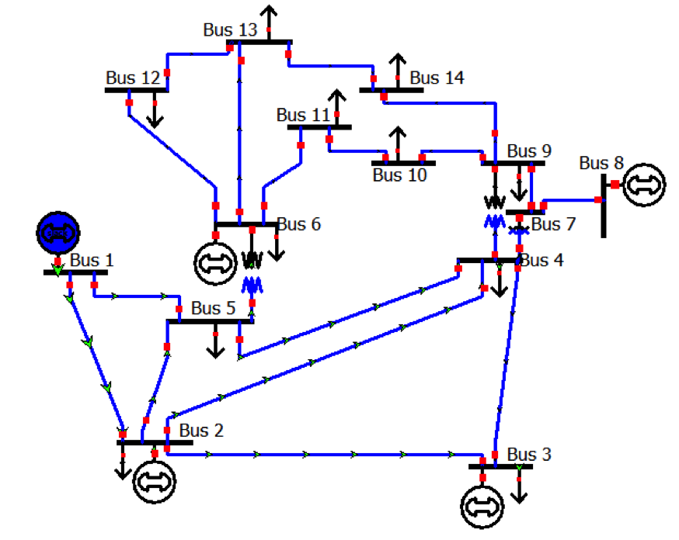
T&D Co-Sim (ATD)
TDcoSim: Transmission and distribution co-simulation platform
Source code repository: https://github.com/tdcosim/TDcoSim
Connected to
Transmission system
Distribution system

