Slide 1
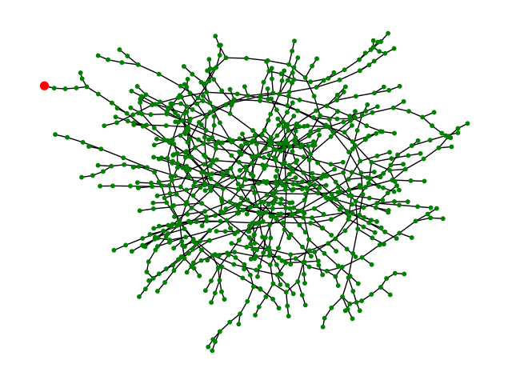
Feeder_7732
871 unique buses
670 line connections
335 single-phase lines
6 two-phase lines
329 three-phase lines
There is a three-phase line which is disabled
224 transformers
174 single-phase transformers
50 three-phase transformers
168 fuses
224 loads
174 two-phase loads
50 six-phase loads
5 three-phase capacitor banks
There are loops in the network
SOURCE_7732

Slide 2
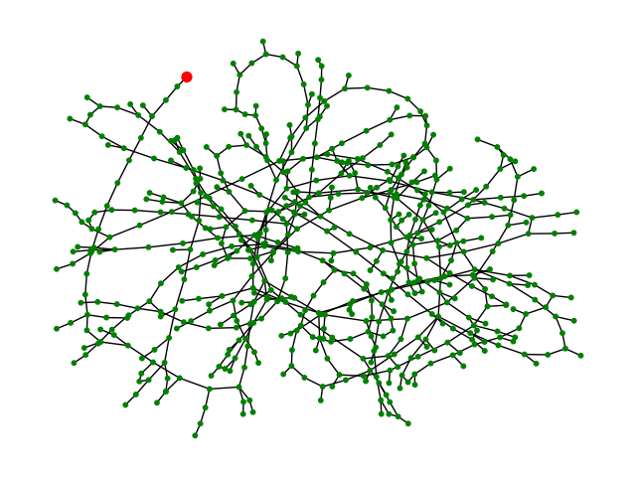
Feeder_7773
607 unique buses
143 loads
138 two-phase loads
5 six-phase loads
480 lines
274 single-phase lines
5 two-phase lines
201 three-phase lines
88 fuses
143 transformers
138 single-phase transformers
5 three-phase transformers
6 three-phase cap banks
The network is not a tree; there are loops
SOURCE_7773

Slide 3
Issues
The following nodes are located outside the Baltimore area:
source_7732
source_7732-1
31109103031_5517425
31109103032_5517430
5517698-1
tiepoint_31114303153
source_7773
source_7773-1
4932737
31114303147
31114303132
Loads appear as 6-phase and 2-phase loads
Feeder_7732 has a duplicated three-phase line
The loops that appear in the graph may be due to assuming that all switches are enabled

