Slide 1

101: From Zero to Hero
Lu Lu
DPD Club Meeting
Jan 24, 2018

Slide 2

History
……
In December 1989, I was looking for a 'hobby' programming project that would keep me occupied during the week around Christmas. My office ... would be closed, but I had a home computer, and not much else on my hands.
…...
I chose Python as a working title for the project, being in a slightly irreverent mood (and a big fan of Monty Python's Flying Circus).
------ Guido van Rossum

Slide 3
What is Python?
Python is an interpreted high-level programming language for general-purpose programming.
Python has a design philosophy that emphasizes code readability, and a syntax that allows programmers to express concepts in fewer lines of code.
Python features a dynamic type system and automatic memory management. It supports multiple programming paradigms, including object-oriented, imperative, functional and procedural.
------ Wikipedia

Slide 4
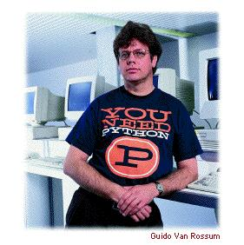
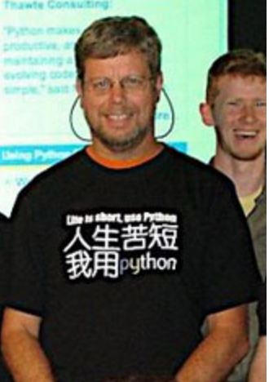
Why Python?
Life is short
You need Python
------ Bruce Eckel
ANSI C++ Committee member

Slide 5
Why Python?
Scientific computation
NumPy
SciPy
Pandas
Visualization
Matplotlib
Seaborn
Bokeh
Plotly
Machine learning
SciKit-Learn
Theano
TensorFlow
Keras
PyTorch
Caffe

Slide 6
Hello World!
hello.py
# This is a comment.
print(‘Hello World!’)
python hello.py

Slide 7
Math
Logic
Variables
String
+, -, /, *, %, <, >, <=, >=, **
True, False, !=, ==, and, or, not
a = 100
b = a / 2
c = a + b
print(c)
‘I am a string’
“I also am a string”
“””Me
too
”””
‘’’Me
too
‘’’

Slide 8
Functions
def add(x, y):
return x + y
add(1, 2)

Slide 9
import
nektar.py
def add(x, y):
return x + y
crunch.py
import nektar from nektar import add
x = netkar.add(1, 2) x = add(1, 2)

Slide 10
If
if x < y:
print(‘x is smaller than y’)
elif x == y:
print(‘x is equal to y’)
else:
print(‘x is bigger than y’)

Slide 11
Loops and Lists
the_count = [1, 2, 3, 4, 5]
for x in the_count:
print(x)
for i in range(5): # range(5): [0, 1, 2, 3, 4]
print(the_count[i])
x = 0
while x < 6:
print(x)
x +=1

Slide 12
dictionary
stuff = {‘name’: ‘Zed’,
‘age’: 39,
‘height’: 6}
print(stuff[‘name’])
print(stuff[‘age’])

Slide 13
Resources
The Official Documentation
Basics
Learn Python the Hard Way
Head First Python
Learning Python
More advanced
Python Cookbook
Fluent Python
Effective Python

Slide 14
Questions?

Slide 15

Exercises
http://www.pythonchallenge.com/
Challenge 0 – 5

