Slide 1

DeepXDE: A deep learning library for solving differential equations
Lu Lu
Department of Statistics and Data Science
Yale University
Mar. 19, 2026

Slide 2
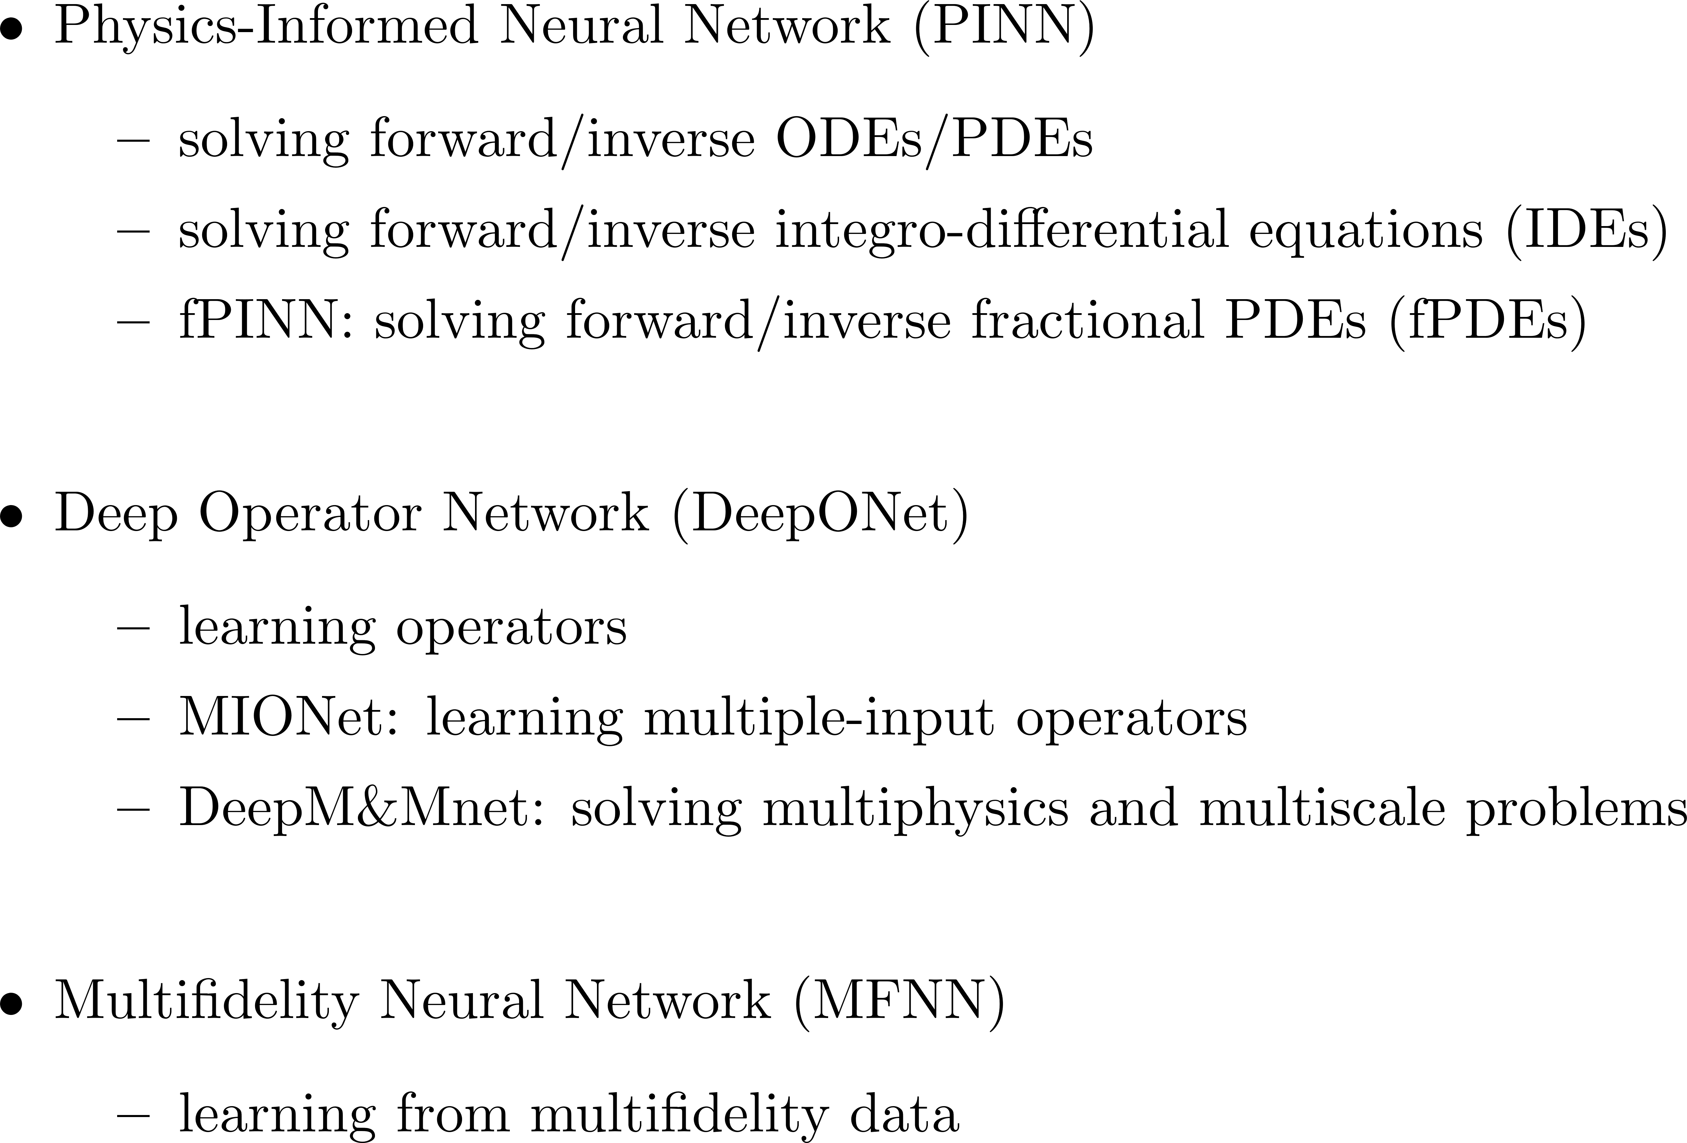
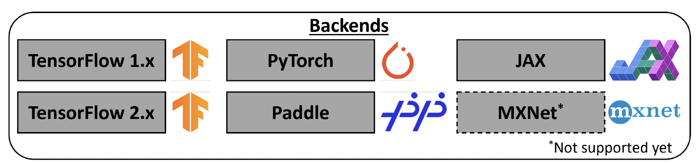
DeepXDE: Capabilities
Lu, Meng, Mao, Karniadakis. DeepXDE: A deep learning library for solving differential equations. SIAM Review, 2021.
GitHub: https://github.com/lululxvi/deepxde
Documentation: https://deepxde.readthedocs.io
Notes:
Multiple algorithms, and multiple backends

Slide 3
Workflow for PINNs using DeepXDE
Physics-Informed Neural Network (PINN)
Choose a network
Specify the problem using build-in modules
NN
dde.nn.FNN
dde.nn.PFNN
dde.nn.ResNet
dde.nn.MsFFN
dde.nn.STMsFFN
Geometry
dde.geometry
Forward/Inverse
ODE/PDE/IDE/fPDE
dde.grad
IC/BC/Data
dde.icbc
dde.data.PDE, dde.data.TimePDE, dde.data.IDE
dde.data.FPDE, dde.data.TimeFPDE
Model
dde.Model
Visualization
Prediction
Model.predict
Solve
Model.compile
Model.train

Slide 4
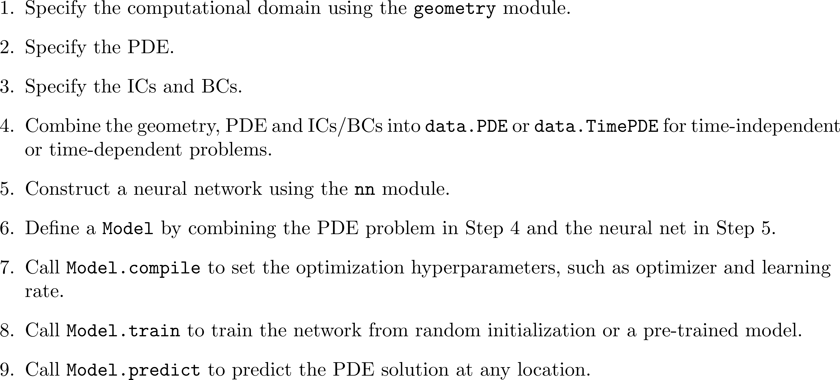
Workflow for PINNs using DeepXDE

Slide 5
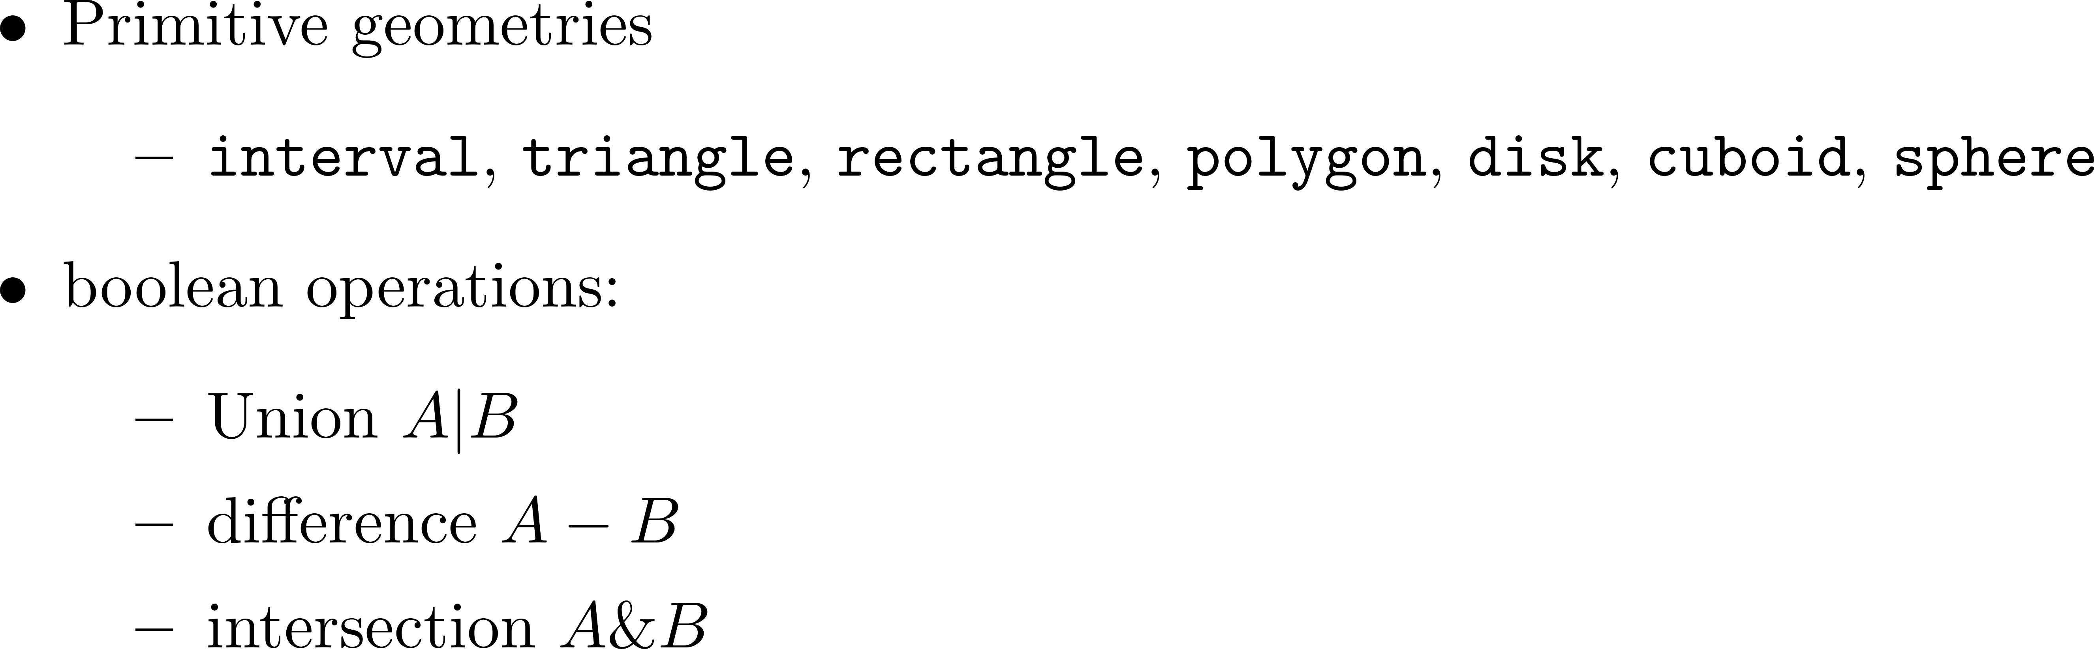
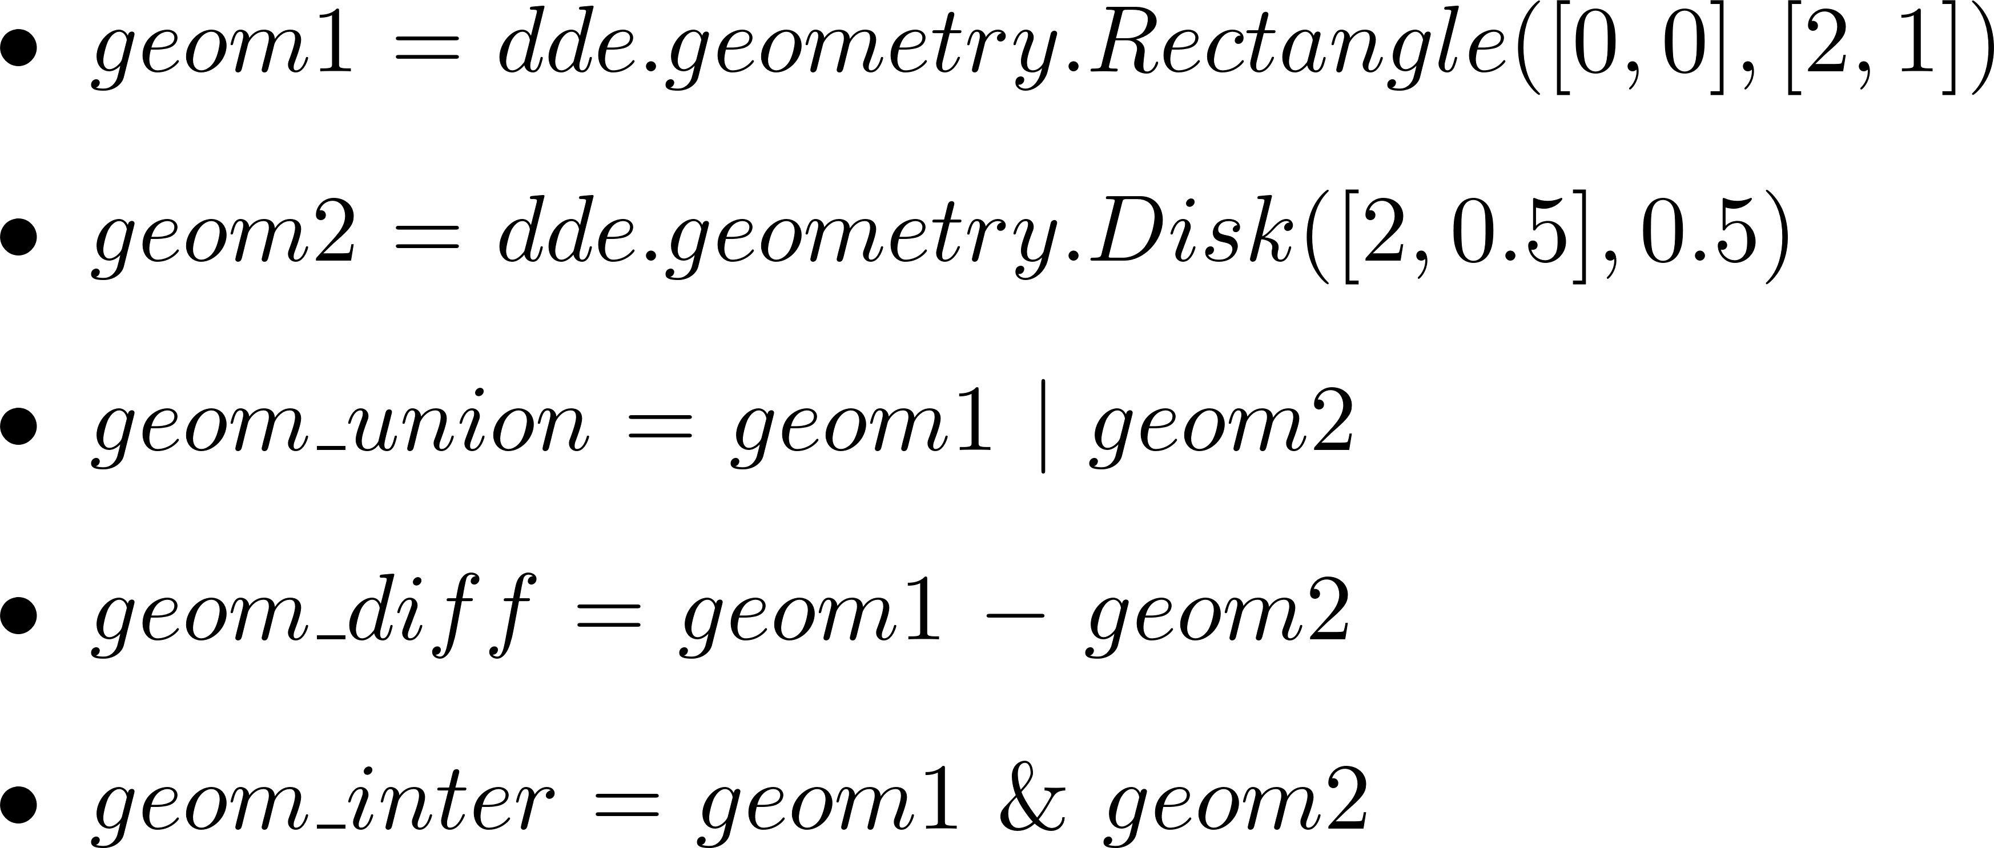
Complex domains using DeepXDE
Notes:
CSG: Constructive solid geometry

Slide 6
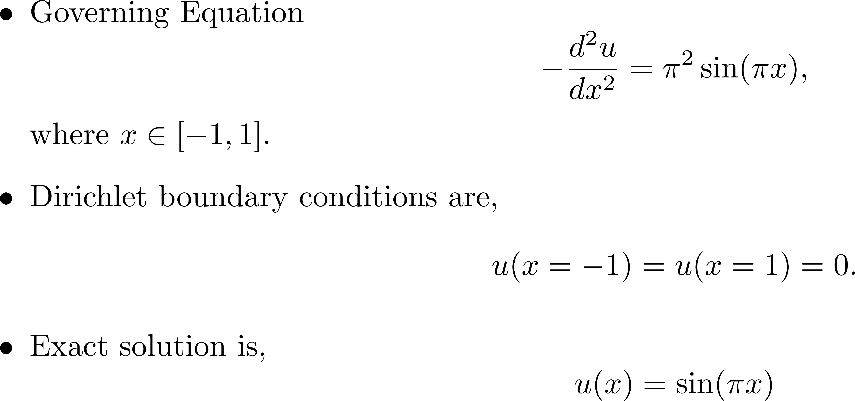
Demo 1: 1D Poisson equation
Goal is to obtain an approximate solution using PINNs

Slide 7
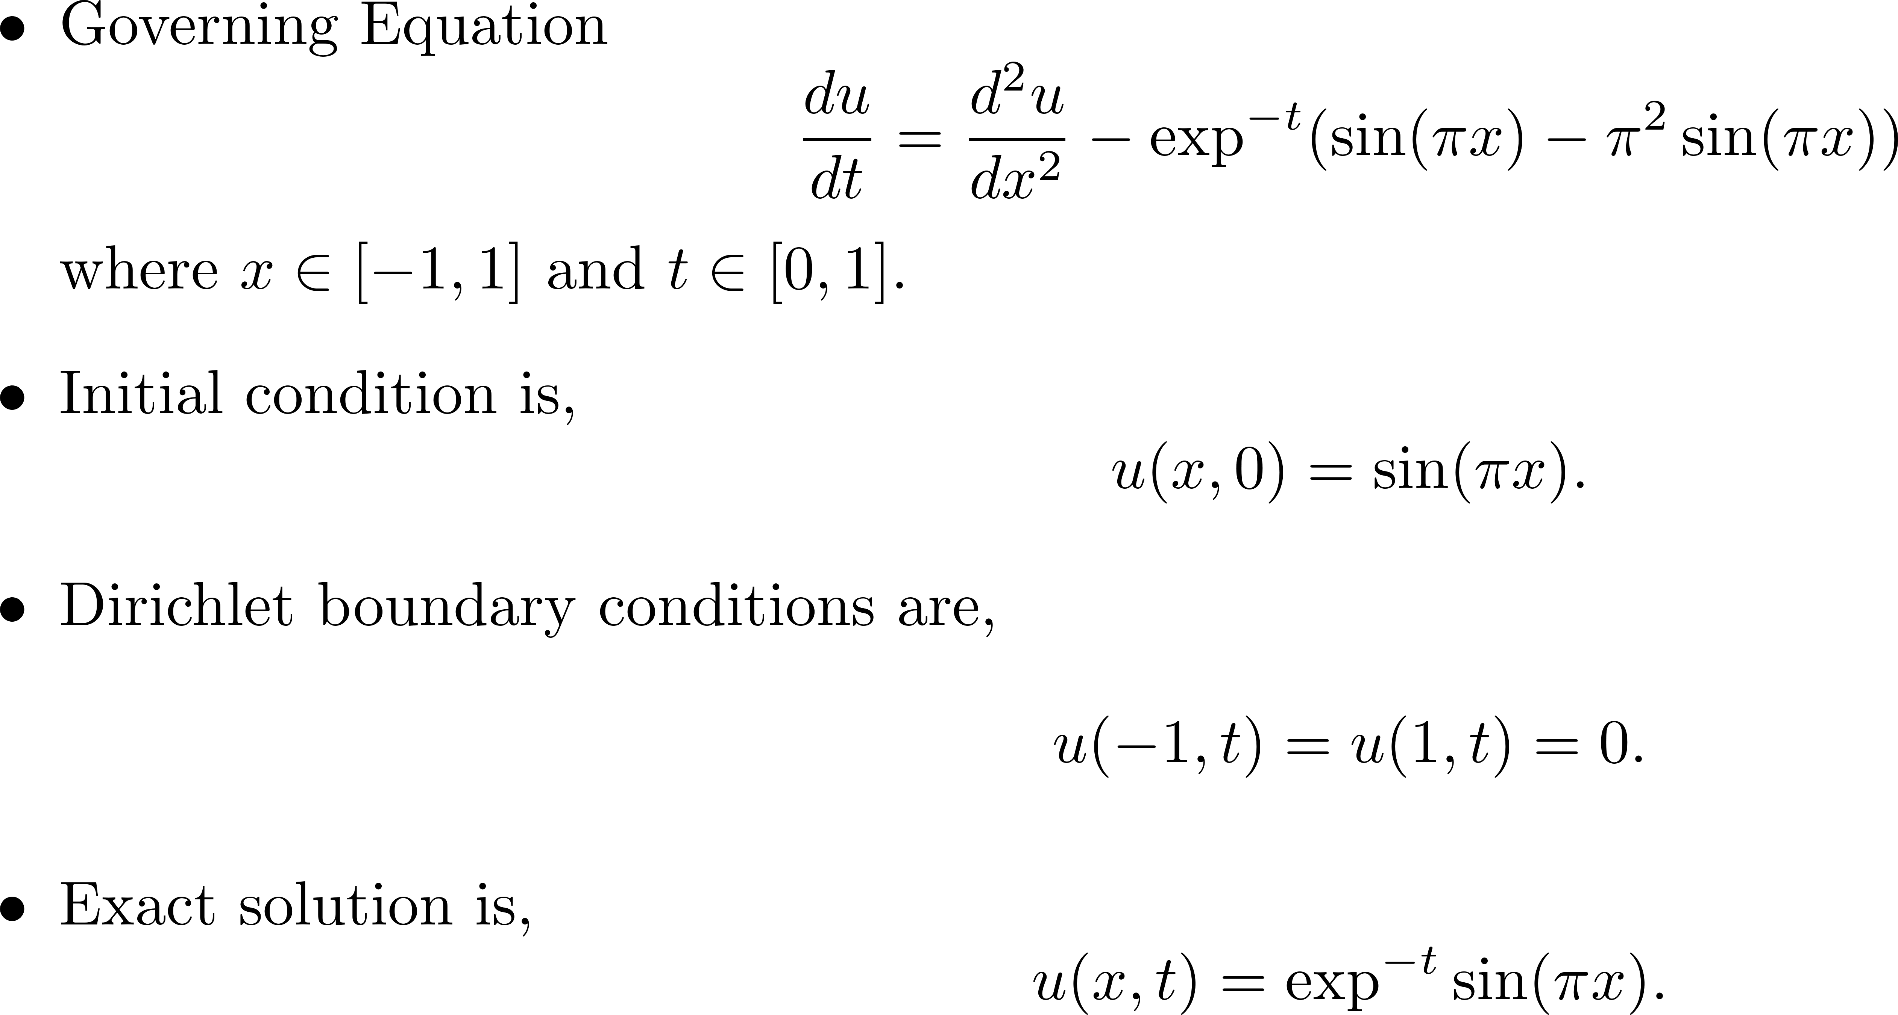
Demo 2: Diffusion Equation
Goal is to obtain an approximate solution using PINNs

Slide 8
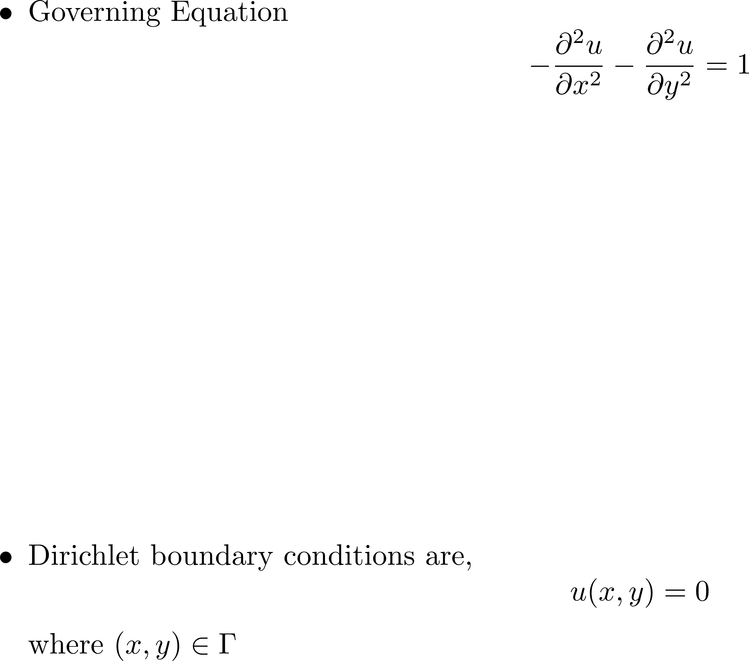
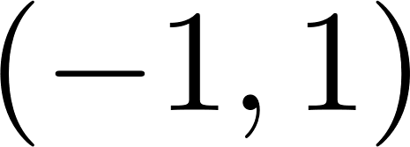
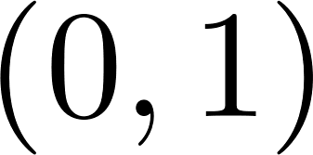
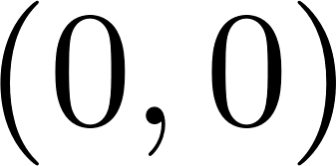
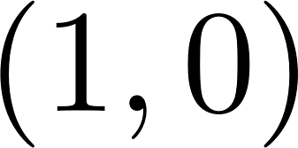
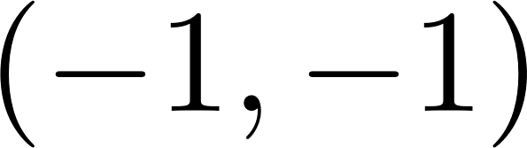
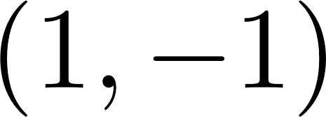
Demo 3: Poisson equation in L-shaped domain
Goal is to obtain an approximate solution using PINNs

Slide 9
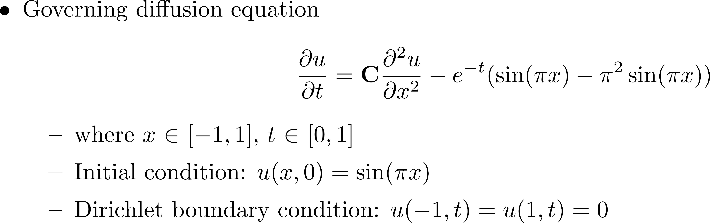


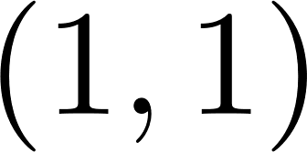
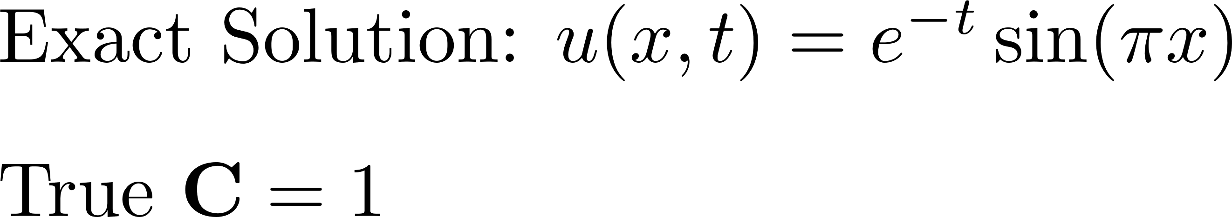
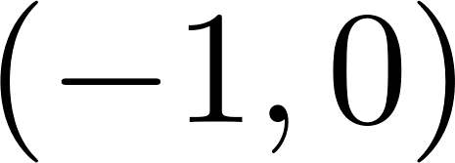

Demo 4: Inverse problem
Goal is to infer the parameter C and simultaneously obtain solution for U given data

