Slide 1
ENGI 301 Table Roomba Proposal
2/17/2024
Lulu Shih

Slide 2
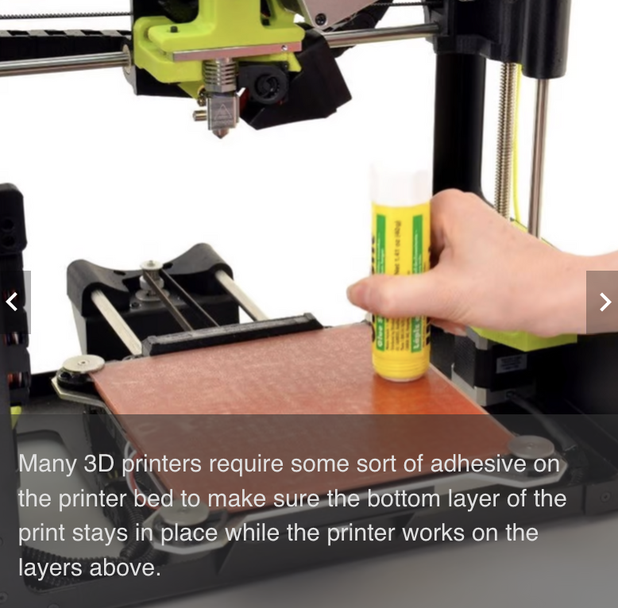
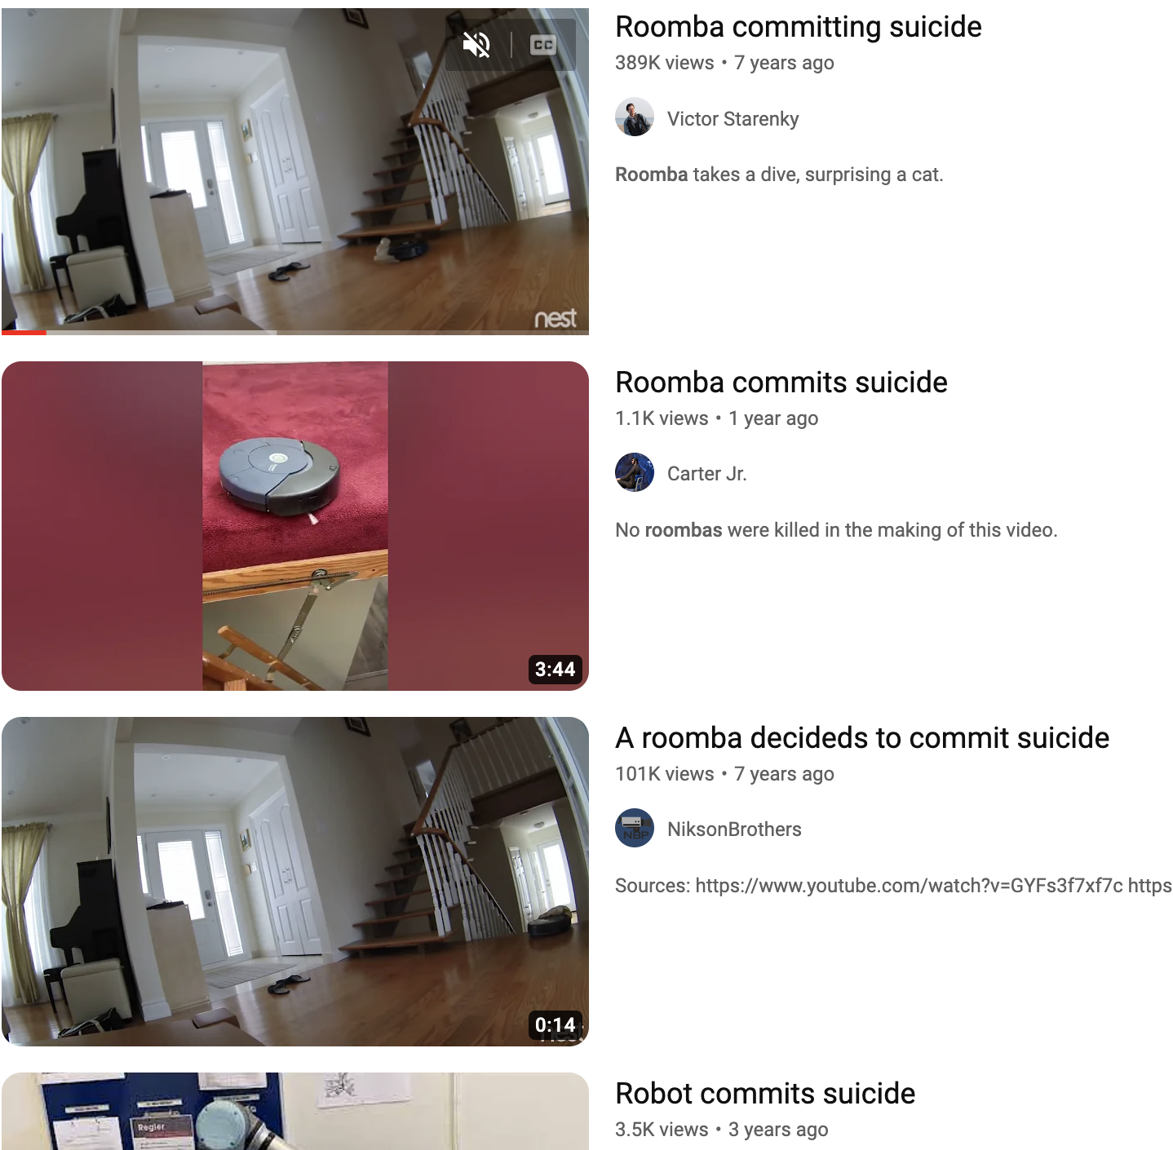
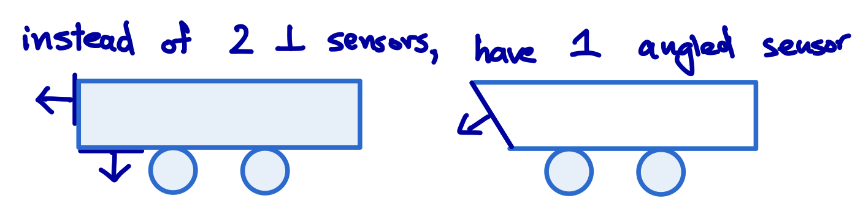
Background Information
Roomba for a small elevated surface (table)
Can be used to clean tables or counters
Possibly used to apply adhesive to 3D print beds (see my ENGI 200 Project: https://rice.digication.com/stick2it/engi-120-220)
Currently Roombas have a cliff detector, but it’s known to fail
Implement edge detecting systems:
https://www.hackster.io/InfineonTeam/edge-detecting-bot-using-xensiv-bgt60utr11aip-radar-62981a
In addition to Roomba’s current system:
https://www.thezebra.com/resources/home/how-roomba-works/
But I want to try putting distance sensor at an angle to reduce costs

Slide 3
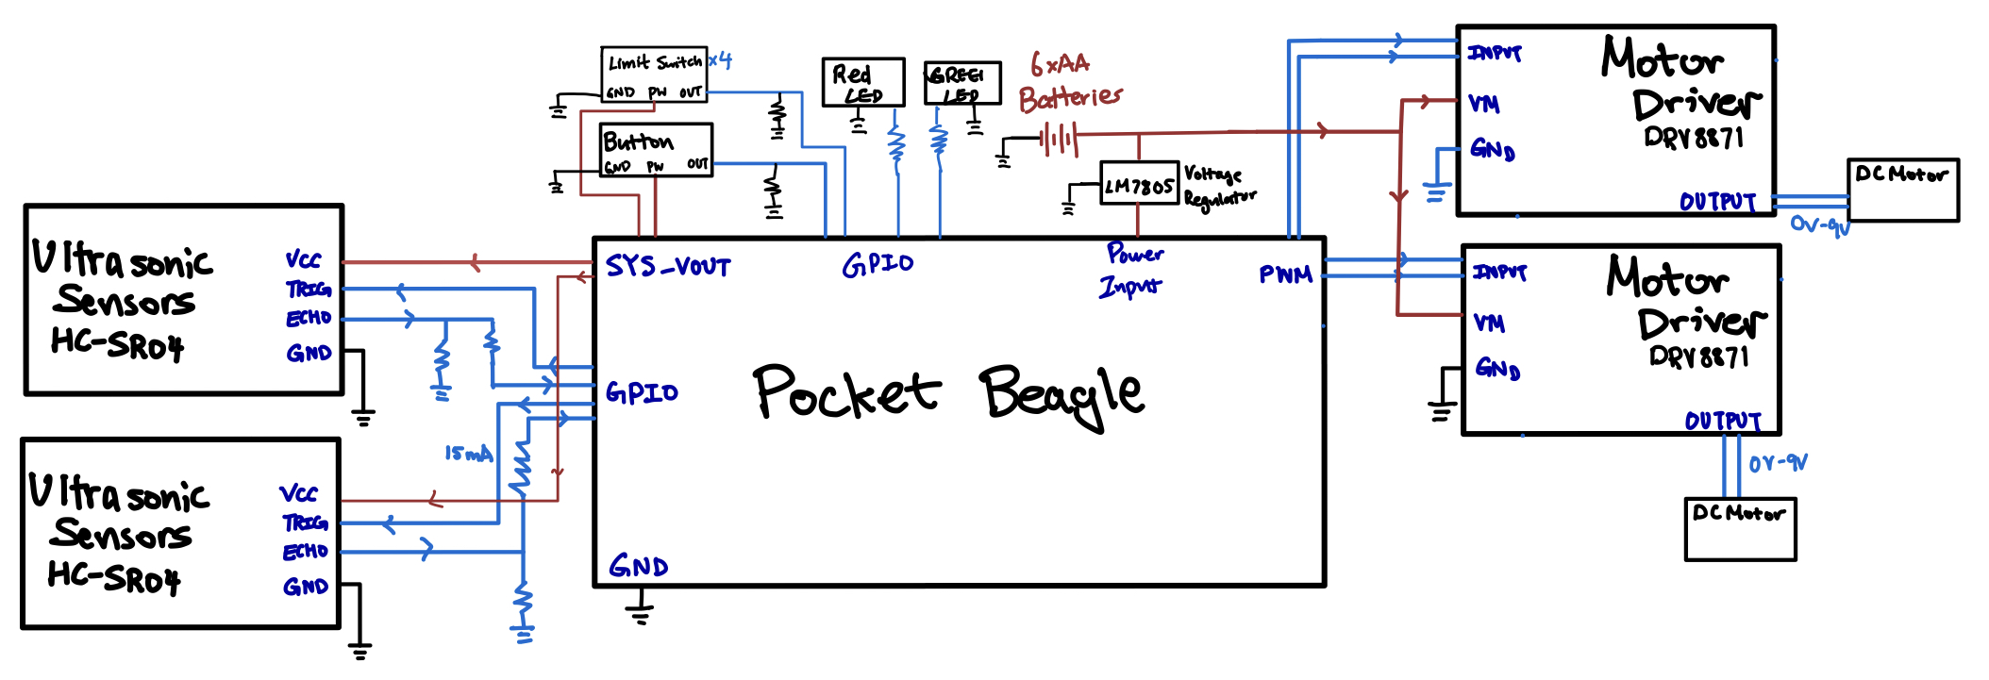
System Block Diagram

Slide 4
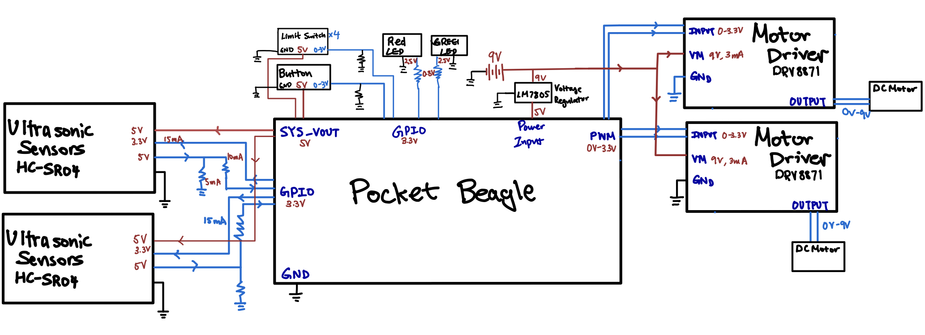
Power Block Diagram

Slide 5
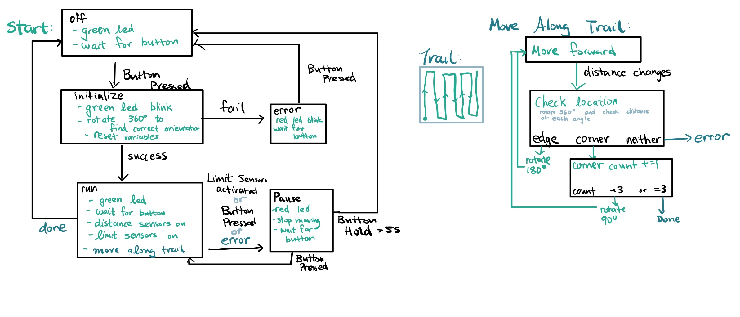
Software Block Diagram

Slide 6
Components / Budget
Component | ENGI301 to Buy? | Cost
Ultrasonic sensor * 2 www.adafruit.com/product/4007 |  | 3.95*2
DC Motors *2 + Wheels *3 www.amazon.com/dp/B08GPPJR1T |  | 11.99
Motor Drivers https://www.adafruit.com/product/3190 | Y | 7.5*2
9V Battery Holder https://www.amazon.com//dp/B07SRDPZ9Z |  | 5.99
Voltage Regulator https://www.amazon.com/dp/B07YPZLF2W |  | 5.45
Limit Switch https://www.digikey.com/en/products/detail/omron-electronics-inc-emc-div/404490 | Y | 3.53*4
 | =29.12
See Next Slide for Instructions

