Slide 1


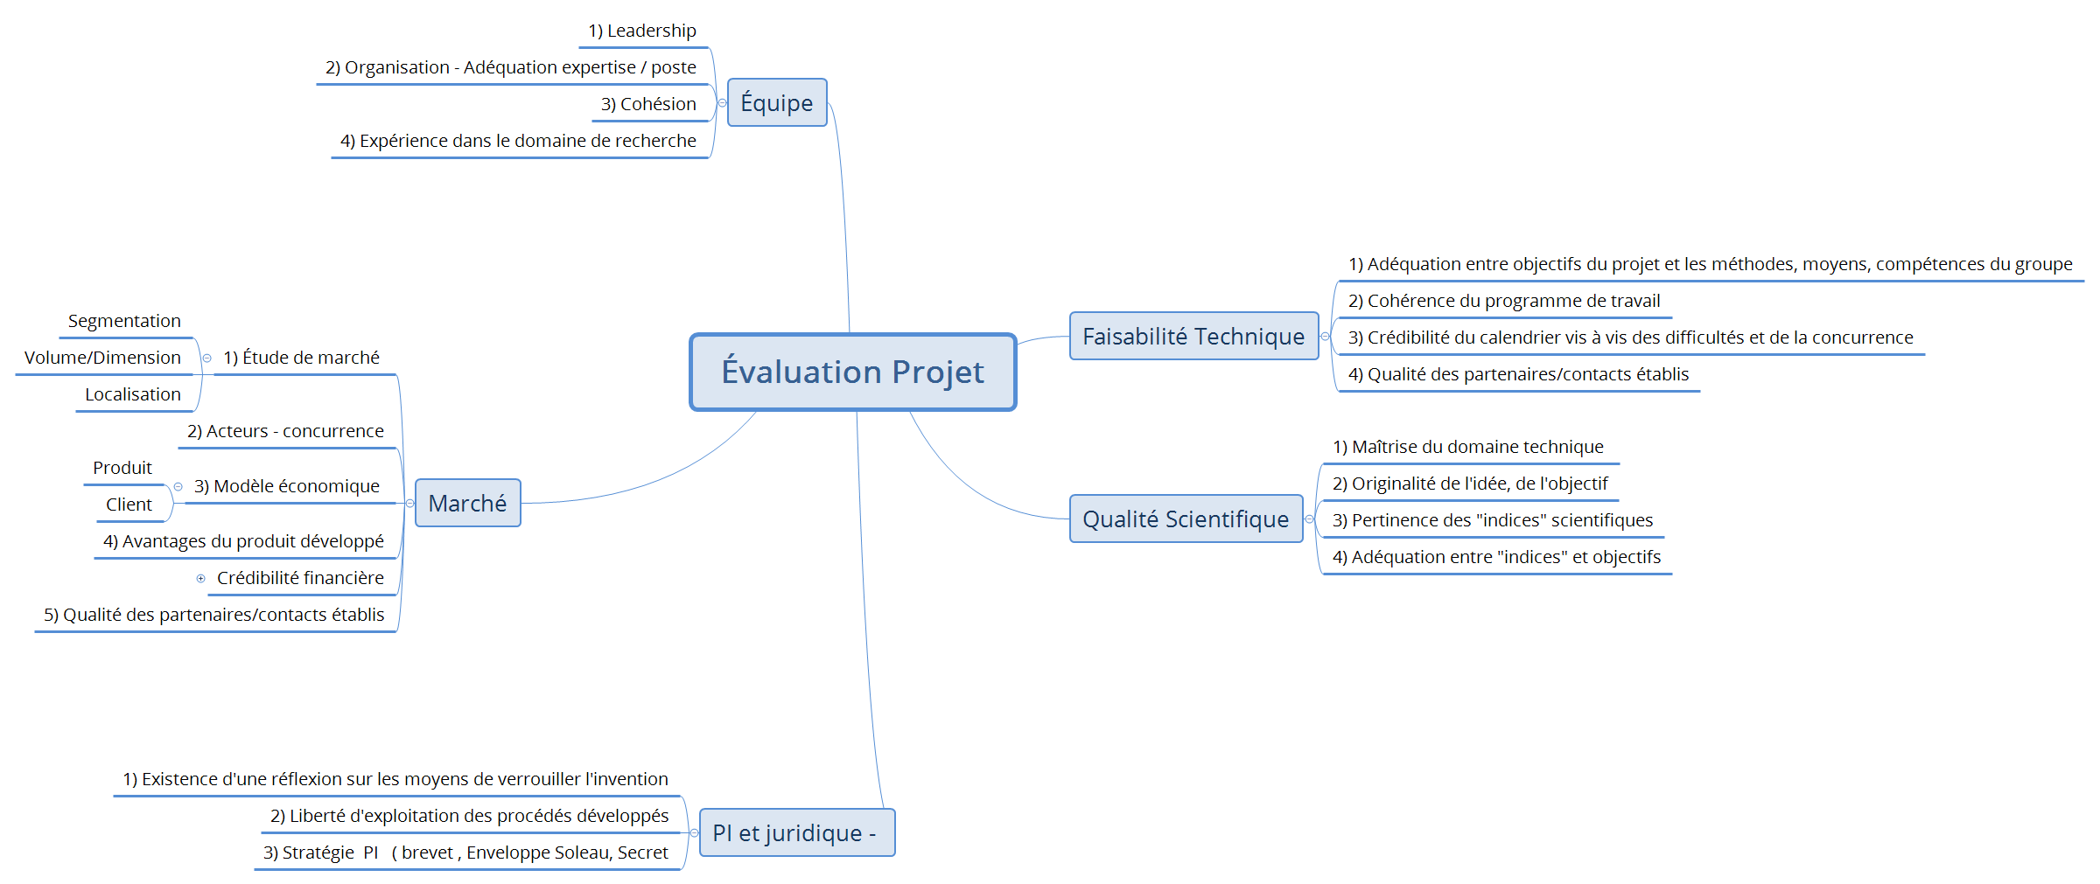
Critères d’évaluation pour la 1ère semaine SPRINT
Forces
Faiblesse
Opportunité
Risque
Convaincre le jury
de la faisabilité de votre projet
Adéquation entre la technicité du projet, l’équipe et le choix de la valo (s)

Slide 2


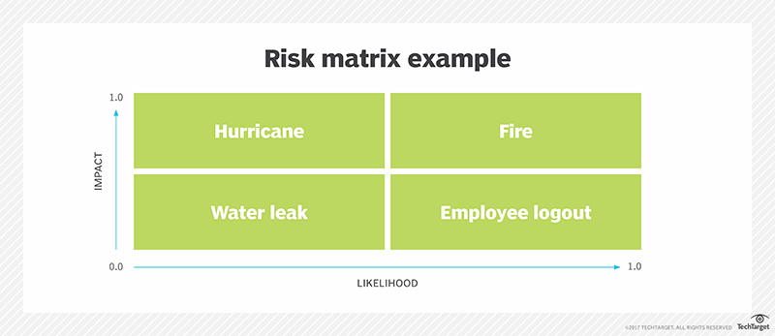
Nom du Projet & n°
Project overall
Remplacer la Photo /illustration Projet
v
v
Valo visée:
Risks
La Vision de votre groupe:
What is the Problem?
Contexte/ Enjeux
Concurrences/Can’t be easily copied…
Replace this blurb with other details.
Replace this blurb with other details
Replace this blurb with other details
Replace this blurb with other details
Replace this blurb with other details.
v
Mot Clés: Replace this blurb with other details
v
Secteurs d’activités :Replace this blurb with other details
07.
Roadmap: when?
What is your Solution
Opportunities
Milestones | Deadline
Replace this blurb with other details | Week XX
Replace this blurb with other details | Week XX
Replace this blurb with other details | Week XX
 | Week 46
 | Week 47
 | Week 49
 | Week 50
High level concept
Positionnement/ Gap Analysis
Replace this blurb with other details
Replace this blurb with other details
Replace this blurb with other details
Replace this blurb with other details
Replace this blurb with other details
Replace this blurb with other details
Replace this blurb with other details
Replace this blurb with other details
This is an incredible idea? AVANTAGES & BENEFICES
Les + forts et les + innovation
Roles and responsibilities: who?
Bonus ?
Strategy
Element/brique de Bio inspiration
Environmental & social Cost:
Environmental & social Benefit:
PI, Partenariat, adossement industriel, TRL visé, challenge(com),
NAMES | VALO | SKILLS
Xxxxxxxx | Propriété intellectuelle | SE
Xxxxxx | Partenariat | SI
Xx | Inititiation Recherche & Innov | Santé
X | Concours/Start-Up | Energie
xxx |  | Se
.
Replace this blurb with other details.
Replace this blurb with other details
Replace this blurb with other details
Outside partner(s): who else?
Company:
Key contact:
Mentor Ecole? Mentro Entreprise

