Slide 1
Exploratory Data Analysis Process
Step 1: original
Step 2: Check NaN Values
Step 3: Check Duplicated Columns
Step 6: Extract Top 10 Related Titles
Step 5: Extract Top 10 Tags
Step 4: Replace Punctuations
Step 7: Analyze Distribution of
Length of Prompts and Titles

Slide 2


Feature Engineering
original
Merge Columns
Drop Unnecessary Columns & Lowercase the Text
prompts
related_titles
tag
Sentence Transformer
BERT Encoder (for BERT)
Tag Generation
Top 100 Frequent Words
from Data Source 2
If in Data Source 1
Common 27 Tags
1 | 2 | … | 100
1 | 2 | … | 27

Slide 3
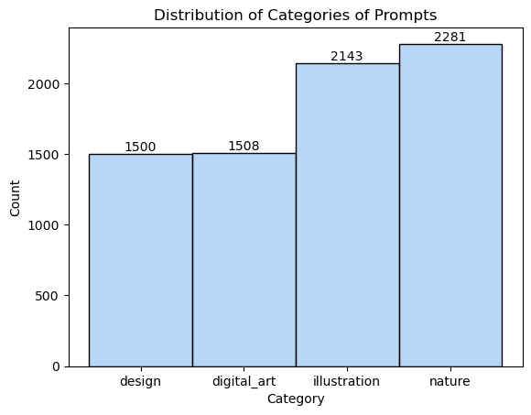
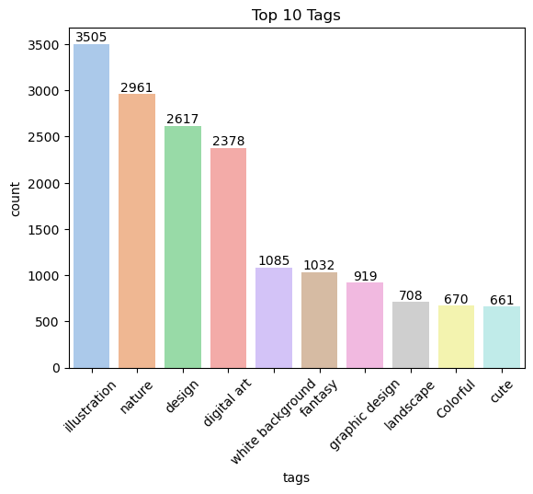
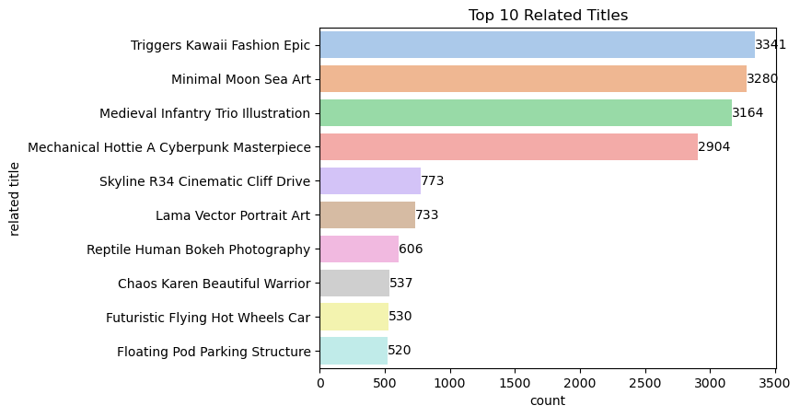
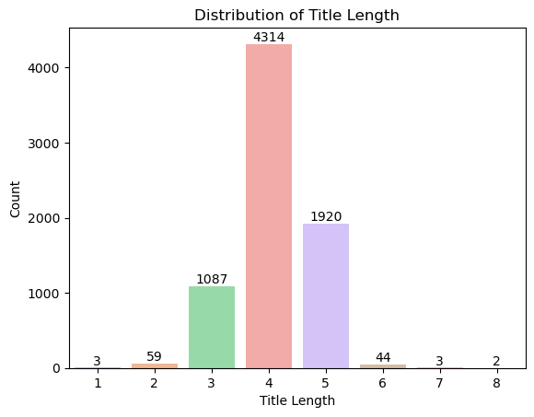

Slide 4
