Slide 1
INVENTORY MANAGEMENT SYSTEM
A Convenient tool to manage all your products

Slide 2
PURPOSE
The Inventory management system is a web-based project that seeks to provide effective management of stock data and data regarding the purchase and sale of the said stock. It consists of a few modules: a stock module, a purchased stock module, a stock sale module, etc. While the stock module is concerned with the management including the addition and deletion of products. The purchased stock module is concerned with keeping a record of all the purchased products. The stock sale module is for clients concerned with the management of products they sold.

Slide 3
MODULE DESCRIPTION
MINIMAL IMGT
It’s an online Inventory Management service which is named IMGT. It’s convenient, it gives you the widest choice possible and it can be done sitting in the privacy of one’s cubicle. Today when professionals across the world are spending 10-12 hours at work every day, Online Inventory Management reduces the time and complexity.

Slide 4
01
02
NUMBER OF MODULES
03
04
STOCK MODULE
Here you could maintain the product data
PURCHASED STOCK
Here you would have all the products that you purchased
SOLD STOCK
Here you would have all the products that you sold
BILL AND RECEIPT
Here you could get all the bills and receipts with necessary details

Slide 5
STOCK MODULE
01
It keeps a record of all present products.

Slide 6
STOCK MODULE
In this module, the admin maintains the stock data, consisting of the number of stocks and their respective amount, needed to buy them. Through this, they can add stock to the existing product list while filling out the necessary details required, such as product name, transaction mode, amount, sold by, etc. The products listed then are stored in the system with other existing ones to be sold or purchased.

Slide 7
02
PURCHASEDSTOCK MODULE
It keeps a record of all present products purchased.

Slide 8
PURCHASED STOCK MODULE
This will hold the details of the stocks purchased by the person at any given time, while also keeping a record of all the transactions made, with their bills and receipts. This module helps you manage all of your products conveniently and safely.
This module helps you manage all the products that you purchased while also keeping a record of the necessary details of the products purchased.

Slide 9
SOLD STOCK MODULE
03
It keeps a record of all present products sold.

Slide 10
SOLD STOCK MODULE
This module helps you manage all the products that, you created in the system, that have been sold to other clients with all the required details such as payment mode, payment by, etc.
This module in particular holds the data of all the products sold by one another through this system while also keeping a record of the many important details of the transaction.

Slide 11
BILL & RECEIPT MODULE
04
It keeps a record of all present products’ bills and receipts.

Slide 12
BILL & RECEIPT MODULE
This module helps you manage the bills and receipts of all the payments made, transactions made in the system generate bills for every product purchased, and a receipt for every product sold. The bills would show the payment mode and other necessary details required by the user or for the user. Similarly, receipts would show the products sold and their required details.

Slide 13
TECHNOLOGIES USED
Various web development technologies are used to create IMGT.

Slide 14
FRONTEND TECHNOLOGY
Frontend AND backend refers to the separation of concerns between the presentation layer, and the data access layer of a piece of software

Slide 15
HTML, JAVASCRIPT
HTML: (HyperText Markup Language) is the most basic building block of the Web. It defines the meaning and structure of web content. HTML is the standard markup language for Web pages. With HTML we can create our Website.
JS: It is a lightweight, interpreted programming language. It is designed for creating network-centric applications. JavaScript is very easy to implement because it is integrated with HTML. It is open and cross-platform. JavaScript can be used for client-side developments as well as server-side developments. It is used to make web pages interactive (e.g., having complex animations, clickable buttons, popup menus, etc.

Slide 16
REACT JS, MUI
React JS: It is a JavaScript library that combines the speed of JavaScript and uses a new way of rendering web pages, making them highly dynamic and responsive to user input. aces. React is not a framework – it's not even exclusive to the web. It's used with other libraries to render to certain environments. React's primary goal is to minimize the bugs that occur when developers are building UIs. It does this through the use of components — self-contained, logical pieces of code that describe a portion of the user interface. These components can be composed together to create a full UI, and React abstracts away much of the rendering work, leaving you to concentrate on the UI design.
Material UI: Material-UI is simply a library that allows us to import and use different components to create a user interface in our React applications. This saves a significant amount of time since the developers do not need to write everything from scratch.

Slide 17
AXIOS, YUP, REACT ROUTER
Axios: It is a promise-based HTTP Client for node.js and the browser. It is isomorphic (= it can run in the browser and nodejs with the same codebase). On the server-side it uses the native node.js http module, while on the client (browser) it uses XMLHttpRequests. Axios also comes with client side support for protecting against XSRF (Cross-Site Request Forgery).
Yup: Yup is a JavaScript schema builder for value parsing and validation. Define a schema, transform a value to match, validate the shape of an existing value, or both. Yup schema are extremely expressive and allow modeling complex, interdependent validations, or value transformations. Built-in async validation support and model server-side and client-side validation equally well.
React Router: It is a standard library for routing in React. It enables the navigation among views of various components in a React Application, allows changing the browser URL, and keeps the UI in sync with the URL

Slide 18
MIDDLEWARE TECHNOLOGY
Frontend AND backend refers to the separation of concerns between the presentation layer, and the data access layer of a piece of software

Slide 19
COOKIE-PARSER, JWT, Compression, CORS
Cookies-parser: Express.js, or simply Express, is a back-end web application framework for Node.js, released as free and open-source software under the MIT License. It is designed for building web applications and APIs. It has been called the de facto standard server framework for Node.js. Express is a minimal and flexible Node.js web application framework that provides a robust set of features for web and mobile applications.
JWT: To authenticate a user, a client application must send a JSON Web Token (JWT) in the authorization header of the HTTP request to your backend API. API Gateway validates the token on behalf of your API, so you don't have to add any code in your API to process the authentication. JSON Web Token (JWT) is a standard RFC 7519 for exchanging cryptographically signed JSON data. It is probably the most popular current standard of authorization on the web, especially when it comes to microservices and distributed architecture.
CORS: Cross-origin resource sharing (CORS) is a mechanism that allows restricted resources on a web page to be requested from another domain outside the domain from which the first resource was served. A web page may freely embed cross-origin images, stylesheets, scripts, iframes, and videos. Certain "cross-domain" requests, notably Ajax requests, are forbidden by default by the same-origin security policy. CORS defines a way in which a browser and server can interact to determine whether it is safe to allow the cross-origin request. It allows for more freedom and functionality than purely same-origin requests but is more secure than simply allowing all cross-origin requests.
Compression: Compression is a Node.js module which returns a compression middleware which can be used to compress the request and response bodies for all the requests that traverse through the middleware. This middleware can be customized according to the need using customization options to selectively change some compression settings.

Slide 20
BACKEND TECHNOLOGY
Frontend AND backend refers to the separation of concerns between the presentation layer, and the data access layer of a piece of software

Slide 21
NODEJS/EXPRESS, MONGODB, MONGOOSE
NodeJS: Node.js is an open-source and cross-platform JavaScript runtime environment. It is a popular tool for almost any kind of project. Node.js runs the V8 JavaScript engine, the core of Google Chrome, outside of the browser. This allows Node.js to be very performant. A Node.js app runs in a single process, without creating a new thread for every request. Node.js provides a set of asynchronous I/O primitives in its standard library that prevent JavaScript code from blocking and generally, libraries in Node.js are written using non-blocking paradigms, making blocking behavior the exception rather than the norm.
MongoDB: It is a source-available cross-platform document-oriented database program. Classified as a NoSQL database program, MongoDB uses JSON-like documents with optional schemas. MongoDB is developed by MongoDB Inc. and licensed under the Server-Side Public License (SSPL). MongoDB, Inc. is an American software company that develops and provides commercial support for the source-available database MongoDB, a NoSQL database that stores data in JSON-like documents with flexible schemas. MongoDB Atlas makes it easy to control access to your database. Your database instances are deployed in a unique Virtual Private Cloud (VPC) to ensure network isolation. Other security features include IP whitelisting or VPC Peering, always-on authentication, encryption at rest and encryption in transit, sophisticated role-based access management, and more.
Mongoose: Mongoose is a MongoDB object modelling tool designed to work in an asynchronous environment. It provides a straight-forward, schema-based solution to model an application data. It includes built-in type casting, validation, query building, business logic hooks and more, out of the box.

Slide 22
SENDGRID, BCRYPTJS, CRYPTOJS
SendGrid provides a cloud-based service that assists businesses with email delivery. The service manages various types of email including shipping notifications, friend requests, sign-up confirmations, and email newsletters. It also handles Internet service provider (ISP) monitoring, domain keys, sender policy framework (SPF), and feedback loops. Additionally, the company provides link tracking and open rate reporting. It also allows companies to track email opens, unsubscribes, bounces, and spam reports. Beginning in 2012, the company integrated SMS, voice, and push notification abilities into its service through a partnership with Twilio.
BCryptJS: bcrypt is a password-hashing function designed by Niels Provos and David Mazières, based on the Blowfish cipher and presented at USENIX in 1999. Besides incorporating a salt to protect against rainbow table attacks, bcrypt is an adaptive function: over time, the iteration count can be increased to make it slower, so it remains resistant to brute-force search attacks even with increasing computation power. Blowfish is notable among block ciphers for its expensive key setup phase. It starts with subkeys in a standard state, then uses this state to perform block encryption using part of the key, and uses the result of that encryption (which is more accurate at hashing) to replace some of the subkeys.

Slide 23
UML DIAGRAMS
A UML diagram is a diagram based on the UML (Unified Modeling Language) with the purpose of visually representing a system

Slide 24
ER DIAGRAM
Login
Admin_name
Admin_email
Admin_number
Stock
Stock_name
Stock_amount
Stock_quantity
Stock_category
Stock_sellerName
Stock_sellerAddress
Stock_sellerPhoneNo
Stock_transactionMode
Stock_transactionID
Bill
Bill_name
Bill_id
Bill_createdAt
Bill_paymentMode
Bill_transactionId
Bill_category
Bill_amount
Bill_quantity
Purchased Stock
Stock_name
Stock_seller
Stock_category
Stock_purchasedDate
Stock_amount
Stock_quantity
Sold Stock
Stock_name
Stock_seller
Stock_category
Stock_purchasedDate
Stock_amount
Stock_quantity

Slide 25
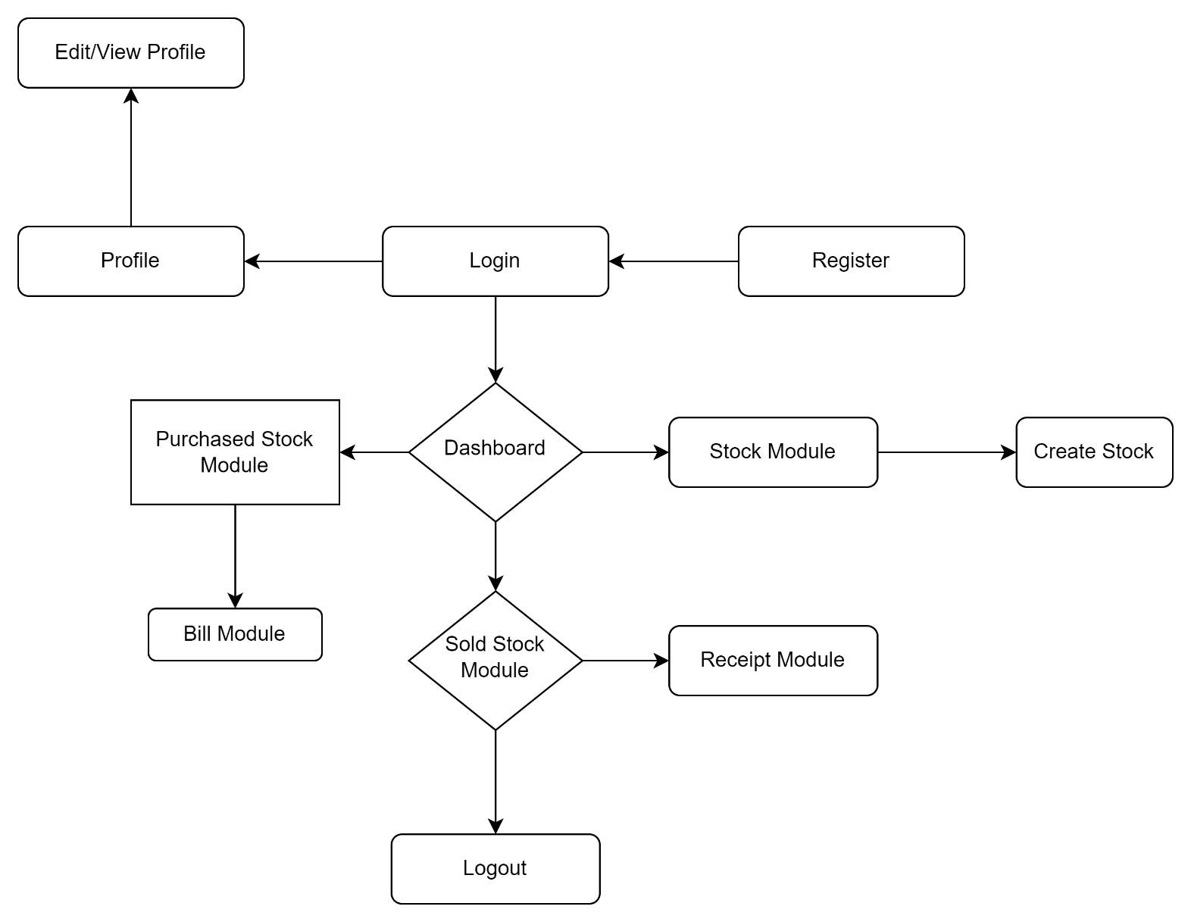
DATA FLOW DIAGRAM

Slide 26
SCREENSHOTS
Screenshots of the project – Inventory Management System

Slide 27
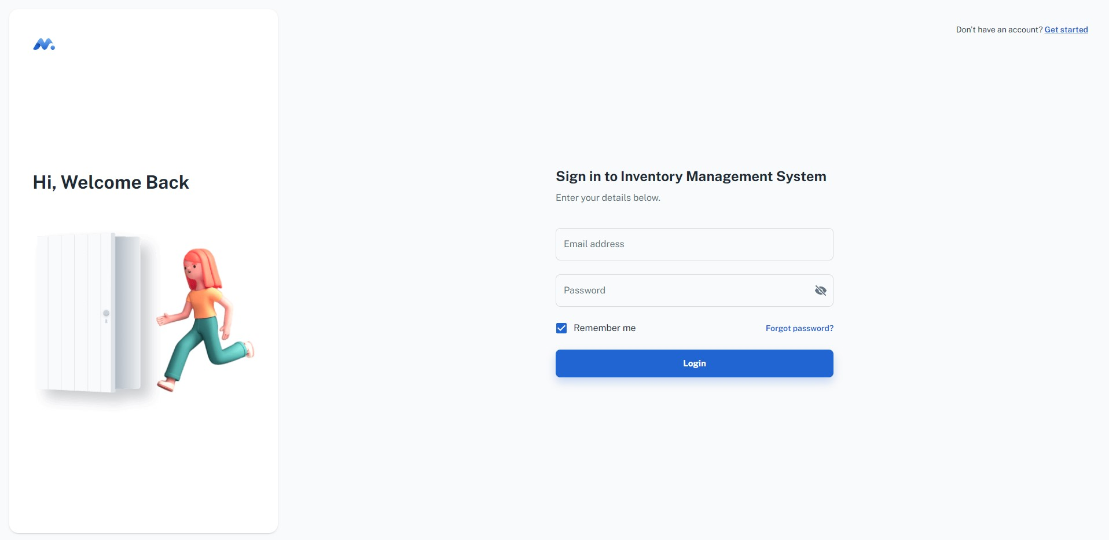

Slide 28
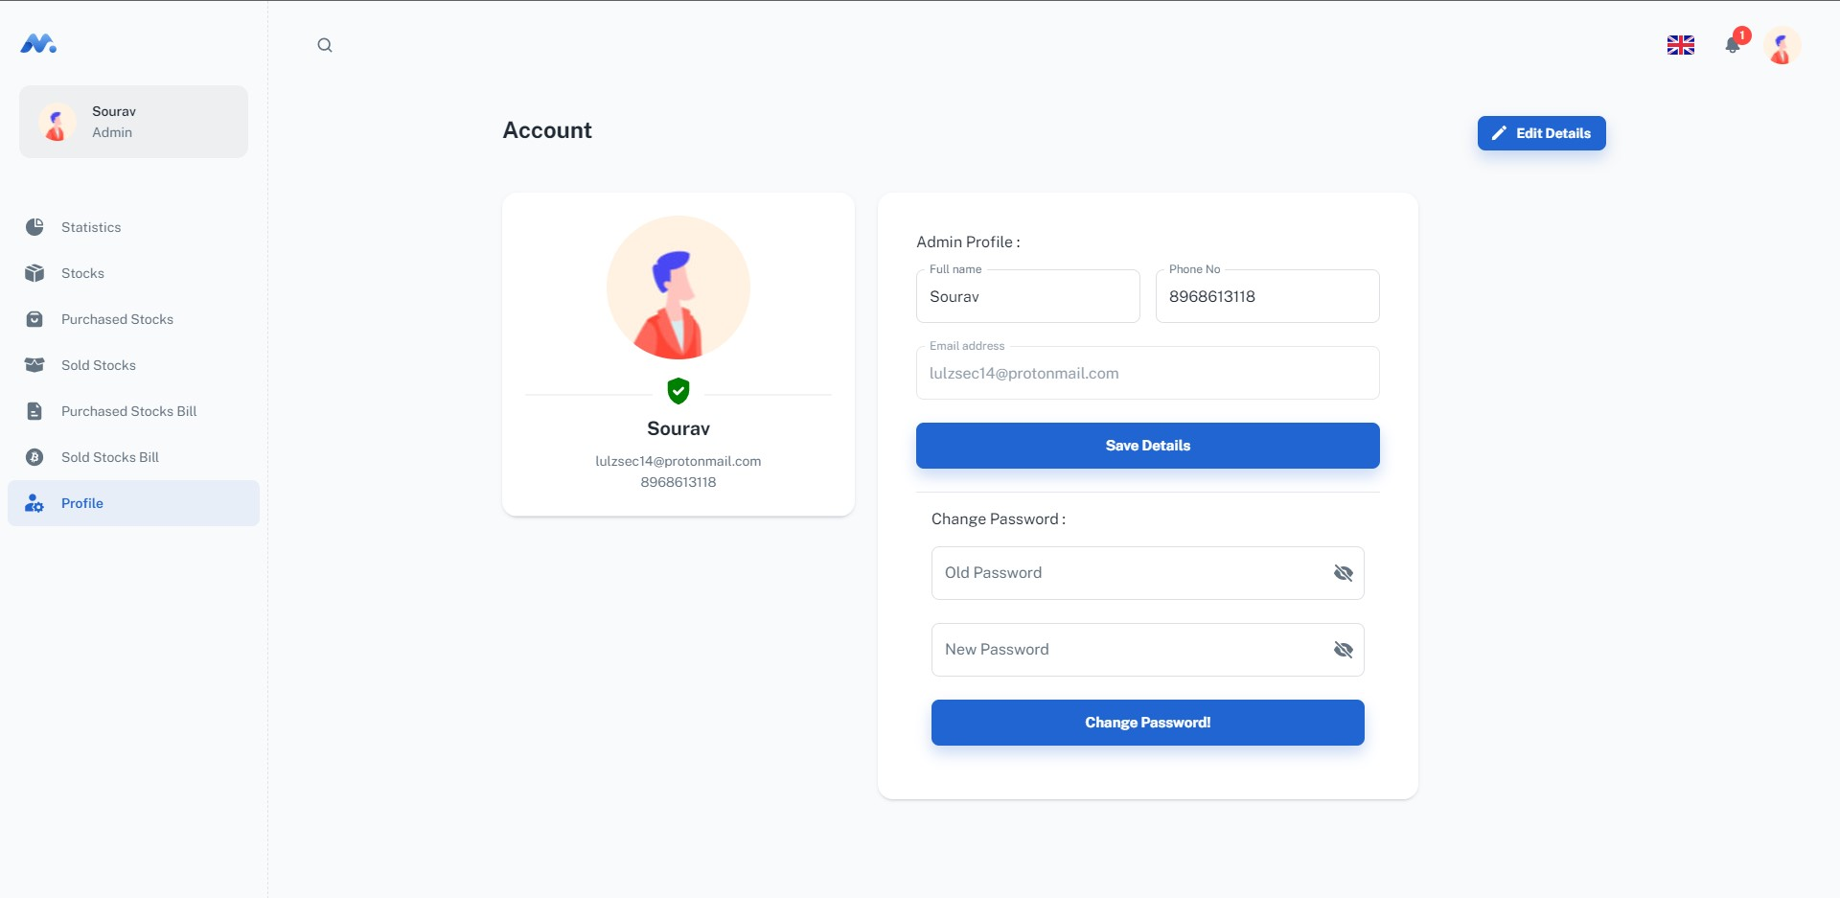

Slide 29
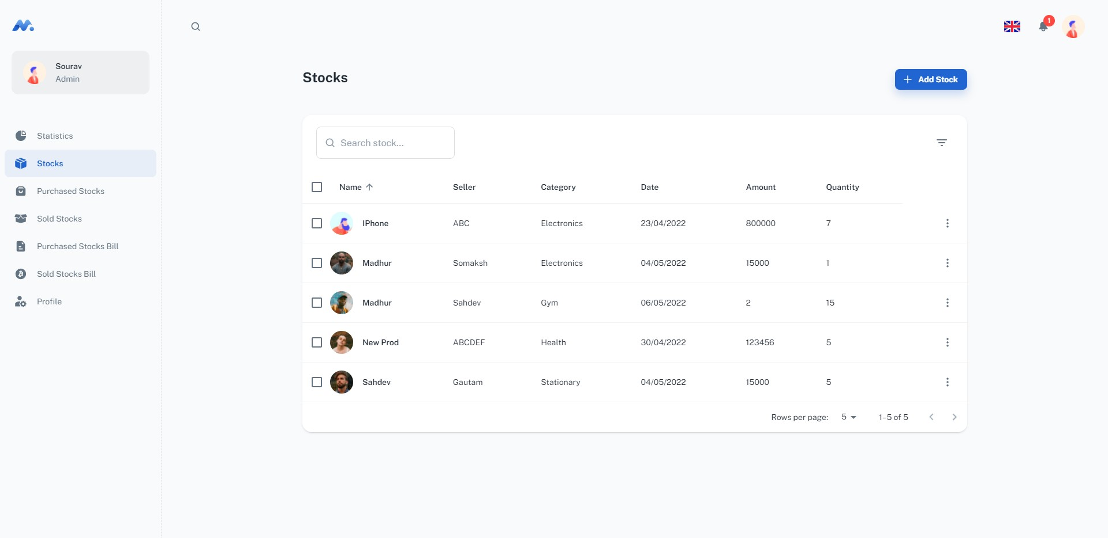

Slide 30
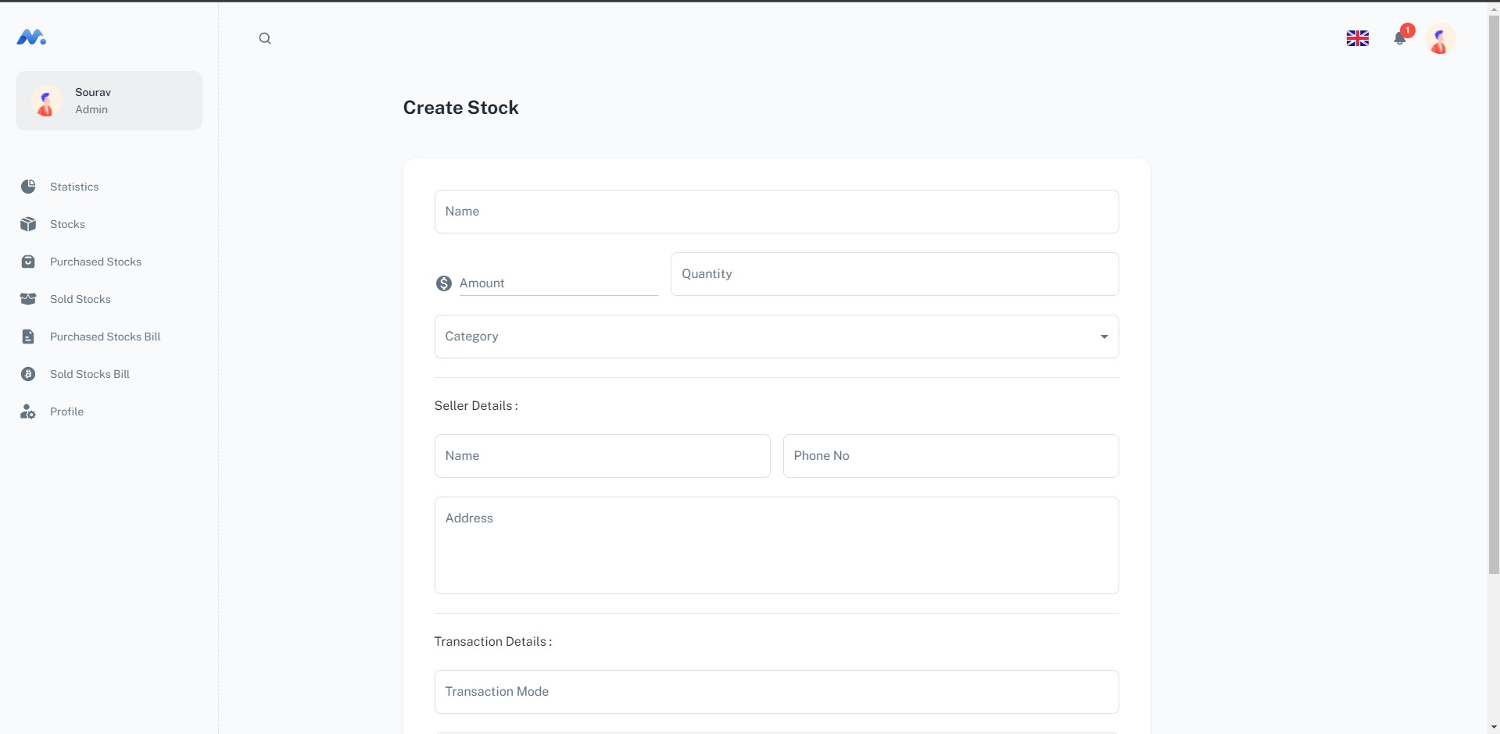

Slide 31
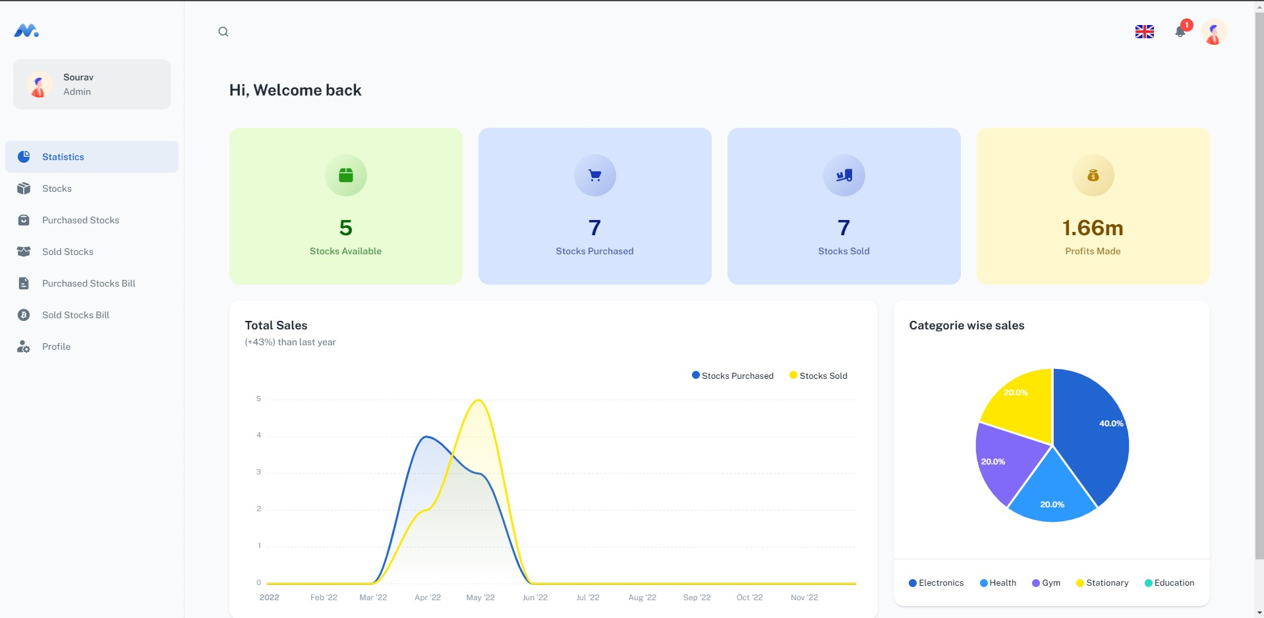

Slide 32
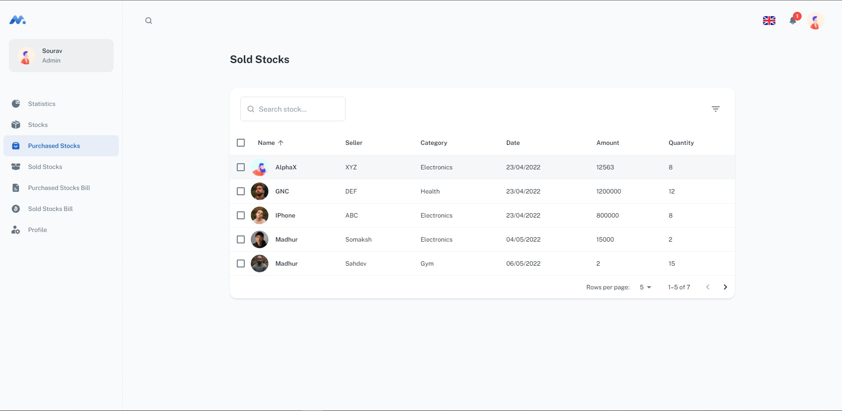
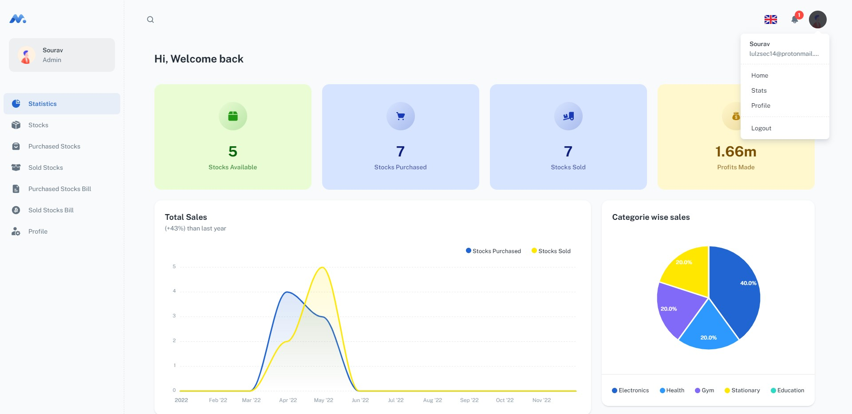

Slide 34
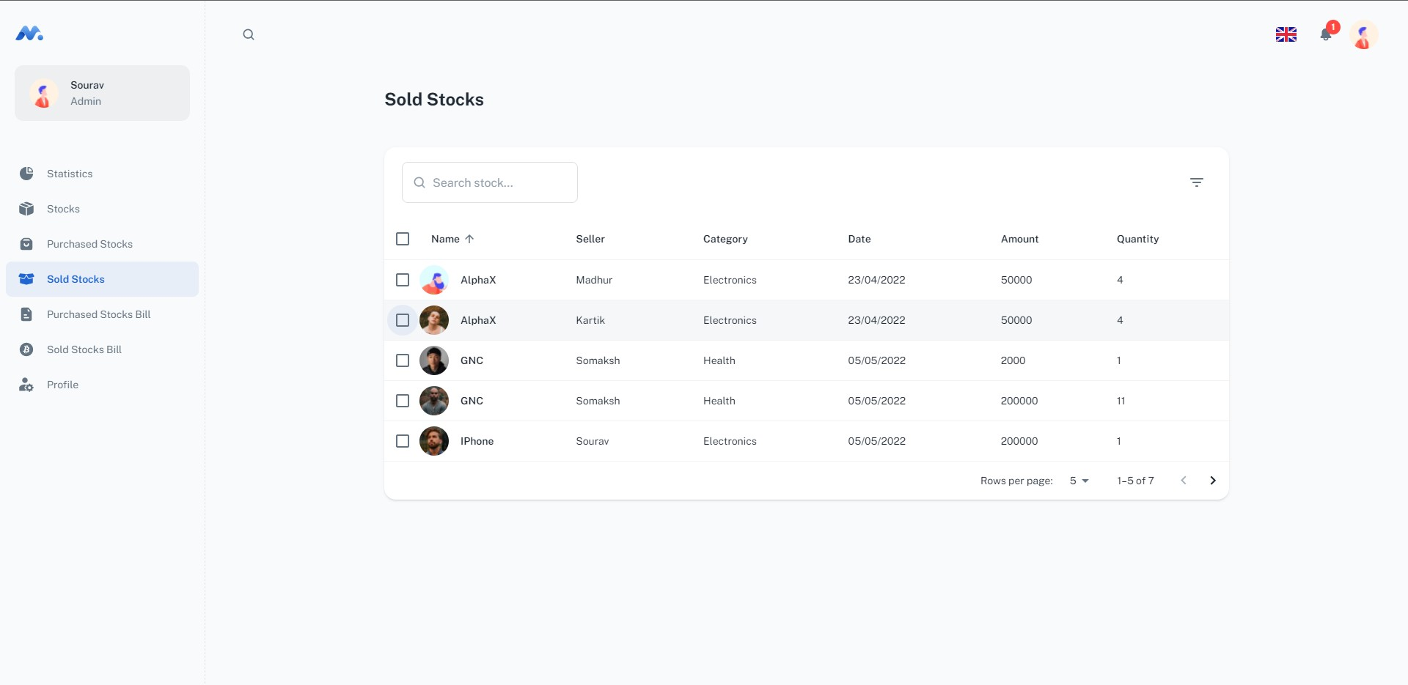

Slide 35
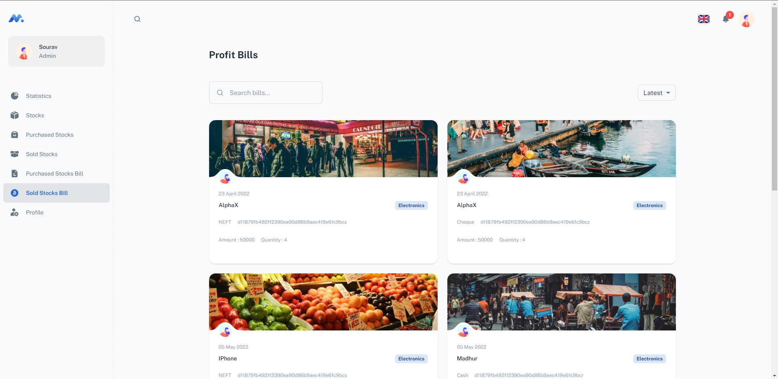

Slide 36
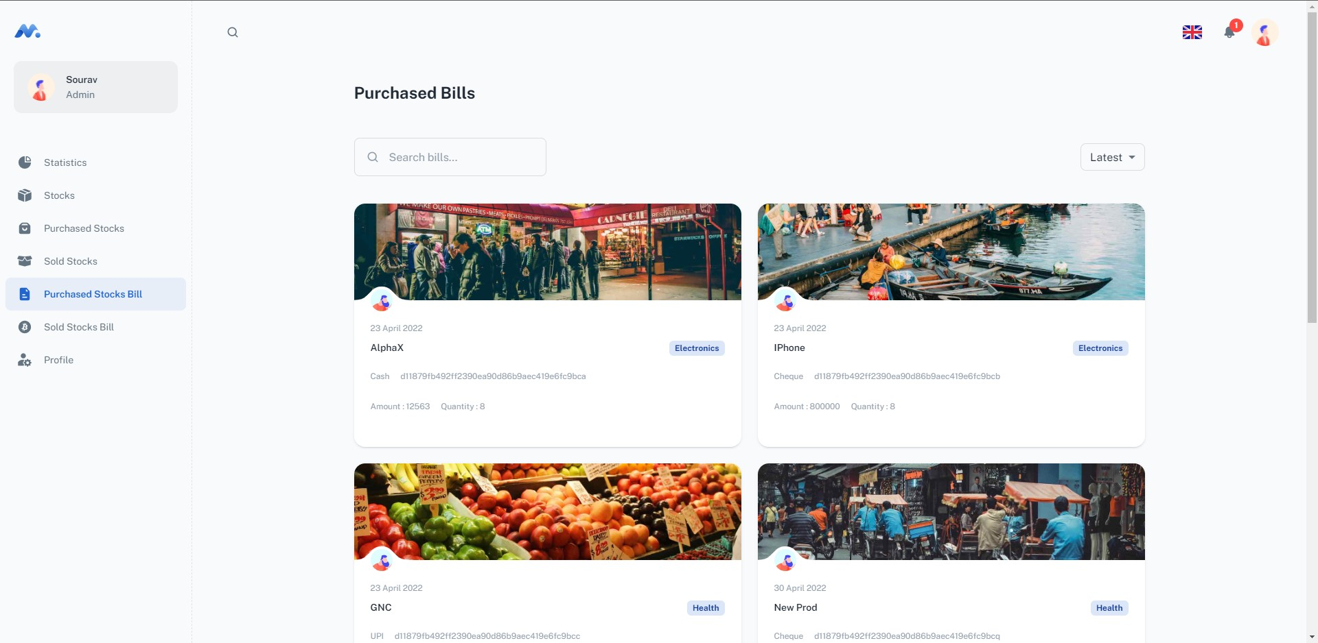

Slide 37
FUTURE ASPECTS
Future aspects of the project – Inventory Management System

Slide 38
FUTURE ASPECTS
The proposed system ‘Inventory Management’ can be further developed into a separate, automated system with the following enhancements:
Addition of chat application between seller and buyers.
Additional security additions.
Forgot password feature.
Data visualization of transactional history.
Bill Management System.
Addition of Recent Orders

Slide 39
THANK YOU!
Minimal
IMGT
Sourav
1911985018

