Slide 1
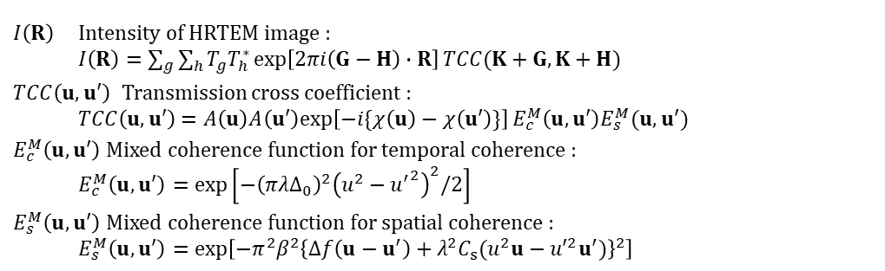
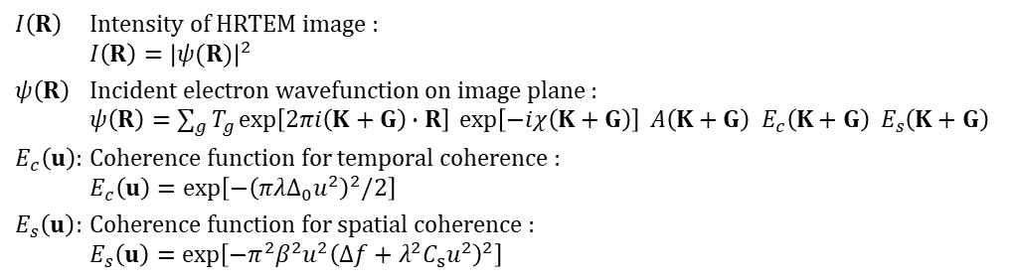
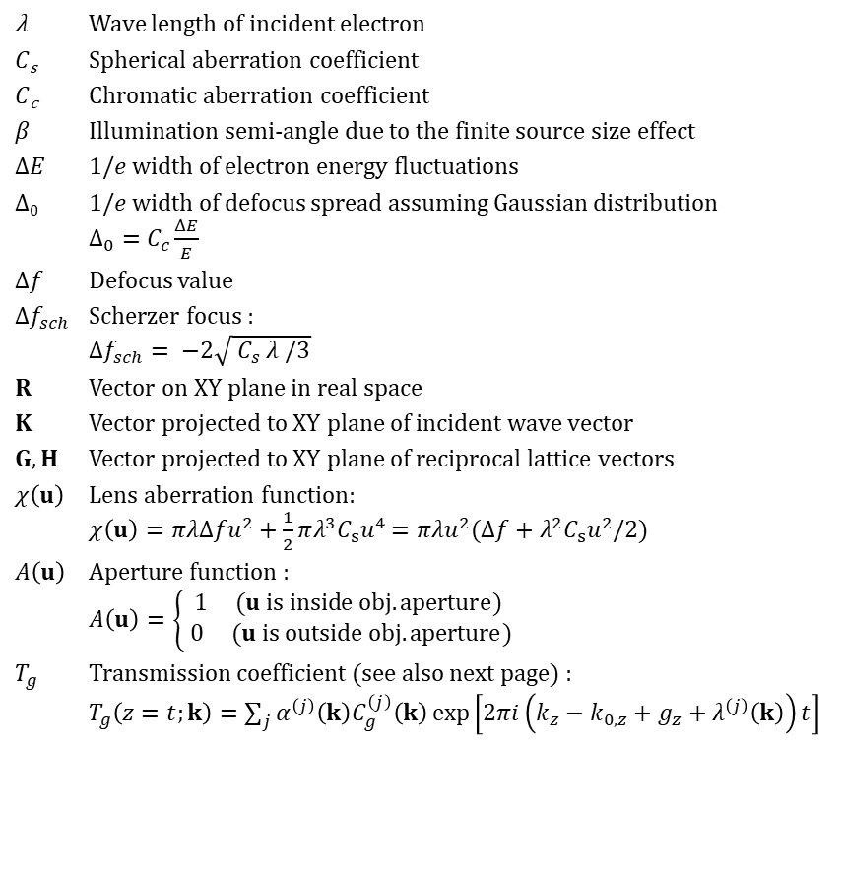
Basic concept of HRTEM simulation
Common parameters/functions
λ Wave length of incident electron
𝐶_{s} Spherical aberration coefficient
𝐶_{c} Chromatic aberration coefficient
𝛽 Illumination semi-angle due to the finite source size effect
Δ𝐸 1/𝑒 width of electron energy fluctuations
Δ₀ 1/𝑒 width of defocus spread assuming Gaussian distribution
$Δ_{0}=C_{c}\frac{ΔE}{E}$
Δ𝑓 Defocus value
$∆f_{sch}$ Scherzer focus :
$∆f_{sch}= −2\sqrt{ C_{s} λ /3}$
$R$ Vector on XY plane in real space
$K$ Vector projected to XY plane of incident wave vector
$G, H$ Vector projected to XY plane of reciprocal lattice vectors
$χ\left(u\right)$ Lens aberration function:
$χ\left(u\right)=πλΔfu^{2}+\frac{1}{2}πλ^{3}C_{s}u^{4}$ $=πλu^{2}(Δf+λ^{2}C_{s}u^{2}/2)$
$A\left(u\right)$ Aperture function :
$A\left(u\right)=\left\{\begin{aligned}1 (u is inside obj. aperture) \\ 0 (u is outside obj. aperture)\end{aligned}\right.$
$T_{g}$ Transmission coefficient (see also next page) :
$T_{g}\left(z=t;k\right)=\sum_{j}{α^{\left(j\right)}\left(k\right)C_{g}^{\left(j\right)}\left(k\right)\exp\left[2πi\left(k_{z}−k_{0,z}+g_{z}+λ^{\left(j\right)}\left(k\right)\right)t\right]}$
Quasi-coherent model
$I\left(R\right)$ Intensity of HRTEM image :
$I\left(R\right)={\left|ψ(R)\right|}^{2}$
$ψ\left(R\right)$ Incident electron wavefunction on image plane :
$ψ\left(R\right)=\sum_{g}{T_{g}\exp\left[2πi\left(K+G\right)∙R\right] \exp\left[−iχ\left(K+G\right)\right] A\left(K+G\right) E_{c}\left(K+G\right) E_{s}\left(K+G\right)}$
$E_{c}\left(u\right)$: Coherence function for temporal coherence :
$E_{c}\left(u\right)=\exp\left[−{\left(πλΔ_{0}u^{2}\right)}^{2}/2\right]$
$E_{s}\left(u\right)$: Coherence function for spatial coherence :
$E_{s}\left(u\right)=\exp\left[−π^{2}β^{2}u^{2}{\left(Δf+λ^{2}C_{s}u^{2}\right)}^{2}\right]$
Transmission cross coefficient model
$I\left(R\right)$ Intensity of HRTEM image :
$I\left(R\right)=\sum_{g}{\sum_{h}{T_{g}T_{h}^{∗}\exp\left[2πi\left(G−H\right)∙R\right]}TCC(K+G,K+H)}$
$TCC\left(u,u′\right)$ Transmission cross coefficient :
$TCC\left(u,u′\right)$ $=A\left(u\right)A\left(u′\right)exp\left[−i\{χ\left(u\right)−χ\left(u′\right)\}\right]E_{c}^{M}\left(u,u′\right)E_{s}^{M}(u,u′)$
$E_{c}^{M}\left(u,u′\right)$ Mixed coherence function for temporal coherence :
$E_{c}^{M}\left(u,u′\right)=\exp\left[−{\left(πλΔ_{0}\right)}^{2}{\left(u^{2}−{u^{′}}^{2}\right)}^{2}/2\right]$
$E_{s}^{M}\left(u,u′\right)$ Mixed coherence function for spatial coherence :
$E_{s}^{M}\left(u,u′\right)=\exp\left[−π^{2}β^{2}{\left\{Δf\left(u−u^{′}\right)+λ^{2}C_{s}(u^{2}u−{u′}^{2}u^{′})\right\}}^{2}\right]$

Slide 2


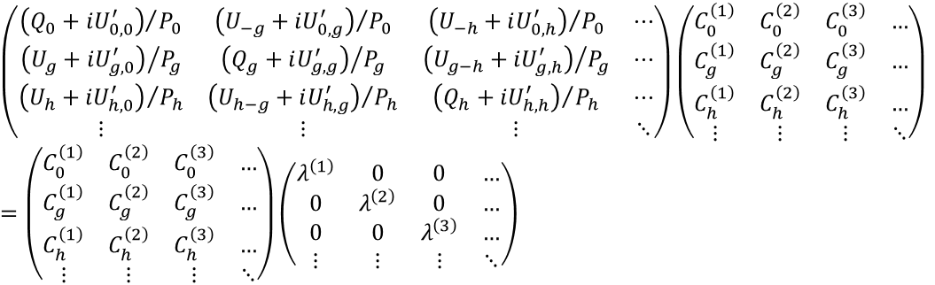



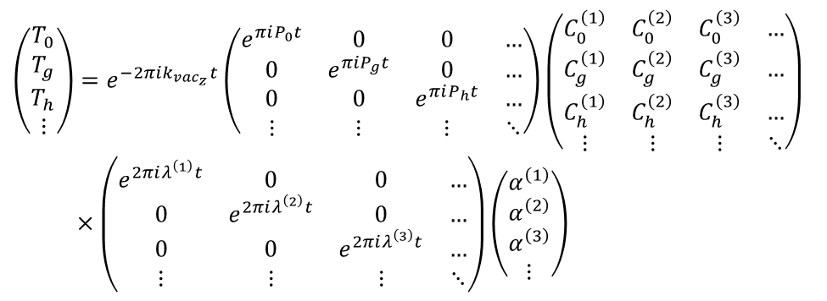

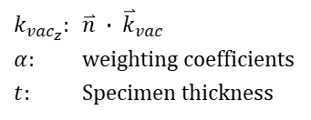









Definitions of vectors and scalars
Center of Ewald sphere
Surface
Vector
$$\overset{⃑}{n}$$
Scalar
$${\overset{⃑}{k}}_{vac}$$
$$γ^{j}$$
$$\frac{P_{g}}{2}$$
$$\overset{⃑}{n}:Unit vector normal to surface$$
$$P_{g}=2\overset{⃑}{n}(\overset{⃑}{k}+\overset{⃑}{g})$$
$$Q_{g}={\left|\overset{⃑}{k}\right|}^{2}−{\left|\overset{⃑}{k}+\overset{⃑}{g}\right|}^{2}$$
$=−\overset{⃑}{g}(2\overset{⃑}{k}+\overset{⃑}{g})$
$$\overset{⃑}{k}$$
$$\overset{⃑}{k^{j}}$$
$$\overset{⃑}{k}+ \overset{⃑}{g}$$
$$S_{g}=\frac{\sqrt{P_{g}^{ 2}+{4Q}_{g}}−P_{g}}{2}$$
$$o$$
$$\overset{⃑}{g}$$
$$S_{g}$$
$$R={\left|\overset{⃑}{g}\right|}^{2}|Q_{g}|$$
Ewald sphere
(Evaluation function)
Eigen values/vectors equation
$$\left(\begin{matrix}{\left(Q_{0}+iU_{0,0}^{′}\right)}/{P_{0}} & {\left(U_{−g}+iU_{0,g}^{′}\right)}/{P_{0}} & {\left(U_{−h}+iU_{0,h}^{′}\right)}/{P_{0}} & ⋯ \\ {\left(U_{g}+iU_{g,0}^{′}\right)}/{P_{g}} & {\left(Q_{g}+iU_{g,g}^{′}\right)}/{P_{g}} & {\left(U_{g−h}+iU_{g,h}^{′}\right)}/{P_{g}} & ⋯ \\ {\left(U_{h}+iU_{h,0}^{′}\right)}/{P_{h}} & {\left(U_{h−g}+iU_{h,g}^{′}\right)}/{P_{h}} & {\left(Q_{h}+iU_{h,h}^{′}\right)}/{P_{h}} & ⋯ \\ ⋮ & ⋮ & ⋮ & ⋱\end{matrix}\right)\left(\begin{matrix}C_{0}^{\left(1\right)} & C_{0}^{\left(2\right)} & C_{0}^{\left(3\right)} & … \\ C_{g}^{\left(1\right)} & C_{g}^{\left(2\right)} & C_{g}^{\left(3\right)} & … \\ C_{h}^{\left(1\right)} & C_{h}^{\left(2\right)} & C_{h}^{\left(3\right)} & … \\ ⋮ & ⋮ & ⋮ & ⋱\end{matrix}\right)=\left(\begin{matrix}C_{0}^{\left(1\right)} & C_{0}^{\left(2\right)} & C_{0}^{\left(3\right)} & … \\ C_{g}^{\left(1\right)} & C_{g}^{\left(2\right)} & C_{g}^{\left(3\right)} & … \\ C_{h}^{\left(1\right)} & C_{h}^{\left(2\right)} & C_{h}^{\left(3\right)} & … \\ ⋮ & ⋮ & ⋮ & ⋱\end{matrix}\right)\left(\begin{matrix}λ^{\left(1\right)} & 0 & 0 & … \\ 0 & λ^{\left(2\right)} & 0 & … \\ 0 & 0 & λ^{\left(3\right)} & … \\ ⋮ & ⋮ & ⋮ & ⋱\end{matrix}\right)$$
$U_{g}$: Crystal potential
$U_{g}′$: Crystal potential
$P, Q$: Defined in above figure
$λ^{\left(j\right)}$: j ^{th} eigen value
$C_{∗}^{\left(j\right)}$: j ^{th} eigen vectors
Matrix representation of transmission coefficient T_{g}
$$\left(\begin{matrix}T_{0} \\ T_{g} \\ T_{h} \\ ⋮\end{matrix}\right)=e^{−2πik_{{vac}_{z}}t}\left(\begin{matrix}e^{πiP_{0}t} & 0 & 0 & … \\ 0 & e^{πiP_{g}t} & 0 & … \\ 0 & 0 & e^{πiP_{h}t} & … \\ ⋮ & ⋮ & ⋮ & ⋱\end{matrix}\right)\left(\begin{matrix}C_{0}^{\left(1\right)} & C_{0}^{\left(2\right)} & C_{0}^{\left(3\right)} & … \\ C_{g}^{\left(1\right)} & C_{g}^{\left(2\right)} & C_{g}^{\left(3\right)} & … \\ C_{h}^{\left(1\right)} & C_{h}^{\left(2\right)} & C_{h}^{\left(3\right)} & … \\ ⋮ & ⋮ & ⋮ & ⋱\end{matrix}\right)$$
$×\left(\begin{matrix}e^{2πiλ^{\left(1\right)}t} & 0 & 0 & … \\ 0 & e^{2πiλ^{\left(2\right)}t} & 0 & … \\ 0 & 0 & e^{2πiλ^{\left(3\right)}t} & … \\ ⋮ & ⋮ & ⋮ & ⋱\end{matrix}\right)\left(\begin{matrix}α^{\left(1\right)} \\ α^{\left(2\right)} \\ α^{\left(3\right)} \\ ⋮\end{matrix}\right)$
$k_{{vac}_{z}}$: $\overset{⃑}{n} ∙ {\overset{⃑}{k}}_{vac}$
$α$: weighting coefficients
$t$: Specimen thickness

Slide 3
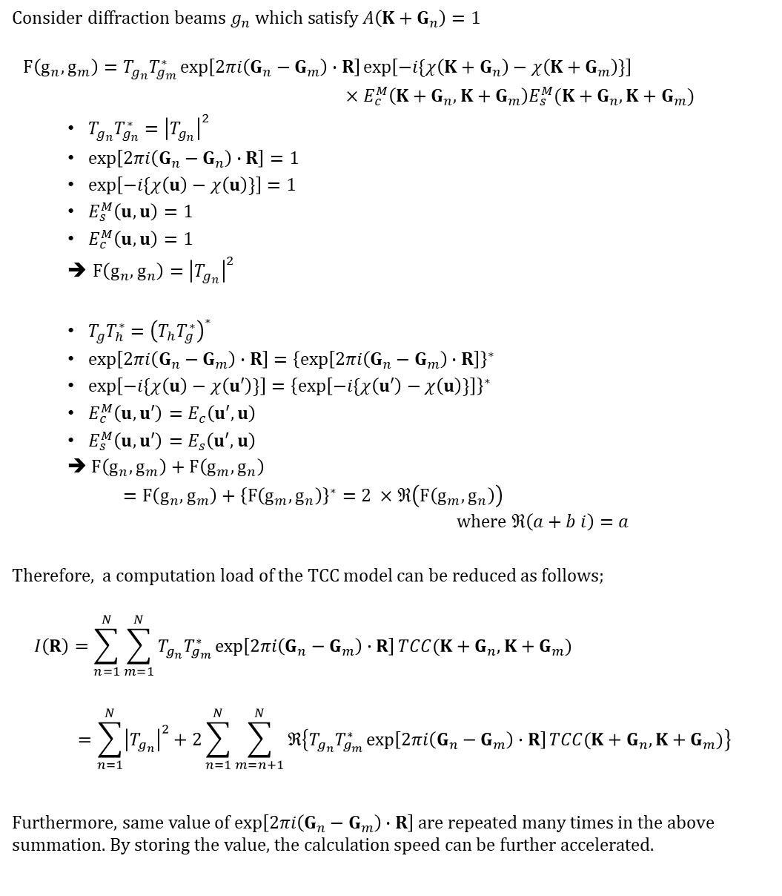
Simplification of transmission cross coefficient model
$$Consider diffraction beams g_{n} which satisfy A\left(K+G_{n}\right)=1$$
$$F\left(g_{n}, g_{m}\right)=T_{g_{n}}T_{g_{m}}^{∗}\exp\left[2πi\left(G_{n}−G_{m}\right)∙R\right]exp\left[−i\{χ\left(K+G_{n}\right)−χ\left(K+G_{m}\right)\}\right]$$
$×E_{c}^{M}\left(K+G_{n},K+G_{m}\right)E_{s}^{M}(K+G_{n},K+G_{m})$
$T_{g_{n}}T_{g_{n}}^{∗}={\left|T_{g_{n}}\right|}^{2}$
$\exp\left[2πi\left(G_{n}−G_{n}\right)∙R\right]=1$
$exp\left[−i\{χ\left(u\right)−χ\left(u\right)\}\right]=1$
$E_{s}^{M}\left(u,u\right)=1$
$E_{c}^{M}\left(u,u\right)=1$
$F\left(g_{n}, g_{n}\right)={\left|T_{g_{n}}\right|}^{2}$
$T_{g}T_{h}^{∗}={\left(T_{h}T_{g}^{∗}\right)}^{∗}$
$\exp\left[2πi\left(G_{n}−G_{m}\right)∙R\right]={\left\{\exp\left[2πi\left(G_{n}−G_{m}\right)∙R\right]\right\}}^{∗}$
$exp\left[−i\{χ\left(u\right)−χ\left(u′\right)\}\right]={\left\{\exp\left[−i\{χ\left(u′\right)−χ\left(u\right)\}\right]\right\}}^{∗}$
$E_{c}^{M}\left(u,u′\right)=E_{c}\left(u′,u\right)$
$E_{s}^{M}\left(u,u′\right)=E_{s}\left(u′,u\right)$
➔ $F\left(g_{n}, g_{m}\right)+F\left(g_{m}, g_{n}\right)$
$=F\left(g_{n}, g_{m}\right)+{\left\{F\left(g_{m}, g_{n}\right)\right\}}^{∗}=2 ×ℜ\left(F\left(g_{m}, g_{n}\right)\right)$ $where ℜ\left(a+b i\right)=a$
Therefore, a computation load of the TCC model can be reduced as follows;
$$I\left(R\right)=\sum_{n=1}^{N}{\sum_{m=1}^{N}{T_{g_{n}}T_{g_{m}}^{∗}\exp\left[2πi\left(G_{n}−G_{m}\right)∙R\right]TCC(K+G_{n},K+G_{m})}}$$
$$=\sum_{n=1}^{N}{{\left|T_{g_{n}}\right|}^{2}}+2\sum_{n=1}^{N}{\sum_{m=n+1}^{N}{ℜ\left\{T_{g_{n}}T_{g_{m}}^{∗}\exp\left[2πi\left(G_{n}−G_{m}\right)∙R\right]TCC(K+G_{n},K+G_{m})\right\}}}$$
Furthermore, same value of $\exp\left[2πi\left(G_{n}−G_{m}\right)∙R\right]$ are repeated many times in the above summation. By storing the value, the calculation speed can be further accelerated.

