Slide 1

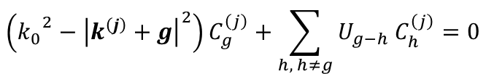
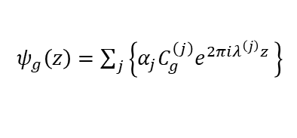
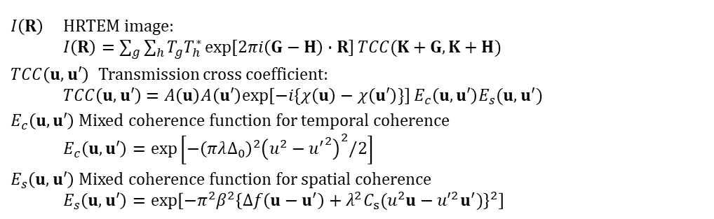
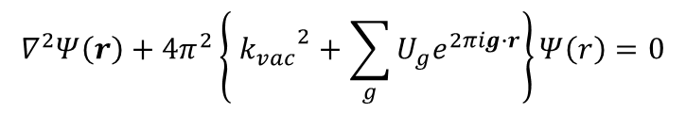
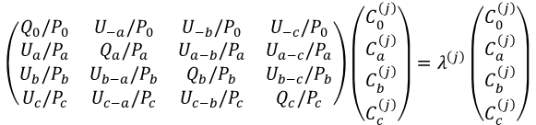
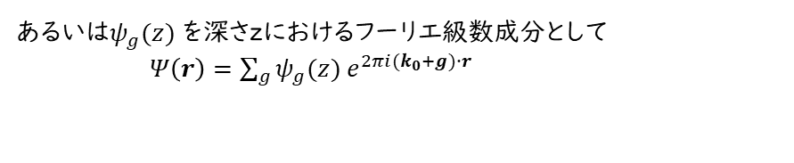
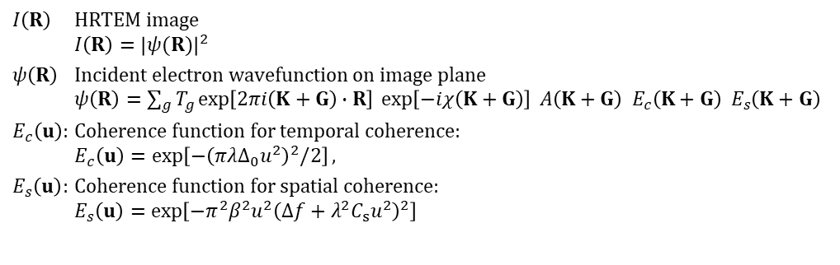
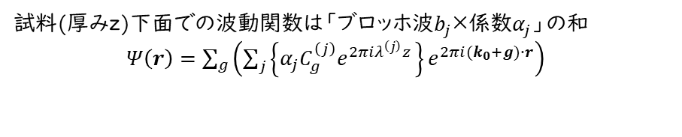


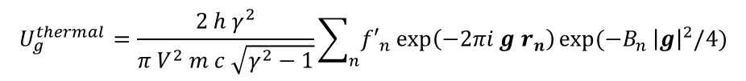
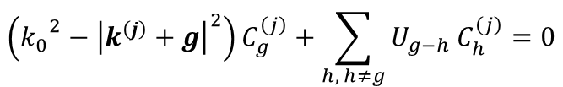
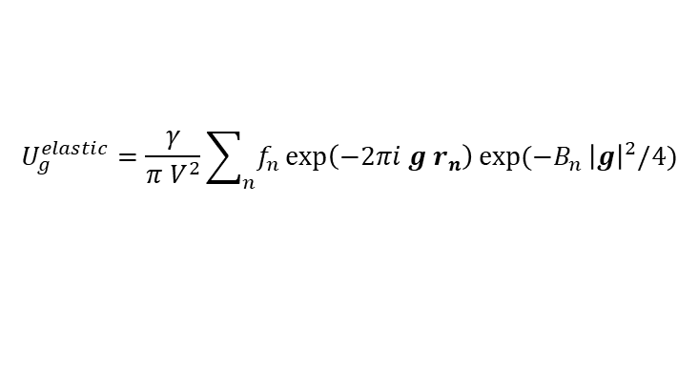

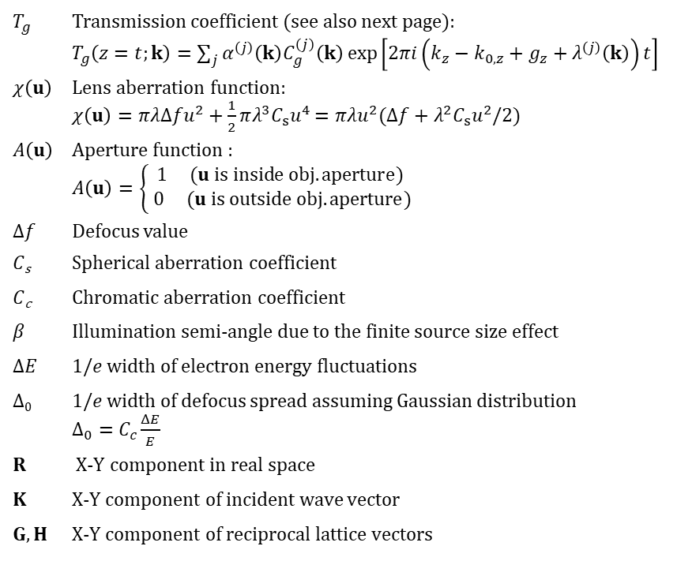

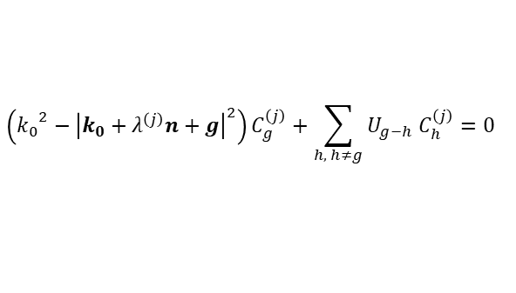
Basic concept of the Bethe method
Common parameters/functions
Schrödinger's equation
$T_{g}$ Transmission coefficient (see also next page):
$T_{g}\left(z=t;k\right)=\sum_{j}{α^{\left(j\right)}\left(k\right)C_{g}^{\left(j\right)}\left(k\right)\exp\left[2πi\left(k_{z}−k_{0,z}+g_{z}+λ^{\left(j\right)}\left(k\right)\right)t\right]}$
$χ\left(u\right)$ Lens aberration function:
$χ\left(u\right)=πλΔfu^{2}+\frac{1}{2}πλ^{3}C_{s}u^{4}$ $=πλu^{2}(Δf+λ^{2}C_{s}u^{2}/2)$
$A\left(u\right)$ Aperture function :
$A\left(u\right)=\left\{\begin{aligned}1 (u is inside obj. aperture) \\ 0 (u is outside obj. aperture)\end{aligned}\right.$
Δ𝑓 Defocus value
𝐶_{s} Spherical aberration coefficient
𝐶_{c} Chromatic aberration coefficient
𝛽 Illumination semi-angle due to the finite source size effect
Δ𝐸 1/𝑒 width of electron energy fluctuations
Δ₀ 1/𝑒 width of defocus spread assuming Gaussian distribution
$Δ_{0}=C_{c}\frac{ΔE}{E}$
$R$ X-Y component in real space
$K$ X-Y component of incident wave vector
$G, H$ X-Y component of reciprocal lattice vectors
$$∇^{2}Ψ\left(r\right)+4π^{2}\left\{ {k_{vac}}^{2}+\sum_{g}{U_{g}e^{2πig∙r}}\right\}Ψ\left(r\right)=0$$
Wavenumber of electron in vacuum
Fourier component of crystal potential
ブロッホの定理
格子と同じ周期の関数
j^{th} Bloch wave vector
$$Ψ\left(r\right)=b\left(k^{(j)},r\right)=u\left(r\right)exp⁡(2πik^{(j)}∙r)$$
Bethe’s dynamical equation
$$\left({k_{0}}^{2}−{\left|k^{\left(j\right)}+g\right|}^{2}\right)C_{g}^{\left(j\right)}+\sum_{h, h≠g}{U_{g−h} C_{h}^{\left(j\right)}}=0$$
試料中の電子の波数 ${\left|k_{0}\right|}^{2}={\left|k_{vac}\right|}^{2}+U_{0}$
Bloch波のFourier成分
Fourier component of crystal potential
$$U_{g}=U_{g}^{elastic}+U_{g}^{themal}$$
相対論補正因子
原子散乱因子
温度因子
Quasi-coherent model
$$U_{g}^{elastic}=\frac{γ}{{π V}^{2}}\sum_{n}{f_{n}\exp\left(−2πi g r_{n}\right)\exp{(−B_{n }{\left|g\right|}^{2}/4)}}$$
$I\left(R\right)$ HRTEM image
$I\left(R\right)={\left|ψ(R)\right|}^{2}$
$ψ\left(R\right)$ Incident electron wavefunction on image plane
$ψ\left(R\right)=\sum_{g}{T_{g}\exp\left[2πi\left(K+G\right)∙R\right] \exp\left[−iχ\left(K+G\right)\right] A\left(K+G\right) E_{c}\left(K+G\right) E_{s}\left(K+G\right)}$
$E_{c}\left(u\right)$: Coherence function for temporal coherence:
$E_{c}\left(u\right)=\exp\left[−{\left(πλΔ_{0}u^{2}\right)}^{2}/2\right],$
$E_{s}\left(u\right)$: Coherence function for spatial coherence:
$E_{s}\left(u\right)=\exp\left[−π^{2}β^{2}u^{2}{\left(Δf+λ^{2}C_{s}u^{2}\right)}^{2}\right]$
$$U_{g}^{thermal}=\frac{2 h γ^{2}}{π V^{2} m c \sqrt{γ^{2}−1}}\sum_{n}{{f′}_{n}\exp\left(−2πi g r_{n}\right)\exp{(−B_{n }{\left|g\right|}^{2}/4)}}$$
単位格子体積
吸収散乱因子
Eigen value problem
Bloch波
$$\left({k_{0}}^{2}−{\left|k^{\left(j\right)}+g\right|}^{2}\right)C_{g}^{\left(j\right)}+\sum_{h, h≠g}{U_{g−h} C_{h}^{\left(j\right)}}=0$$
Transmission cross coefficient model
存在できるBloch波は $k^{\left(j\right)}=k_{0}+λ^{\left(j\right)}n$ を満たす
$I\left(R\right)$ HRTEM image:
$I\left(R\right)=\sum_{g}{\sum_{h}{T_{g}T_{h}^{∗}\exp\left[2πi\left(G−H\right)∙R\right]}TCC(K+G,K+H)}$
$TCC\left(u,u′\right)$ Transmission cross coefficient:
$TCC\left(u,u′\right)$ $=A\left(u\right)A\left(u′\right)exp\left[−i\{χ\left(u\right)−χ\left(u′\right)\}\right]E_{c}\left(u,u′\right)E_{s}(u,u′)$
$E_{c}\left(u,u′\right)$ Mixed coherence function for temporal coherence
$E_{c}\left(u,u′\right)=\exp\left[−{\left(πλΔ_{0}\right)}^{2}{\left(u^{2}−{u^{′}}^{2}\right)}^{2}/2\right]$
$E_{s}\left(u,u′\right)$ Mixed coherence function for spatial coherence
$E_{s}\left(u,u′\right)=\exp\left[−π^{2}β^{2}{\left\{Δf\left(u−u^{′}\right)+λ^{2}C_{s}(u^{2}u−{u′}^{2}u^{′})\right\}}^{2}\right]$
$$\left({k_{0}}^{2}−{\left|k_{0}+λ^{\left(j\right)}n+g\right|}^{2}\right)C_{g}^{\left(j\right)}+\sum_{h, h≠g}{U_{g−h} C_{h}^{\left(j\right)}}=0$$
$$−{{ λ}^{\left(j\right)}}^{2}−2λ^{\left(j\right)}n\left(k_{0}+g\right)−g\left(2k_{0}+g\right)≅λ^{\left(j\right)}P_{g}−Q_{g}$$
固有値問題に帰結
$$\left(\begin{matrix}Q_{0}/P_{0} & U_{−a}/P_{0} & U_{−b}/P_{0} & U_{−c}/P_{0} \\ U_{a}/P_{a} & Q_{a}/P_{a} & U_{a−b}/P_{a} & U_{a−c}/P_{a} \\ U_{b}/P_{b} & U_{b−a}/P_{b} & Q_{b}/P_{b} & U_{b−c}/P_{b} \\ U_{c}/P_{c} & U_{c−a}/P_{c} & U_{c−b}/P_{c} & Q_{c}/P_{c}\end{matrix}\right)\left(\begin{matrix}C_{0}^{\left(j\right)} \\ C_{a}^{\left(j\right)} \\ C_{b}^{\left(j\right)} \\ C_{c}^{\left(j\right)}\end{matrix}\right)=λ^{\left(j\right)}\left(\begin{matrix}C_{0}^{\left(j\right)} \\ C_{a}^{\left(j\right)} \\ C_{b}^{\left(j\right)} \\ C_{c}^{\left(j\right)}\end{matrix}\right)$$
境界条件
試料(厚みz)下面での波動関数は「ブロッホ波$b_{j}$×係数$α_{j}$」の和
$Ψ\left(r\right)=\sum_{g}{\left(\sum_{j}{\left\{α_{j}C_{g}^{\left(j\right)}e^{2πiλ^{\left(j\right)}z }\right\}}e^{2πi(k_{0}+g)∙r}\right)}$
あるいは$ψ_{g}(z)$を深さzにおけるフーリエ級数成分として
$Ψ\left(r\right)=\sum_{g}{ψ_{g}(z) e^{2πi(k_{0}+g)∙r}}$
まとめると
$ψ_{g}\left(z\right)=\sum_{j}{\left\{α_{j}C_{g}^{\left(j\right)}e^{2πiλ^{\left(j\right)}z }\right\}}$
入射波$ψ_{g}\left(0\right)$が既知であれば
$$ψ_{g}\left(z\right)=C [e^{2πiλ^{\left(j\right)}z}]C^{−1}ψ_{g}\left(0\right)$$

Slide 2


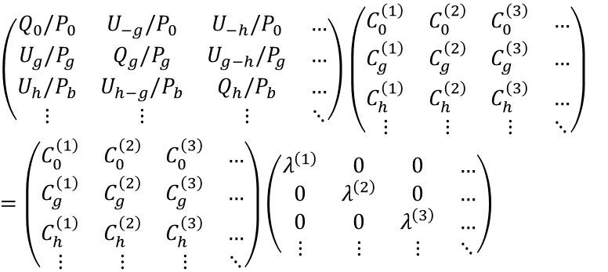



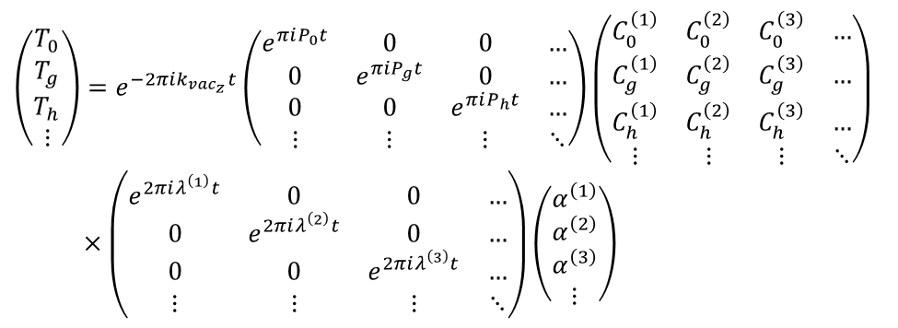

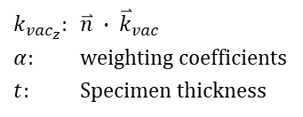





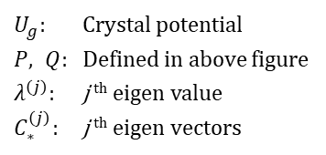



Definitions of vectors and scalars
Center of Ewald sphere
Surface
Vector
$$\overset{⃑}{n}$$
Scalar
$${\overset{⃑}{k}}_{vac}$$
$$γ^{j}$$
$$\frac{P_{g}}{2}$$
$$\overset{⃑}{n}:Unit vector normal to surface$$
$$P_{g}=2\overset{⃑}{n}(\overset{⃑}{k}+\overset{⃑}{g})$$
$$Q_{g}={\left|\overset{⃑}{k}\right|}^{2}−{\left|\overset{⃑}{k}+\overset{⃑}{g}\right|}^{2}$$
$=−\overset{⃑}{g}(2\overset{⃑}{k}+\overset{⃑}{g})$
$$\overset{⃑}{k}$$
$$\overset{⃑}{k^{j}}$$
$$\overset{⃑}{k}+ \overset{⃑}{g}$$
$$S_{g}=\frac{\sqrt{P_{g}^{ 2}+{4Q}_{g}}−P_{g}}{2}$$
$$o$$
$$\overset{⃑}{g}$$
$$S_{g}$$
$$R={\left|\overset{⃑}{g}\right|}^{2}|Q_{g}|$$
Ewald sphere
(Evaluation function)
Eigen values/vectors equation
$$\left(\begin{matrix}Q_{0}/P_{0} & U_{−g}/P_{0} & U_{−h}/P_{0} & … \\ U_{g}/P_{g} & Q_{g}/P_{g} & U_{g−h}/P_{g} & … \\ U_{h}/P_{b} & U_{h−g}/P_{b} & Q_{h}/P_{b} & … \\ ⋮ & ⋮ & ⋮ & ⋱\end{matrix}\right)\left(\begin{matrix}C_{0}^{\left(1\right)} & C_{0}^{\left(2\right)} & C_{0}^{\left(3\right)} & … \\ C_{g}^{\left(1\right)} & C_{g}^{\left(2\right)} & C_{g}^{\left(3\right)} & … \\ C_{h}^{\left(1\right)} & C_{h}^{\left(2\right)} & C_{h}^{\left(3\right)} & … \\ ⋮ & ⋮ & ⋮ & ⋱\end{matrix}\right)$$
$$=\left(\begin{matrix}C_{0}^{\left(1\right)} & C_{0}^{\left(2\right)} & C_{0}^{\left(3\right)} & … \\ C_{g}^{\left(1\right)} & C_{g}^{\left(2\right)} & C_{g}^{\left(3\right)} & … \\ C_{h}^{\left(1\right)} & C_{h}^{\left(2\right)} & C_{h}^{\left(3\right)} & … \\ ⋮ & ⋮ & ⋮ & ⋱\end{matrix}\right)\left(\begin{matrix}λ^{\left(1\right)} & 0 & 0 & … \\ 0 & λ^{\left(2\right)} & 0 & … \\ 0 & 0 & λ^{\left(3\right)} & … \\ ⋮ & ⋮ & ⋮ & ⋱\end{matrix}\right)$$
$U_{g}$: Crystal potential
$P, Q$: Defined in above figure
$λ^{\left(j\right)}$: j ^{th} eigen value
$C_{∗}^{\left(j\right)}$: j ^{th} eigen vectors
Matrix representation of transmission coefficient T_{g}
$$\left(\begin{matrix}T_{0} \\ T_{g} \\ T_{h} \\ ⋮\end{matrix}\right)=e^{−2πik_{{vac}_{z}}t}\left(\begin{matrix}e^{πiP_{0}t} & 0 & 0 & … \\ 0 & e^{πiP_{g}t} & 0 & … \\ 0 & 0 & e^{πiP_{h}t} & … \\ ⋮ & ⋮ & ⋮ & ⋱\end{matrix}\right)\left(\begin{matrix}C_{0}^{\left(1\right)} & C_{0}^{\left(2\right)} & C_{0}^{\left(3\right)} & … \\ C_{g}^{\left(1\right)} & C_{g}^{\left(2\right)} & C_{g}^{\left(3\right)} & … \\ C_{h}^{\left(1\right)} & C_{h}^{\left(2\right)} & C_{h}^{\left(3\right)} & … \\ ⋮ & ⋮ & ⋮ & ⋱\end{matrix}\right)$$
$×\left(\begin{matrix}e^{2πiλ^{\left(1\right)}t} & 0 & 0 & … \\ 0 & e^{2πiλ^{\left(2\right)}t} & 0 & … \\ 0 & 0 & e^{2πiλ^{\left(3\right)}t} & … \\ ⋮ & ⋮ & ⋮ & ⋱\end{matrix}\right)\left(\begin{matrix}α^{\left(1\right)} \\ α^{\left(2\right)} \\ α^{\left(3\right)} \\ ⋮\end{matrix}\right)$
$k_{{vac}_{z}}$: $\overset{⃑}{n} ∙ {\overset{⃑}{k}}_{vac}$
$α$: weighting coefficients
$t$: Specimen thickness

