Slide 1
Upper-left corer of detector (origin of pixel coordinates)
X’’
Detector
Detector
Upper-left corer of detector (origin of pixel coordinates)
X’’
Y’’
Foot (origin of detector coordinates)
Y’’
Foot (origin of detector coordinates)
X’
Z (beam direction)
X’
Sample (origin of real coordinates)
Rotation
Y’
Camera length 2
X
Z (beam direction)
Camera length 2
Sample (origin of real coordinates)
Direct
spot
Camera length 1
φ
τ
X
Y’
Direct
spot
φ
τ
Camera length 1
τ
Y
rotation axis
Y
rotation axis
Real coordinates (X, Y, Z): Three dimensional coordinates of the experimental setup with millimeter unit. The origin of the coordinates is always the sample position, and Z axis direction is always parallel to the beam direction. If the detector is normal to the incident beam, X & Y axes are parallel to X’ & Y’ axes, respectively.
Sample: Scattering material by the incident beam.
Rotation of detector: The rotation state of the detector is represented by rotation axis direction and angle. The axis is defined on Z=0 plane (namely XY plane).
φ: Angle from X axis to the rotation axis. Right-hand rule.
τ: Rotation angle around the rotation axis. Right-hand rule.
Detector coordinates (X’, Y’): Two dimensional coordinates on the detector plane with millimeter unit. The origin is the foot (see below). X’ & Y’ axes are always parallel to X’’ & Y’’, respectively.
Foot: The foot of the perpendicular from the sample. If the detector is normal to the incident beam, the foot position is identical to the direct spot. To use overlapped image mode, the foot position should be set in the pixel coordinates.
Camera length 2: Distance from the sample to the foot. The value is defined in millimeter.
Direct spot: Intersection of the incident beam and the detector.
Camera length 1: Distance from the sample to direct spot.
Pixel coordinates (X’’, Y’’): Two dimensional coordinates on the detector plane with pixel unit. X’’ and Y’’ directions correspond to pixel arrays of the detector. The origin is always upper-left corner of the detector.
Pixel size: Length of one side of the pixel. The value is defined in millimeter. A square pixel is only acceptable.
Detector width/height: Pixel numbers horizontally/vertically.

Slide 2
Upper-left corer of detector (origin of pixel coordinates)
Detector
X’’
Y’’
Foot (origin of detector coordinates)
Z (beam direction)
X’
Sample (origin of real coordinates)
Camera length 2
X
Direct
spot
Camera length 1
φ
Y’
τ
Y
rotation axis

Slide 3
Upper-left corer of detector (origin of pixel coordinates)
X’’
Detector
Y’’
Foot (origin of detector coordinates)
X’
Y’
Z (beam direction)
Camera length 2
Sample (origin of real coordinates)
τ
X
Direct
spot
Camera length 1
φ
τ
Y
rotation axis

Slide 4
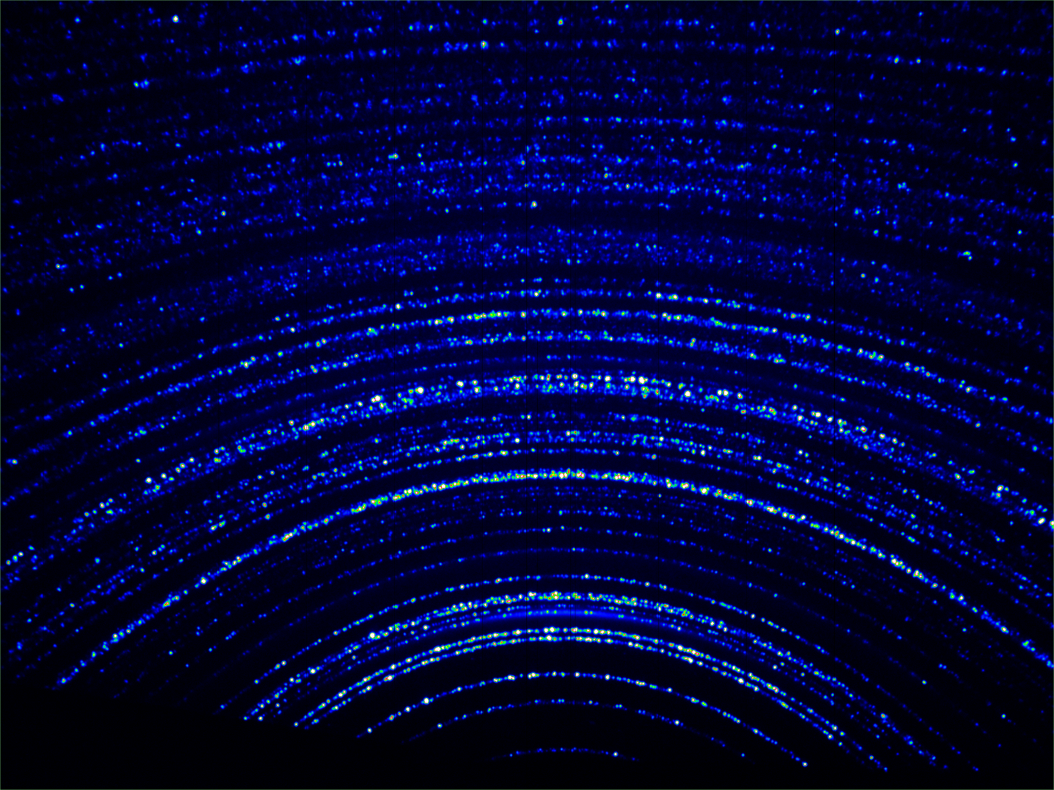
＃916723 (forsterite 粉末試料)
1,200
1,100
1000
900
800
700
改良前
600
500
400
300
改良後
200
100
22
24
26
28
30
32
34
36
38
40
42
44
46
48
50
52
54
56
58
60
62
64
66
68
70
72
74
76
78

