Slide 1
Team La Girafe
Notes:
Hello Guys
The Team “La Girafe” and especially I welcome you at the our pitch.

Slide 2

Dachfenster
the ridesharing platform with a match for every special need
Team La Girafe
Notes:
Im happy to present you our Project “Dachfenster”.
You might ask yourself why we gave our project such an exotic name.
It is simply beacause we intend to provide ridesharing for a broad target group, even as exotic as our mascot animal, the girafe.

Slide 3
Reaching Climate Goals Together
1.9 million commutes by car per day
matching people with similar routes
custom needs/requirements
baggage
similar music taste
Team La Girafe
Notes:
In order to reach climate goals, we have to take every possibility to cut down on emissions.
In Switzerland alone, around 1.9 million people commute by car between home and work every day. Many of them drive alone from A to B.
Now imagine if we could match some of those rides together, and thereby reduce the amount of cars on the street.
This is exactly what our Challenge is about.
At the same time we can make the experience of ridesharing more pleasant.
For example by including the amount of baggage or even the music taste of the individuals in the matching process.

Slide 4
This is what distinguishes our solution
minimize
detour time for driver
difference between ideal departure times
maximize
the social aspect of ridesharing
comfort
freedom of choice for driver/passenger
reliability
safety of the user
Team La Girafe
Notes:
Our solution differs greatly from already existing ones.
because we do not just minimize the disadvantages of ridesharing,
like detour time for the driver and difference between ideal departure times,
we also try to maximize the social aspect of ridesharing.
Additionally we increase the safety of the user and the reliability factor, by providing a driver rating.
Every passenger has the chance to rate his driver.

Slide 5
And how we achieve this
the final decision lies in the hand of the driver
every user on this platform can describe himself with a few tags
no sensitive data is shared before both parties agree the match
Team La Girafe
Notes:
The main principle of our matching is to provide a selection of matching rides, ranked by geogrphaical suitability.
The user then can slect the driver suited best for his needs, based on the tags provided by the other matching partner.
At last we try to maximize the safety of the user by only providing non identifiable personal data before a match is accepted by bot, the driver and the passenger.

Slide 6
Demo
Team La Girafe
Notes:
sebug
Kowalski

Slide 7
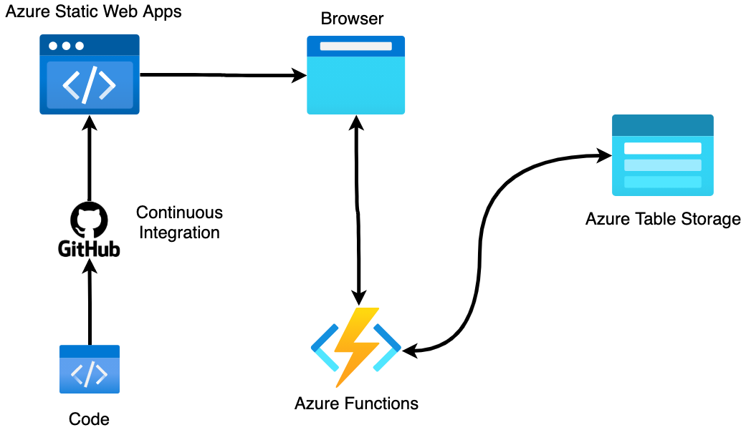
Tech Stack
Vuetify
NuxtJS
Python
JavaScript
HTML5
Team La Girafe

Slide 8

Try it out
Team La Girafe
Notes:
The main principle of our matching is to provide a selection of matching rides, ranked by geogrphaical suitability.
The user then can slect the driver suited best for his needs, based on the tags provided by the other matching partner.
At last we try to maximize the safety of the user by only providing non identifiable personal data before a match is accepted by bot, the driver and the passenger.

Slide 9

Thank you all for these great 24h!!
Notes:
Before ending our pitch I would like to thank the organizers and sponorse in the name of our team.
Thank you, It was very nice!

