Slide 1
Team La Girafe
Notes:
Hello Guys
The Team “La Girafe” welcomes you at the our pitch.

Slide 2

Dachfenster
the ridesharing platform with a match for every special need
Notes:
Im happy to present you our Project “Dachfenster”.
You might ask yourself why we gave our project this exotic name.
It is simply beacause we intend to provide ridesharing for a broad target group, even as exotic as our heraldic animal, the girafe.

Slide 3
Reaching Climate Goals Together
1.9 million commutes by car per day
matching people with similar routes
easy choice between possible driver with reliability score
custom needs/requirements
baggage
similar music taste

Slide 4
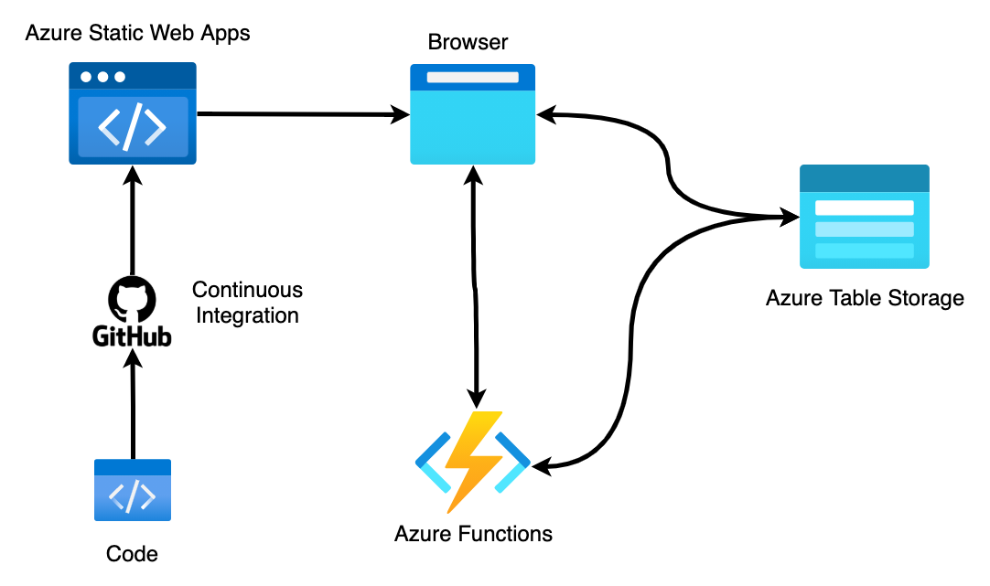
Project Architecture

Slide 5
This is what makes our solution stand out
minimize
detour time for driver
difference between ideal departure times
maximize
the social aspect of ridesharing
comfort
freedom of choice for driver/passenger
reliability
safety of the user

Slide 6
And how we achieve this
the final decision lies in the hand of the driver
no sensitive data is shared before the both parties agreed
we provide the option to search for drivers with individual requirements

Slide 7
Short Demo
both perspectives
driver
passenger

Slide 8

Thank you all for these great 24h!!

Slide 9
Template
template

