Slide 1
Team La Girafe
Notes:
Hello Guys
The Team “La Girafe” welcomes you at the our pitch.

Slide 2

Dachfenster
the ridesharing platform with a match for every special need
Notes:
Im happy to present you our Project “Dachfenster”.
You might ask yourself why we gave our project this exotic name.
It is simply beacause we intend to provide ridesharing for a broad target group, even as exotic as our heraldic animal, the girafe.

Slide 3
Reaching Climate Goals Together
1.9 million commutes by car per day
matching people with similar routes
custom needs/requirements
baggage
similar music taste
Notes:
In order to reach climate goals, we have to take every possibility to cut down on emissions.
In Switzerland, around 1.9 million people commute by car between home and work every day. Many of them drive alone from A to B.
Now imagine if we could match some of those rides together, and thereby reduce the amount of cars on the street.
This is exactly what our Application is about.
At the same time we can make the experience of ridesharing more pleasant.
For example by including the amount of baggage or even the music taste of the individuals in the matching process.

Slide 4
This is what distinguishes our solution
minimize
detour time for driver
difference between ideal departure times
maximize
the social aspect of ridesharing
comfort
freedom of choice for driver/passenger
reliability
safety of the user
Notes:
Our solution differs greatly from already existing ones.
because we do not just minimize the disadvantages of ridesharing,
like detour time for the driver and difference between ideal departure times,
we also try to maximize the social aspect of ridesharing.
Additionally we include the satefety of the user and the reliability factor, by providing a driver rating.
Every passenger has the chance to rate his driver.

Slide 5
And how we achieve this / Demo
the final decision lies in the hand of the driver
every user on this platform can describe himself with a few tags
no sensitive data is shared before both parties agreed
Notes:
The main principle of our matching is to provide a selection of matching rides, ranked by geogrphaical suitability.
The user then can slect the driver suited best for his needs, based on the tags provided by the other matching partner.
At last we try to maximize the safety of the user by only providing non identifiable personal data before a match is accepted by bot, the driver and the passenger.

Slide 6
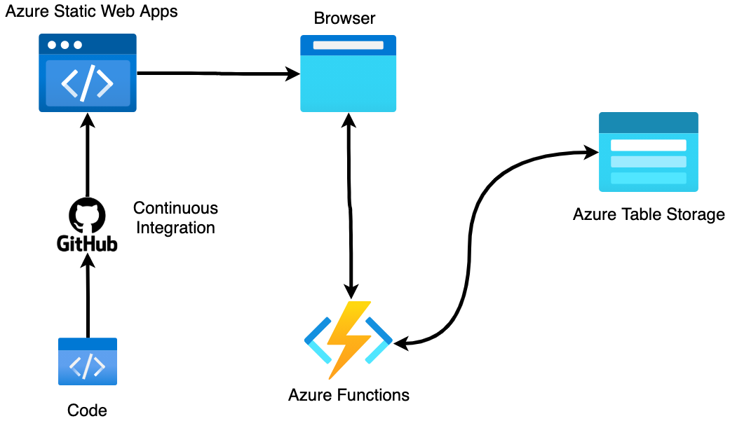
Project Architecture
Notes:
Our Project is completely based on Microsoft Services.
We decided for this no-nonsense architecture because it is easy to setup but scalable at the same time.
The process of finding the optimal matches is very time consuming and would completely destroy the user experience. This is why we decided to precalculate potential matches as soon as the user enters his adress, and store them them in Azure Table Storage.
As soon as the user actually starts looking for someone share a ride with, the results of our algorithm are already stored and can be provided instantly.

Slide 7
Tech Stack
Vuetify
NuxtJS
Python
JavaScript
HTML5

Slide 8
Short Demo
both perspectives
driver
passenger

Slide 9

Thank you all for these great 24h!!

Slide 10
Template
template

