Slide 1

EmailRouter with Sentiment Classification
CS410- Text Information Systems
University of Illinois – Urbana Champaign
Nathan Ramaker
William Lumala
Fall 2017

Slide 2
Problem Statement
Large Businesses and Non-Profit Organizations often have several different products, and therefore they often service many different sets of customers. These disparate customer sets often experience very different types of problems from one another, and each group brings unique questions to the Business’s Customer Service department via Email.
In this scenario, it is not feasible for a single employee of the Business to service the wide range of requests that are coming from the customer base, and some requests must be delegated to other employees who specialize in each area.
Today this is often a manual process. A human must manually triage each incoming Email, examine it for content, and forward it to the appropriate owner.
Our EmailRouter utility intends to remove this friction by Automating the triage and routing process using both Text and Sentiment Classification.

Slide 3
Problem Statement
Example Use Case of EmailRouter : Amazon.com
Despite starting its life as a simple online book store, Amazon.com has quickly diversified its business both through acquisition and through internal entrepreneurship.
Today Amazon’s problem set is diverse, but their customers may not be precise when directing their complaint and questions.
Major Divisions within Amazon:
Amazon.com Ecommerce Website
Amazon Web Services
Amazon Echo and Amazon Fire Devices
Amazon Prime Video and Music Services
Amazon Original Entertainment Content

Slide 4
Problem Statement
No single employee of Amazon.com is likely able to service a customer from every one of these categories, so many requests must be forwarded to someone who is more suited to the task.
Further, not every customer issue has the same urgency. Complaints from customers who are very upset should take priority over those who only have a question.
Major Divisions within Amazon:
Amazon.com Ecommerce Website
Amazon Web Services
Amazon Echo and Amazon Fire Devices
Amazon Prime Video and Music Services
Amazon Original Entertainment Content

Slide 5
Problem Statement
EmailRouter can solve both of these problems by examining the content of each incoming email and classifying it as belonging to one of the distinct document types defined by the user.
Email Router evaluates the sentiment of the incoming email and grades it based on observed customer dissatisfaction.
Major Divisions within Amazon:
Amazon.com Ecommerce Website Kristina in Ecommerce
Amazon Web Services William in AWS
Amazon Echo and Amazon Fire Devices Nathan in Hardware
Amazon Prime Video and Music Services Jasdeep in Subscriptions
Amazon Original Entertainment Content Grace in Content Production

Slide 6
Architecture
EmailRouter Depends on the Google Mail Service for
Mail Delivery Services, and two custom microservices for Sentiment and
Document Classification
Google Mail API
Document Classification Service
EmailRouter
Sentiment Classification Service
User Defined Email Lists

Slide 7
Processing an Email
Constant Polling of the Google Mail API for Unread Emails
Google Mail API
Document Classification Service
EmailRouter
Sentiment Classification Service
User Defined Email Lists

Slide 8

Processing an Email
Email Arrives in Google Inbox.
Google Mail API
Document Classification Service
EmailRouter
Sentiment Classification Service
User Defined Email Lists

Slide 9
Processing an Email
Email Router Discovers the new Email
and retrieves it using the Google Mail API.
Google Mail API
Document Classification Service
EmailRouter
Sentiment Classification Service
User Defined Email Lists

Slide 10

Processing an Email
EmailRouter Extracts Text from Email Body.
Google Mail API
Document Classification Service
EmailRouter
Sentiment Classification Service
User Defined Email Lists

Slide 11
Processing an Email
EmailRouter sends Text Body to both Classification Services
Google Mail API
Document Classification Service
EmailRouter
Sentiment Classification Service
User Defined Email Lists

Slide 12


Processing an Email
Document Classification Service Returns a Prediction of the Email Type
Sentiment Classification Service Returns a Score of the Email Sentiment
Google Mail API
Document Classification Service
EmailRouter
Sentiment Classification Service
User Defined Email Lists

Slide 13
Processing an Email
EmailRouter Searches User-Defined Lists According to Category and Sentiment
Google Mail API
Document Classification Service
EmailRouter
Sentiment Classification Service
User Defined Email Lists

Slide 14
Processing an Email
EmailRouter Modifies the Original Email According
to User Defined Rules
Google Mail API
Document Classification Service
EmailRouter
Sentiment Classification Service
User Defined Email Lists

Slide 15
Processing an Email
EmailRouter Uses the Google Mail API to Forward
The Email to All the new Recipients
Google Mail API
Document Classification Service
EmailRouter
Sentiment Classification Service
User Defined Email Lists

Slide 16
Processing an Email
Email is Redistributed
Google Mail API
Document Classification Service
EmailRouter
Sentiment Classification Service
User Defined Email Lists

Slide 17
Sentiment Classification Service
The Sentiment Classification Microservices is built upon existing technology developed by Stanford’s NLP group.
https://nlp.stanford.edu/
The Stanford CoreNLP library performs multiple Natural Language Processing tasks on the text from each email such as Parts of Speech tagging and Entity Extraction, then uses a Recurrent Neural Network (RNN) to provide Sentiment Analysis from a model that as been pretrained at Stanford.
EmailRouter invokes the CoreNLP library via a custom RESTful microservice built upon the Apache Spark framework.
Each sentence is graded on a scale from Very Negative to Very Positive, and the scores are averaged to calculate the overall sentiment of the Email.

Slide 18
Sentiment Classification Service
Once deployed, the stateless service provides a classify() method to score the text provided, and returns the results as a JSON object.
Request:
GET http://localhost:4567/classify&text=‘Im+very+angry+with+my+service!+Call+me!’
Request:
{
score: 1.5,
text: “I’m very angry with my service! Call me!”
}

Slide 19
Document Classification Service
The text classification was done using the Scikit-learn library. Initially released in 2007, Scikit-learn is a free software machine learning library for the Python programming language.
For this project, the Naive Bayes (multinomial) algorithm was used. For the purpose of text classification and in general machine learning with text, Scikit-learn provides a lot of useful tools and methods besides the algorithms such as vectorizing the text data or removing some common terms among others.
Before, selecting the algorithm, both a generative (Naive Bayes) and discriminative (Logistic) classifier were trained and tested using labeled data, essentially supervised learning. This labeled data (in the form of a csv file) contained 100 examples i.e the text and its category.
To train our default model we collected sample data from four categories; Hotel Reviews, Movie Reviews, Product Reviews and Restaurant Reviews. The model was trained over 25 examples per category.
Our assumption was that the company X had four major kinds of businesses and would like their emails from customers or business partners to be categorized automatically before being forwarded to the right person.

Slide 20
Document Classification Service
Once deployed, the stateless service provides a classifyText() method to score the text provided, and returns the results as a JSON object.
Request:
GET http://localhost:5000/classifyText?text=Try+the+hamburger!+Its+huge!
Request:
{
"status": "success",
"message": "Classification successful",
"label": "restaurant“
}

Slide 21
Google Mail Service
The EmailRouter currently supports the monitoring of Google Mail inboxes, and performs mail operations via the Google Mail API.
https://developers.google.com/gmail/api/
In a production environment it is unlikely that the target user of EmailRouter will prefer Google Mail as their organization’s email provider.
For the purposes of this demo the Google Mail service is preferred due to it providing its services free of charge, and because of it’s readily available developer APIs. When put into production, EmailRouter could easily be extended to support other mail services with only minor modifications.

Slide 22
Google Mail Service
The Google Mail API uses OAuth to allow external applications to access a Google Inbox. Google provides a website to generate and download a Secret Key file, and applications that use the Google API must have access to this file.
To generate a Secret Key file:
Open a Gmail account via the browser.
Allow a Google Mail Client to connect to your account by turning on the external services and generating a secret file that contains your authorization key.
Instructions on this process are available here: https://console.developers.google.com/flows/enableapi?apiid=gmail&pli=1
Download the secret key file to your local PC and make it available to EmailRouter by providing the path to it in our configuration files.
On first use of EmailRouter, the Google Mail libraries will attempt to read your secret key and authenticate with your Google Inbox.

Slide 23
Steps to set up the EmailRouter
Clone the GitHub repository: https://github.com/lumalaW/Text-Classification-Project
Start the Document Classification Service
(OPTIONAL) Provided Sample Documents and Train a custom model.
The service has been pretrained against a set of example documents sourced from Amazon product reviews, movie reviews, and Yelp reviews of restaurants. The service can function with this model, or it can be retrained over your data.
Start the Sentiment Classification Service
Create and Download your Google Mail Secret Key File, and make sure you’re logged into the Google Account on your PC.
Edit the properties files within EmailRouter, providing the host and port of the services, the path to the secret file, and the email lists for each Document class.
Launch the EmailRouter application.

Slide 24
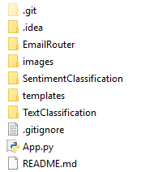
Cloning the Git Repository
Clone the GitHub repository: https://github.com/lumalaW/Text-Classification-Project
Prerequisite: Install and Configure Git on your system.
https://git-scm.com/book/en/v2/Getting-Started-Installing-Git
From a GitBash command prompt, run the git clone command:
git clone git@github.com:lumalaW/Text-Classification-Project.git
The contents of the Repositiory will be copied into a
directory named ‘Text-Classification-Project’
This directory contains three independent applications:
EmailRouter
SentimentClassification
TextClassification

Slide 25
Starting the Document Classification Service
Installing Prerequisites:
Install the latest version of Python 3 on your system and verify that the Python shell is working on your system.
https://www.python.org/downloads/
Use Pip to install all dependencies
scikit-learn - http://scikit-learn.org/stable/install.html
Flask - http://flask.pocoo.org/
Pandas - https://pandas.pydata.org/
Starting the Service:
From the TextClassification directory of your local Repository run the command:
python ../App.py

Slide 26
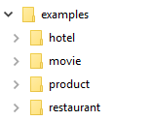
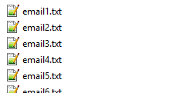
(Optional)Training the Service
By default, the Document Classification Service has been trained over example sample provided by our team.
To customize the Service to suit your organization’s needs you must collect examples of the emails that you’d like the service to recognize and classify.
At minimum, the Document Classification Service requires 25 examples of each unique email classification, however providing significantly more examples is highly recommended and will increase classification accuracy.
Collect these example and separate them into category folders. The name of each folder will serve as the class type for all documents inside. The name is not important for the examples inside each folder.

Slide 27
(Optional)Training the Service
Once an adequate number of samples have been collected for every category of email, make sure the Document Training Service has been started and call the train method to retrain.
From a web browser or a RESTful web service utility such as Postman, run the following request:
http://<HOST>:<PORT>/train?examples_dir=<PATH>
Where HOST is the system that your service that the service is running on, PORT is the correct port for the service, and PATH is the location of the examples to train on.
Example: http://localhost:5000/train?examples_dir=./examples
If the service trains successfully, a message similar to this one will be returned. The labels field contains a set of categories that the service now recognizes. Save this information for later.
{"labels": ["hotel", "movie", "product", "restaurant"], "message": "Finished Model Retraining."}

Slide 28
Starting the Sentiment Classification Service
Building and the Service:
Prerequisite: Install a Java 1.8 JDK on your system. (A JRE will not suffice.) Configure your JAVA_HOME Environment variable to point to the install directory.
Prerequisite: Install Apache Maven and add it to your system PATH.
Maven Install Instructions: https://maven.apache.org/install.html
Verify that Maven is installed correctly by typing the command ‘mvn’ from a Command Prompt.
From the SentimentClassification directory of your local Repository, run the command:
mvn clean package (NOTE: This may take a long time while downloading dependencies.)
Starting the Service:
From the SentimentClassification directory of your local Repository run the command:
java –jar target/SentimentAnalyzer-1.0.jar

Slide 29
Configuring Google Mail API
Building and the Service:
Create a Gmail Account
This will be both the account that is monitored by EmailRouter, and the account used to forward emails.
Make sure the Browser is logged into this Gmail account at all times.
Generate a Secret Key File
Follow the instructions to enable access to your Gmail Account: https://console.developers.google.com/flows/enableapi?apiid=gmail
Generate a Credential to Access Application Data.
Download the generated client_id.json file and save it for later use.
Provide EmailRouter with access to the Credential by providing the path to your Secret Key file in EmailRouter’s configuration files.

Slide 30
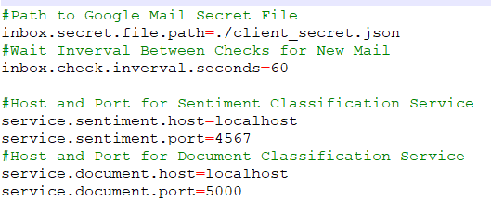
Setting EmailRouter Properties
Configure the EmailRouter Properties to Suit Your Organization's Needs. From the EmailRouter/conf directory:
Modify the general.properties file
Provide the Host and Port to both services
Provide the path to your client_id file
(OPTIONAL) Change the wait interval for email checks.

Slide 31
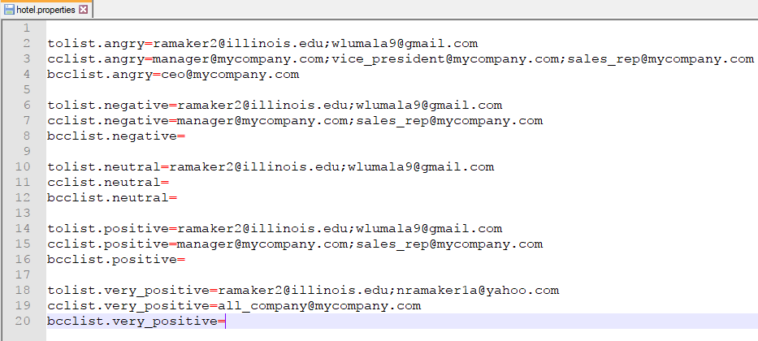
Setting EmailRouter Properties
For each Email Category, configure a <CATEGORY>.properties file where CATEGORY is the name of the Email class you expect to be returned from the Document Classification Service.
Within each file you may define a different email list for every sentiment type returned by the Sentiment Classification Service.
Supported Sentiment Types are: angry, negative, neutral, positive, very_positive
For each sentiment level you may define a To, Cc, and Bcc list.

Slide 32
Starting the EmailRouter
Prerequisites:
Install a Java 1.8 JDK on your system. Configure your JAVA_HOME Environment variable to point to the install directory.
Install Gradle and add it to your system PATH.
Gradle Install Instructions: https://gradle.org/install/
Verify that Gradle is installed correctly by typing the command ‘gradle’ from a Command Prompt.
Make sure that the internal Properties files are correctly configured.
Start the Document Classification and Sentiment Classification Services
Building and Starting the Utility:
From the EmailRouter directory of your local Repository, run the command:
gradle build run

Slide 33
EmailRouter Demo
Demo of the Email Router.

