Slide 1

Kobe Bryant Shot Selection
(CP 1)
Source: https://www.kaggle.com/c/kobe-bryant-shot-selection/overview/description
Fall 2020 – Group 2
Christopher Feltner
Luis Lavieri
Manuel Gonzalez
Zachary Steinberg
Notes:
Hi, we are Project Group 2. Our Project is called Kobe Bryant Shot Selection, extracted from a Kaggle competition from June 2016. Our team members are Christopher Feltner, Luis Lavieri, Manuel Gonzalez and Zachari Steinberg. And this is our Machine Learning project check point 1.

Slide 2
Initially proposed objectives
Data preprocessing & Feature Engineering
Time Series Analysis
Shot prediction
Possible UI
Notes:
This slide represents a reminder of the initially proposed objectives from the project pitch
Data Preprocessing & Feature Engineering
As we become more familiar with ML, we understand the importance of data quality. We have more than 30,000.00 records with 25 features. Our dataset has 5000 missing shot predictions which we are planning to use as our test data and to avoid data leakage, we are planning to train our models based on data up to the shot that we are trying to predict. So, in theory, we have 5000 datasets.
Some of the preprocessing/engineering that we have achieved during these first few weeks are: a) Successfully merged minutes_remaining and seconds_remaining into a single time_remaining feature
b) Successfully Parsed game_date as valid python datetimes to be able to filter and manipulate the interval feature
c) Successfully calculated the horizontal shot angle based on the position of Kobe in the court
d) Similarly, successfully calculated the shot distance from Kobe’s position to the net
e) Shots are grouped by zone with the feature shot_zone_area. However, since these zones are not granular enough, we are still in the process of grouping the data in some other alternatives. More on this later.
Time Series Analysis
Here we’ll present some initial data analysis that we have made on Kobe and the correlation between some of the features and the shot made flag of the 5000 datasets that we mentioned earlier
Shot prediction
Still a work in progress. We have not been able to create any models at the moment. But we are getting close to it.
UI
Hopefully, we’ll have some time to do some of this.

Slide 3
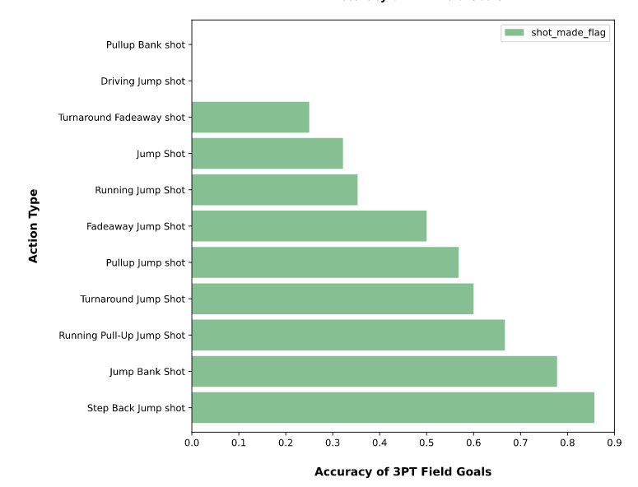
Preliminary Data Analysis and Visualizations
Notes:
In this visualization we can see how good Kobe was on 3pt shots. In particular, the amazing accuracy that he has for step back jump shot, which is the play where the player receives the ball and does a step back (sometimes to cross the boundary of the 3pt line) to do the shot.

Slide 4
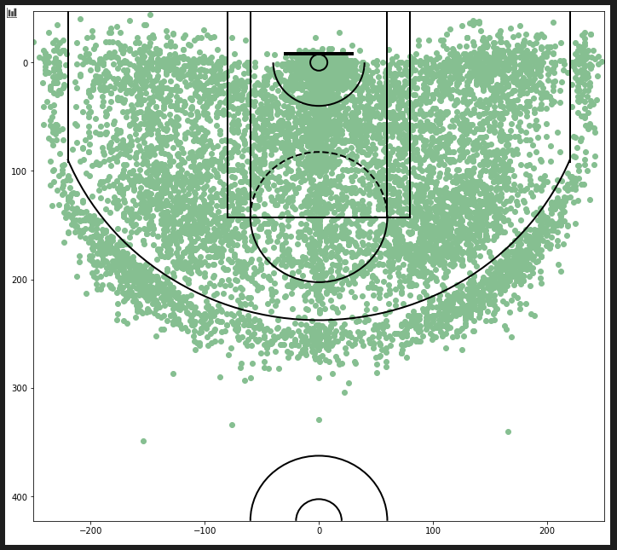
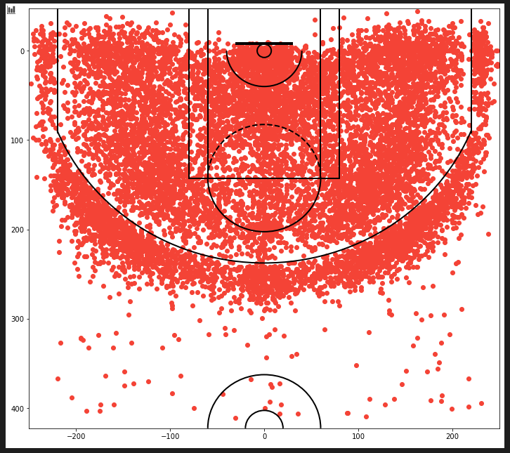
Preliminary Data Analysis and Visualizations
Notes:
Here in these two visualizations we can see all the shots that Kobe did during his career. It is interesting to notice the fact on how players (because this is not only for Kobe) are self aware on their position related to the 3pt line and are trying to avoid step on it when possible. Suggesting, that they are trying to avoid confusion when the referees make the final call for the shot.

Slide 5
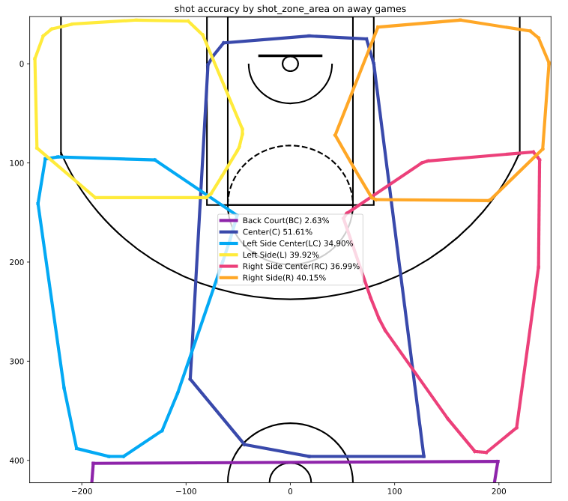
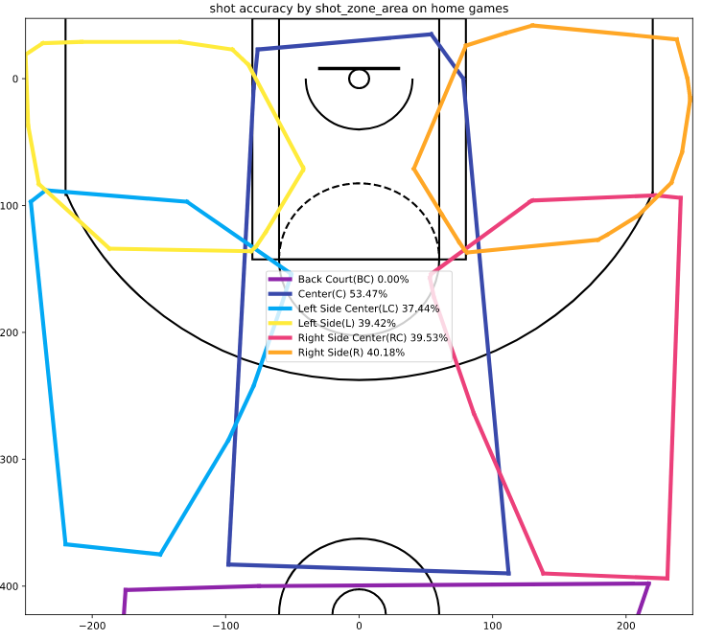
Preliminary Data Analysis and Visualizations
Notes:
In this other visualization, we can see the accuracy that Kobe had by zone in home vs away games. Implying that he was a little better in ‘home’ games and the Center zone as expected. These zones are the official zones used by the NBA. However, using the distance we are planning to create more zones. If we can differentiate center, left, and right from 2pt to 3pt, we are probably going to get some interesting values from these as well.

Slide 6
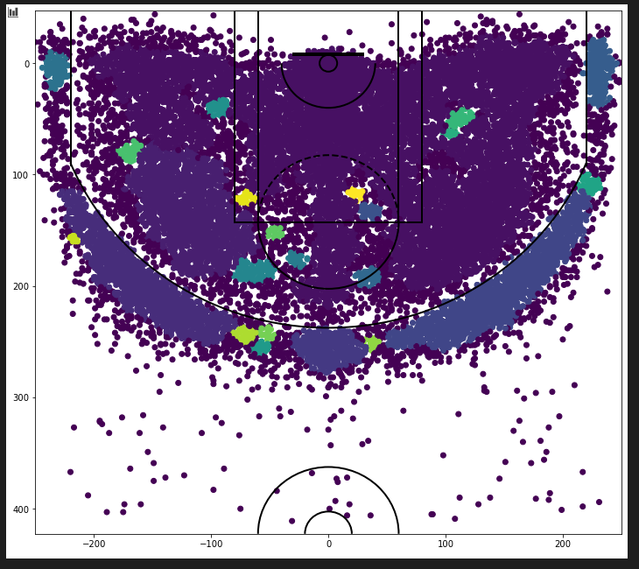
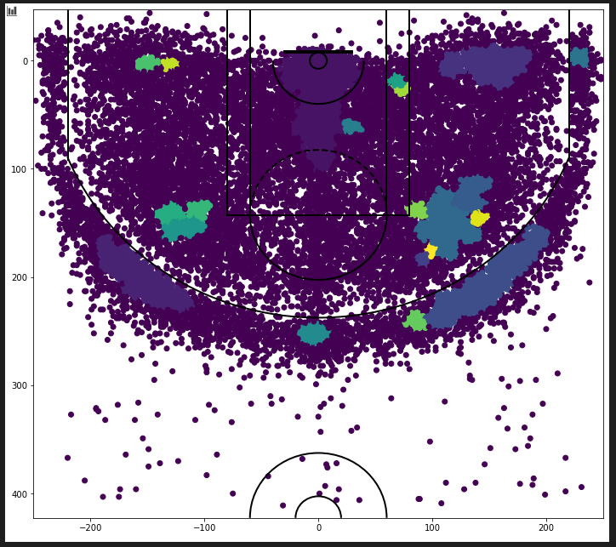
Preliminary Data Analysis and Visualizations
Notes:
In our goal to find interesting results from different zones, We tried running DBScan on Kobe’s shots. The image on the left uses clusters with 25 minimum samples and the one on the right 50. DBScan weakness on varying density can be seen in both images since no definitive uniform clusters are grouped. We might need to fall back to the distance-based clustering idea. However, we learned a lot and was definitely worth a try.

Slide 7
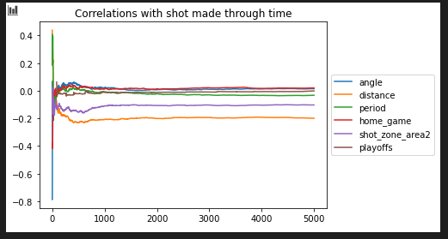
Preliminary Data Analysis and Visualizations
Notes:
As a final visualization, we present the correlation of the most important features that we have found against the shot made flag for the 5000 datasets. We see that the data converges around the 1000th test case. Suggesting that as more points Kobe made, the correlation became stable. We see that distance and area are worth exploring when creating our classification models.

Slide 8
Schedule
Week 1: Data Preprocessing and feature engineering
Week 2: Data Analysis, Time series observations, and visualizations
Week 3: Try different ML algorithms and calculate accuracy using different methods
Week 4: Test algorithm, evaluate results
Week 5: Improve algorithm. Work on more visualizations
Week 6-14: (Tentative) Design and build front end interface
Notes:
This was our initial proposed schedule. As today, we have accomplished the first two ones. Due to time constraint and other responsibilities we are a little behind on the rest of the goals. Hopefully, by this weekend we can start trying different predictive models and move along the project.

