Slide 1
Mapeamento de Colaborações em Obras da UFRN

Slide 2

Algoritmos e Estrutura de Dados II
Profº Ivanovitch Medeiros Dantas da Silva
Luisa de Moura Galvão Mathias (20220080650)
Viviane Stephane Pinheiro Novo (20240001144)

Slide 3
LET’S
PLAY
GUESS THE OBJECT
LET’S PLAY

Slide 4
Object 01
GUESS THE OBJECT
OBJECT 01
01.
Clue Here
02.
Clue Here
03.
Clue Here
04.
Clue Here
05.
Clue Here

Slide 5
Object 01
GUESS THE OBJECT
OBJECT 01
Answer.
Answer Here

Slide 6
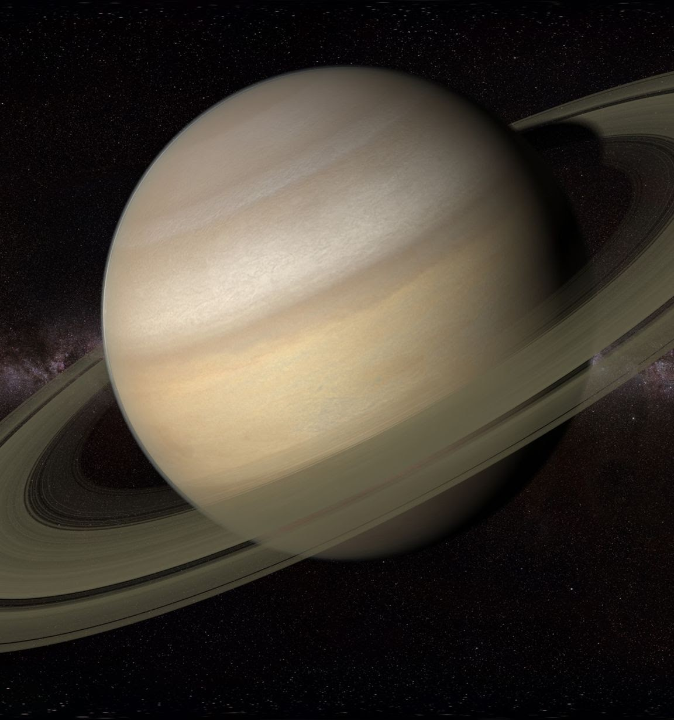
Object 02
GUESS THE OBJECT
OBJECT 02
01.
Clue Here
02.
Clue Here
03.
Clue Here
04.
Clue Here
05.
Clue Here

Slide 7
Object 02
GUESS THE OBJECT
OBJECT 02
Answer.
Answer Here

Slide 8
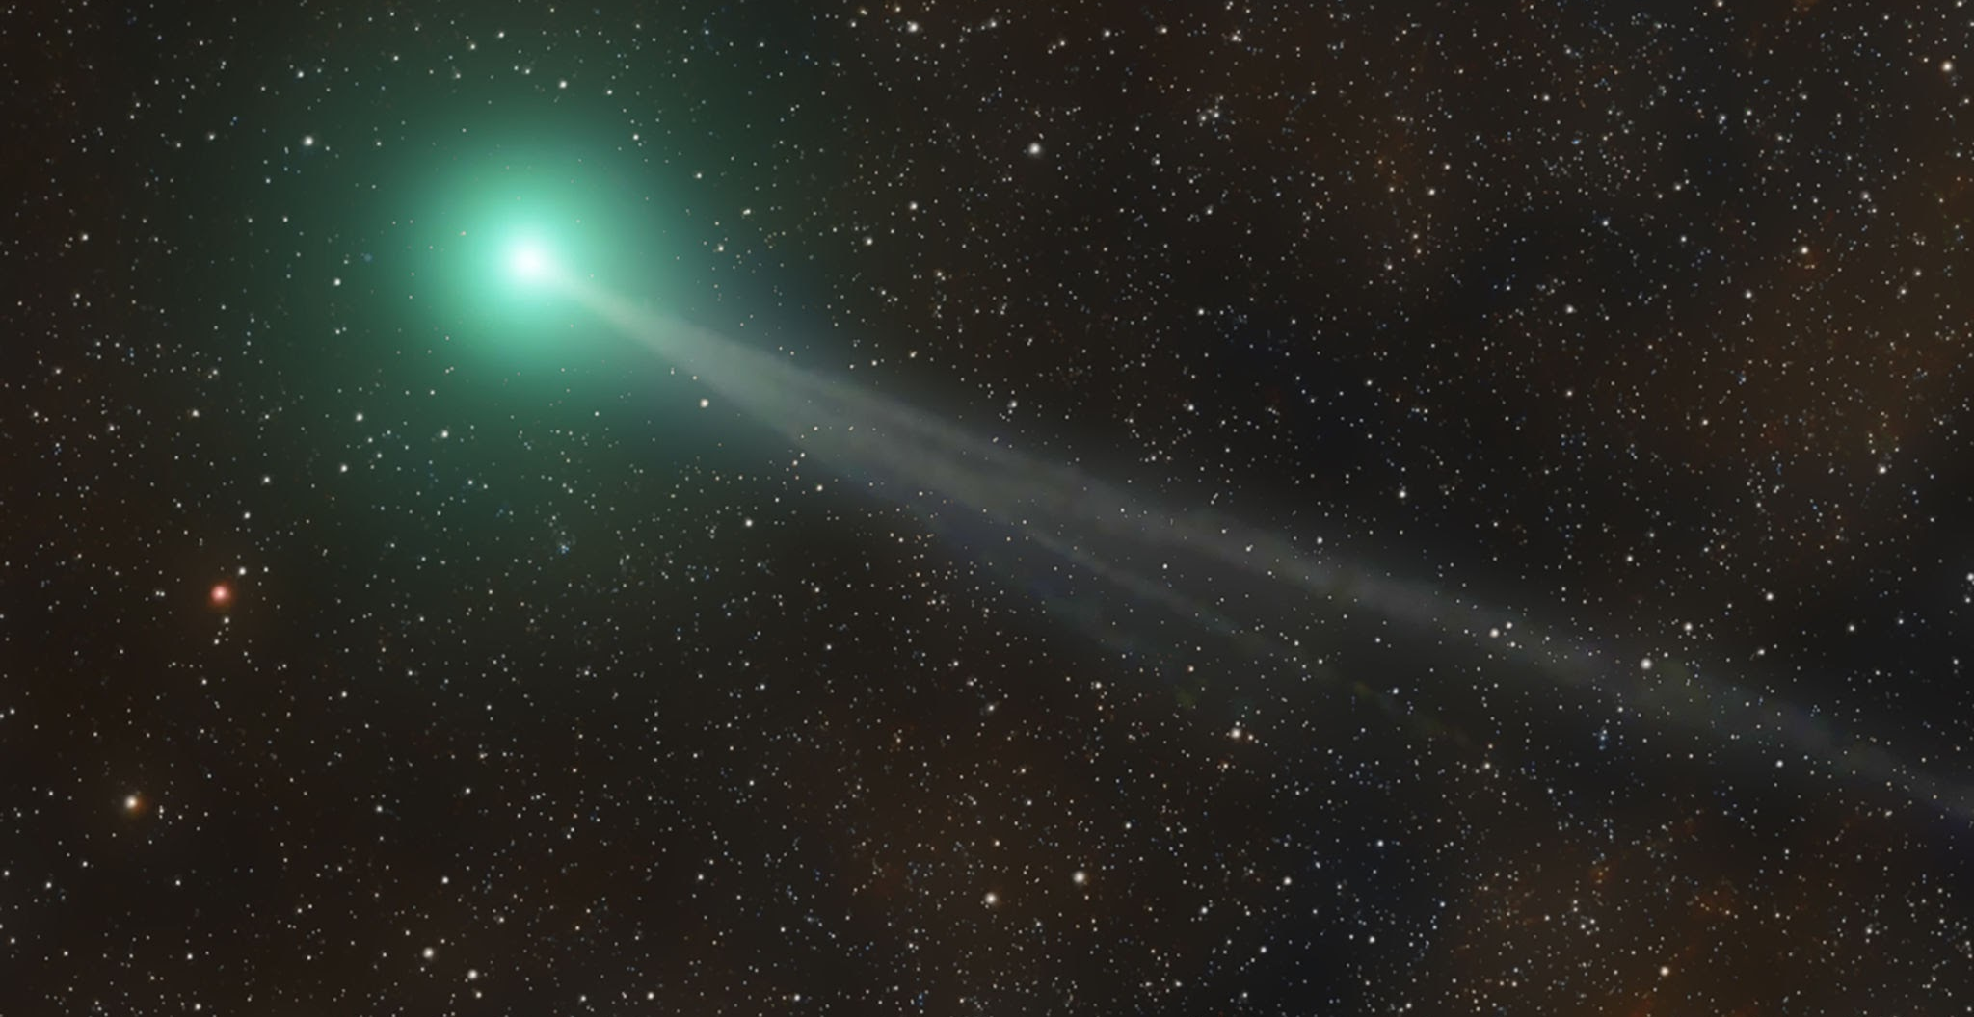
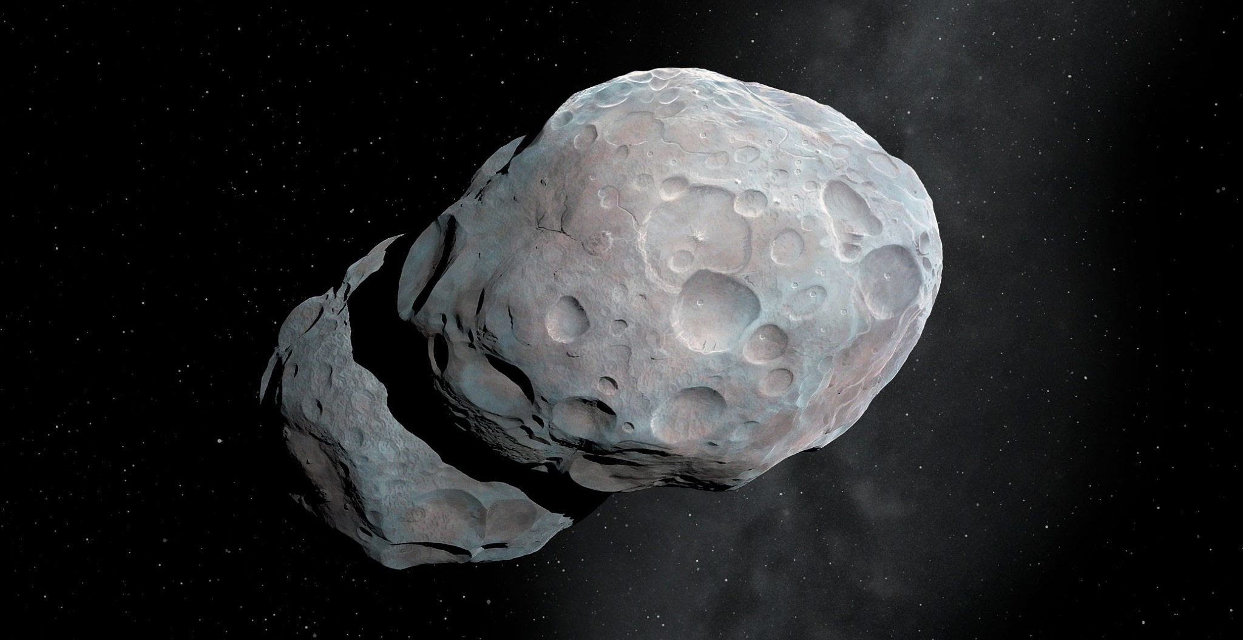
Object 03
GUESS THE OBJECT
OBJECT 03
01.
Clue Here
02.
Clue Here
03.
Clue Here
04.
Clue Here
05.
Clue Here

Slide 9
Object 03
GUESS THE OBJECT
OBJECT 03
Answer.
Answer Here

Slide 10
CLASS
SCORES
GUESS THE OBJECT
CLASS SCORES

Slide 11
SCORE OVERVIEW
GUESS THE OBJECT
SCORE OVERVIEW
Average Class Score
XXXX
Highest Score
XXXX
Median Score
XXXX
Easiest Question
XXXX
Most Challenging Question
XXXX

Slide 12
GUESS THE OBJECT
WINNER
CONGRATULATIONS, THE WINNER IS XXX!

Slide 13
THANKS FOR PLAYING
GUESS THE OBJECT
THANKS FOR PLAYING

