Slide 1
Making Maps with R
Southcoast UseR! October 2021
Lucy McGinnis

Slide 2
Why make a map?
Excellent communication tool
A more intuitive way to visualize data
Can layer a lot of information into one visual. Overlay different ideas to show new findings

Slide 3
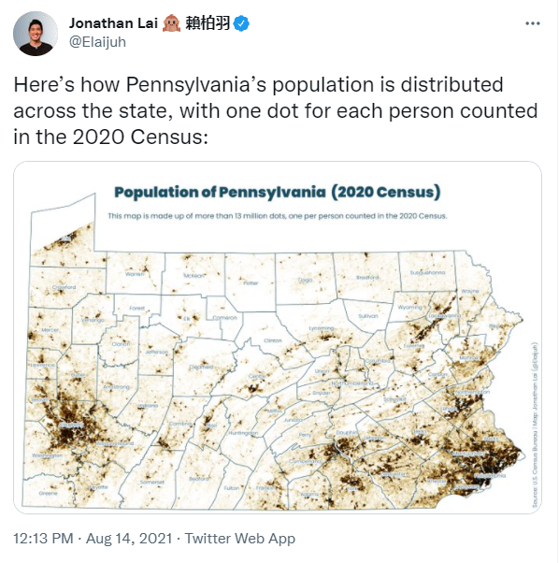

Slide 4
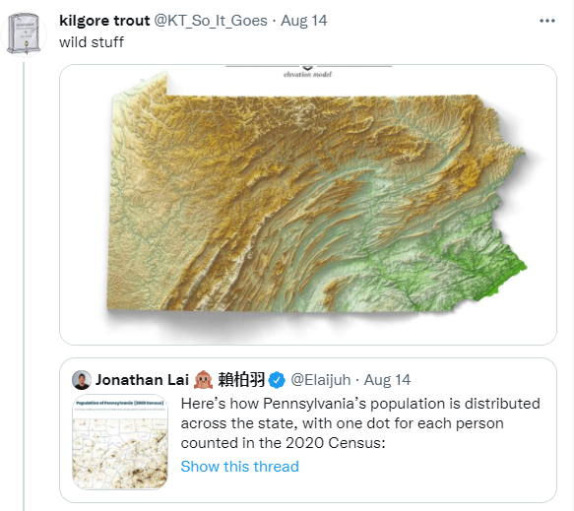

Slide 5
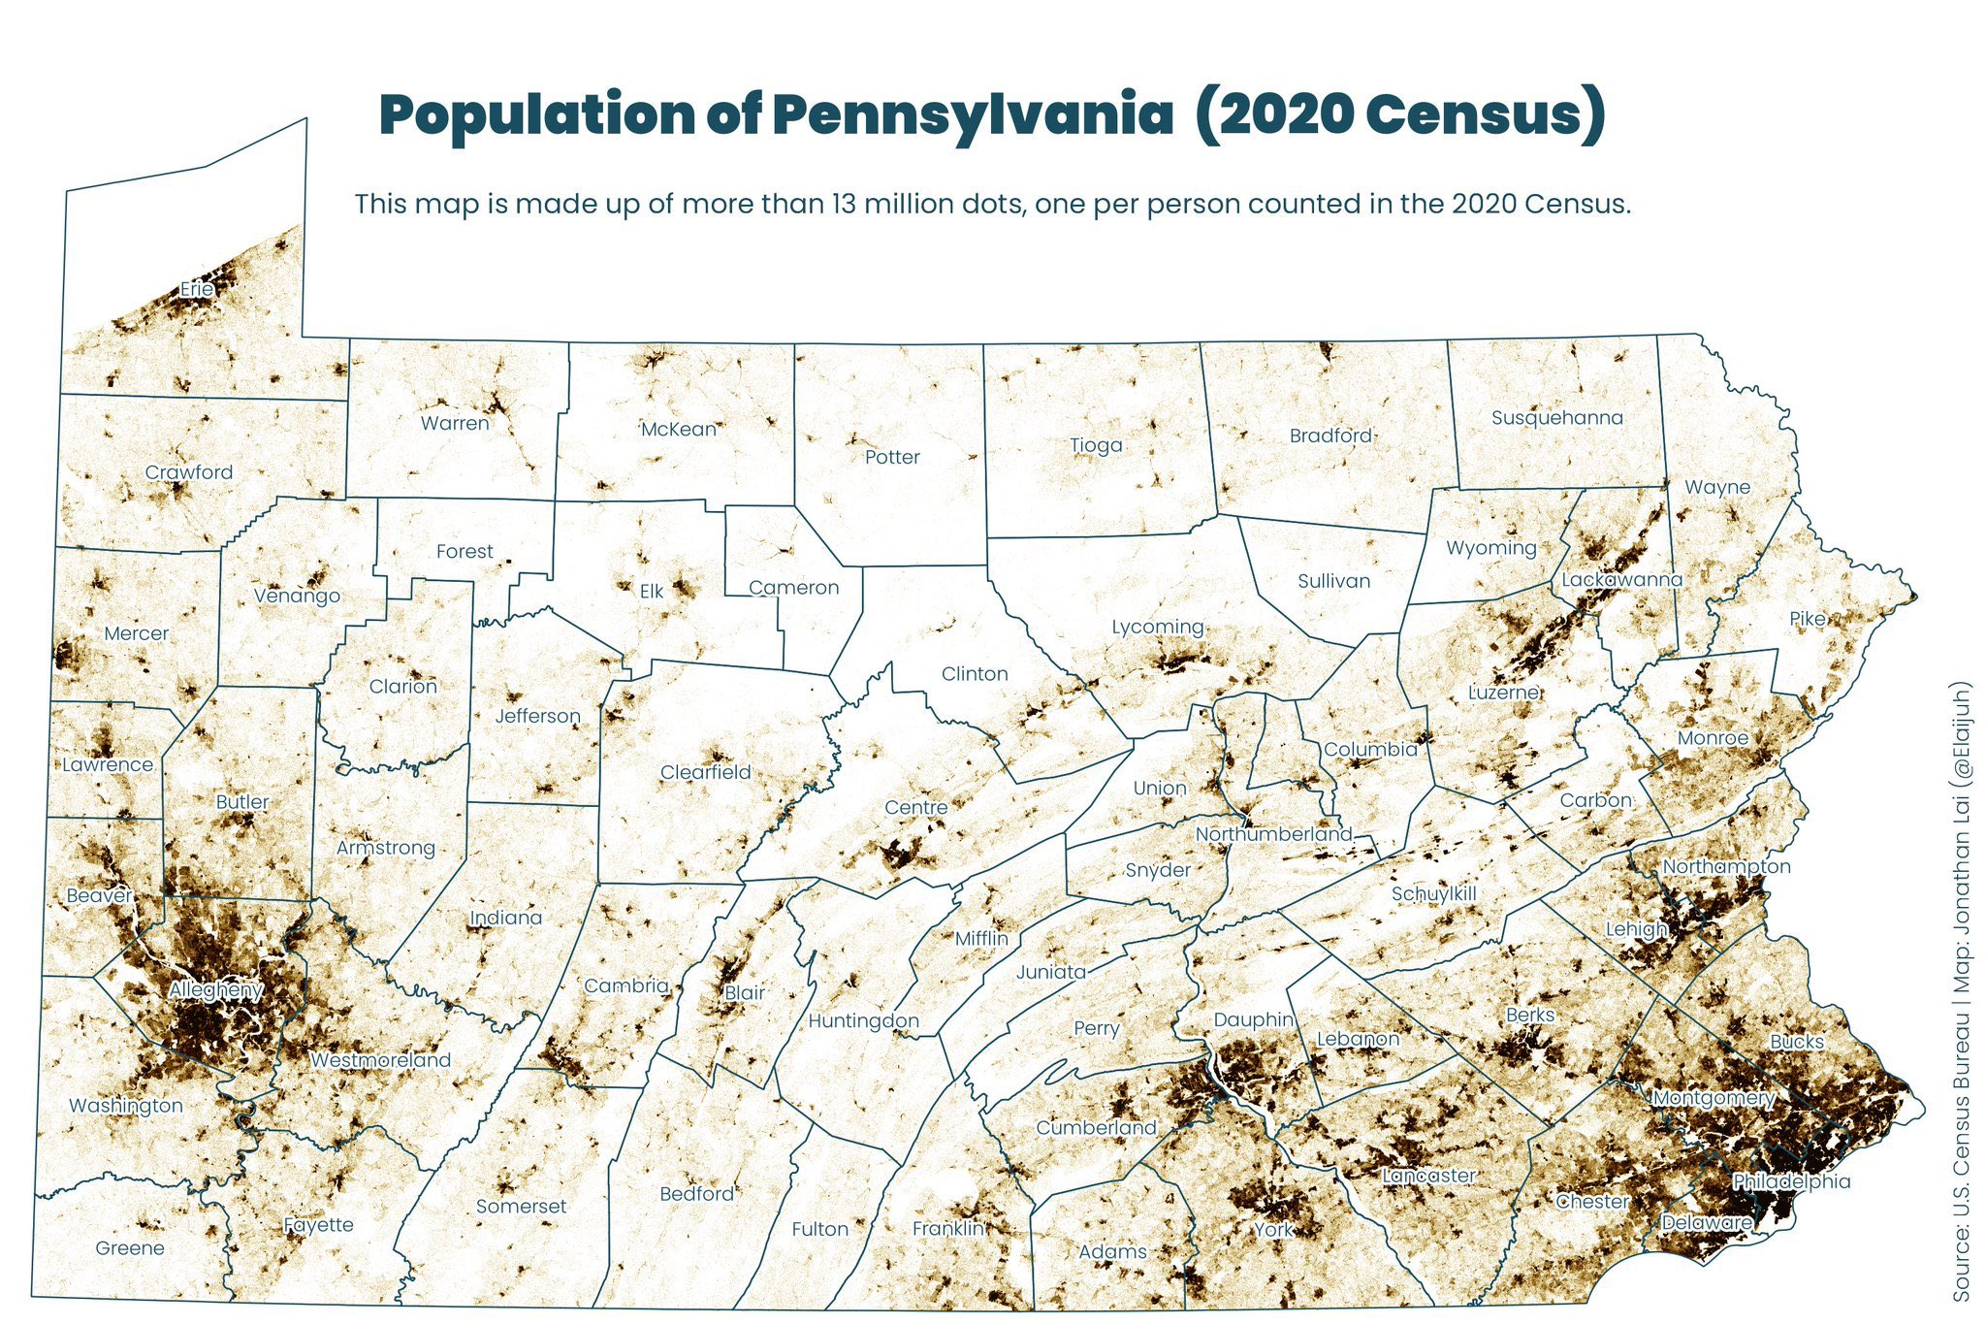

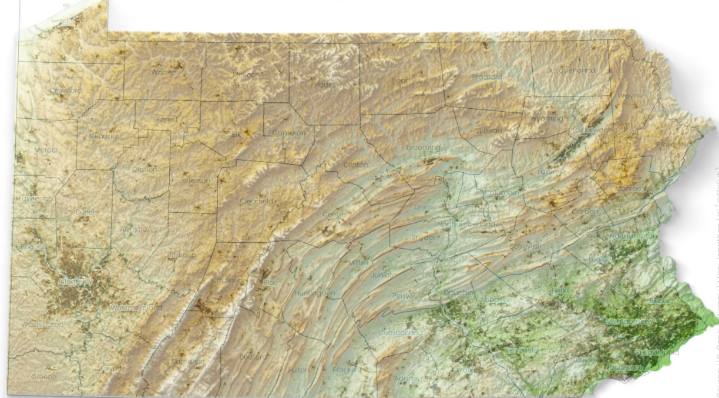
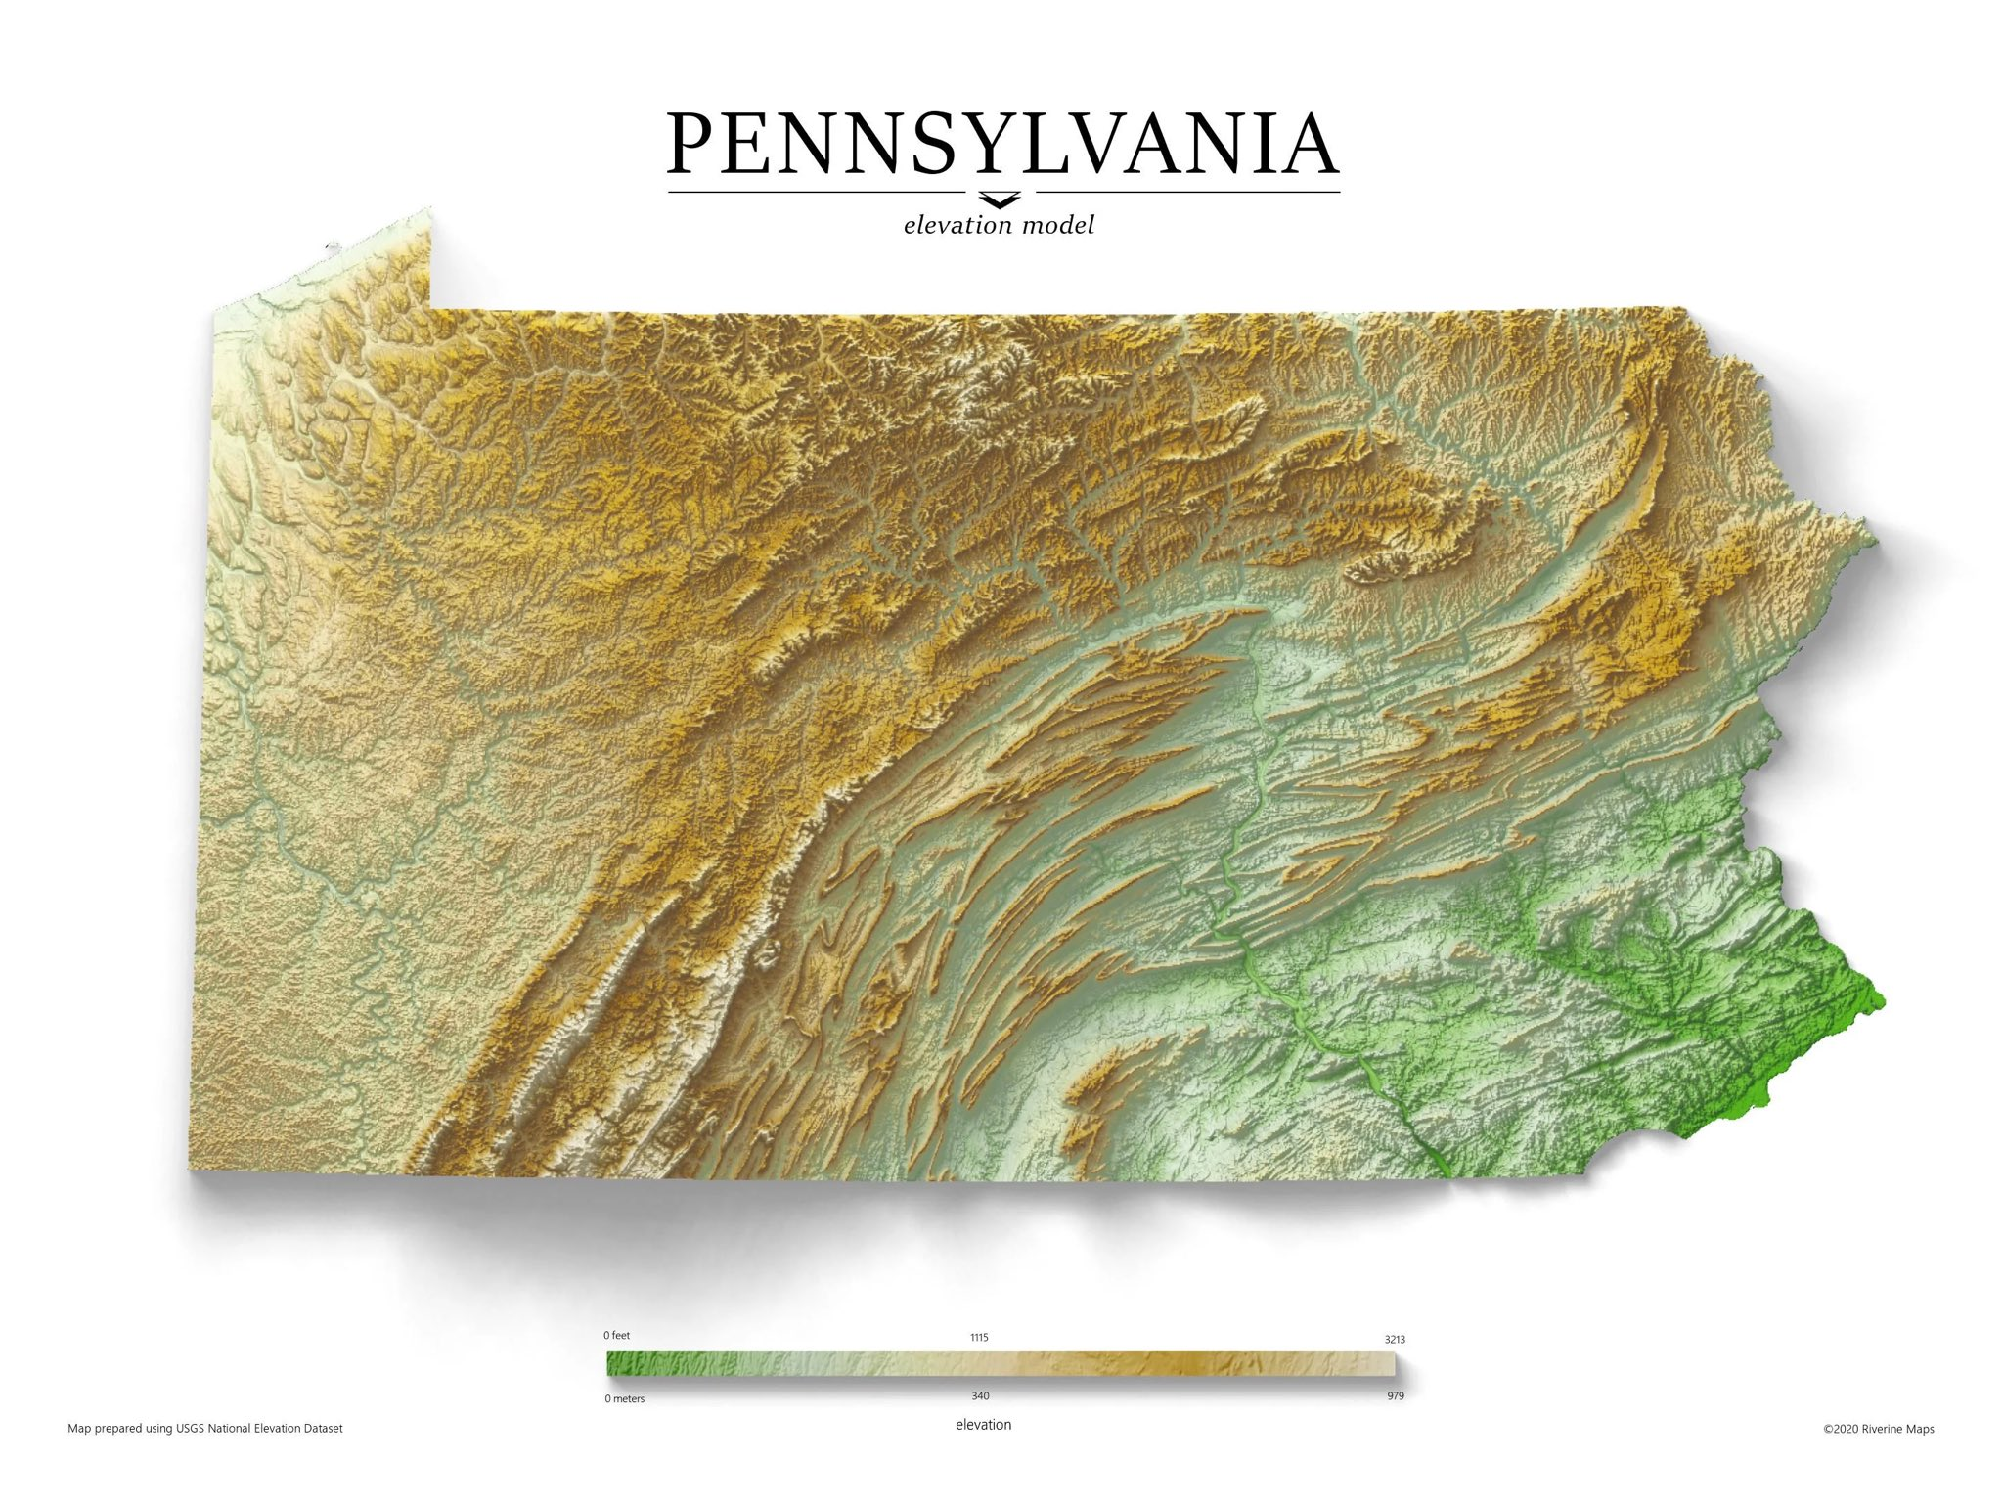

Slide 6
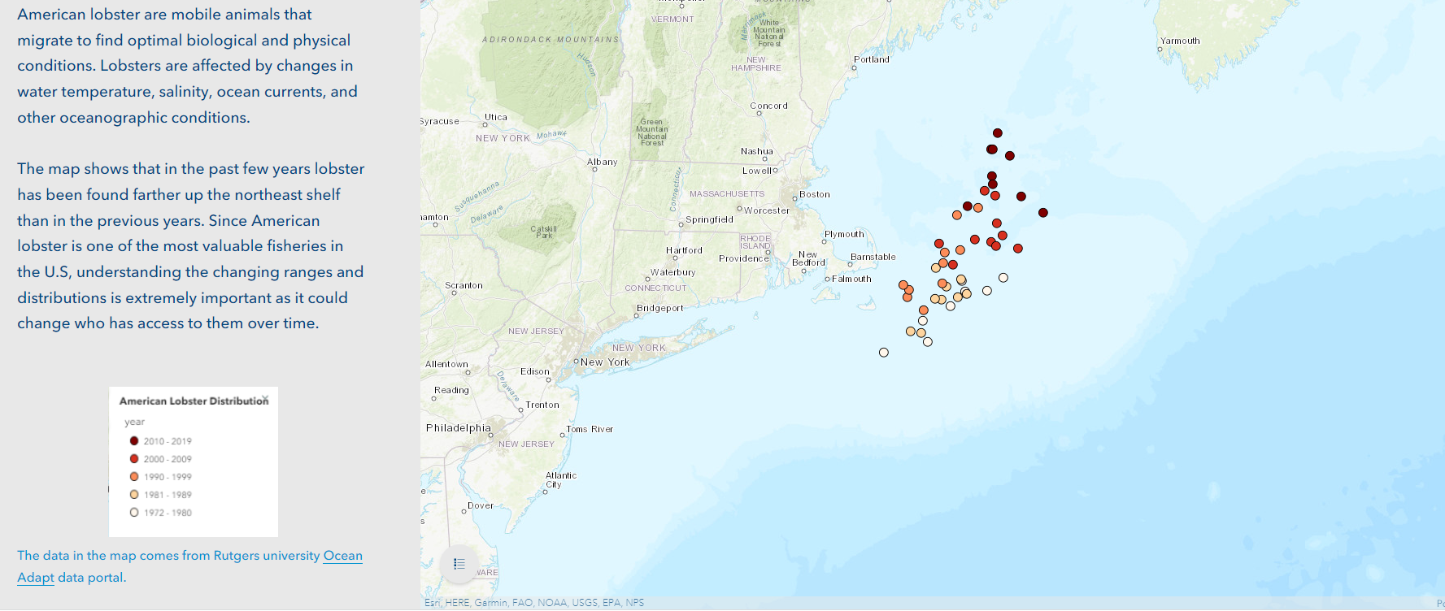
https://storymaps.arcgis.com/stories/b3321ee343c9424eb6557332f81509c6

Slide 7
What we’re working with
Packages
Sf
Ggplot2
File types
Data frames
Shapefiles (.shp)

Slide 8
Where do I get data
Some packages have data built in
MARMAP – bathymetry data
Publicly available geographic data
Google “_____ GIS”

Slide 9
Additional resources
Geocomputation in R
Sf
Ggplot cheat sheet?

