Slide 1
深度学习及应用
实践1
侯淇彬
南开大学计算机学院

Slide 2
大纲
Python安装
Windows
Ubuntu
Numpy包安装
Jupyter包安装
Python3教程

Slide 3
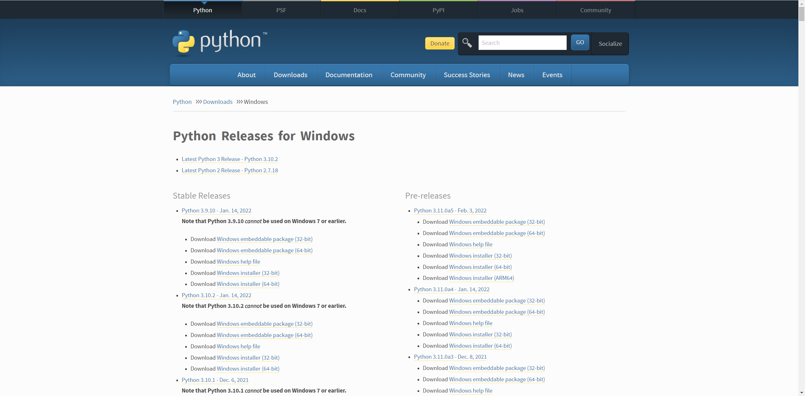
Python安装-Windows
Python安装(https://www.python.org/downloads/windows/)

Slide 4
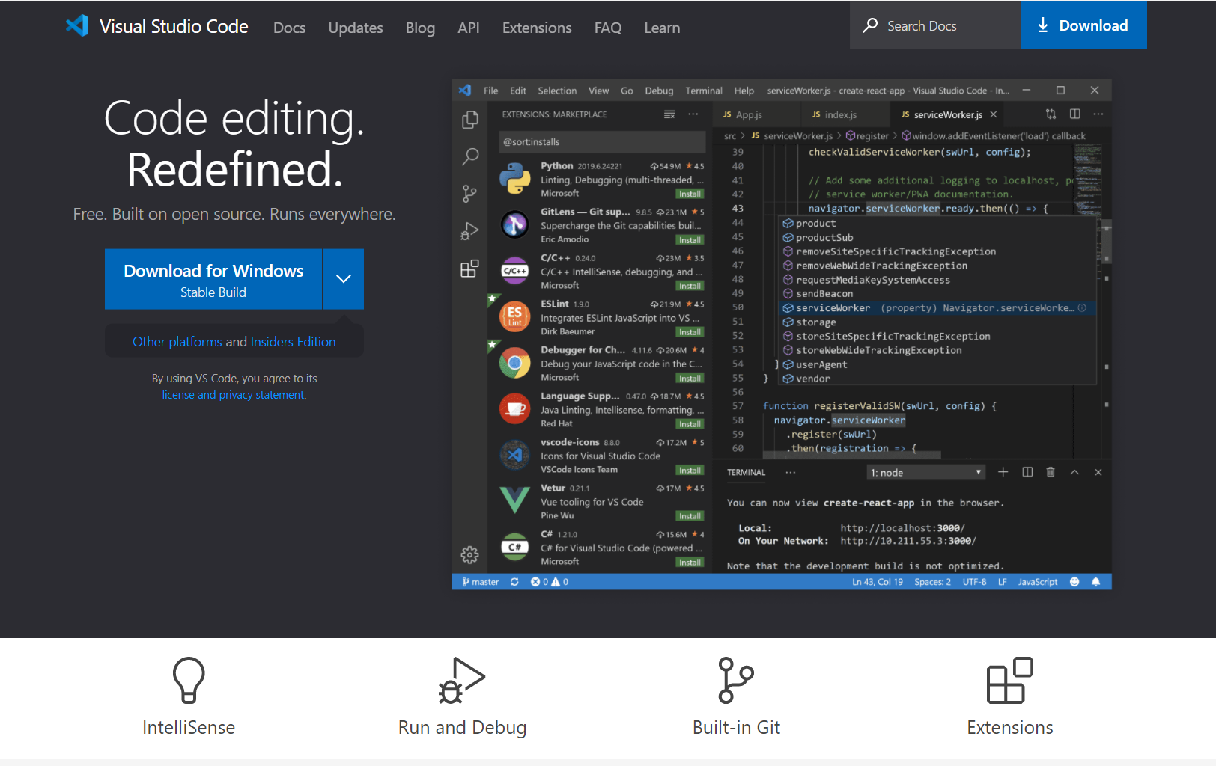
VSCode安装-Windows
VSCode安装(https://code.visualstudio.com/)

Slide 5
安装Numpy, Jupyter
pip install numpy
pip install jupyter
pip install matplotlib

Slide 6
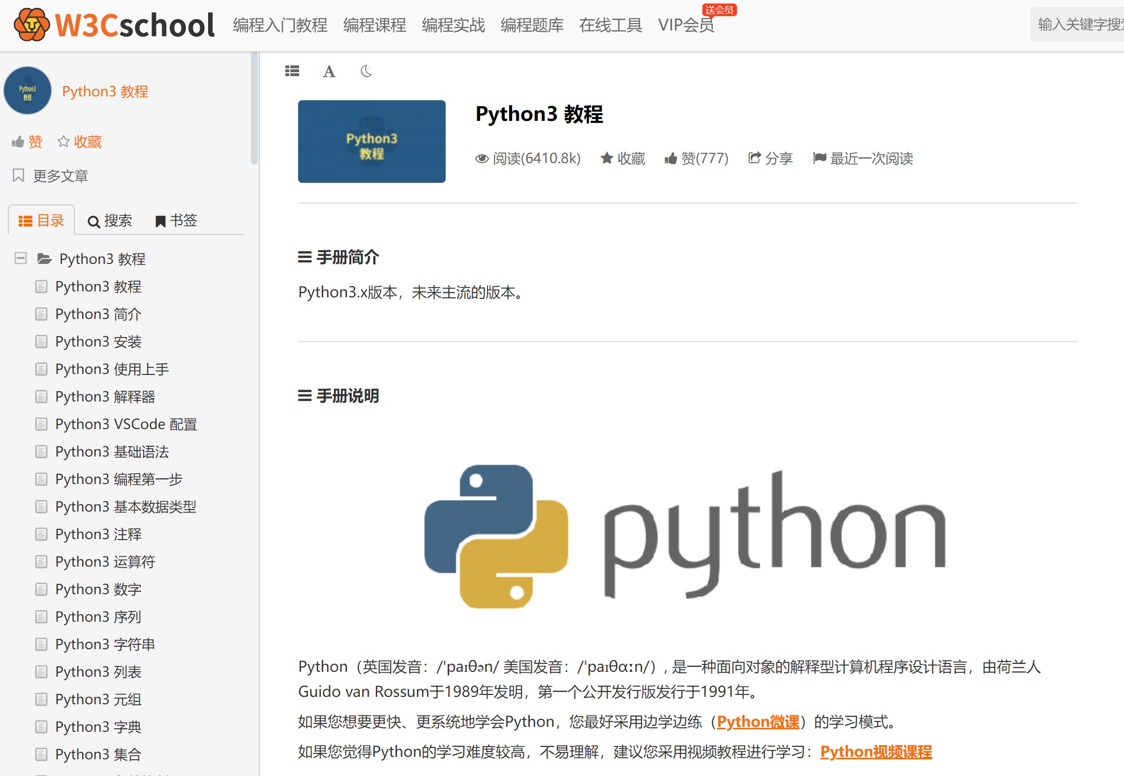
Python3教程
https://www.w3cschool.cn/python3/python3-tutorial.html

Slide 7
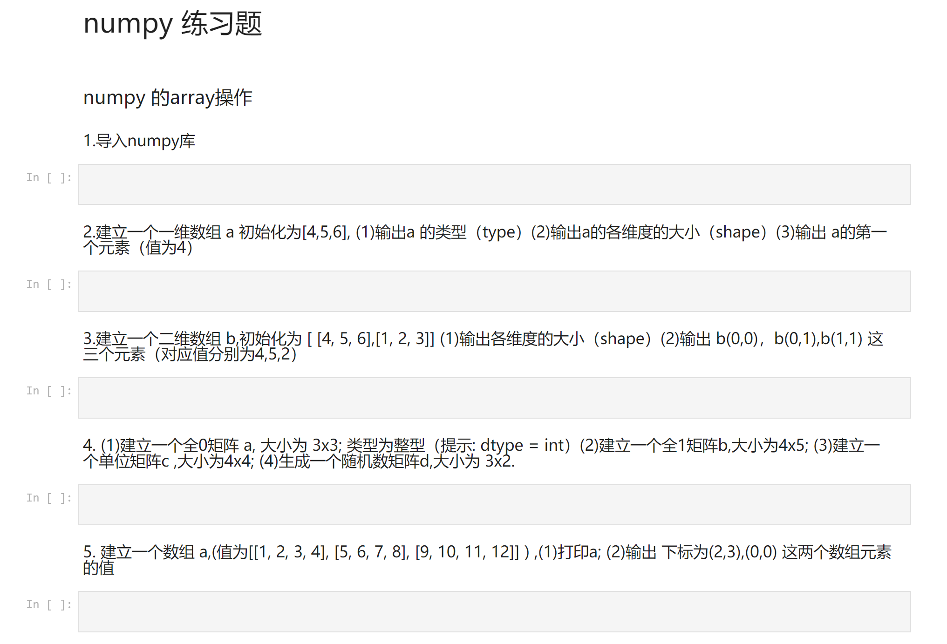
Numpy练习
https://github.com/nndl/exercise/tree/master/chap1_warmup

