Slide 1
Review

Slide 2
0: Malware Analysis Primer & 1: Basic Static Techniques

Slide 3
If you open a malware file in IDA Pro and determine the purpose of each module, which type of analysis are you performing?
Basic static analysis
Basic dynamic analysis
Advanced static analysis
Advanced dynamic analysis
None of the above

Slide 4
If you run strings.exe on a malware file, which type of analysis are you performing?
Basic static analysis
Basic dynamic analysis
Advanced static analysis
Advanced dynamic analysis
None of the above

Slide 5
Which type of malware conceals the existence of other code?
Backdoor
Botnet
Downloader
Keylogger
Rootkit

Slide 6
2: Malware Analysis in Virtual Machines & 3: Basic Dynamic Analysis

Slide 7
Which item below can be used to conceal the strings in an executable?
UPX
PEiD
PE
ELF
DLL

Slide 8
What type of file is calc.exe?
UPX
PEiD
PE
ELF
DLL

Slide 9
How many bytes are used to store the string HELLO in Unicode?
5
6
10
12
Some other number

Slide 10
Which library is the interface to the Windows kernel?
Kernel32.dll
User32.dll
Ntdll.dll
WSock32.dll
Wininet.dll

Slide 11
Which PE section contains CPU instructions?
.text
.rdata
.data
.rsrc
.reloc

Slide 12
Which tool reveals which services are hosted by each instance of scvhost?
Procmon
Process explorer
Dependency Walker
Regshot
INetSim

Slide 13
Which tool is specifically intended to aid analysis of the network traffic from malware?
Procmon
Process explorer
Dependency Walker
Regshot
INetSim

Slide 14
4: A Crash Course in x86 Disassembly

Slide 15
Which type of language contains commands like this? xor eax,eax
Machine code
Interpreted language
High-level language
Low-level language
None of the above

Slide 16
Which memory section contains objects created by the malloc() function?
Stack
Heap
Code
Data
None of the above

Slide 17
Which register points to the top of the stack?
EFLAGS
EAX
EIP
EBP
ESP

Slide 18
What is the value in eax after these instructions? mov ebx, 0x10 mov eax, ebx inc ebx
0xf
0x5
0x9
0x10
0x11

Slide 19
5: IDA Pro

Slide 20
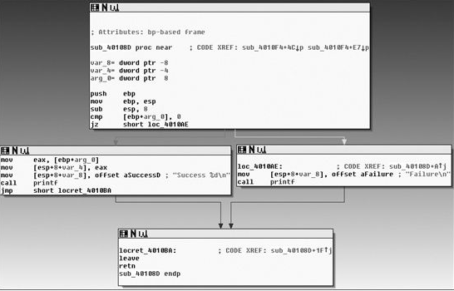
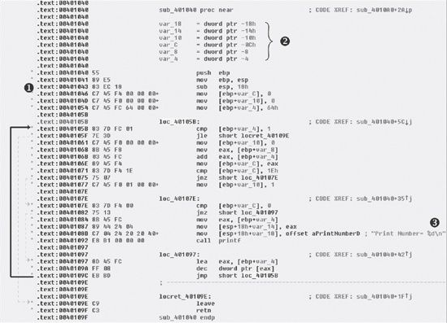
In IDA Pro, you are in graph mode, as shown to the right. How can you get into text mode, as shown in the lower image?
F9
SPACEBAR
Enter
Ctrl+C
None of the above

Slide 21
6: Recognizing C Code Constructs in Assembly

Slide 22
When printf("%d", 2); is executed, how is the value 2 passed to the printf function?
As a global variable
On the stack
In the heap
In the .rsrc section
None of the above

Slide 23
7: Analyzing Malicious Windows Programs

Slide 24
Which item allows malware to launch each time Windows is started?
Handle
Run key
ADS
.reg file
WinINet

Slide 25
Which item is used to refer to a menu, process, or other Windows object?
Handle
Run key
ADS
.reg file
WinINet

Slide 26
Which item allows interprocess communication?
DLLMain
Process
Thread
Mutex
Service

Slide 27
Which of these specifies what will happen after division by zero?
COM
SEH
User mode
Kernel mode
Services

Slide 28
Which of these items runs in kernel mode?
Kernel32.dll
Ntdll.dll
Ntoskrnl.exe
Svchost.exe
COMMAND.COM

Slide 29
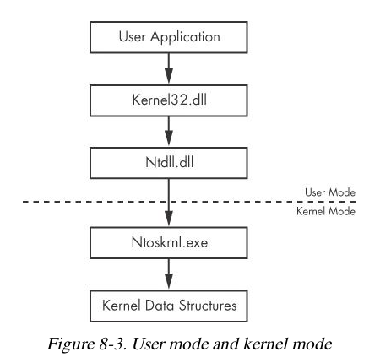

Slide 30
8: Debugging

Slide 31
Which debugger feature slows down execution substantially?
Step over
Step into
INT 3
Hardware execution breakpoints
Conditional breakpoints

Slide 32
What is the most common type of breakpoint?
Step over
Step into
INT 3
Hardware execution breakpoints
Conditional breakpoints

Slide 33
9: OllyDbg

Slide 34
Which process requires a .reloc section?
Rebasing
0xCC
DLLMain
Back trace
Run Trace

Slide 35
Which process happens when you press the - key in OllyDbg?
Rebasing
0xCC
DLLMain
Back trace
Run Trace

Slide 36
10: Kernel Debugging with WinDbg

Slide 37
How many of these objects run in kernel mode? Driver Device object Ntdll.exe Ntoskrnl.exe Kernel32.dll
1
2
3
4
Some other number

Slide 38
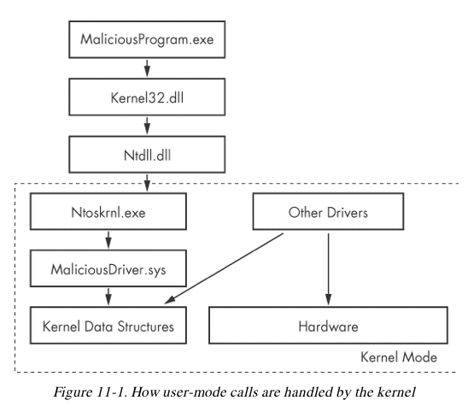

Slide 39
Which software allows kernel debugging?
INetSim
OllyDbg
WinDbg
IDA Pro
Process Monitor

Slide 40
Which software can analyze a crash dump?
INetSim
OllyDbg
WinDbg
IDA Pro
Process Monitor

Slide 41
What technique is most commonly used in kernel-mode rootkits?
SSDT Hooking
Interrupts
Breakpoints
DLL Injection
Drivers

Slide 42
11: Malware Behavior

Slide 43
Which item refers to a connection originating from inside the Windows firewall?
Downloader
Launcher
Backdoor
Reverse shell
RAT

Slide 44
Which category contains Poison Ivy?
Downloader
Launcher
Backdoor
Reverse shell
RAT

Slide 45
Which technique specifically steals credentials?
GINA Interception
Hash dumping
GetAsyncKeyState
AppInit_DLLs
DLL Load-Order Hijacking

Slide 46
Which technique is also called Companion Trojan?
GINA Interception
Hash dumping
GetAsyncKeyState
AppInit_DLLs
DLL Load-Order Hijacking

Slide 47
Which technique allows malware to load in Safe Mode?
Privilege escalation
IAT hooking
Inline hooking
Trojanized system binaries
Winlogon notify

Slide 48
12: Covert Malware Launching

Slide 49
What is the most popular covert launching technique?
DLL Injection
Direct injection
Process replacement
Hook injection
Detours

Slide 50
Which technique only works in suspended states?
DLL Injection
Direct injection
Process replacement
Hook injection
Detours

Slide 51
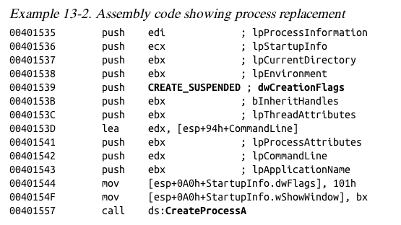

Slide 52
Which technique allows kernel-mode malware to run user-space code?
APC Injection
DLL Injection
Direct injection
Process replacement
Hook injection

Slide 53
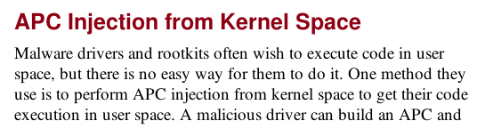

Slide 54
13: Data Encoding

Slide 55
Which encoding leaves the length of the text unchanged?
XOR
ROL
Base64
ROT
More than one of the above

Slide 56
Which encoding reverses itself?
XOR
ROL
Base64
ROT
More than one of the above

Slide 57
Which encoding often produces text ending in = or ==?
XOR
ROL
Base64
ROT
More than one of the above

Slide 58
What is the entropy of bytes that are all zero?
0
1
4
6
8

Slide 59
What is the entropy of encrypted bytes?
0
1
4
6
8

Slide 60
14: Malware-Focused Network Signatures

Slide 61
Which technique below is most likely to breach OPSEC?
Check domain blacklists
Whois
Upload sample to VirusTotal
View Google cache
Scan domain through Tor

Slide 62
Which signals do owned hosts send to C&C servers?
Snort
Beacon
User-Agent
HTTP
DNS

Slide 63
Which Windows networking API can download a file with a single function call?
WInSock
WinINet
COM
All of the above

