Slide 1
Southeast University
Path Tracking Simulation
and Control of Autonomous Vehicles
Four Problems on the VDM Platform: Speed Sensitivity, Key Variables, Vehicle Models,
and Dorm-to-Classroom Navigation
Notes:
Good morning, everyone. My topic is Problem 1 — why path tracking gets harder the faster the car goes.
That sounds like a trivial statement, but pinning down exactly which step becomes hard is not that easy to explain. I used three controllers — pure pursuit, LQR and MPC — and ran them on a 12-metre-radius circle at 3, 5 and 7 m/s, nine runs in total. Once they finished, the answer could be written as a single formula.

Slide 2
Southeast University
Contents
Problem 1: Theoretical Analysis and Experimental Validation
Problem 2: Sensitivity Analysis of Three Key Variables with Simulation, Visualization and Data Analysis
Problem 3:Model Reconstruction and Comparative Analysis of Kinematic and Dynamic Models
Problem 4:Map Construction, Reference Path Generation and Pure Pursuit Tracking
Notes:
Good morning, everyone. My topic is Problem 1 — why path tracking gets harder the faster the car goes.
That sounds like a trivial statement, but pinning down exactly which step becomes hard is not that easy to explain. I used three controllers — pure pursuit, LQR and MPC — and ran them on a 12-metre-radius circle at 3, 5 and 7 m/s, nine runs in total. Once they finished, the answer could be written as a single formula.

Slide 3
Southeast University
1. Why Path Tracking
Gets Harder at Higher Speed
Problem 1: Theoretical Analysis and Experimental Validation
Notes:
Good morning, everyone. My topic is Problem 1 — why path tracking gets harder the faster the car goes.
That sounds like a trivial statement, but pinning down exactly which step becomes hard is not that easy to explain. I used three controllers — pure pursuit, LQR and MPC — and ran them on a 12-metre-radius circle at 3, 5 and 7 m/s, nine runs in total. Once they finished, the answer could be written as a single formula.

Slide 4
The faster you go, the harder it gets,
because three things happen at once
Cornering lateral acceleration grows with the square of speed
Hard physical constraint
01
Speed 3 → 7 m/s: demand rises from 0.75 to 4.08 m/s²
aₙ = v²κ ×5.44
Look-ahead distance grows with speed, and the PP steady-state corner cut is proportional to it
02
Lf rises from 4.05 to 5.12 m; fitted over 13 controlled runs, R² = 0.99881
e_ss ≈ 0.93 · (L₀ + 0.35v) · β
Primary cause in this work
Distance travelled per step grows, so available corrections fall as 1/v
Timing cost
03
Control period is fixed at dt = 0.1 s, so a given corner gets fewer control steps
Distance per step v·dt: 0.3 m → 0.7 m
Note: it is not that “steering runs out” —— steady-state steer is speed-independent, and at high speed only 38%
02
Problem 1 · Speed and Path-Tracking Difficulty
Notes:
Let me give the conclusion first. Getting harder at speed is not caused by one thing — three things come together, and they differ a lot in magnitude.
First, the lateral acceleration a corner demands is v² times the curvature. Going from 3 to 7 m/s takes that demand from 0.75 to 4.08 — more than a factor of five. There is no way around this one; it is physics.
Second, and most important: the look-ahead distance grows together with speed, and pure pursuit's corner cut is exactly proportional to that look-ahead distance. I fitted that relationship from 13 runs; R² is 0.9988, essentially a straight line.
Third, the control period is fixed. The faster the car goes, the further it travels per step, so the number of corrections available in a given corner falls off as 1/v.
One point I want to stress here: it is not that steering runs out. Steady-state steer depends only on curvature, not on speed, and even at high speed it uses just 38% of the limit — there is plenty of steering margin left.

Slide 5
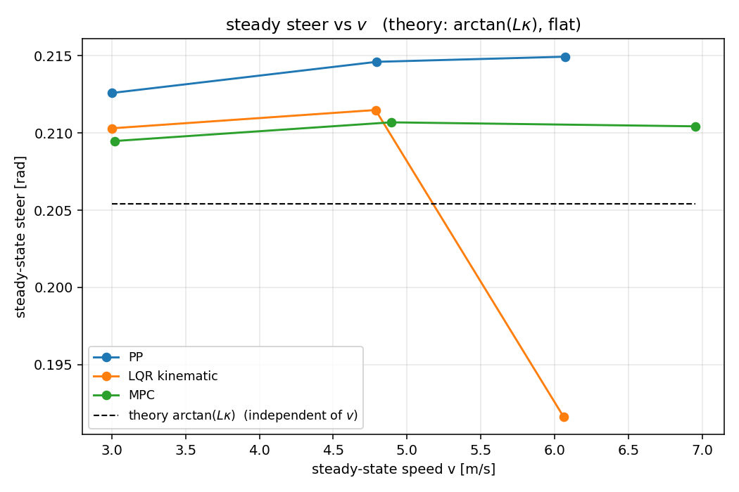
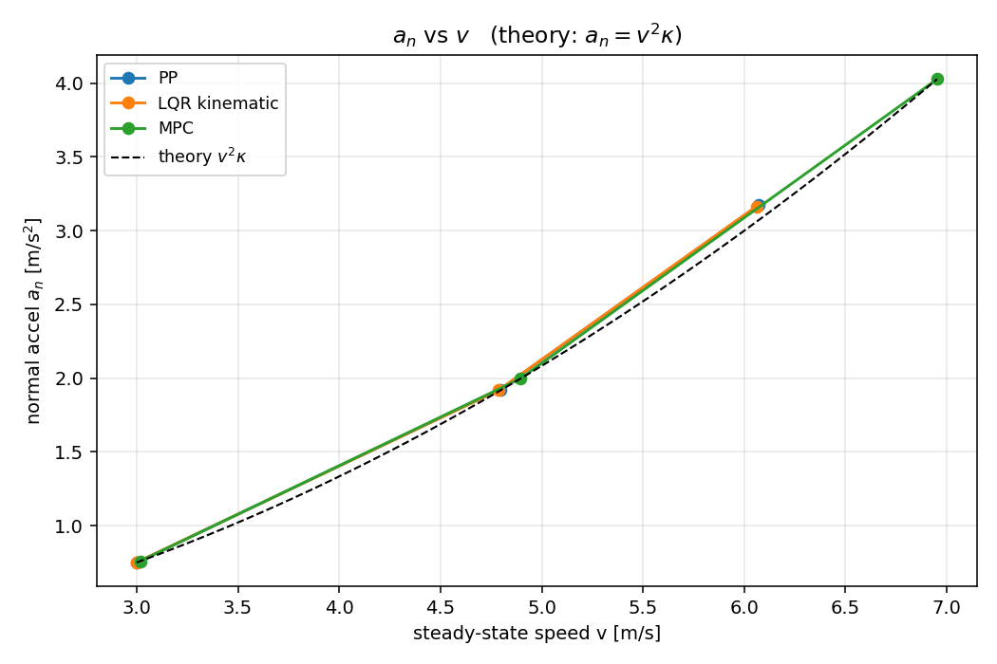
Experimental setup and the three speed-dependent quantities
Platform: vdm_lab kinematic bicycle model · dt = 0.1 s · wheelbase L = 2.50 m · circle radius R = 12.0 m
SETUP · Three quantities
Steer limit ±35° · steer-rate limit 45°/s · scope: 3 controllers × 3 speeds = 9 runs, plus 19 additional runs of controlled experiments
Quantity (unit)
3 m/s
7 m/s
Ratio
Law
Steady-state steer δ (rad)
0.2126
0.2149
Almost unchanged
δ ≈ arctan(Lκ)
Yaw rate ψ̇ (rad/s)
0.2575
0.5270
×2.05
ψ̇ = vκ
Normal acceleration aₙ (m/s²)
0.750
3.172
×4.23
aₙ = v²κ
03
Circle steer is independent of speed; peak aₙ matches v²κ to within 3.42% relative error
Notes:
The experiment itself is simple. The car has a 2.5 m wheelbase, the front wheels go to at most 35 degrees, and the steering rate is at most 45 degrees per second.
I split the effect of speed into three quantities and the conclusion is very clean.
The steering angle does not move — across the three speeds it is basically a horizontal line, because it depends only on wheelbase and curvature.
Yaw rate grows linearly, from 0.26 to 0.53 — a little over a factor of two.
Normal acceleration grows with the square, from 0.75 to 3.17 — more than four times — and it sits right on the theoretical v²κ line, within 3.4%.
So what speed really changes is not “how many degrees must I turn” but “how much lateral drift those degrees correspond to”.

Slide 6
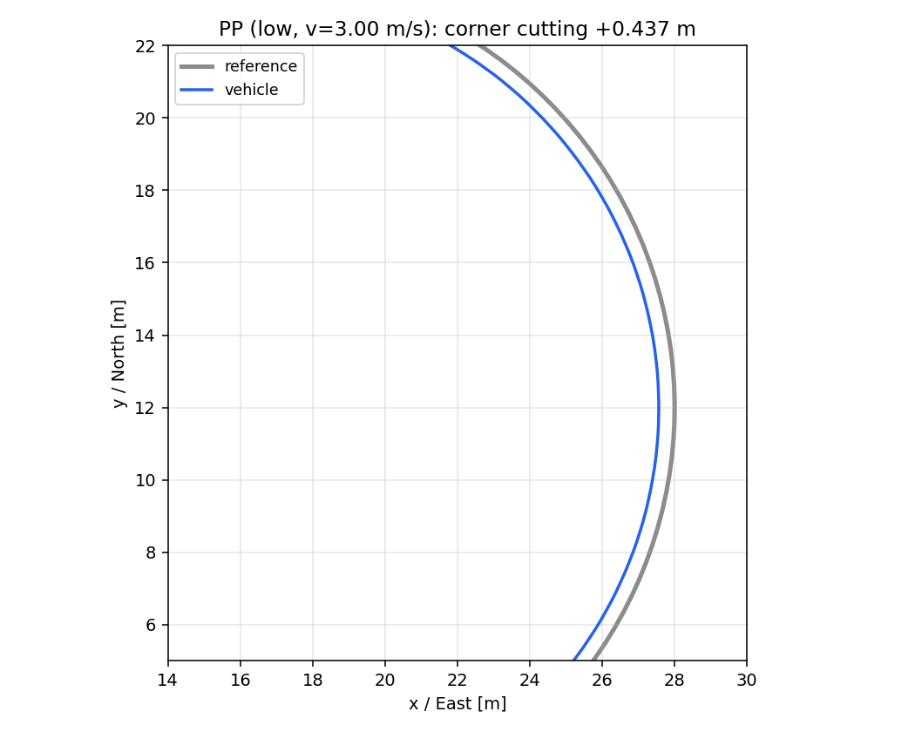
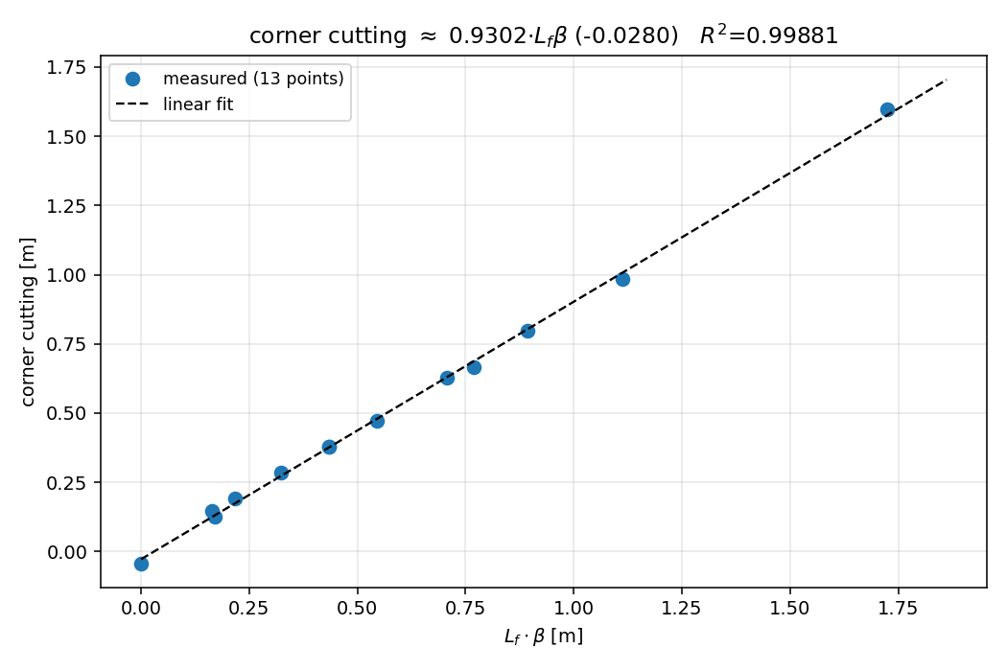
Main cause: the PP corner cut is proportional to the look-ahead distance
MAIN CAUSE
Circle tracking at 3 m/s: an actual cut of 0.437 m, while the steady-state steer is only 0.205 rad
—— the cut cannot be explained by the steering angle
e_cut ≈ 0.9302 · (L_f · β) − 0.0280 m
R² = 0.99881
Regression over 13 controlled runs · max residual 0.0227 m · decisive control: setting lf/lr → (2.5, 0) forces β = 0 → cut −0.0423 m
Causal chain: speed v ↑ → look-ahead L_f = L₀ + 0.35v ↑ → steady-state cut ↑
04
Left: 3 m/s circle trajectory and the reference circle; right: cut-vs-look-ahead regression over 13 controlled runs
Notes:
This is the most important slide in the whole talk.
When pure pursuit runs the circle, it does not sit on the reference circle — it settles onto a slightly smaller concentric circle.
At 3 m/s it drifts 0.437 m inwards. But the theoretical steer needed there is only 0.205 rad, so steering is nowhere near saturation. So where do those 0.44 m come from?
I ran several controls, changing one thing at a time: only the look-ahead distance, only the front/rear axle split, only the resampling spacing.
In the end I fitted 13 points: the cut is roughly 0.93 times the look-ahead distance times the sideslip angle.
The most convincing one is the second group. I set the front/rear axle split to 2.5 and 0, forcing the sideslip angle β to exactly zero — and the cut immediately became −0.042 m, essentially gone.
So the cut is caused by β. Speed enters that chain through the look-ahead distance: higher speed, longer look-ahead, larger cut.

Slide 7
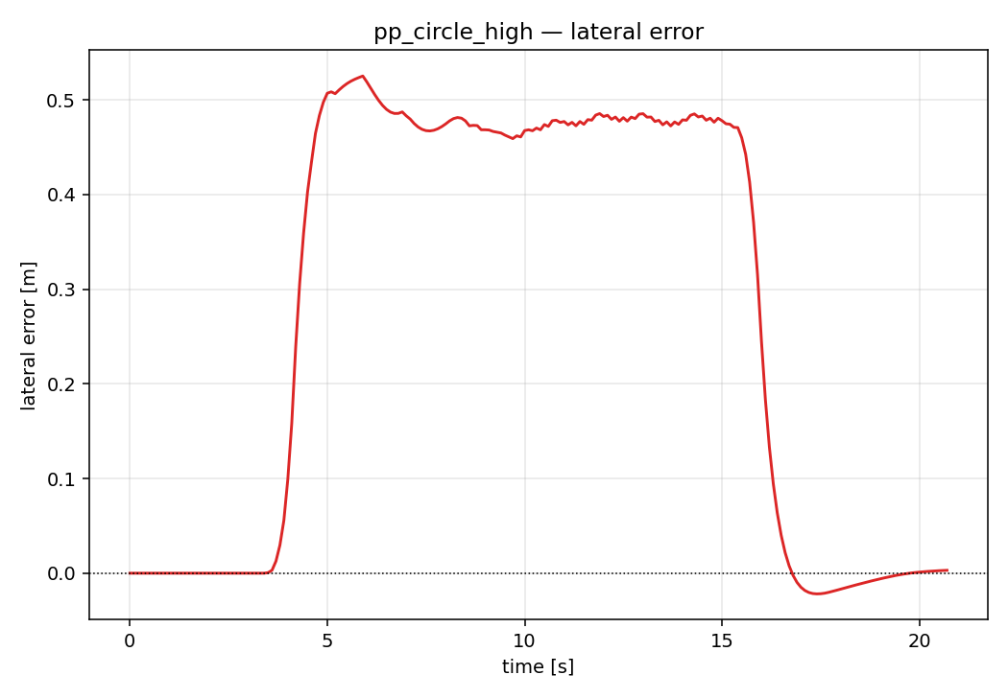
Error rises with speed across the board, but there is a trap
Steady-state and peak lateral error rise together; accuracy ranks MPC > LQR > PP
EVIDENCE · Error comparison
3 m/s
7 m/s
Lateral error (m)
MPC
0.226
0.348
LQR
0.342
0.476
PP
0.446
0.525
0.20
0.30
0.40
0.50
0.60
PP lateral error over time at 7 m/s: the cut persists
Trap: looking only at the whole-run mean error reverses the conclusion —— PP's mean error falls from 0.286 m to 0.275 m
At higher speed the car enters the large-cut state earlier and stays in it longer, averaging out the transition. Difficulty must be judged on the steady segment and the peak value.
05
Circle R = 12.0 m · steady-segment / peak lateral error · comparison of three controllers
Notes:
The peak steady-state lateral error of all three controllers rises with speed. At the high-speed setting they are 0.53, 0.48 and 0.35 m. MPC is best, LQR in the middle, pure pursuit worst.
But there is a trap here that I should point out. If you look at the whole-run mean error, the conclusion flips — it goes down, with pure pursuit dropping from 0.286 to 0.275.
Why? Because as speed rises the trajectory contains more samples on the straight sections. Straight-section error is always zero, and that drags the mean down.
So to judge whether tracking is hard, you have to look at the steady segment and the peak value, not the whole-run mean.

Slide 8
Conclusions and engineering recommendations
CONCLUSION
aₙ = v²κ
e_ss ∝ L_f · β
Δs = v · dt
Quadratic · hard physical constraint
Linear · geometric corner cut
Order 1/v · fewer correction steps
01
Do not scale the look-ahead distance blindly with speed
Switch to curvature feed-forward or a steering-offset compensation, to cancel the steady-state cut caused by L_f · β directly.
02
Trigger the end-of-run deceleration on remaining arc length
Braking distance is longer at high speed; triggering on the current distance alone will inevitably overshoot the goal.
06
The three costs differ in magnitude and must be treated separately in engineering practice
Notes:
To sum up. Getting harder at speed is three costs stacked on top of each other: a quadratic physical cost, a linear geometric cost, and a timing cost that falls off as 1/v. The dominant issue is still pure pursuit's corner cut.
Two recommendations.
First, do not scale the look-ahead distance blindly with speed — pair it with curvature feed-forward or a steering-offset compensation. LQR and MPC are accurate precisely because they use curvature explicitly.
Second, when decelerating near the goal, trigger it on the remaining arc length along the path, not on straight-line distance, otherwise the car will slow down in the middle of the run for no reason.

Slide 9
Part 2.
Three Key Variables
Analysis

Slide 10

Experimental Design
Background: path tracking is a fundamental capability of autonomous driving, requiring the vehicle to follow a reference path accurately
Objective: identify the key factors affecting tracking performance and how they act
Variables studied: control algorithm, target speed, and path geometry
Method: control-variable approach — change one variable at a time while holding the others fixed
Scope: ten experiment runs in total, all reaching the goal
Common settings: the same vehicle parameters, the same reference implementations, and unified evaluation metrics
Metrics: lateral error, steering angle, normal acceleration, yaw rate, and steering rate
Notes:
Today I will talk about two vehicle models and four control methods. Thirty of 31 tests finished the route.
Dynamic LQR had the smallest errors on the four built-in routes.
All tests used a kinematic model to move the car. The dynamic model helped design one controller. These results compare the controllers in this simulation.
Sources: reports/course_tasks/all_results.json; outputs/course_tasks; outputs/course_tasks_gpx; vdm_lab/common/bicycle_model.py; vdm_lab/student/lqr_dynamic.py.
All tests use the kinematic vehicle backend. Dynamic LQR stiffness conventions and discretization need further review.

Slide 11
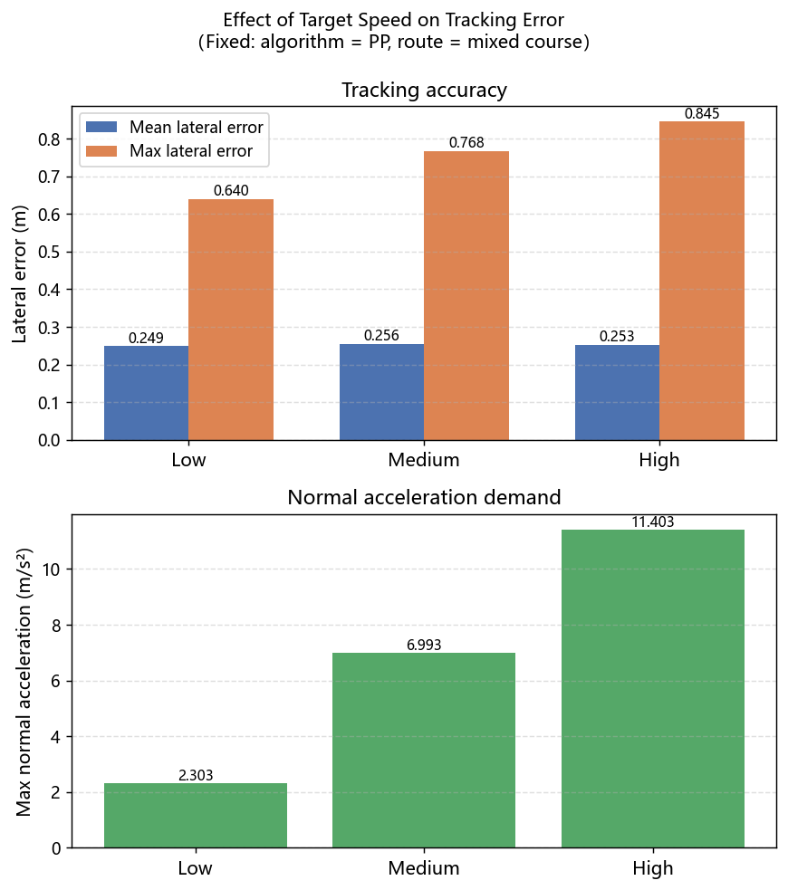
Effect of Target Speed
Comparison across three speed levels: low, medium, and high
As speed increases, the mean tracking error changes little
The peak error at sharp turns increases markedly, so the difficulty is concentrated in the transient
The normal acceleration grows with the square of speed, so the lateral demand rises sharply
The yaw rate grows linearly with speed, so the yaw response must be established faster
The steady-state steering angle is independent of speed, but the time available for correction shrinks with speed
Conclusion: tracking is harder at high speed because of the lateral load and the response time, not because of the steering angle magnitude
01
Notes:
Today I will talk about two vehicle models and four control methods. Thirty of 31 tests finished the route.
Dynamic LQR had the smallest errors on the four built-in routes.
All tests used a kinematic model to move the car. The dynamic model helped design one controller. These results compare the controllers in this simulation.
Sources: reports/course_tasks/all_results.json; outputs/course_tasks; outputs/course_tasks_gpx; vdm_lab/common/bicycle_model.py; vdm_lab/student/lqr_dynamic.py.
All tests use the kinematic vehicle backend. Dynamic LQR stiffness conventions and discretization need further review.

Slide 12
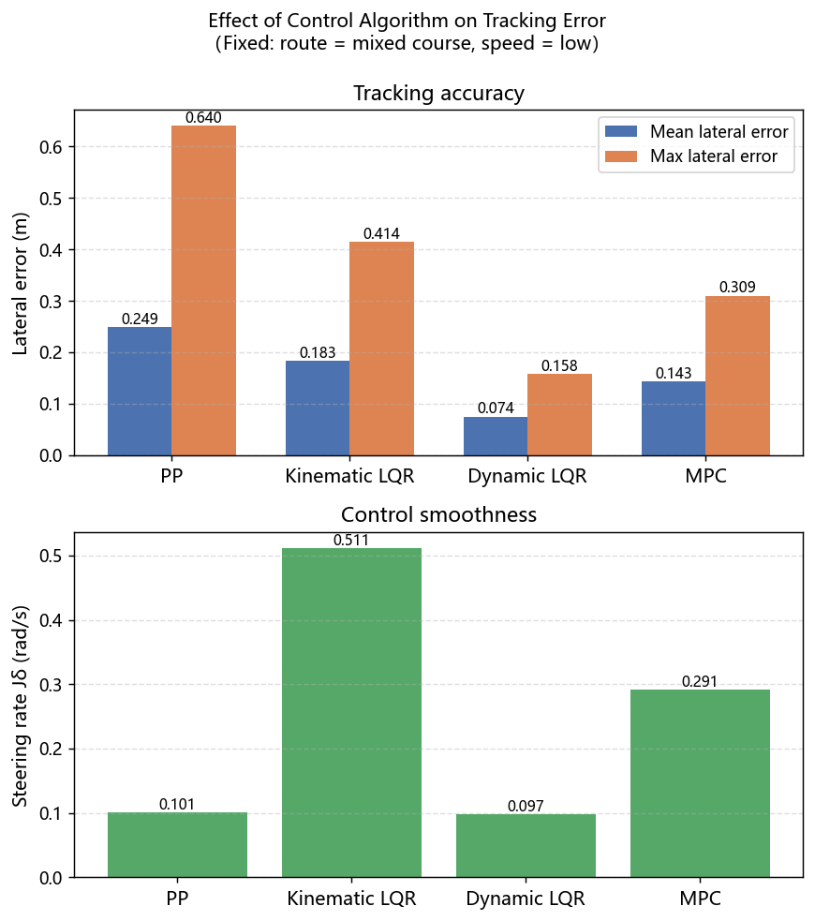
Effect of Control Algorithm
Four algorithms compared: Pure Pursuit (PP), kinematic LQR, dynamic LQR, and MPC
PP tracks using geometric relations; it is simple and produces the smoothest control
Kinematic LQR introduces error feedback, improving accuracy, but changes the steering angle most rapidly
Dynamic LQR accounts for tire sideslip and achieves the highest tracking accuracy with the smallest error along the path
MPC plans ahead through receding-horizon optimization, achieving the best endpoint convergence and the most accurate final position
Conclusion: no single algorithm is optimal on all metrics; the choice depends on the priority among accuracy, endpoint convergence, and smoothness
01
Notes:
Today I will talk about two vehicle models and four control methods. Thirty of 31 tests finished the route.
Dynamic LQR had the smallest errors on the four built-in routes.
All tests used a kinematic model to move the car. The dynamic model helped design one controller. These results compare the controllers in this simulation.
Sources: reports/course_tasks/all_results.json; outputs/course_tasks; outputs/course_tasks_gpx; vdm_lab/common/bicycle_model.py; vdm_lab/student/lqr_dynamic.py.
All tests use the kinematic vehicle backend. Dynamic LQR stiffness conventions and discretization need further review.

Slide 13
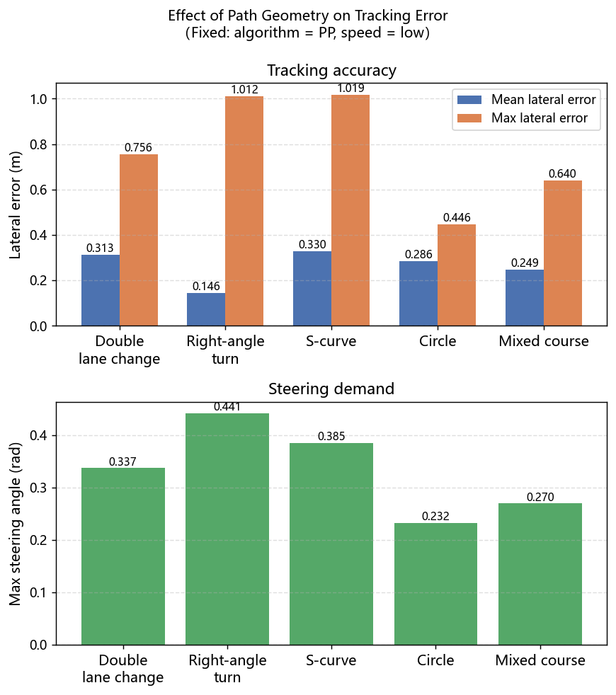
Effect of Path Geometry
Five routes compared: double lane change, right-angle turn, S-curve, circle, and mixed course
The double lane change involves consecutive lane changes with rapid reversal of curvature sign, stressing the transient response
The right-angle turn has a step change in curvature, producing a prominent error spike
The S-curve alternates positive and negative curvature and is the hardest to track, with the largest peak error
The circular path of constant curvature is the easiest, with the smallest error
Conclusion: a curvature discontinuity is harder to handle than the curvature magnitude itself; smooth geometry is easier to track
01
Notes:
Today I will talk about two vehicle models and four control methods. Thirty of 31 tests finished the route.
Dynamic LQR had the smallest errors on the four built-in routes.
All tests used a kinematic model to move the car. The dynamic model helped design one controller. These results compare the controllers in this simulation.
Sources: reports/course_tasks/all_results.json; outputs/course_tasks; outputs/course_tasks_gpx; vdm_lab/common/bicycle_model.py; vdm_lab/student/lqr_dynamic.py.
All tests use the kinematic vehicle backend. Dynamic LQR stiffness conventions and discretization need further review.

Slide 14
Conclusion
The control algorithm determines tracking accuracy: dynamic LQR is the most accurate, MPC has the best endpoint accuracy
The target speed determines the transient difficulty: high speed amplifies the peak error at sharp turns
The path geometry determines the peak error: a curvature discontinuity is harder to track than its magnitude
The three variables act on different aspects of tracking and can compound with one another
Engineering implications: choose the algorithm by scenario, reserve a lateral margin at high speed, and smooth the response ahead of sharp turns
Limitations: simplified simulation models; normal acceleration is a reference value; the geometry dimension was verified with only a single algorithm
Notes:
Today I will talk about two vehicle models and four control methods. Thirty of 31 tests finished the route.
Dynamic LQR had the smallest errors on the four built-in routes.
All tests used a kinematic model to move the car. The dynamic model helped design one controller. These results compare the controllers in this simulation.
Sources: reports/course_tasks/all_results.json; outputs/course_tasks; outputs/course_tasks_gpx; vdm_lab/common/bicycle_model.py; vdm_lab/student/lqr_dynamic.py.
All tests use the kinematic vehicle backend. Dynamic LQR stiffness conventions and discretization need further review.

Slide 15
Southeast University
3.Which Vehicle Model
Explains What We Actually Observe?
Problem 3:Model Reconstruction and Comparative Analysis of Kinematic and Dynamic Models
Notes:
Good morning, everyone. My topic is Problem 1 — why path tracking gets harder the faster the car goes.
That sounds like a trivial statement, but pinning down exactly which step becomes hard is not that easy to explain. I used three controllers — pure pursuit, LQR and MPC — and ran them on a 12-metre-radius circle at 3, 5 and 7 m/s, nine runs in total. Once they finished, the answer could be written as a single formula.

Slide 16
Vehicle Models and Path Tracking
Model reconstruction and evidence from 31 experiments
We tested two vehicle models and four control methods in 31 experiments.
Thirty tests finished the planned route. The only unfinished test was MPC on the long GPX route.
The chart shows where that one incomplete run occurred. Later slides compare accuracy, steering behavior and route completion.
31 experiments: 16 route comparisons, 9 circle runs, 2 steering-limit runs and 4 GPX runs.
01

Slide 17
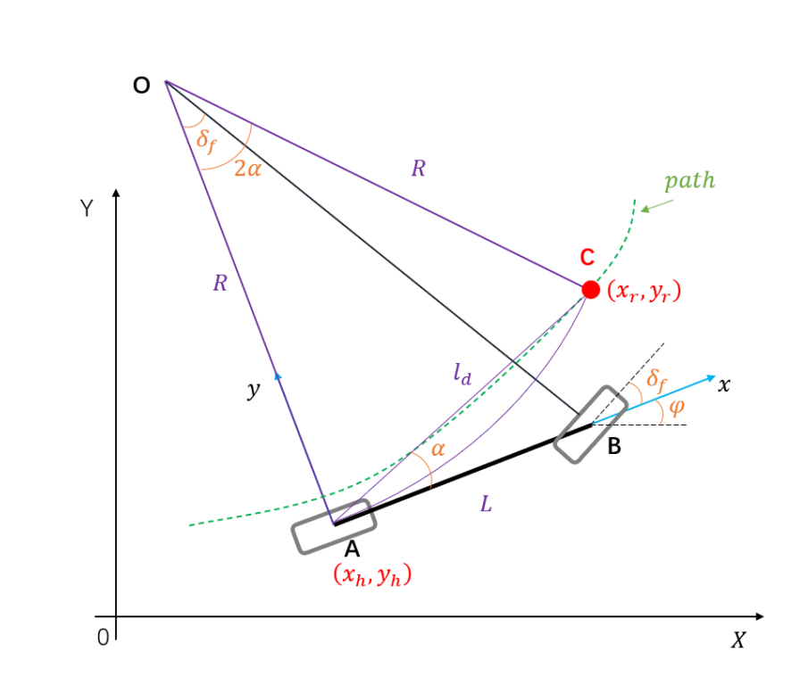
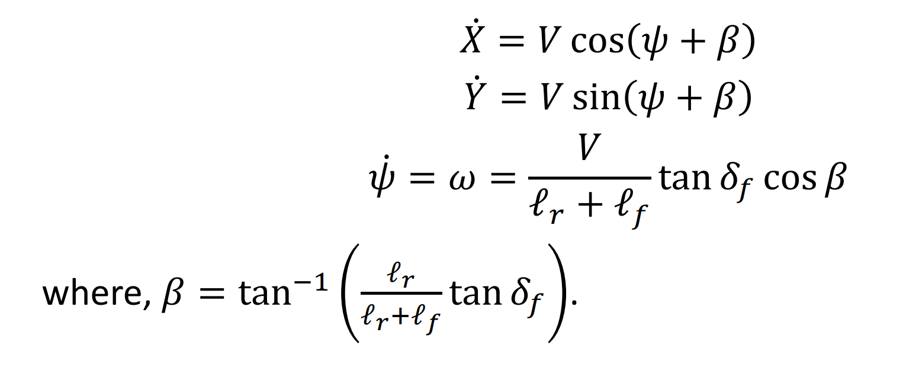
Kinematic Model
Pure rolling constraints determine the motion
The kinematic model uses speed, steering angle and car size to describe motion. It assumes that the wheels roll without sideways slip.
The formulas below calculate turning and position from geometry.
Kinematic bicycle model
02

Slide 18
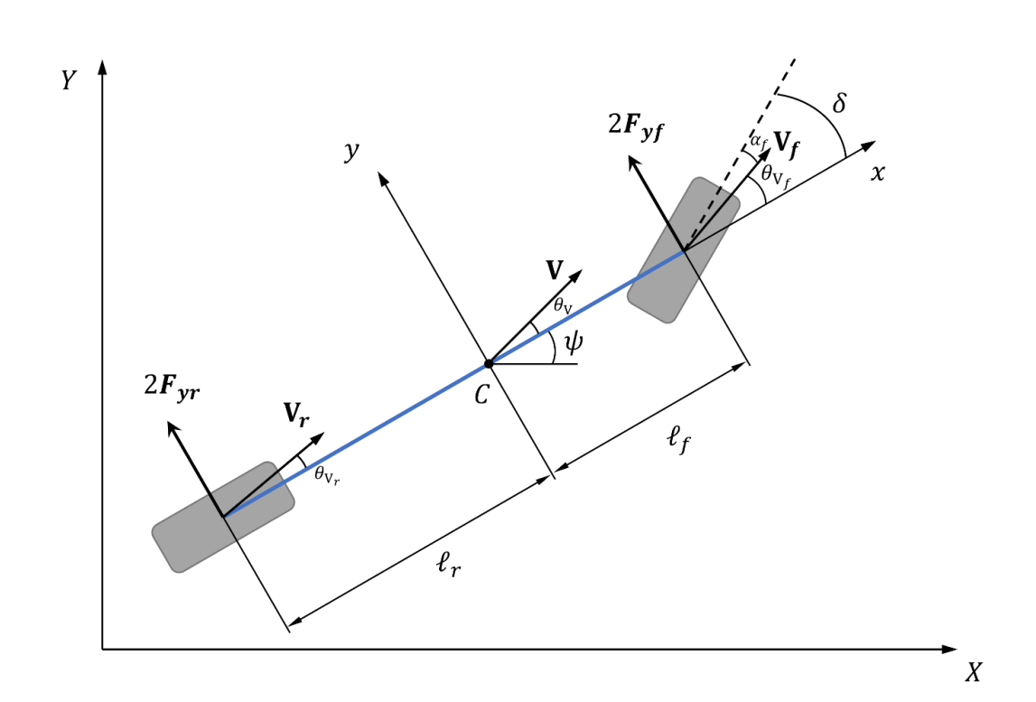
Dynamic Model
Tire forces determine lateral and yaw response
The dynamic model also considers tire forces, vehicle mass and resistance to turning. It describes sideways motion and yaw response.
Dynamic LQR uses this model to choose steering. In the double lane-change test, it produced the lowest mean error.
Dynamic bicycle model
Assumptions: small angles, linear tires and locally constant longitudinal speed. No tire saturation model.
03

Slide 19
Task 1: Built-in Route Tracking
Four controllers were tested on four standard routes
All 16 runs reached the goal. The routes included a double lane change, a right-angle turn, an S-curve and a mixed course.
Dynamic LQR produced the lowest mean lateral error on every route.
PP was smooth but cut corners. Kinematic LQR improved accuracy. MPC also reduced error compared with PP, but required more tuning.
The chart shows mean absolute lateral error. Lower values indicate better path tracking.
03

Slide 20
Task 1: Main Findings
Dynamic LQR gave the best average accuracy in this simulation
Across the four routes, Dynamic LQR had the lowest average mean error at 0.076 meters. Kinematic LQR averaged 0.166 meters.
The result shows the benefit of including lateral and yaw dynamics in controller design.
Optional parameter check: lowering the steering limit from 35 to 20 degrees increased the kinematic LQR peak error on the right-angle route from 0.719 to 1.093 meters.
The steering-limit check is an optional Task 1 parameter experiment, not a separate course task.
04

Slide 21
Task 2: Circular Tracking at Different Speeds
Circle radius 12 m, time step 0.1 s
At low speed, all three controllers followed the circle with steering close to the geometric value of 0.205 radians.
At high speed, kinematic LQR steering oscillated more and reached the steering limit for 22.6 percent of the run.
PP produced the smoothest steering. MPC changed steering less than kinematic LQR. Actual mean speeds differed, so this was not an equal-speed comparison.
Mean high-speed arc speeds: PP 6.09, kinematic LQR 6.08 and MPC 6.95 m/s.
05

Slide 22
Task 3: GPX Route Tracking
Repository example route, 3.914 km
At a target speed of 8 meters per second, PP and kinematic LQR completed the full route.
MPC stopped after 96.1 seconds and covered about 732 meters because its solver reached a limit. Its partial result cannot be compared fairly with the completed runs.
PP also completed the route at 4 meters per second. The lower speed reduced error but almost doubled travel time.
The GPX test used the repository example route. Sparse points and sharp corners limit real-road interpretation.
06

Slide 23
Southeast University
4. Can the Car Find Its Way
from the Dorm to the Classroom?
Problem 4:Map Construction, Reference Path Generation and Pure Pursuit Tracking
Notes:
Good morning, everyone. My topic is Problem 1 — why path tracking gets harder the faster the car goes.
That sounds like a trivial statement, but pinning down exactly which step becomes hard is not that easy to explain. I used three controllers — pure pursuit, LQR and MPC — and ran them on a 12-metre-radius circle at 3, 5 and 7 m/s, nine runs in total. Once they finished, the answer could be written as a single formula.

Slide 24
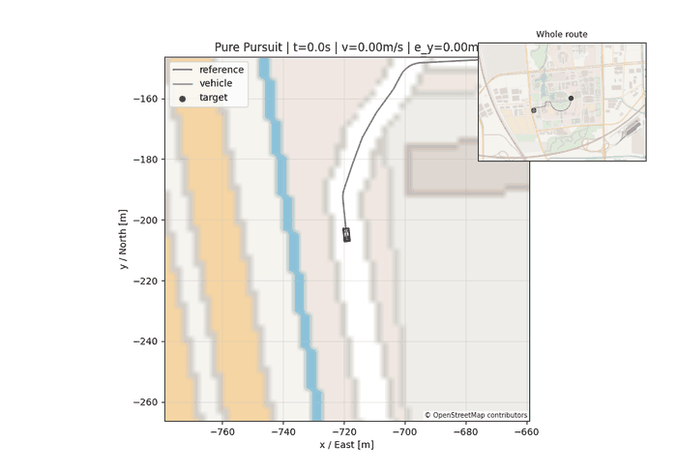
Task pipeline
1450.6 m total · 2903 reference points · 7 sharp turns · runs offline
Map construction
Reference path generation
Pure Pursuit implementation
Experimental data analysis
Outputs a GPX path
Outputs a speed profile
Outputs the controller
Outputs the conclusions
02
Following animation, the full 1450.6 m
Notes:
This is the whole pipeline. The four stages are map construction, reference path generation, pure-pursuit implementation and experimental data analysis; the output of each is the input of the next. Everything runs offline, with no network. The clip below is the first-person view of the car driving the full reference path, 1450.6 metres.

Slide 25
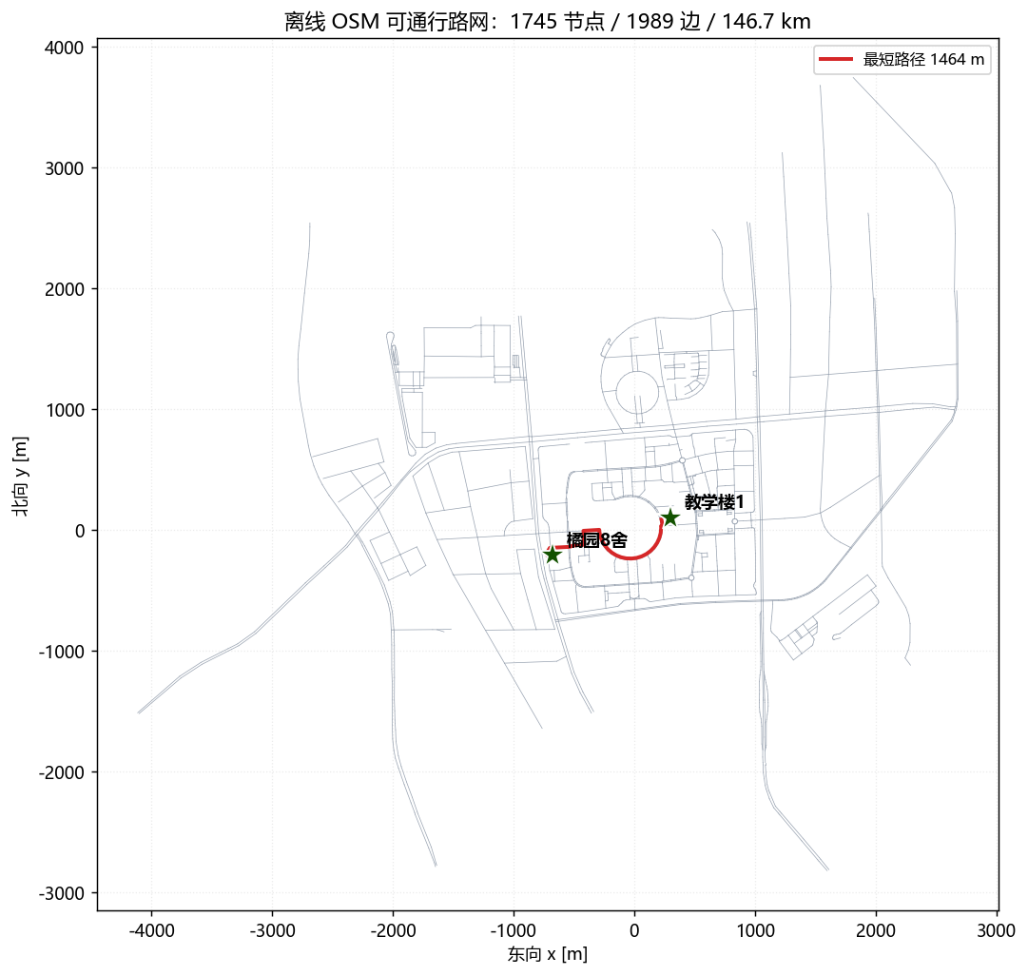
Map construction
Road network nodes
Road segments
1,745
1,989
After merging duplicate intersections
Drivable segments
Total network length
Connected components
146.7 km
1
Campus and surroundings
The whole graph is connected
Start and goal are first snapped to the nearest nodes (44.4 m / 74.5 m off), then Dijkstra is run.
This yields a 54-node, 1463.5 m polyline; 1450.6 m after filleting.
Fully offline, no network access.
Road network, with this route highlighted
03
Notes:
The map uses raw OSM data. I extracted the drivable roads around campus into a road network: 1745 nodes, 1989 edges, 146.7 km total length, and the whole graph is connected. The start and goal are first snapped to the nearest nodes, 44.4 m and 74.5 m off respectively, then Dijkstra is run, giving a 1463.5 m polyline.

Slide 26
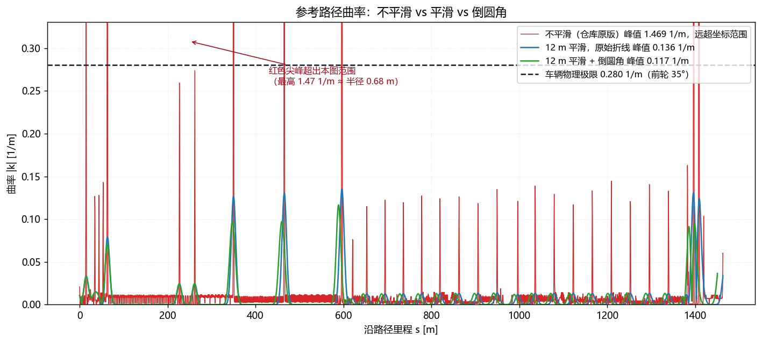
Reference path
The raw polyline has a radius of only 2.4 m at s = 589 m
Dashed line: the vehicle's curvature limit of 0.2801 1/m (front wheel 35°, wheelbase 2.50 m); the raw polyline exceeds it by 5.7 times
Limit
Raw polyline
1.6049 1/m (R 0.62 m)
After Gaussian smoothing
0.1355 1/m
Then filleted
0.1166 1/m
Curvature along the distance: smoothing accounts for 92% of the reduction, filleting a further 14%
04
Notes:
This is where the biggest problem was. Taken as-is, the polyline has a peak curvature of 1.6049, a radius of only 0.62 m. With a 35-degree front-wheel limit and a 2.5 m wheelbase, this car's curvature limit is 0.2801, corresponding to a 3.57 m radius — the raw polyline exceeds it by 5.7 times and is physically impossible to drive. I did two things: Gaussian smoothing of the curvature first, then filleting the corners. Curvature came down to 0.1166. Smoothing accounted for 92% of the reduction and filleting only 14%.

Slide 27
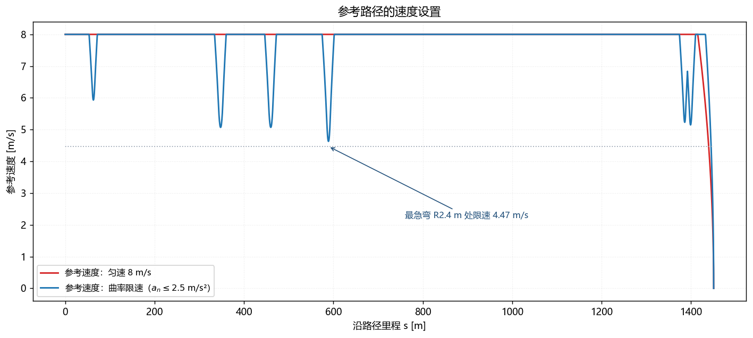
Speed profile
v = √(alat,max / κ)
Peak lateral acceleration
Planned deceleration
Deceleration lead distance
4.34 m/s²
1.75 m/s²
15 m
It is 7.30 at constant speed along the same path — a 41% reduction
Slope of the deceleration ramp, set to half the tyre limit
Length of the deceleration ramp before the curvature peak
The speed limit must be propagated point by point: scan the deceleration sections backwards and the acceleration sections forwards. Written as a one-shot array operation, neighbouring points are missed.
Speed profile, decelerating ahead of the sharp turns
05
Notes:
With the curvature in hand I can assign speeds: v equals the square root of the lateral-acceleration limit divided by the curvature. On the same route, the peak lateral acceleration is 7.30 at constant speed and drops to 4.34 under the curvature-based limit. I hit one pitfall here: the speed limit must be propagated point by point — scan the deceleration sections backwards and the acceleration sections forwards. I first wrote it as a one-shot array operation where each point only looks at itself, and the car simply would not slow down.

Slide 28
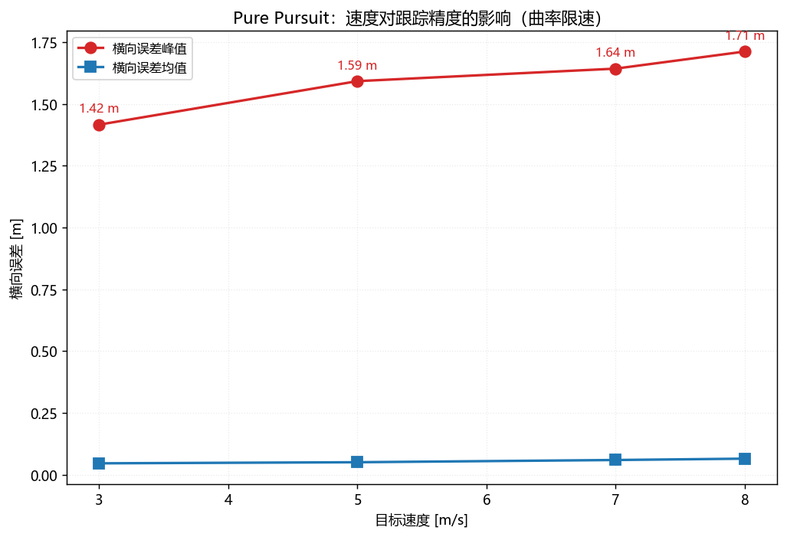
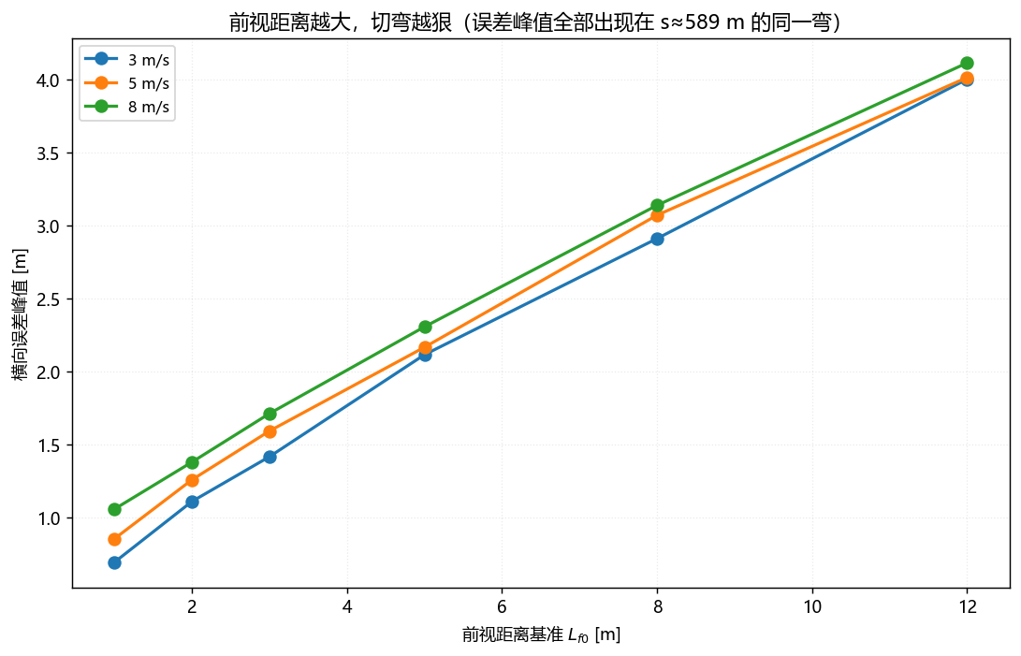
Look-ahead distance and speed
18 L_f sweeps; the peak error of every case falls at s ≈ 589 m
Peak error vs speed
Peak error vs look-ahead distance
Independent variable
Observed quantity
Trend
Increasing L_f (1 → 12 m)
Peak error
@8 m/s, from 1.06 m to 4.12 m
Increasing L_f (1 → 12 m)
Steering rate P95
@3 m/s, from 23.8 down to 1.8 °/s, reversals 463 → 1
Increasing speed (3 → 8 m/s)
Peak error
At L_f = 3 m, from 1.42 m to 1.71 m
06
Notes:
This page sweeps two parameters: the look-ahead distance from 1 to 12 m and the speed from 3 to 8 m/s, 18 simulations in total. As the look-ahead grows, the peak error rises from 1.06 to 4.12 m, but the steering chatter falls from 23.8 to 1.8 degrees per second — you can only have one of line-following and smoothness. Raising the speed also raises the error: from 3 to 7 m/s the peak error goes from 1.42 to 1.64 m.

Slide 29
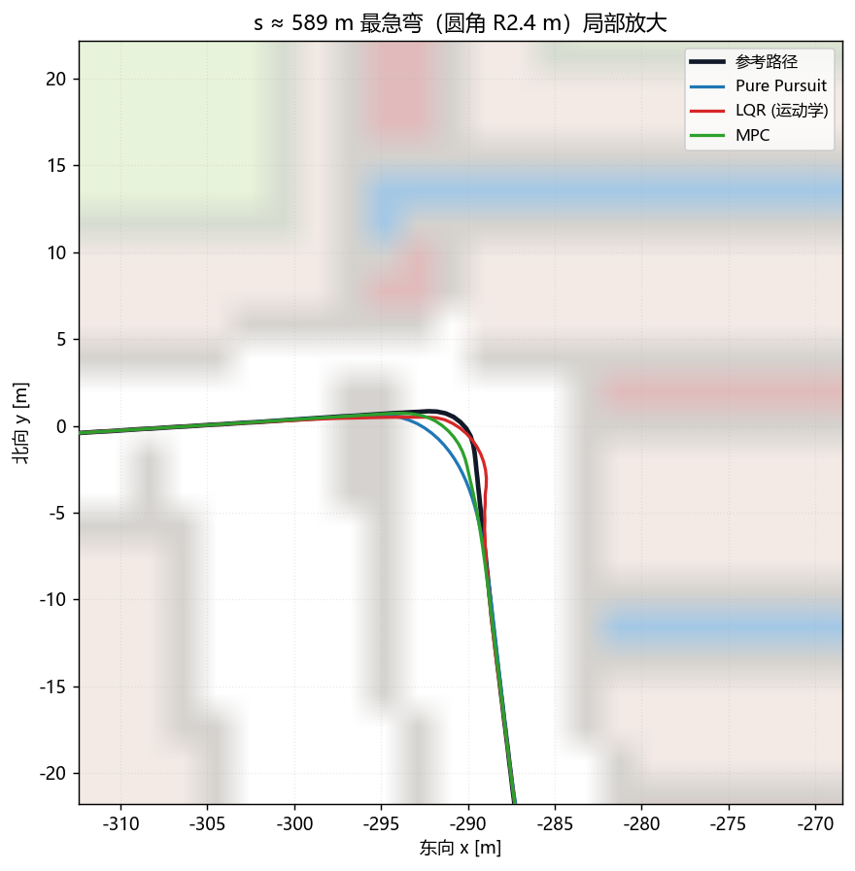
Four conclusions
Curvature smoothing has the largest effect
1
Same car, same speed, smoothing alone: 17.83 → 7.97 m/s²
The curvature-based speed limit lowers the lateral acceleration
2
Same route, constant speed 7.30 → limited 4.34 m/s², terminal error +0.31 m
The higher the speed, the larger the error
3
3 → 7 m/s, peak error 1.42 → 1.64 m, quantitatively confirming Problem 1
The look-ahead distance requires a trade-off
4
L_f 1 → 12 m: peak error 1.06 → 4.12 m, chatter 23.8 → 1.8 °/s
Amplified by the sharp bend at s ≈ 589 m; the peak error of the whole run is here
07
Notes:
Four conclusions. One: curvature smoothing has the largest effect — same car, same speed, adding smoothing alone takes the peak lateral acceleration from 17.83 down to 7.97. Two: the curvature-based speed limit pushes the lateral acceleration down from 7.30 to 4.34, at the cost of 0.31 m more terminal error. Three: the higher the speed, the larger the error — from 3 to 7 m/s the peak error rises from 1.42 to 1.64 m. Four: the look-ahead distance has to be a compromise. There is also a detail that stuck with me: the peak error of all 18 simulations falls at the same place — the sharp bend at about s = 589 m with a 2.4 m radius. The tracking-quality ceiling for the whole route is set by that one corner.

Slide 30
Southeast University
Thank you for listening
Comments and criticism welcome
Map construction · Reference path generation · Pure Pursuit implementation · Tracking visualisation · Experimental analysis
08
Course assignment for Intelligent Vehicles and Autonomous Driving
Notes:
That is my report. Thank you, and I welcome your comments.

