Slide 1
Part 2.
Three Key Variables
Analysis

Slide 2

Experimental Design
Background: path tracking is a fundamental capability of autonomous driving, requiring the vehicle to follow a reference path accurately
Objective: identify the key factors affecting tracking performance and how they act
Variables studied: control algorithm, target speed, and path geometry
Method: control-variable approach — change one variable at a time while holding the others fixed
Scope: ten experiment runs in total, all reaching the goal
Common settings: the same vehicle parameters, the same reference implementations, and unified evaluation metrics
Metrics: lateral error, steering angle, normal acceleration, yaw rate, and steering rate
Notes:
Today I will talk about two vehicle models and four control methods. Thirty of 31 tests finished the route.
Dynamic LQR had the smallest errors on the four built-in routes.
All tests used a kinematic model to move the car. The dynamic model helped design one controller. These results compare the controllers in this simulation.
Sources: reports/course_tasks/all_results.json; outputs/course_tasks; outputs/course_tasks_gpx; vdm_lab/common/bicycle_model.py; vdm_lab/student/lqr_dynamic.py.
All tests use the kinematic vehicle backend. Dynamic LQR stiffness conventions and discretization need further review.

Slide 3
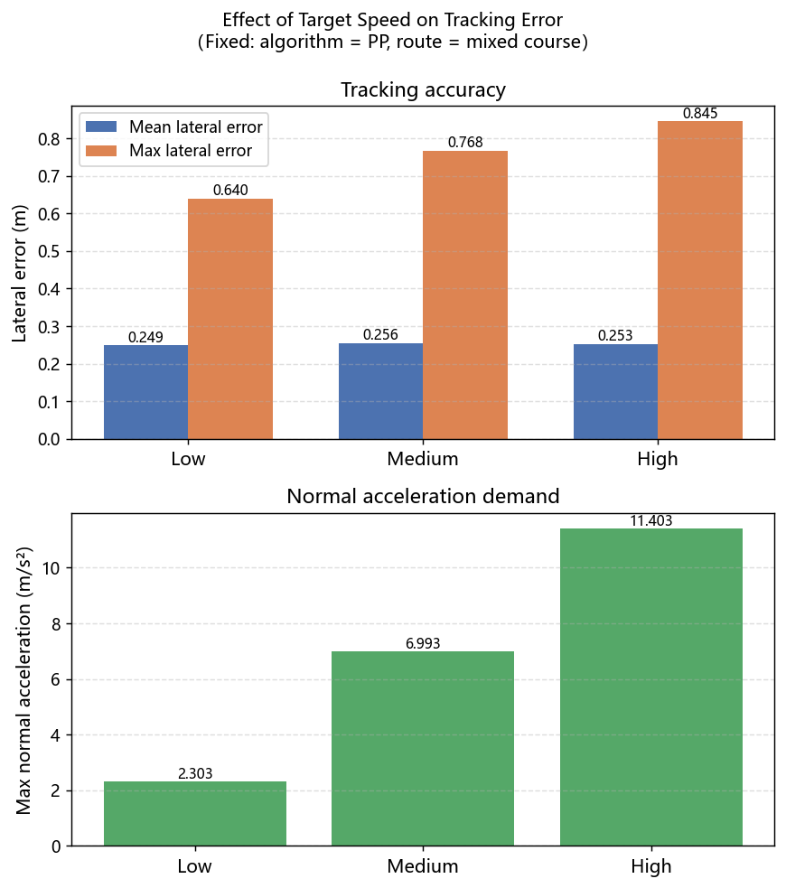
Effect of Target Speed
Comparison across three speed levels: low, medium, and high
As speed increases, the mean tracking error changes little
The peak error at sharp turns increases markedly, so the difficulty is concentrated in the transient
The normal acceleration grows with the square of speed, so the lateral demand rises sharply
The yaw rate grows linearly with speed, so the yaw response must be established faster
The steady-state steering angle is independent of speed, but the time available for correction shrinks with speed
Conclusion: tracking is harder at high speed because of the lateral load and the response time, not because of the steering angle magnitude
01
Notes:
Today I will talk about two vehicle models and four control methods. Thirty of 31 tests finished the route.
Dynamic LQR had the smallest errors on the four built-in routes.
All tests used a kinematic model to move the car. The dynamic model helped design one controller. These results compare the controllers in this simulation.
Sources: reports/course_tasks/all_results.json; outputs/course_tasks; outputs/course_tasks_gpx; vdm_lab/common/bicycle_model.py; vdm_lab/student/lqr_dynamic.py.
All tests use the kinematic vehicle backend. Dynamic LQR stiffness conventions and discretization need further review.

Slide 4
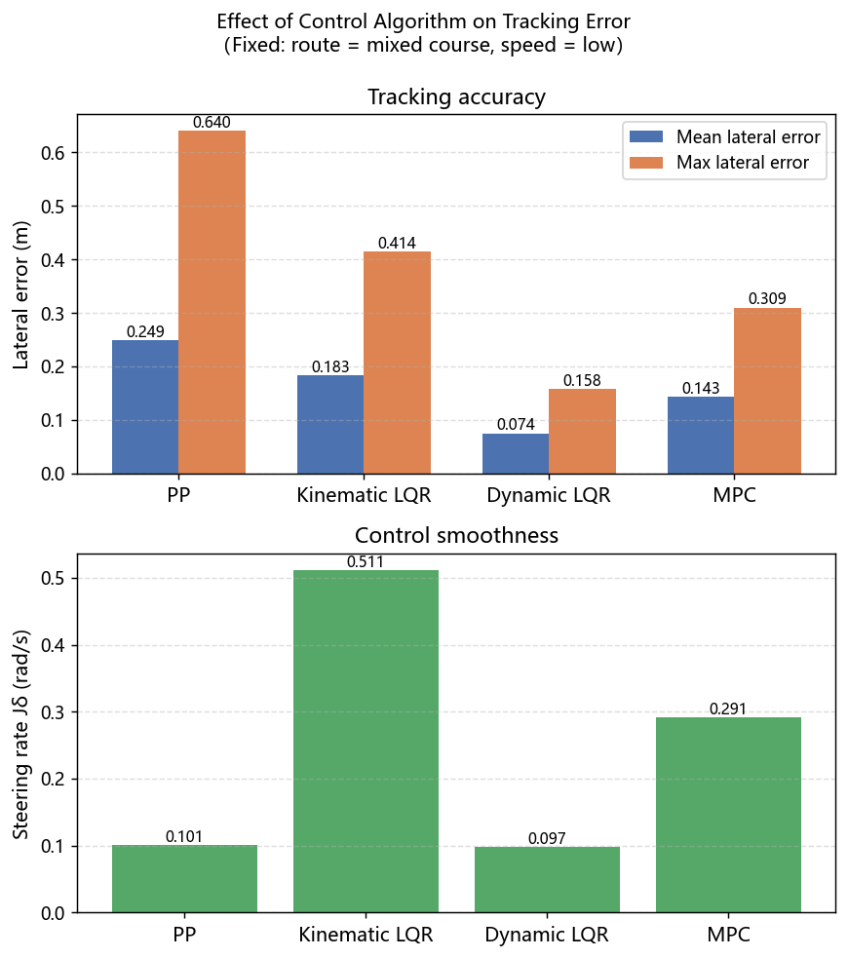
Effect of Control Algorithm
Four algorithms compared: Pure Pursuit (PP), kinematic LQR, dynamic LQR, and MPC
PP tracks using geometric relations; it is simple and produces the smoothest control
Kinematic LQR introduces error feedback, improving accuracy, but changes the steering angle most rapidly
Dynamic LQR accounts for tire sideslip and achieves the highest tracking accuracy with the smallest error along the path
MPC plans ahead through receding-horizon optimization, achieving the best endpoint convergence and the most accurate final position
Conclusion: no single algorithm is optimal on all metrics; the choice depends on the priority among accuracy, endpoint convergence, and smoothness
01
Notes:
Today I will talk about two vehicle models and four control methods. Thirty of 31 tests finished the route.
Dynamic LQR had the smallest errors on the four built-in routes.
All tests used a kinematic model to move the car. The dynamic model helped design one controller. These results compare the controllers in this simulation.
Sources: reports/course_tasks/all_results.json; outputs/course_tasks; outputs/course_tasks_gpx; vdm_lab/common/bicycle_model.py; vdm_lab/student/lqr_dynamic.py.
All tests use the kinematic vehicle backend. Dynamic LQR stiffness conventions and discretization need further review.

Slide 5
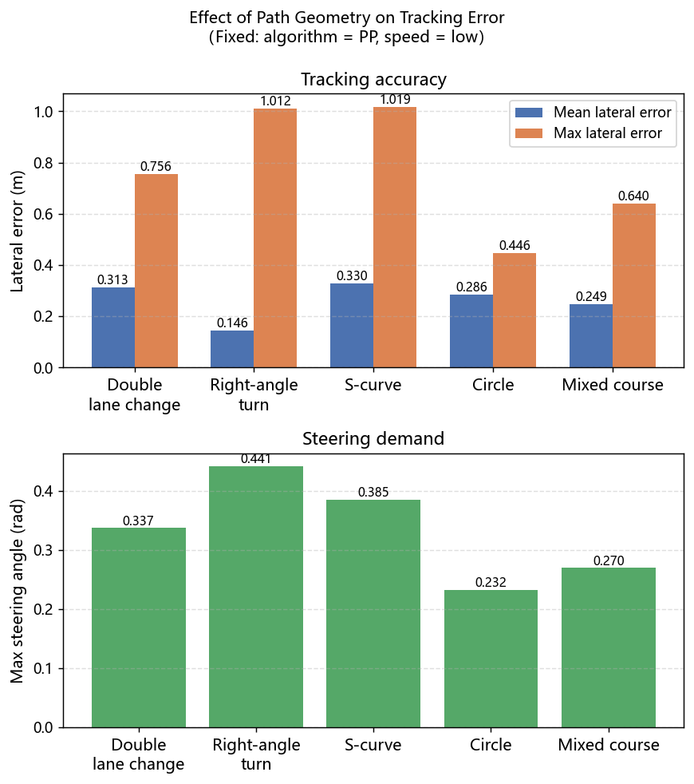
Effect of Path Geometry
Five routes compared: double lane change, right-angle turn, S-curve, circle, and mixed course
The double lane change involves consecutive lane changes with rapid reversal of curvature sign, stressing the transient response
The right-angle turn has a step change in curvature, producing a prominent error spike
The S-curve alternates positive and negative curvature and is the hardest to track, with the largest peak error
The circular path of constant curvature is the easiest, with the smallest error
Conclusion: a curvature discontinuity is harder to handle than the curvature magnitude itself; smooth geometry is easier to track
01
Notes:
Today I will talk about two vehicle models and four control methods. Thirty of 31 tests finished the route.
Dynamic LQR had the smallest errors on the four built-in routes.
All tests used a kinematic model to move the car. The dynamic model helped design one controller. These results compare the controllers in this simulation.
Sources: reports/course_tasks/all_results.json; outputs/course_tasks; outputs/course_tasks_gpx; vdm_lab/common/bicycle_model.py; vdm_lab/student/lqr_dynamic.py.
All tests use the kinematic vehicle backend. Dynamic LQR stiffness conventions and discretization need further review.

Slide 6
Conclusion
The control algorithm determines tracking accuracy: dynamic LQR is the most accurate, MPC has the best endpoint accuracy
The target speed determines the transient difficulty: high speed amplifies the peak error at sharp turns
The path geometry determines the peak error: a curvature discontinuity is harder to track than its magnitude
The three variables act on different aspects of tracking and can compound with one another
Engineering implications: choose the algorithm by scenario, reserve a lateral margin at high speed, and smooth the response ahead of sharp turns
Limitations: simplified simulation models; normal acceleration is a reference value; the geometry dimension was verified with only a single algorithm
Notes:
Today I will talk about two vehicle models and four control methods. Thirty of 31 tests finished the route.
Dynamic LQR had the smallest errors on the four built-in routes.
All tests used a kinematic model to move the car. The dynamic model helped design one controller. These results compare the controllers in this simulation.
Sources: reports/course_tasks/all_results.json; outputs/course_tasks; outputs/course_tasks_gpx; vdm_lab/common/bicycle_model.py; vdm_lab/student/lqr_dynamic.py.
All tests use the kinematic vehicle backend. Dynamic LQR stiffness conventions and discretization need further review.

