Slide 1
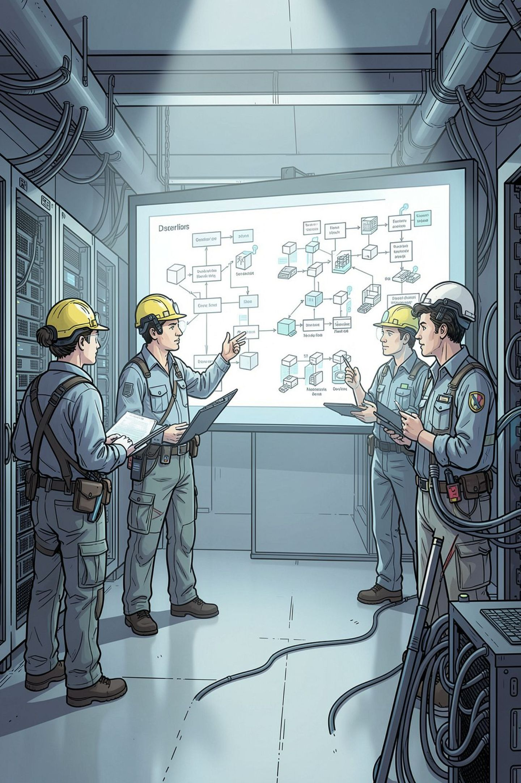
Lumen Academy — Database Schema & Architecture
Assessment engine and LMS built for NEET, JEE Main, and JEE Advanced. PostgreSQL 16 on Supabase, Prisma v6.14.0. 36 Prisma models across 11 domain modules. Security-first design: server-controlled clocks, IDOR-proof authorization, and zero answer leakage.

Slide 2

Core Architectural Principles — 4 Non‑Negotiable Schema Laws
Zero-Leak Answer Keys
Server-Controlled Clocks
Fields like isCorrect and numericalAnswer live only on server-side snapshots and are never selected or returned before attempt submission.
startedAt, deadlineAt, and sectional lockedAt are authoritative on server time — client clocks are untrusted.
IDOR-Proof Authorization
Immutable Result Freeze
Every student row ties to userId or to a parent entity owned by that userId to prevent access-by-id guessing.
AttemptQuestion snapshots question stem, options, marking rules, and answer keys at submit time — edits never touch historical scores.

Slide 3



11 Domain Modules — 36 Prisma Models
Concise module list and representative Prisma models for each domain. This structure guides ownership, RBAC boundaries, and rollup responsibilities for analytics and grading.
01 — Identity & Security
02 — Syllabus Taxonomy
03 — Question Bank
User, StudentProfile, UserPreference, AuditLog
Subject, Unit, Topic
Question, Option — supports 5 interaction formats

Slide 4

Identity & Profile Architecture
Primary user model maps to Supabase auth; optional fields for email/phone and role-based defaults. StudentProfile feeds the AIR rank predictor via categorical inputs.
AIR Rank Inputs
Audit & Compliance
StudentProfile.category (GENERAL, EWS, OBC_NCL, SC, ST) and StudentProfile.state — used to calculate home‑state quotas and cutoffs.
AuditLog stores hashed IP and privileged-action records for forensic review and compliance.

Slide 5





Question Bank — 5 Interaction Formats & Review Lifecycle
SINGLE_CORRECT
MULTIPLE_CORRECT
NUMERICAL
Standard 4-option MCQs used for NEET/JEE Main.
Multiple answers with partial marking contracts for advanced exams.
Integer/decimal inputs graded with numericalTolerance metadata.
MATCHING
ASSERTION_REASON
Left/right matrix mappings with validation rules and UI hints.
Paired statements with combined correctness logic and partial scoring.
Editorial pipeline: DRAFT → PENDING_REVIEW → PUBLISHED → RETIRED with human critic paths and versioning.

Slide 6

Define Test Template
Create Attempt Instance
Submit: Snapshot AttemptQuestion
Separation of template and instance preserves templates for reuse while attempts hold authoritative, immutable snapshots used for grading and audit.

Slide 7

Attempt Engine — Sectional Timing & Autosave
Sectional Clock Enforcement: Independent AttemptSection.lockedAt values let sections lock separately (required for JEE sectional rules).
Autosave Resilience: AttemptQuestion uses upsert semantics keyed by (attemptId, questionId) to support intermittent connectivity.
Scoring: Server computes marks at submission time using snapshotted rules; no client-side scoring trusted.

Slide 8
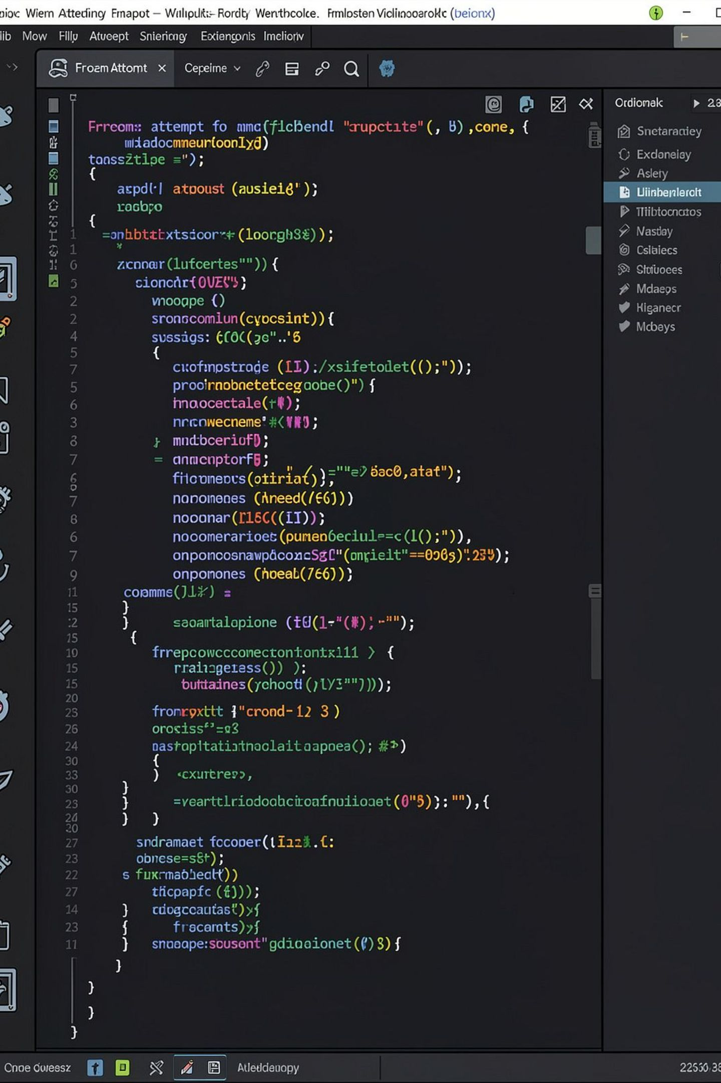

Law 4 — Immutable Snapshotting (Example)
{ "attemptId": "att-9901", "questionId": "q-4412", "contentSnapshot": { "stemEn": "What is unit vector magnitude?" }, "correctOptionIdsSnapshot": ["opt-a-uuid"], "marksSnapshot": 4, "negativeMarksSnapshot": 1, "marksAwarded": 4, "isCorrect": true }
Business value: Corrections to live Question records never retroactively change historical student scores or transcripts.

Slide 9




LMS, Gamification & Productivity Tools
Integrated content and retention features designed to increase daily active use and learning efficacy.
Lesson Video
Gamification
Productivity Suite
Timestamps, bookmarks, and watch-percentage tracking (LessonVideo, VideoTimestamp, LessonProgress).
Streak, Badge, DailyGoal, push Notification queue.
PomodoroSession, StudyPlan (AI-generated timetables), Flashcard, RevisionNote.

Slide 10
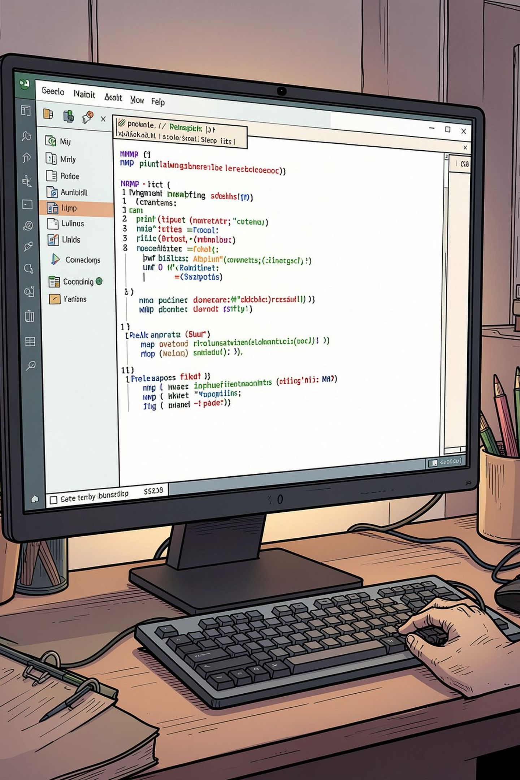
Developer Operations & Production Status
CLI and CI workflows ensure schema validity, type safety, and deployable artifacts.
DB Validation
Client Generation
Model Verification
npm run db:validate — schema syntax and relation checks.
npm run db:generate — generate type-safe @prisma/client.
npm run db:verify-all — populate and sanity-check all 36 models.
Studio & Typecheck
npm run db:studio; npm run typecheck passed clean on PostgreSQL 16 (Supabase).
Production note: All models validated and deployed with zero TypeScript errors. Follow-up items: formalize backup/restore SLAs, run periodic snapshot audits, and codify emergency rollback procedures.

