Slide 1
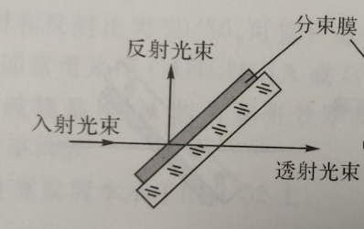
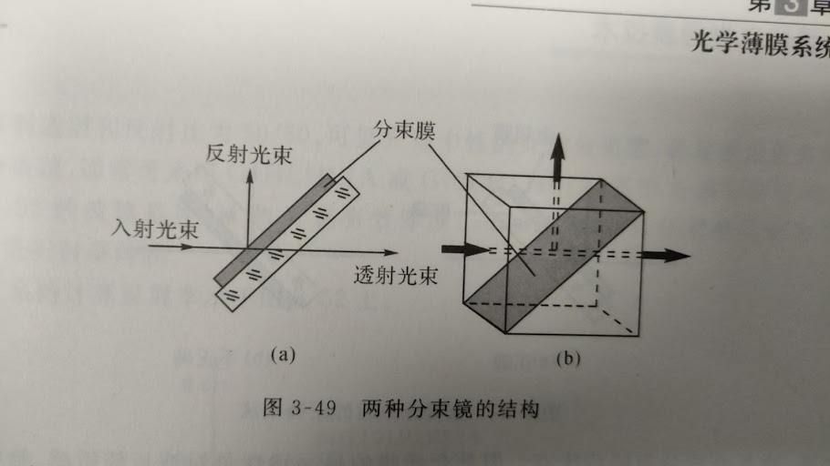
Beam splitting coating
Beam splitting coating
reflected light
reflected light
Incident light
Incident light
transmitted light
transmitted light

Slide 2
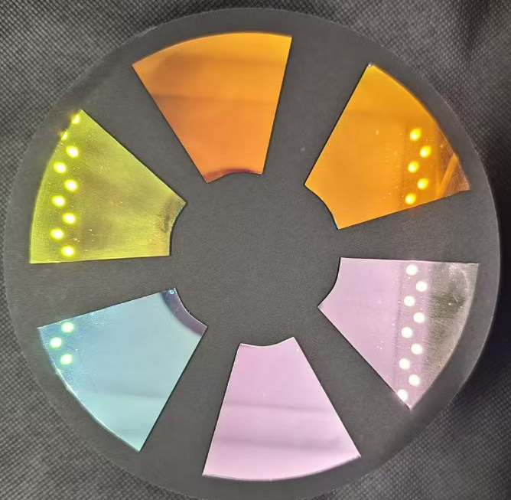
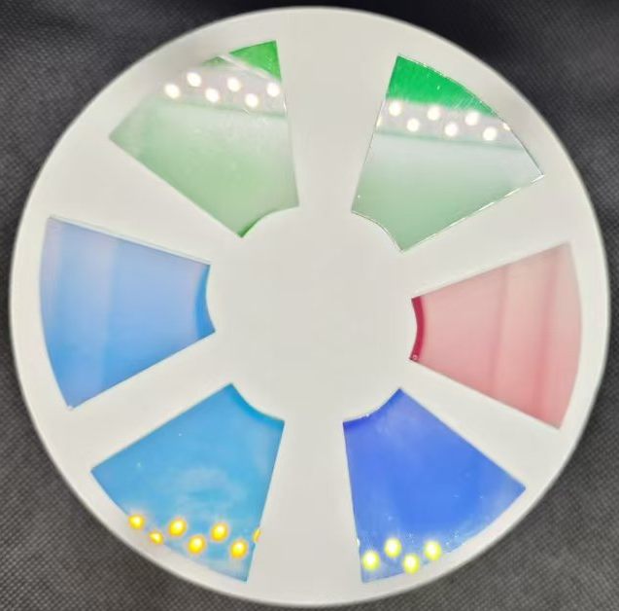
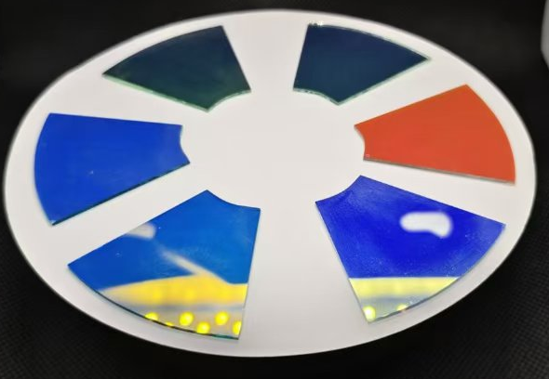
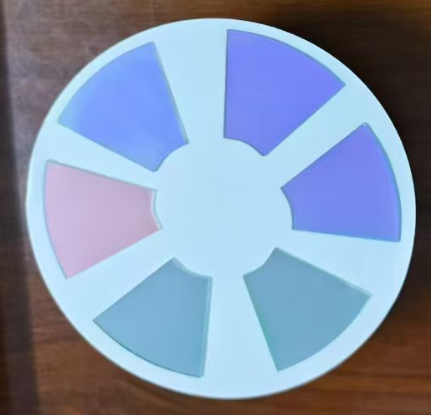
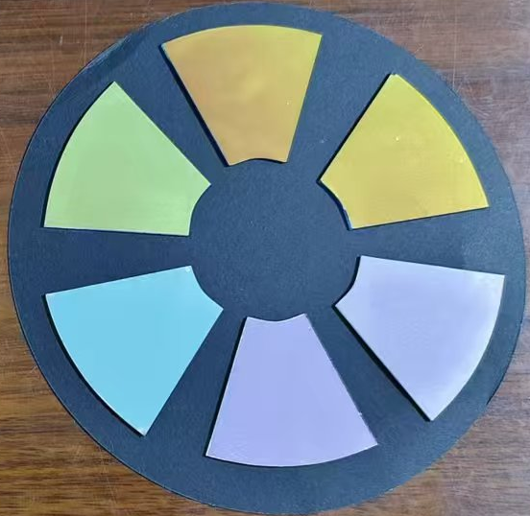

Slide 3
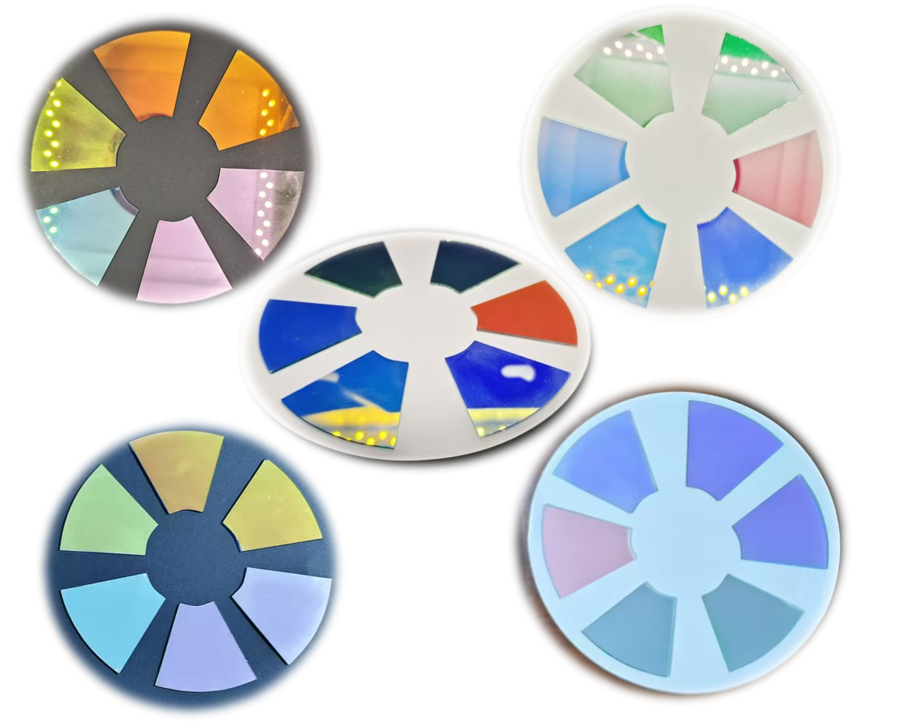

Slide 4
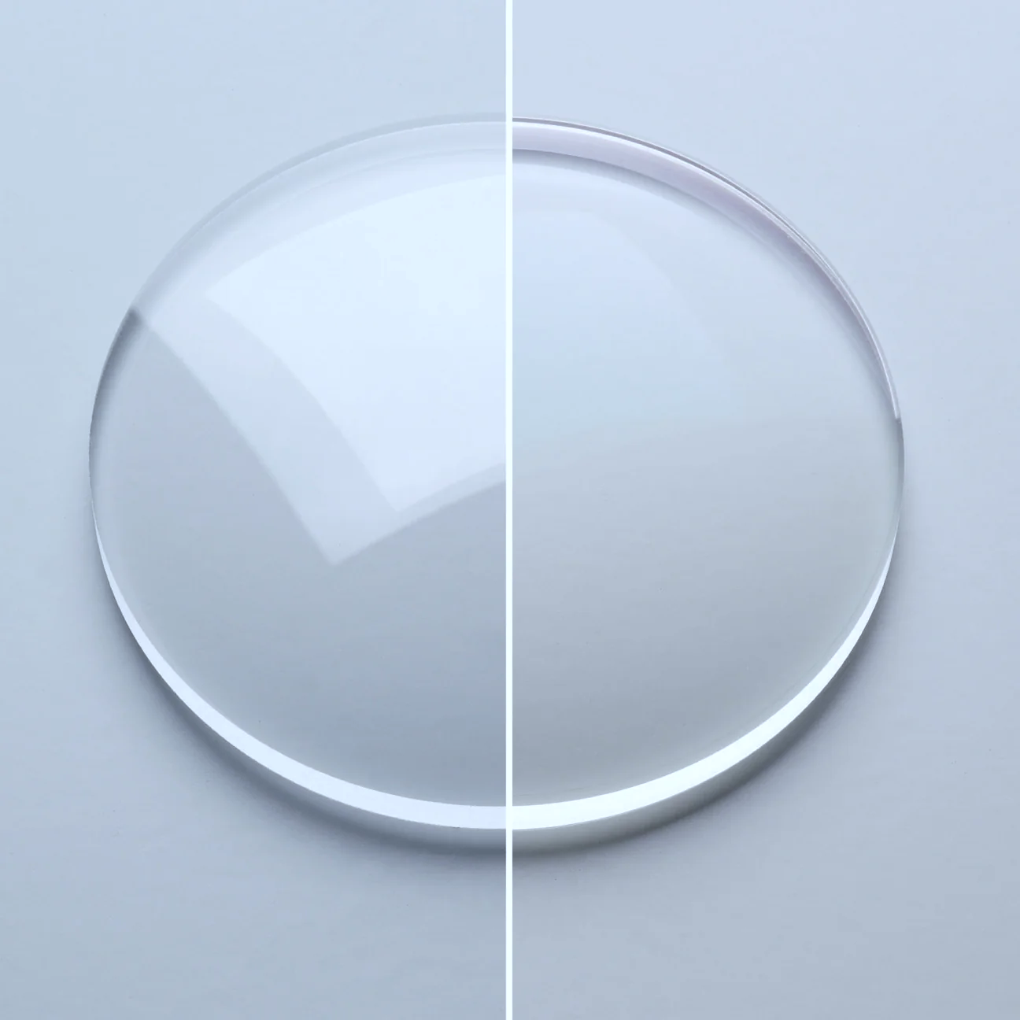
没有减反膜
Without AR Coating
镀了减反膜
With AR Coating

Slide 5
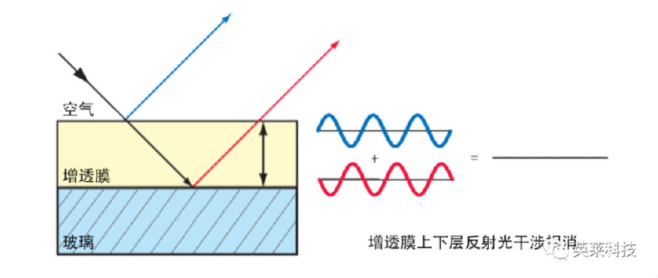
空气
Air
减反膜
AR Coating
玻璃
Glass
上下层的反射光通过干涉被抵消
The reflected light from the upper and lower layers is cancelled out by interference

Slide 6
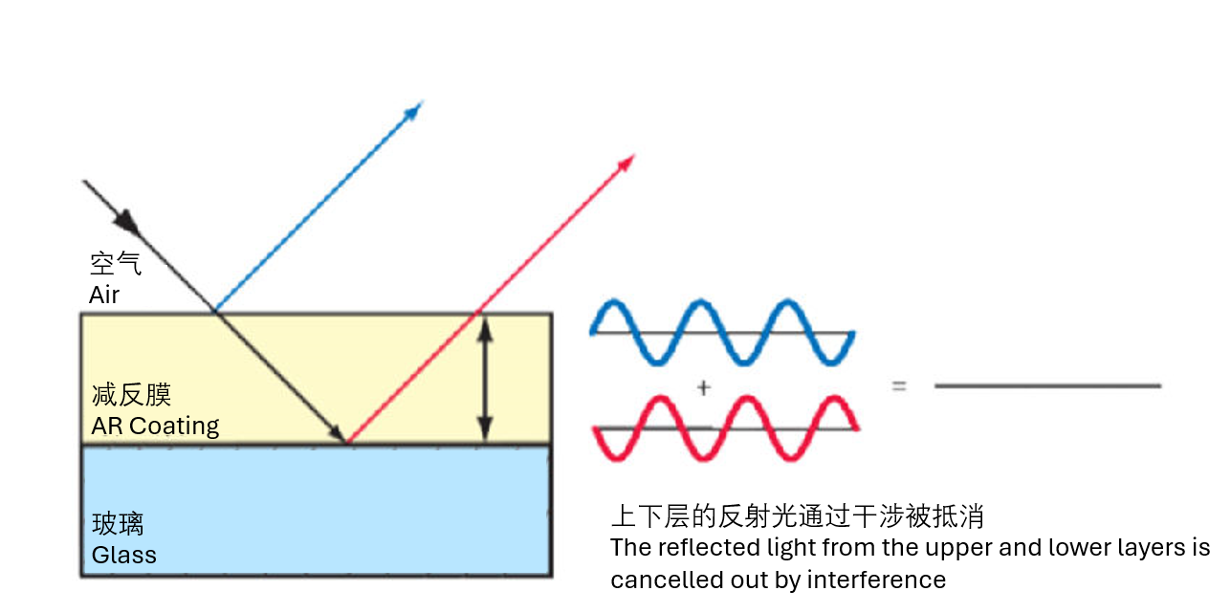

Slide 7
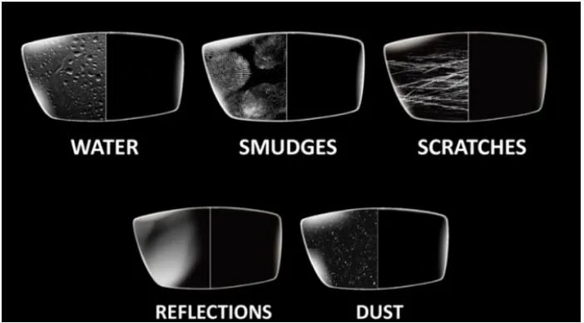

Slide 8
没有防水膜
Without Hydrophobic coating
镀了防水膜
With Hydrophobic coating

Slide 9
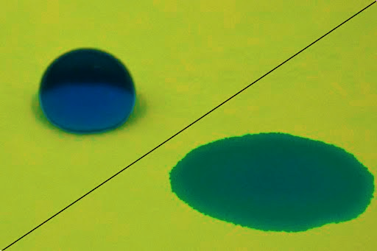
防水膜
Hydrophobic coating
亲水膜
Hydrophilic coating

Slide 10
