Slide 1
IPC144
Introduction to Programming Using C
Week 4 – Lesson 1
(Pages 38 to 46 in IPC144 Textbook)

Slide 2
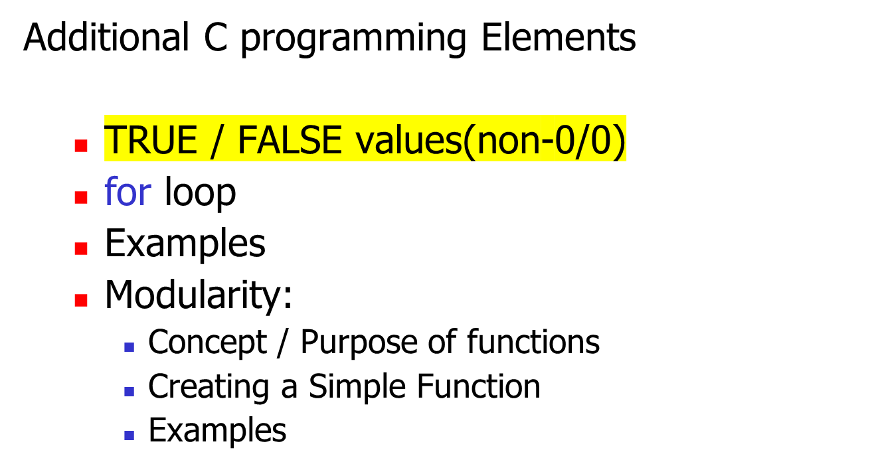
Agenda

Slide 3
TRUE / FALSE Values
So far, we have learned how to test conditions with logic such as an if / else if statement, or test conditions with an indeterminate loops such as a while or do-while statement.
In the C programming language, the TRUE result from testing a condition returns the value non-0, and 0 indicates a FALSE result.

Slide 4

TRUE / FALSE Values
Below is an example of a program that uses values in a while loop:
int x = 1, count = 0;
while(x)
{
printf (“This is a line\n”);
if ( count > 3 )
x = 0;
count = count + 1;
}
When count become “3” then
next time condition is checked, result
becomes 0 (FALSE) thus exits loop.
Each time loop occurs, value of
count is increased by a unit.

Slide 5
Practice
REALITY CHECK (Week 4 – Lesson 1)
  Questions #1 (Walk-thru)

Slide 6
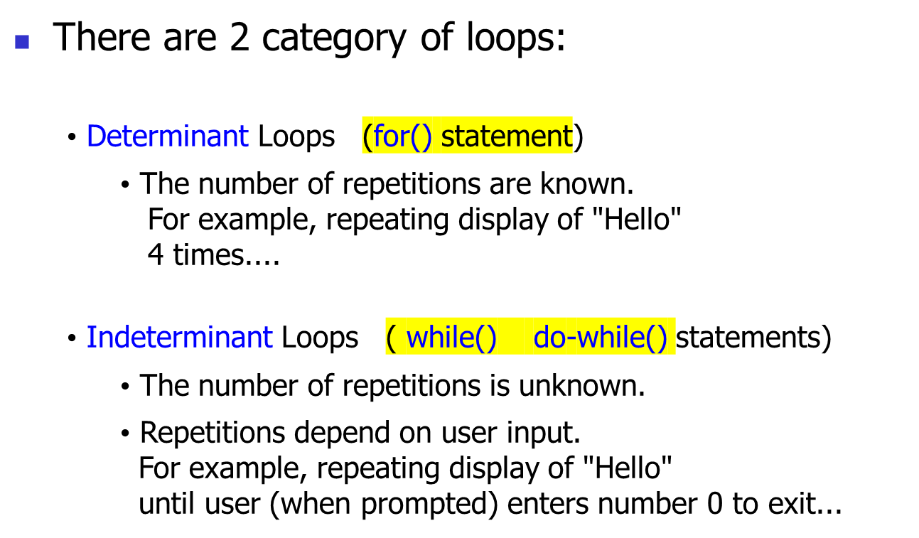
Loops

Slide 7
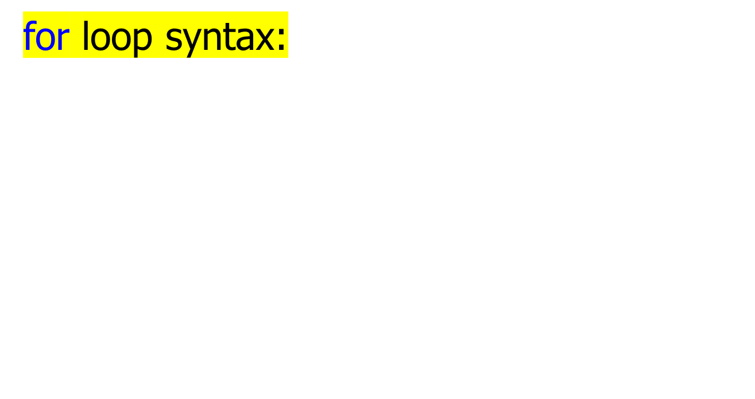
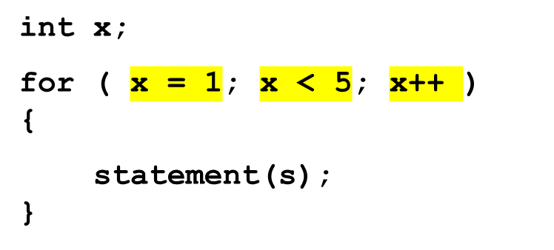
Loops
Inside brackets are 3 items:
- x is initially given a value.
- x is compared to a condition
- value of x is increased by 1
If condition tests TRUE,
then execute statement(s)
in code block. If FALSE,
exit for statement…

Slide 8
Practice
REALITY CHECK (Week 4 – Lesson 1)
  Questions #2 (Word Problem)

Slide 9
Modularity / Functions
As you are starting to work on your assignment #1, you may notice how quickly the coding of even a simple program can get complex.
The major technique for dealing with this complexity is to subdivide a program into a series of smaller program, sometimes called modules or functions.

Slide 10
Modularity / Functions
Perhaps without you knowing it, you have already been using these smaller programs (i.e. functions).
When you put at the top of your program, you are instructing #include<stdio.h> the compiler to link to the “Standard Input/Ouput library” containing such functions (statements to you) as printf() or scanf().

Slide 11
Modularity / Functions
Just like printf() and scanf() functions, you can create your own function to help complete a task.
Some functions ( like printf() and scanf() ) can contain data within the bracket to be used by the function.
Other functions, can simply run without containing data within the bracket…

Slide 12

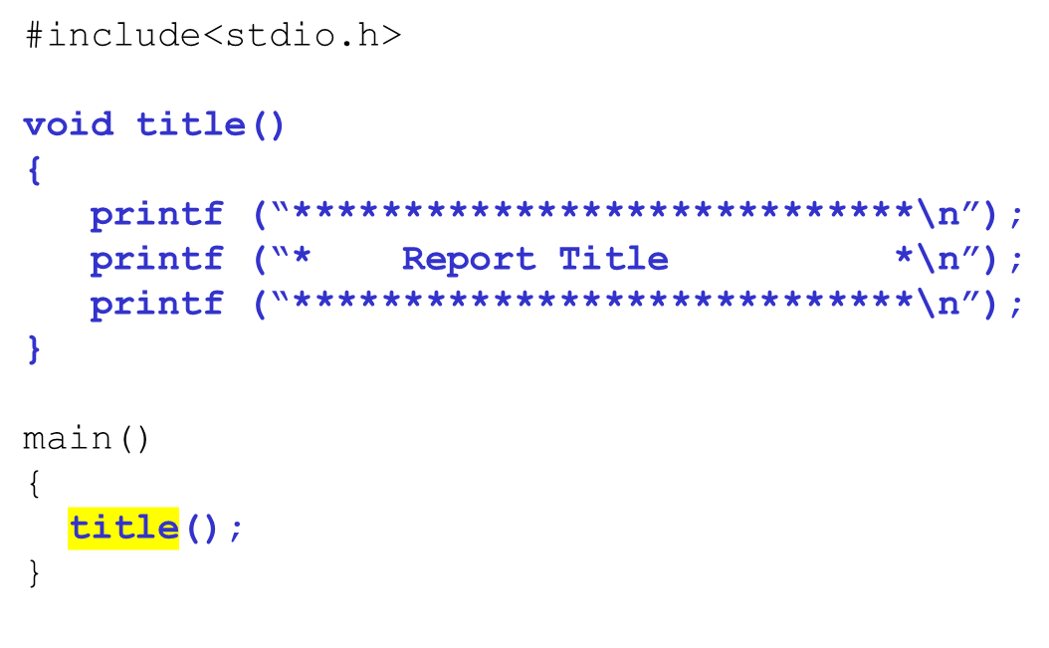
Here is an example:
Just like variables
must indicate the
type of data returned
from a function. If no
data returned, use
void data-type…
The function title() has already
been defined, and when the main()
program runs, the function is run
by calling it by name…

Slide 13
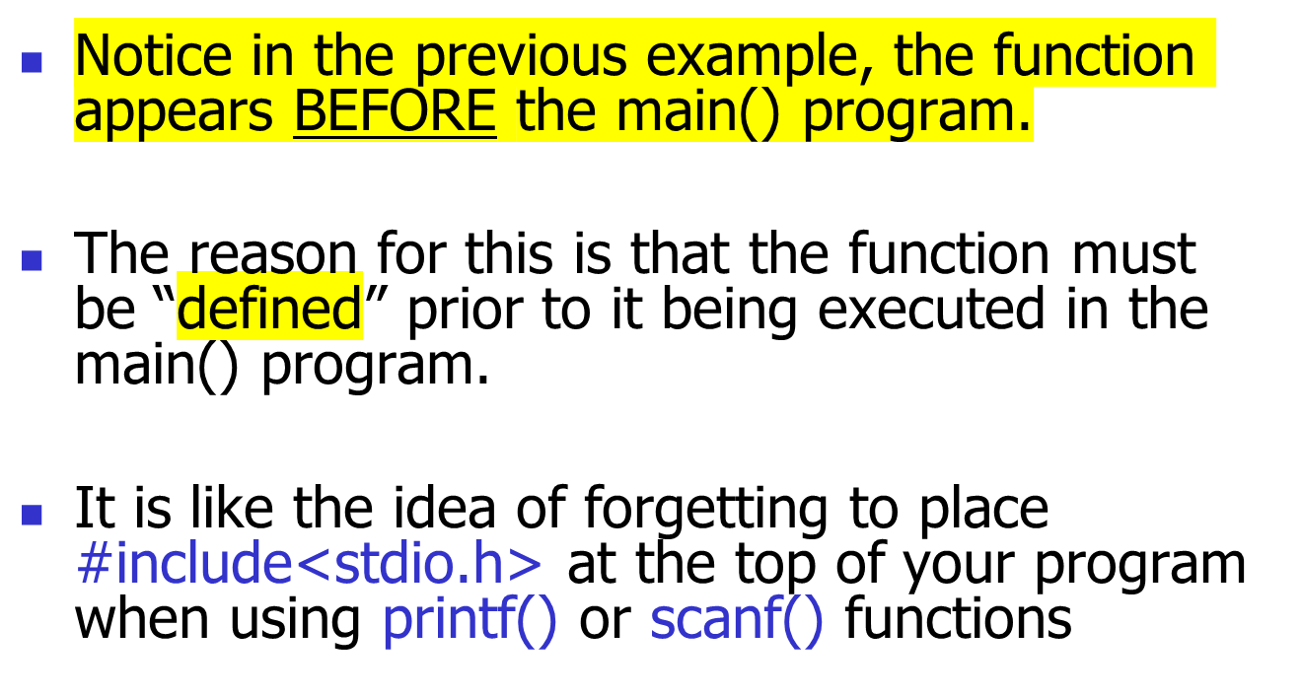
Modularity / Functions

Slide 14
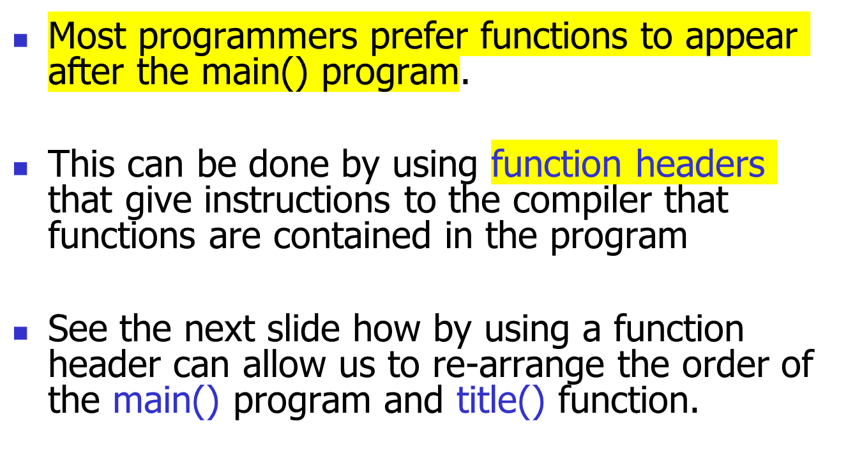
Modularity / Functions

Slide 15
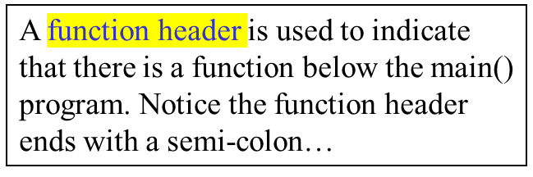
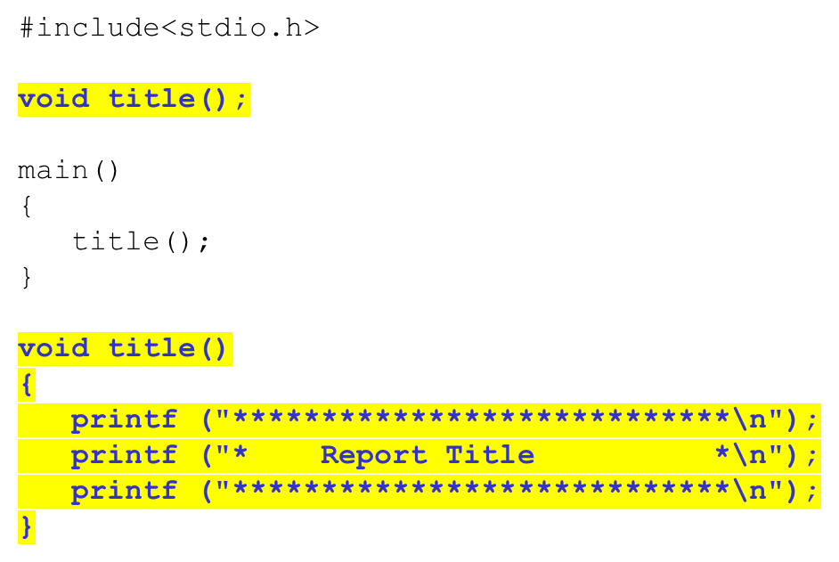
Modularity / Functions
Here is an example:

Slide 16
Practice
REALITY CHECK (Week 4 – Lesson 1)
  Questions #3 (Word Problem)

Slide 17
Homework
TASK #1
  Complete lab #3 since it is due at the beginning of this week’s lab!
TASK #2
  Study for a quiz to be held in this week’s lab based on material taught last week
TASK #3
  Complete and code the solutions for today’s REALITY CHECK QUESTIONS, as well as “hide” and repeat the walk-thru questions
TASK #4 *** Highly Recommended ***
  Read ahead in IPC144 Programming Notes (Modularity / Functions).

