Slide 1
IPC144
Introduction to Programming Using C
Week 5 – Lesson 1
(Pages 38 to 46 in IPC144 Textbook)

Slide 2
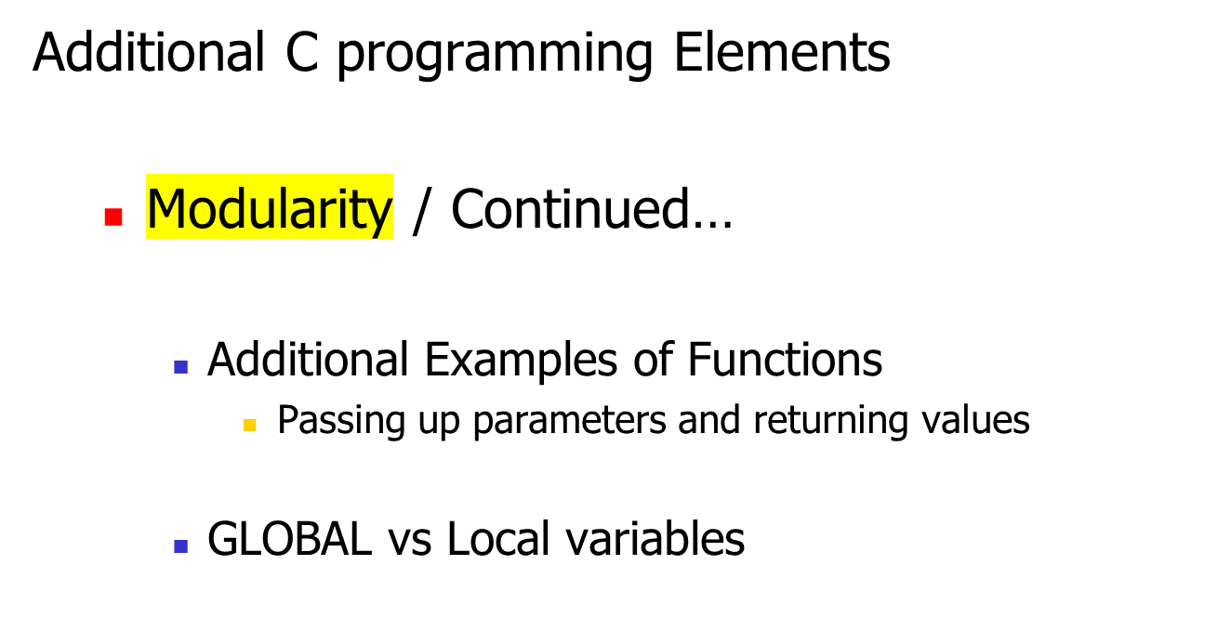
Agenda

Slide 3
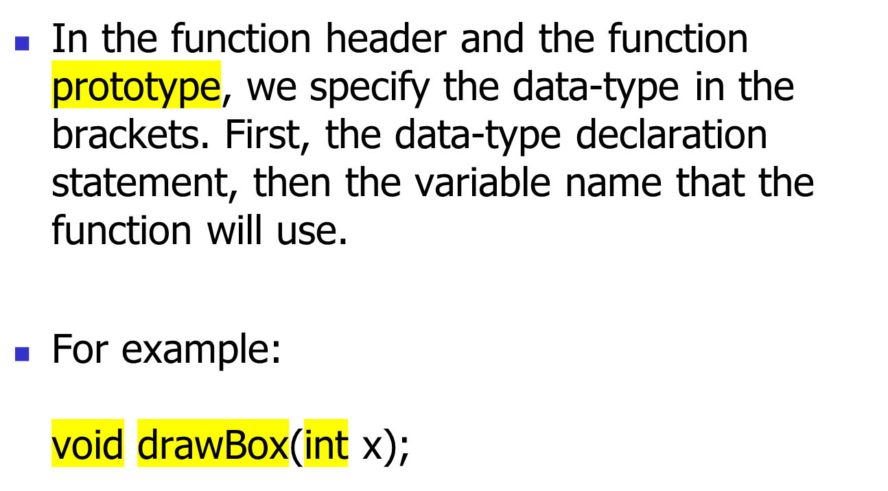
Modularity
We will be learning
later in this course
how to work with
characters and text
(character strings)…

Slide 4
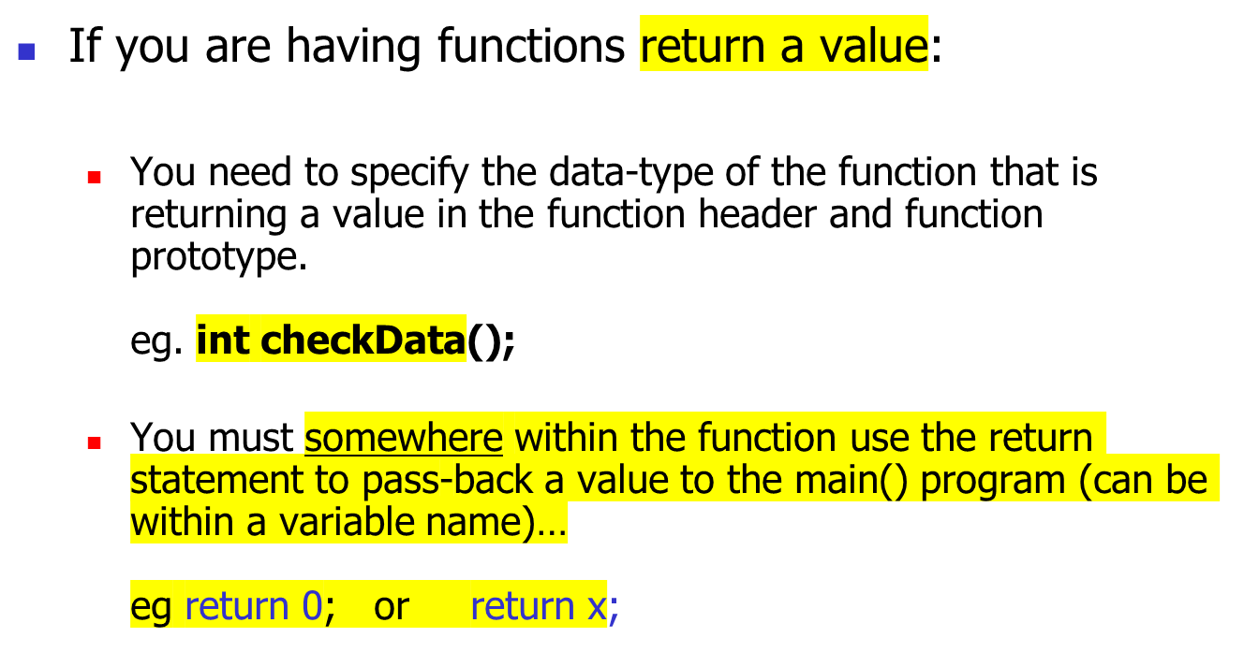
Modularity

Slide 5
Modularity
Of course, functions can accept and return double data-types as well…
Later in this course, we will learn other data-types such as characters, which can be used for a function to accept and/or return as well…

Slide 6
Practice
REALITY CHECK (Week 5 – Lesson 1)
  Question #1 (Word Problem)
  Question #2 (Walk-Thru)
  Question #3 (Walk-Thru)

Slide 7
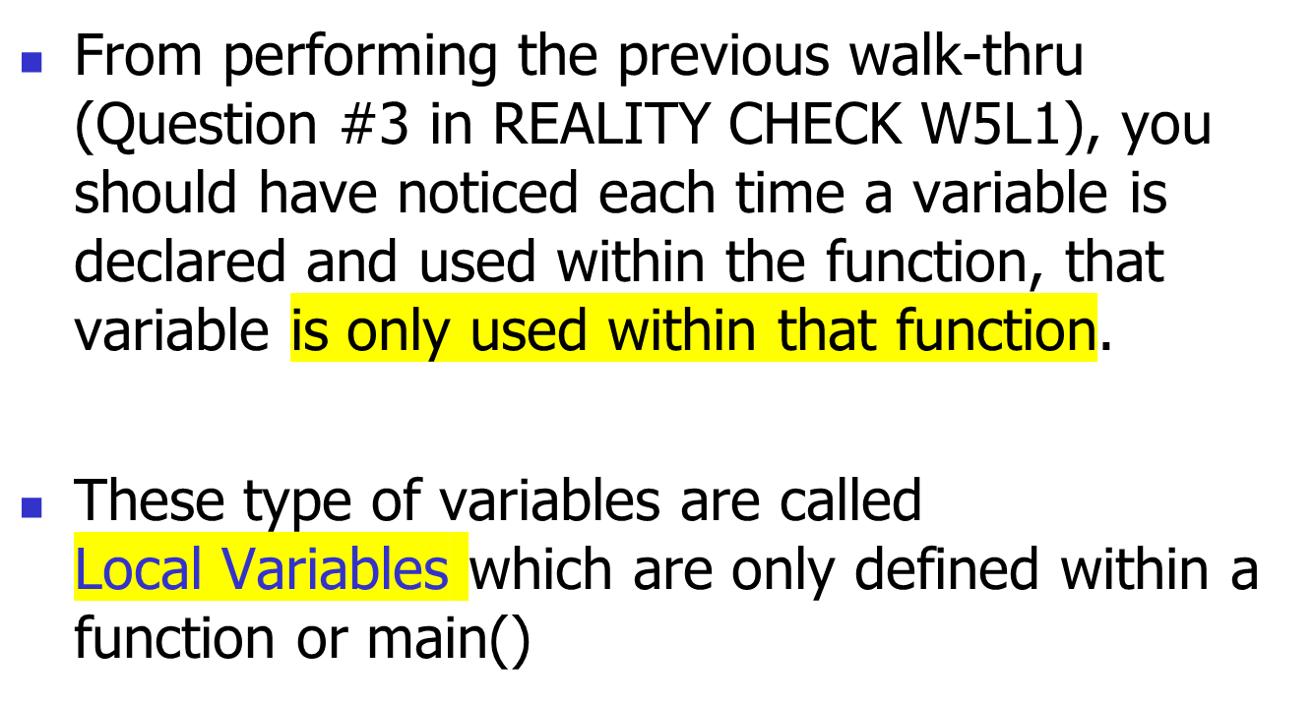
Local Variables

Slide 8
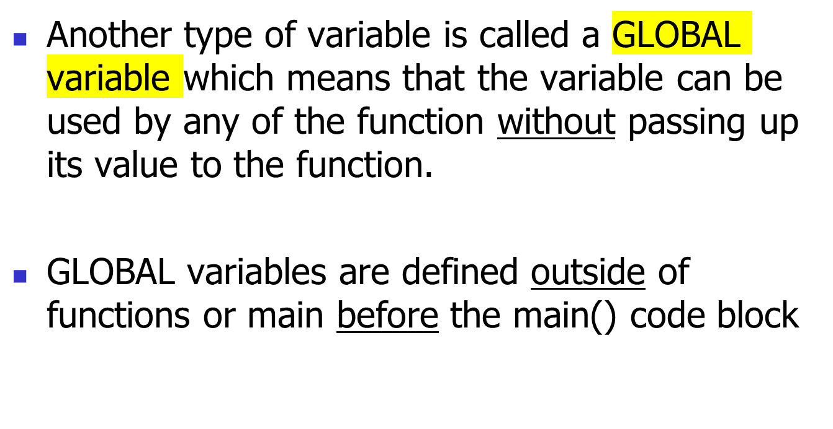
GLOBAL Variables

Slide 9
GLOBAL Variables
For Example:
#include <stdio.h>
int NUM = 1;
void function_1 (void);
int main (void)
{
printf ("NUM = %d\n", NUM);
function_1();
printf ("NUM = %d\n", NUM);
return 0;
}
void function_1 (void)
{
NUM = NUM + 5;
}
The integer NUM is declared
and assigned value outside
main or function code blocks
The GLOBAL variable is changed
in the function and thus main program
as well without passing values to function
or having values returned… This is dangerous!

Slide 10
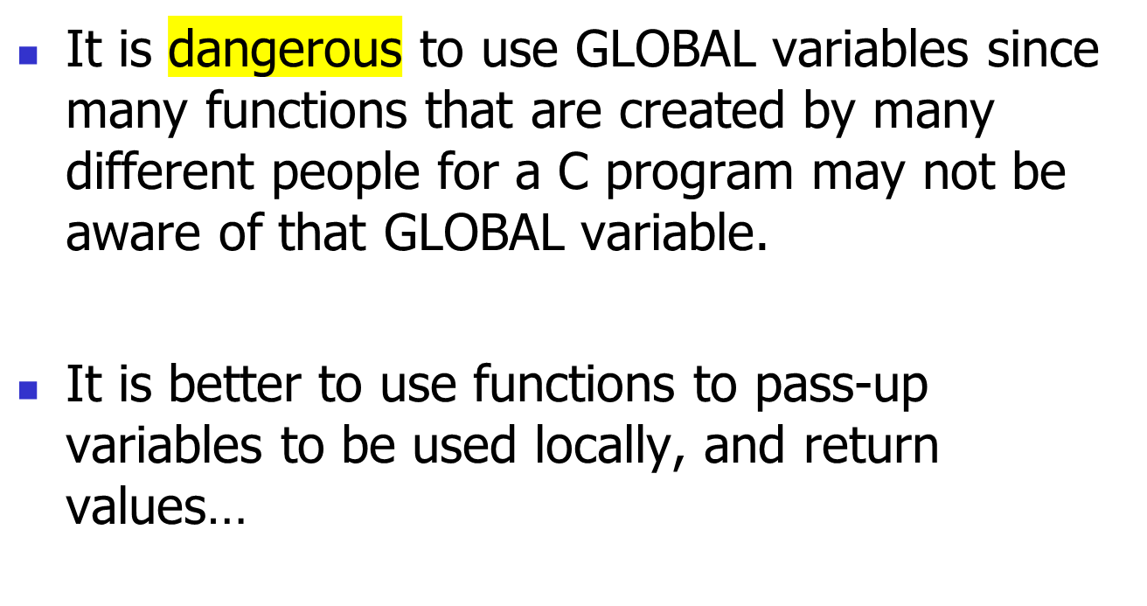
GLOBAL Variables

Slide 11
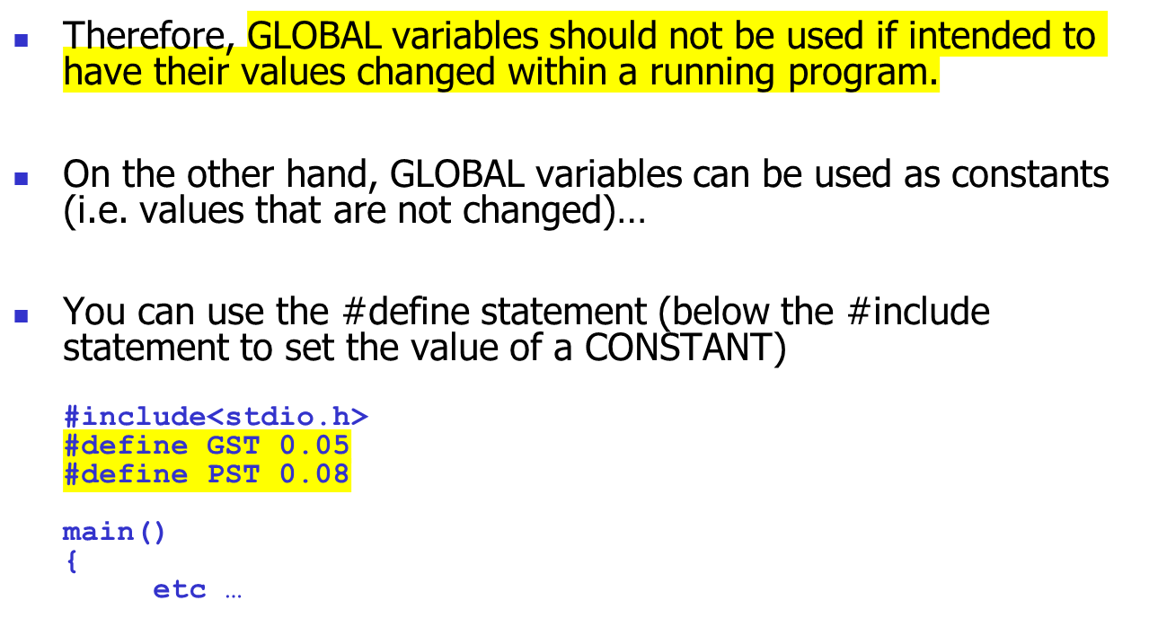
GLOBAL Variables

Slide 12
Practice
REALITY CHECK (Week 5 – Lesson 1)
  Question #4 (Word Problem)

Slide 13
Homework
TASK #1
  Complete lab #4 since it is due at the beginning of this week’s lab!
TASK #2
  Study for a quiz to be held in this week’s lab based on material taught last week
TASK #3
  Complete and code the solutions for today’s REALITY CHECK QUESTIONS, as well as “hide” and repeat the walk-thru questions
TASK #4 *** Highly Recommended ***
  Read ahead in IPC144 Programming Notes (Pointers).

