Slide 1
IPC144
Introduction to Programming Using C
Week 6 – Lesson 1
(Pages 47 to 51 in IPC144 Textbook)

Slide 2
Agenda
Additional C programming Elements
  Pointers
    Purpose
    Passing Pointers to Functions
    Indirection
    Example

Slide 3
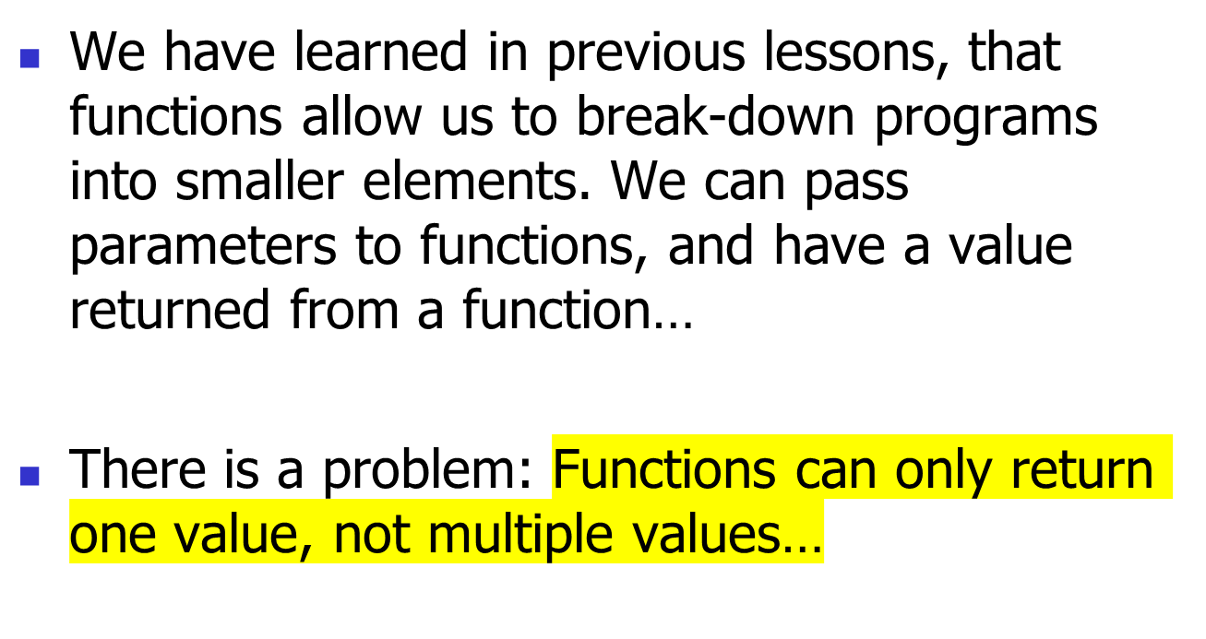
Modularity

Slide 4

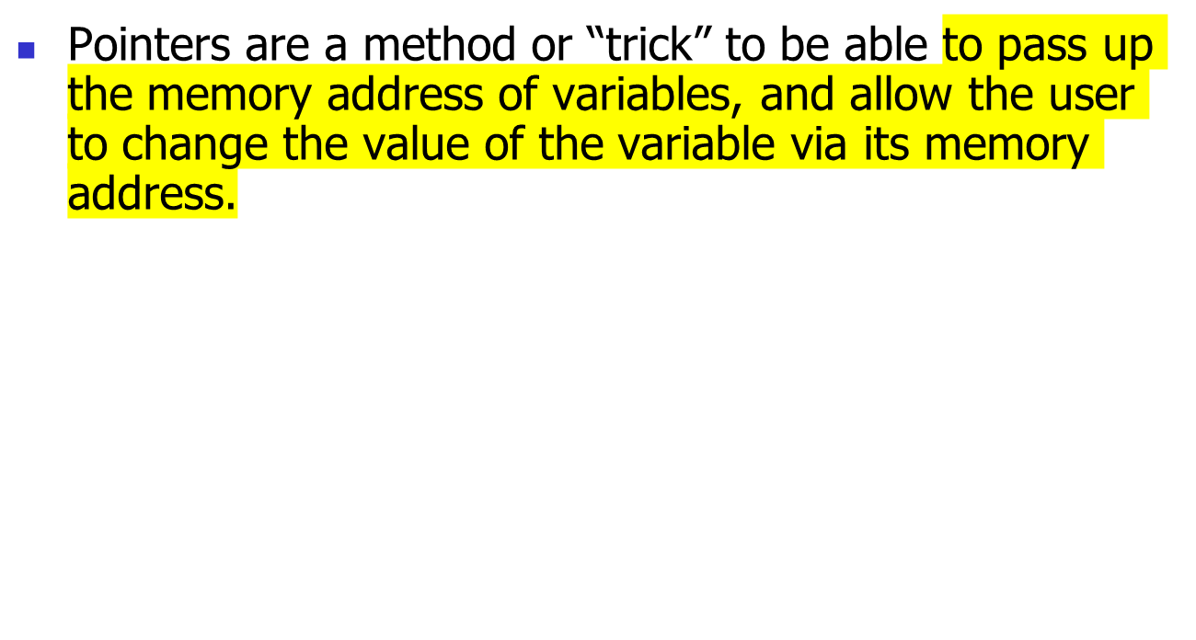
Memory address
of variables
Function
Values of variables
changed in main ( )
for example….
Change values of
variables within Function
(Through a process called
indirection …)

Slide 5
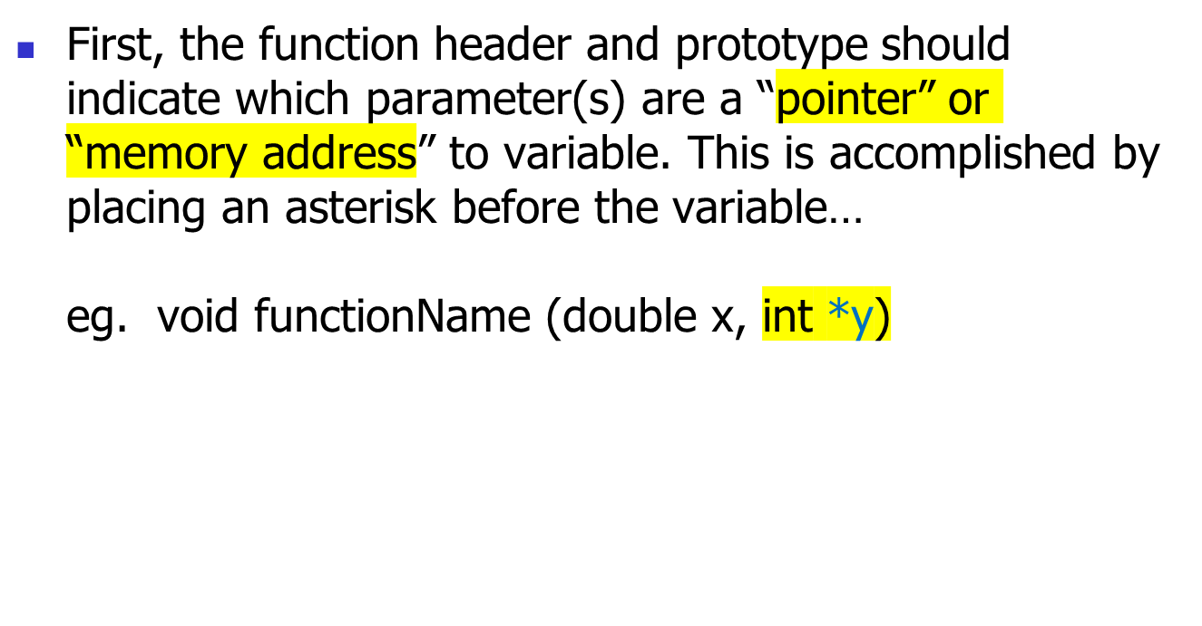
Pointers
Indicates a “cast”
i.e. parameter is
accepting a “Pointer” or
memory address location
of variable called y ….

Slide 6
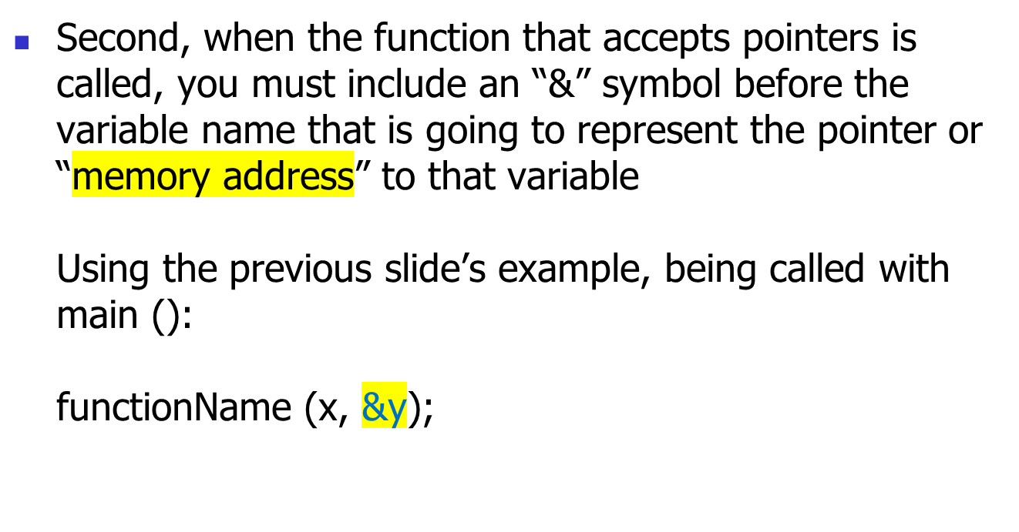
Pointers
Note: second variable used
as a pointer. Just using the
same names in main() for variables
to prevent confusion…

Slide 7
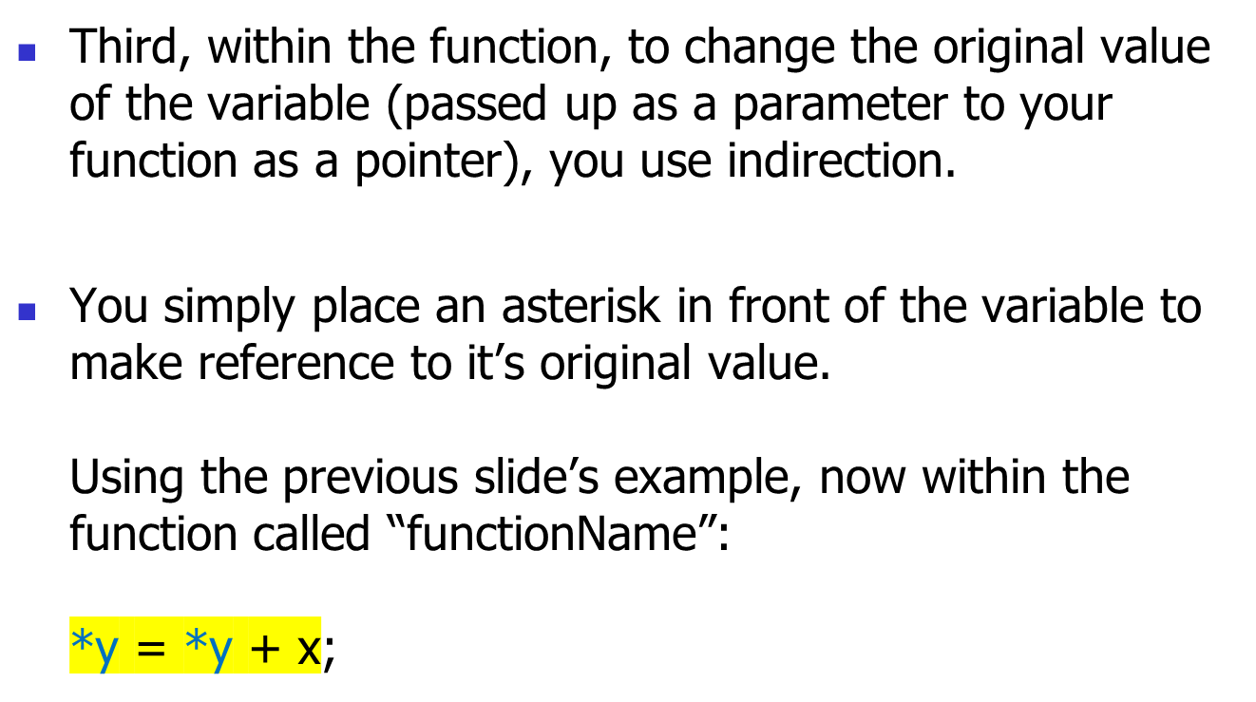
Pointers
For example: original y in main
is equal to original value of y + x

Slide 8
Example
#include <stdio.h>
void hours_and_minutes(int total, int *phrs, int *pmin);
main()
{
int tmin, hr, min;
printf (“Enter total minutes: “);
scanf (“%d”, &tmin);
hours_and_minutes(tmin, &hr, &min);
printf (“%d hours, and %d minutes\n”, hr, min);
}
void hours_and_minutes(int total, int *phrs, int *pmin)
{
*pmin = total % 60;
*phrs = total / 60;
}

Slide 9
Homework
TASK #1
  Complete lab #5 since it is due at the beginning of this week’s lab!
TASK #2
  Study for test #1 – to be held in week #7
TASK #4 *** Highly Recommended ***
  Read ahead in IPC144 Programming Notes (Filling in the Gaps).

