Slide 1
IPC144
Introduction to Programming Using C
Week 4 – Lesson 2
(Pages 38 to 46 in IPC144 Textbook)

Slide 2
Agenda
Additional C programming Elements
  Modularity / Continued…
    Creating a Simple Function
    Sending Parameters to a Function
    Returning values from a Function
    Examples

Slide 3
Modularity
User-defined Functions
  In the previous lesson slides, we used a function that is simply run like a program when executed as a statement within our main program.
  The purpose of functions is to create a smaller program that can be used over-and-over again in the main() program to save coding and reduce the time required to create programs.
  In the REALITY CHECK Question #3 (Week 4 – Lesson 1), we created a function to print the title. Could we use the function more than once?

Slide 4
Modularity
The answer to the previous slide’s question is “NO”. Not in its current form – it is only designed to print the title at the top, or print the footer at the bottom.
We could become efficient, and just use one function to generate a header and a footer, but it would require that we send a value (or values) to the function to use…

Slide 5
Modularity
For example, we could define a function called drawBox() that accepts text inside the function.
When the drawBox() function executes, it prints a line, on the next line, prints the text, then on the last line, prints another line
Here is an example:
drawBox(“Title of Report”);
-----------------------
Title of Report
-----------------------

Slide 6
Modularity
Instead of putting text inside function to pass-up to function when it executes, we can use variables instead!
But remember: when Programming in C, we need to first DEFINE the data-type of the variable…
How is this done with functions?

Slide 7
Modularity
In the function header and the function prototype, we specify the data-type in the brackets. First, the data-type declaration statement, then the variable name that the function will use.
For example:
void drawBox(int x);
We will be learning
later in this course
how to work with
characters and text
(character strings)…

Slide 8
Modularity
We can’t use text for our function example, but we can indicate how to draw our box…
For example: number of columns, and number of rows…
e.g. drawBox (5, 3);
*****
*****
*****

Slide 9
Practice
REALITY CHECK (Week 4 – Lesson 2)
  Question #1 (Word Problem)
  Question #2 (Word Problem)

Slide 10
Modularity
How could we improve Question #2 to error-check the values of number of rows and number of columns to make certain they are in appropriate boundaries (eg. between 1 and 24?)
We can define a function to return a value (for example an int 1 for TRUE and 0 for FALSE). Based on calling the function, the program can loop until the data is correct…

Slide 11
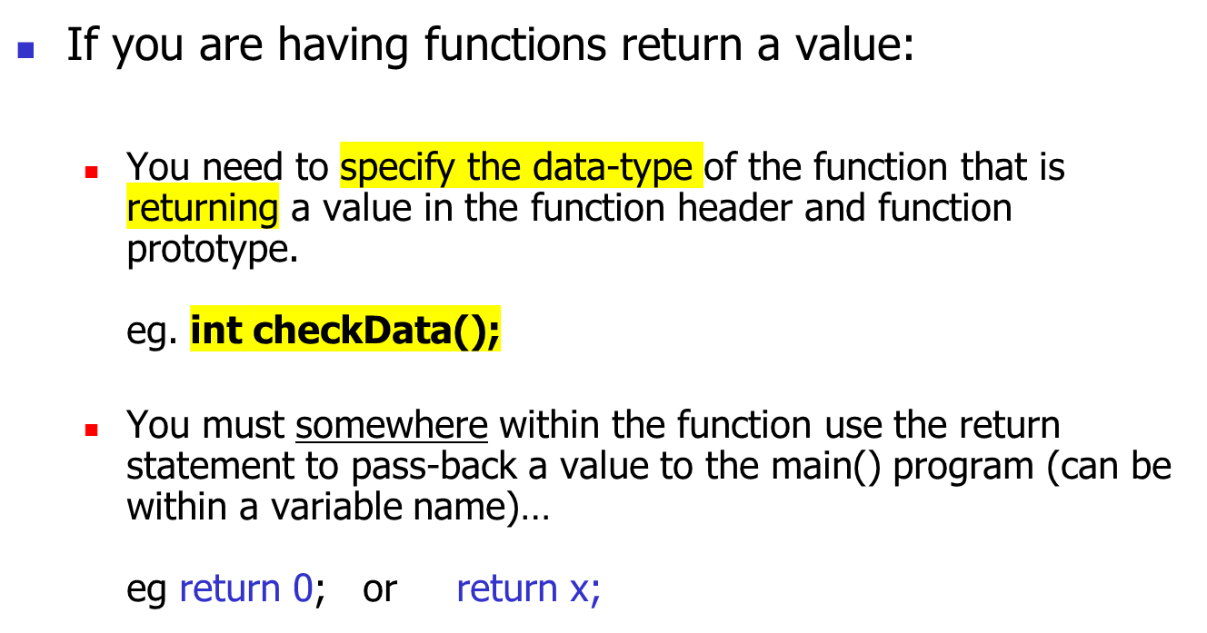
Modularity

Slide 12
Practice
REALITY CHECK (Week 4 – Lesson 2)
  Question #3 (Word Problem)

Slide 13
Modularity
Of course, functions can accept and return double data-types as well…
Later in this course, we will learn other data-types such as characters, which can be used for a function to accept and/or return as well…

Slide 14
Homework
TASK #1
  Complete lab #3 since it is due at the beginning of this week’s lab!
TASK #2
  Study for a quiz to be held in this week’s lab based on material taught last week
TASK #3
  Complete and code the solutions for today’s REALITY CHECK QUESTIONS, as well as “hide” and repeat the walk-thru questions
TASK #4 *** Highly Recommended ***
  Read ahead in IPC144 Programming Notes (Modularity / Functions).

