Slide 1
IPC144
Introduction to Programming Using C
Week 5 – Lesson 2
(Pages 65 to 66 in IPC144 Textbook)‏

Slide 2
Agenda
Additional C programming Elements
  Better Output Control with printf() Function
  Examples

Slide 3
Output Control with printf()‏
We have seen how display decimal places can be specified in a printf() statement involving double data-types.
You can also control the display the width of the data value.

Slide 4
Output Control with printf()‏
Rules:
  The width of a data-type field appears as a number between % and the data type specifier.
  If decimals are to be displayed, then the number appears between the % and the decimal point number, then followed by the data type specifier

Slide 5
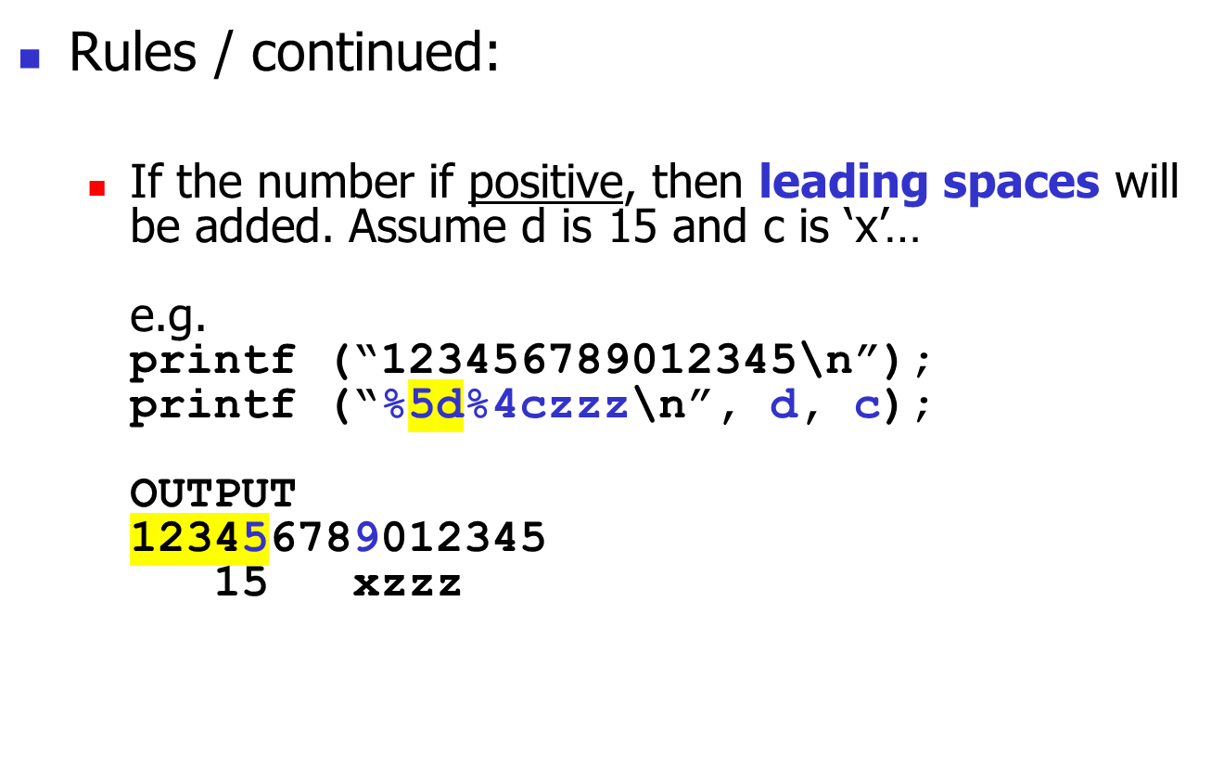
Output Control with printf()‏
Leading spaces added to
right-align d and c

Slide 6
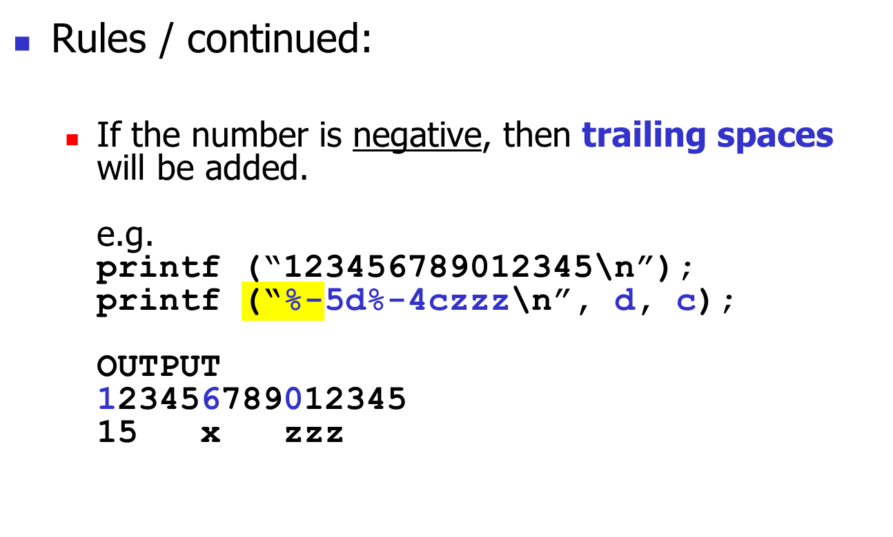
Output Control with printf()‏
Trailing spaces added to
left-align d and c

