Slide 1
Lumina Rising:
Challenging Desktop Orthodoxy
Ken Moore
<ken@ixsystems.com>
Ohio Linux Fest
Columbus, OH
September 29-30

Slide 2
Key Questions
What is a desktop?
How is a desktop assembled?
How does a desktop integrate with the operating system?
How is Lumina 2 any different?

Slide 3
What is a desktop?
Common Answers:
A complete graphical system with a collection of various utilities for common tasks. Examples: KDE, GNOME, and XFCE.
An interface with application shortcuts and manages graphical windows. Examples: Plasma, Lumina, and WM + dock.
Only the window manager.

Slide 4
What is a desktop?
Proposed Answer:
A graphical interface to an operating system which supports industry standards for application interactions and controls.
Examples:
    Window Management: ICCCM and EWMH
    Application Registration: XDG desktop menu and entry specs
    Theming Specs: Icons, cursors, and color schemes (debatable)

Slide 5
How is a desktop assembled?
As time passes, the base desktop grows:
WM
Screensaver
Clipboard
X11
Application
Launcher
Panels
Wallpaper
+ Icons
Screen Lock
Keychain
Session
Manager
Package
Manager
File
Sharing
Network
Manager
Device
Manager
Service
Manager
File
Manager

Slide 6
How is a desktop assembled?
As time passes, the base desktop grows:
Desktop Session
Application
Interfaces
WM
Screensaver
Clipboard
X11
Application
Launcher
Panels
Wallpaper
+ Icons
Screen Lock
Keychain
Session
Manager
Operating System
Control
Package
Manager
File
Sharing
Network
Manager
Device
Manager
Service
Manager
File
Manager

Slide 7
How is a desktop assembled?
As time passes, the base desktop grows:
Desktop Session
Application
Interfaces
WM
Screensaver
Clipboard
X11
Application
Launcher
Panels
Wallpaper
+ Icons
Screen Lock
Keychain
Where is the operating system?
When does the desktop
become the OS?
Session
Manager
Operating System
Control
Package
Manager
File
Sharing
Network
Manager
Device
Manager
Service
Manager
File
Manager

Slide 8
How does a desktop integrate with the operating system?
The OS provides a “system console”
    Keyboard Only
    Users/Groups
    Networking
    Services
    Filesystems
    Shells
    Hardware drivers
    Standard C libraries
The desktop provides a “graphical console”
    Keyboard optional
    Multi-user
    Multi-application
    Visualization of the OS
    X11/Wayland libraries

Slide 9
How does a desktop tie into the operating system?
Recent trends in OS “intrusion” by desktops
    Filesystem interference: GVFS and inotify
    Bypass user restrictions: policykit and dbus
    Bypass removable device management: hald, automount, and autorun
    Bypass shared network protocols using alternate libraries, tools, or versions
    Bypass hardware management: upower
Desktops try to enforce standardized OS interactions, but fail. Desktops need an API!

Slide 10
How is Lumina Different?
What is the desktop?
Other desktops
    KDE/Plasma, GNOME and derivatives
          The “all-in-one” approach
          Lots of dependencies
    XFCE, LXQT, and Lumina 1
          More modular and independent from applications
          Primarily just the “interface”
          Still require several runtime processes
Lumina 2
    Interface only
    No OS services required, modular OS interaction framework
    Requires Qt5/X11 libraries only
    Completely independent from applications

Slide 11
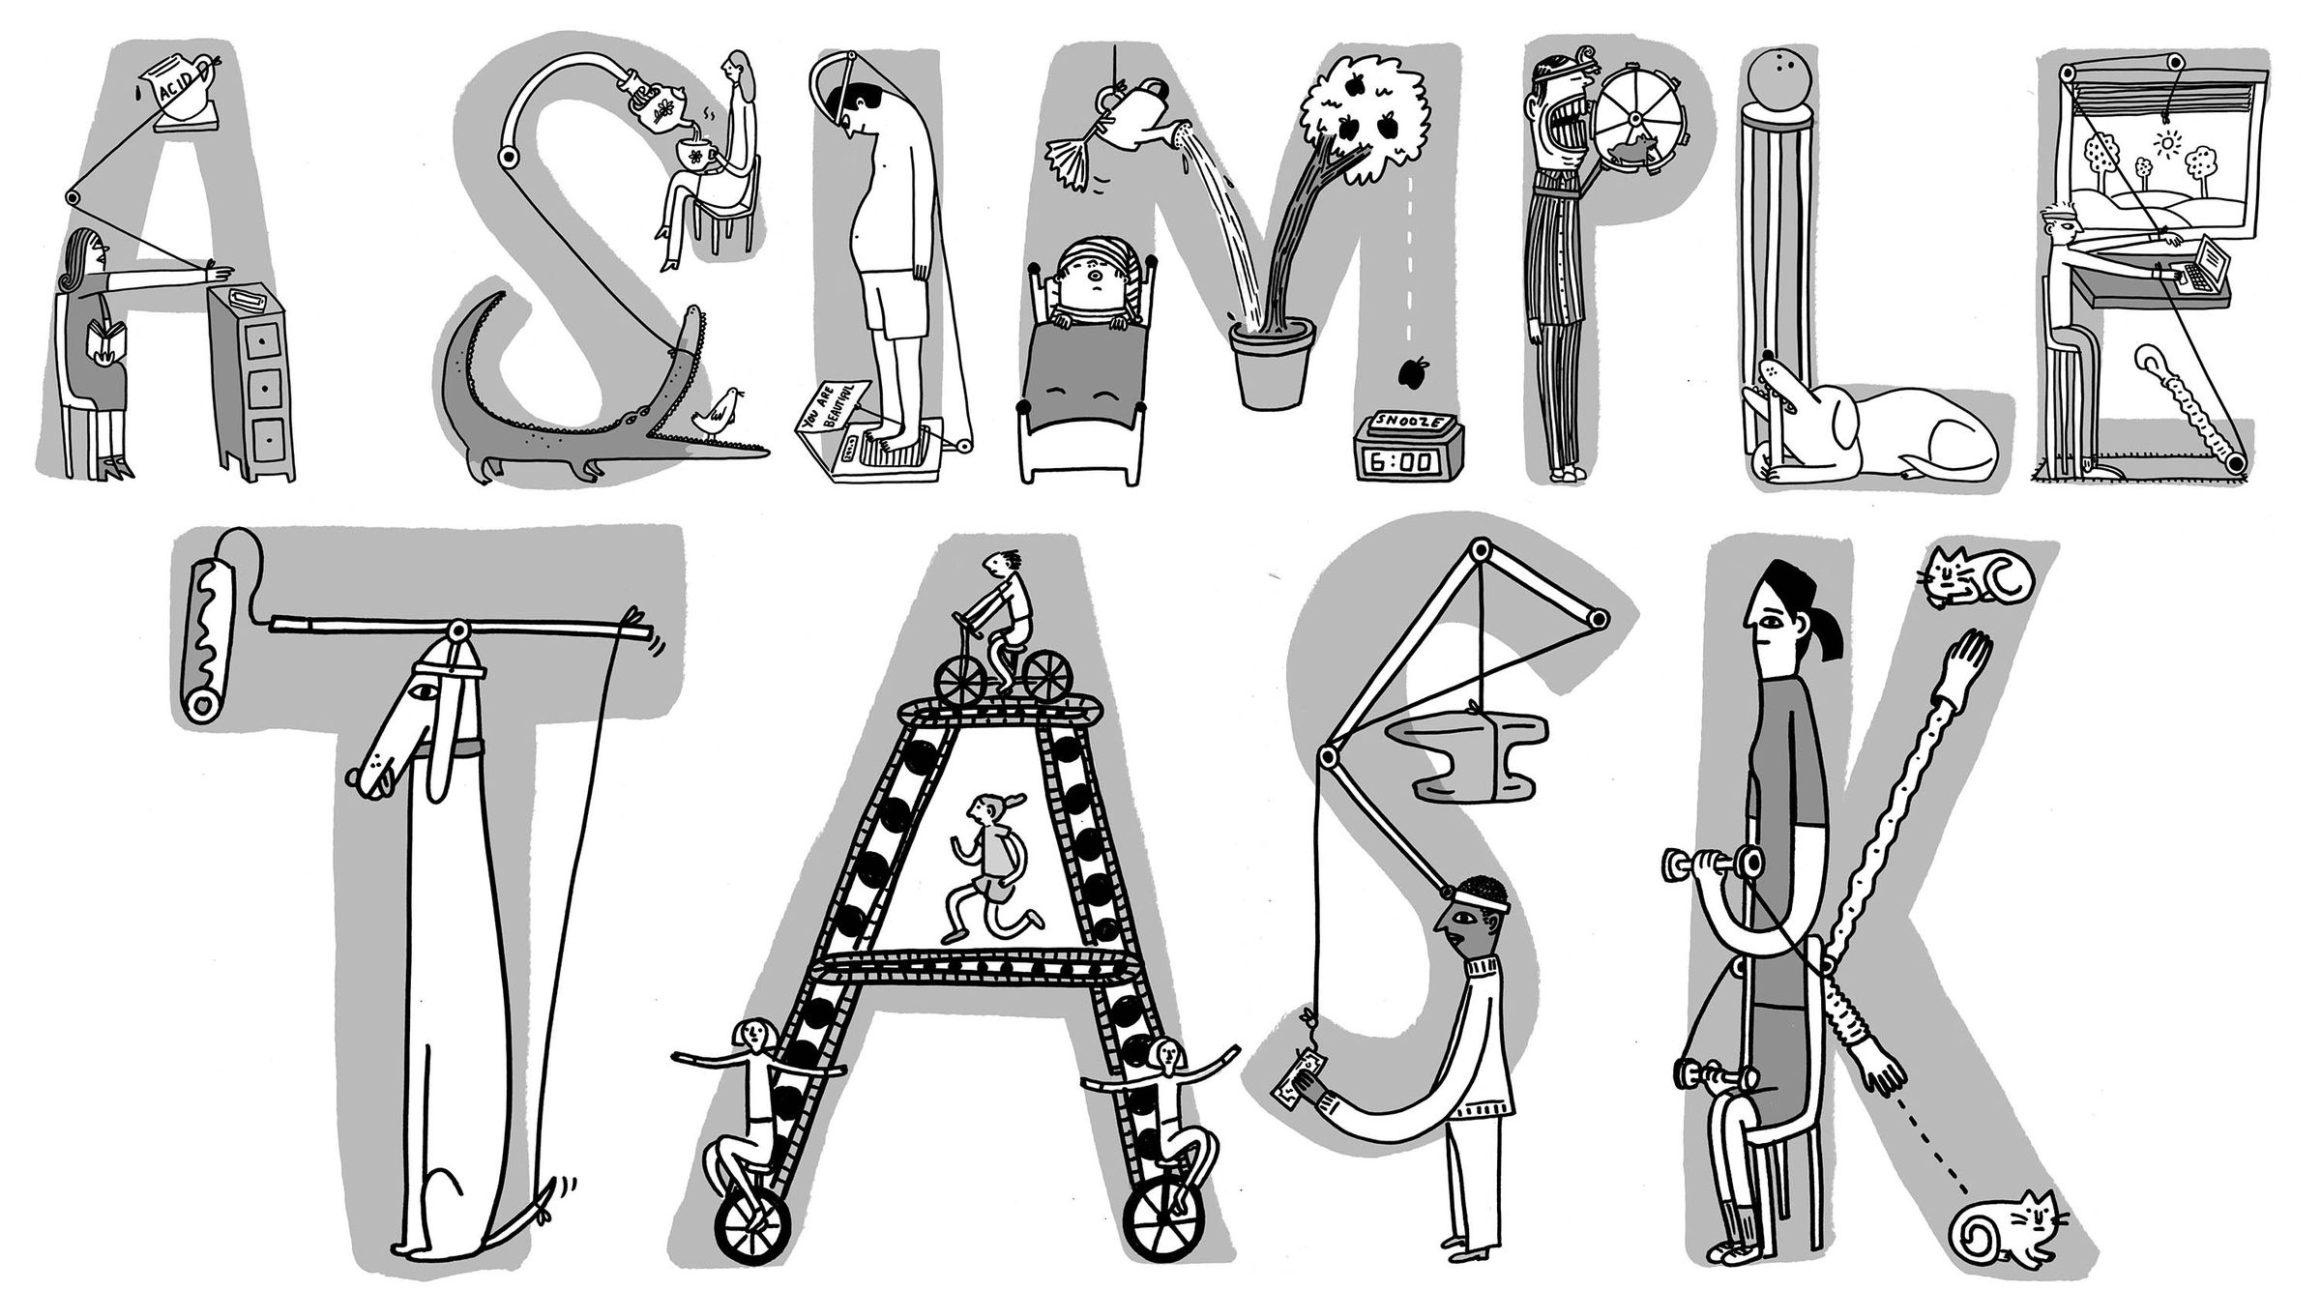
How is Lumina Different?
What is the desktop?

Slide 12
How is Lumina Different?
How is the desktop assembled?
Other desktops
    Lots of binaries/processes
    Uses dbus as IPC “glue”
    Moving toward “Apps-as-services”
    Highly fragmented core, desktop-dependent extra applications
Lumina 2
    One binary/process
    Formalized JSON API
    Transient applications
    Unified core, independent extra applications

Slide 13
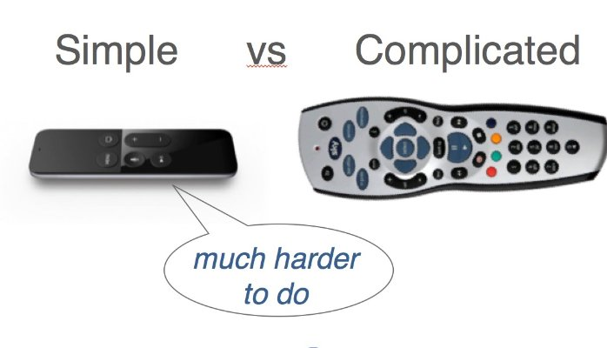
How is Lumina Different?
How is the desktop assembled?

Slide 14
How is Lumina Different?
Desktop and OS Interactions
Other desktops
    Linux-centric. Backend services/tools must be ported to a non-Linux OS first.
    Attempt to “control” OS capabilities. The desktop is dominant.
    Provide a multitude of utilities for OS tasks
Lumina 2 is:
    OS-agnostic. Optional internal mapping for OS interactions.
    An “interface” for any OS capabilities. The OS is dominant.
    Minimal. OS control utilities are installed by the OS.

Slide 15
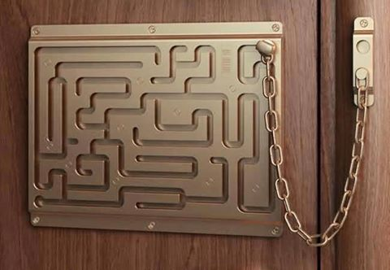
How is Lumina Different?
Desktop and OS Interactions

Slide 16
Conclusions
Open-source desktop developers are at a crossroads. Do we follow the example of Windows and become a central component of a single operating system? Or, do we create and use operating standards for desktop/OS interaction?
The Lumina project is forging ahead with goals of portability, simplicity, and standardization.

Slide 17
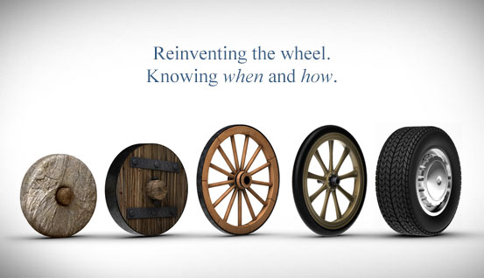
Questions?
Slides Available at:
https://www.slideshare.net/beanpole135

