Slide 1
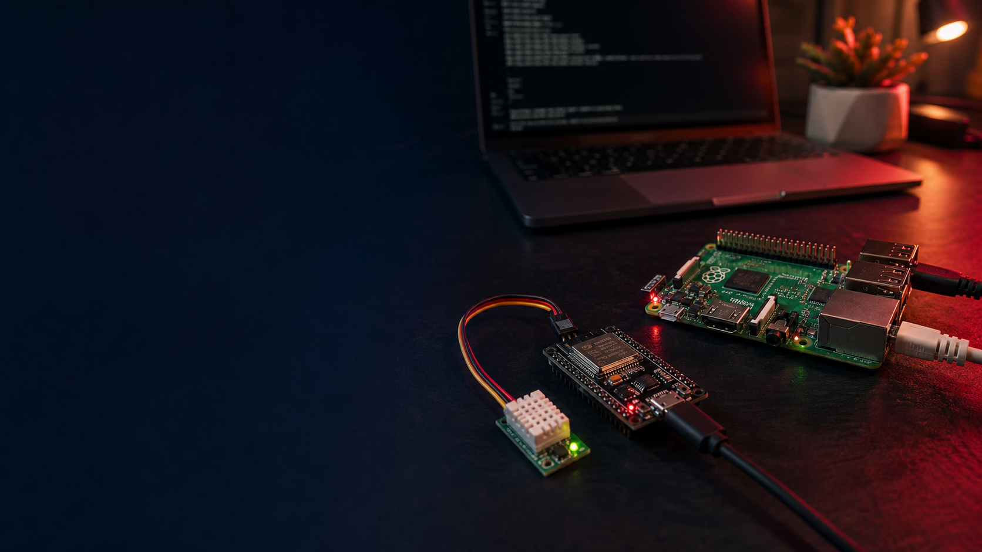
DEMO DAY • AUGUST 31, 2026
What changed
when AI joined
the project
A stalled IoT project—and a practical lesson for our team
Notes:
Open with the contrast: this project began years before modern coding agents. The modernization is real, but the reason for sharing it is broader. It changed my understanding of who can turn an idea into a sustained product—and what our role can become when AI joins the work.
[Sources]
- Generated editorial hero image using built-in image generation
- IOT_MODERNIZATION_TALK_RESEARCH.md
- User project history and Raspberry Pi inspection
[/Sources]

Slide 2
THE IDEA
GATHER
SEE
LEARN
sensor data
the history
from the property
Temperature and humidity across about twenty devices—preserved in one useful dashboard.
The idea was simple enough to survive nine years.
2
Notes:
The original product idea was simple: place sensors around the property, gather temperature and humidity readings, preserve the history, and make the information visible in a dashboard. The idea was useful enough to survive for nine years, even when development stopped.
[Sources]
- User project recollection
- IOT_MODERNIZATION_TALK_RESEARCH.md: original project goal
[/Sources]

Slide 3
PROJECT BACKGROUND
Nine years came before the first prompt.
2017
2021
2026
START
EXPAND
MODERNIZE
Photon sensors
Particle Cloud
ESP32 fleet
AWS IoT
Same fleet
Local PiServer
The hardware remained useful. The friction around it did not.
3
Notes:
Particle helped me begin. AWS helped me learn IoT and expand to about twenty ESP32 devices. In 2026, the physical fleet was still useful. The question was whether I could modernize everything around it without becoming an expert in every technology involved.
[Sources]
- User statements in the presentation-planning conversation
- IOT_MODERNIZATION_TALK_RESEARCH.md: project timeline
[/Sources]

Slide 4
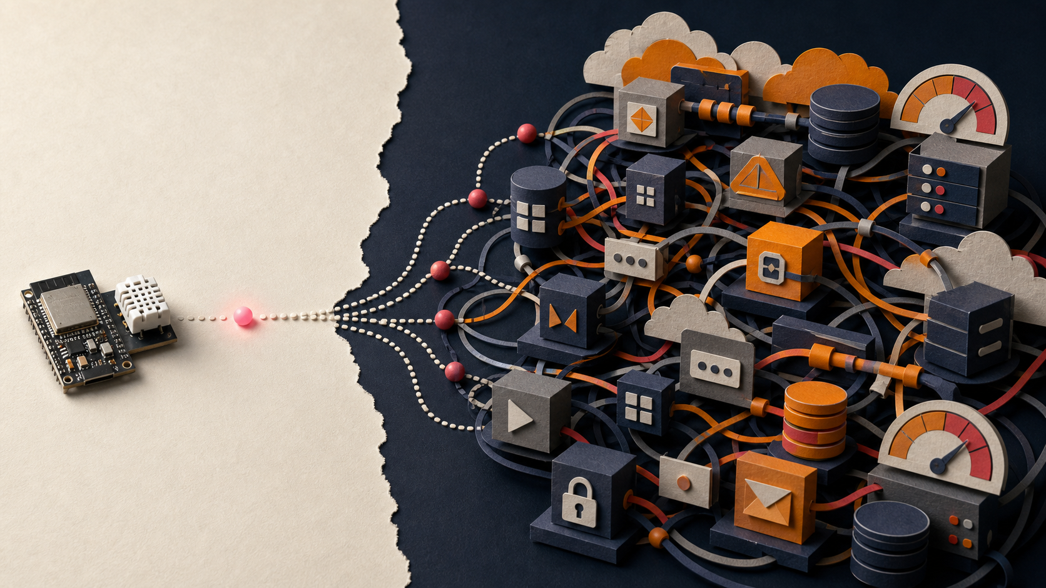
The system worked.
Friction stopped improvement.
Messaging • pipelines • databases • hosting
One reading every 10 minutes
4
Notes:
The system collected data, and I learned AWS IoT in the process. But every improvement required connecting and maintaining more services. With about twenty devices, reporting frequency also affected cost, so I reduced the fleet to one reading every ten minutes. Eventually the system kept working, but I stopped developing it.
[Sources]
- Generated cloud-friction editorial illustration using built-in image generation
- User project recollection
- Legacy repository inspection
- IOT_MODERNIZATION_TALK_RESEARCH.md: cloud-era constraints
[/Sources]

Slide 5
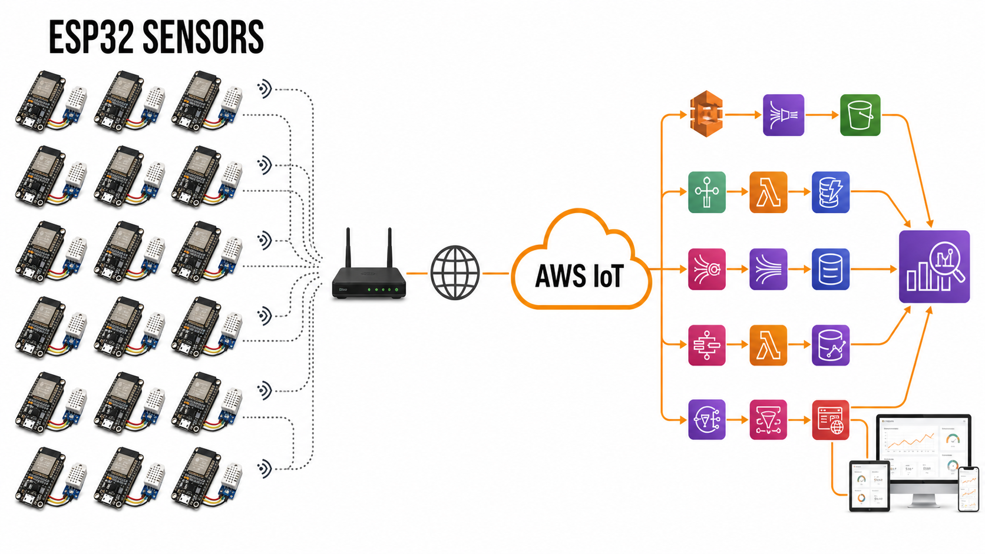
BEFORE
The cloud became the system.
GOAL — NOT BUILT
✕
3,480,081 READINGS
JUL 4, 2021 → OCT 30, 2025
10-MINUTE CADENCE
5
Notes:
This is the old system. The sensors were simple, but the cloud side branched into messaging, routing, pipelines, storage, queries, and hosting. The dashboard shown at the end was the goal, not a finished product—the red X marks that it was never built. Between July 4, 2021 and October 30, 2025, the preserved datasets contain 3,480,081 valid readings. AWS collected the data and taught me IoT, but the architecture around the original idea became the part I no longer wanted to maintain.
[Sources]
- Generated architecture illustration based on the inspected legacy repository and user project history
- presentation_assets/old-system-esp32-to-aws-iot.png
- pasted-text.txt dataset-history analysis: 107,306 + 3,372,775 = 3,480,081 readings
- User clarification: the AWS-era dashboard was the intended end goal but was never built
[/Sources]

Slide 6
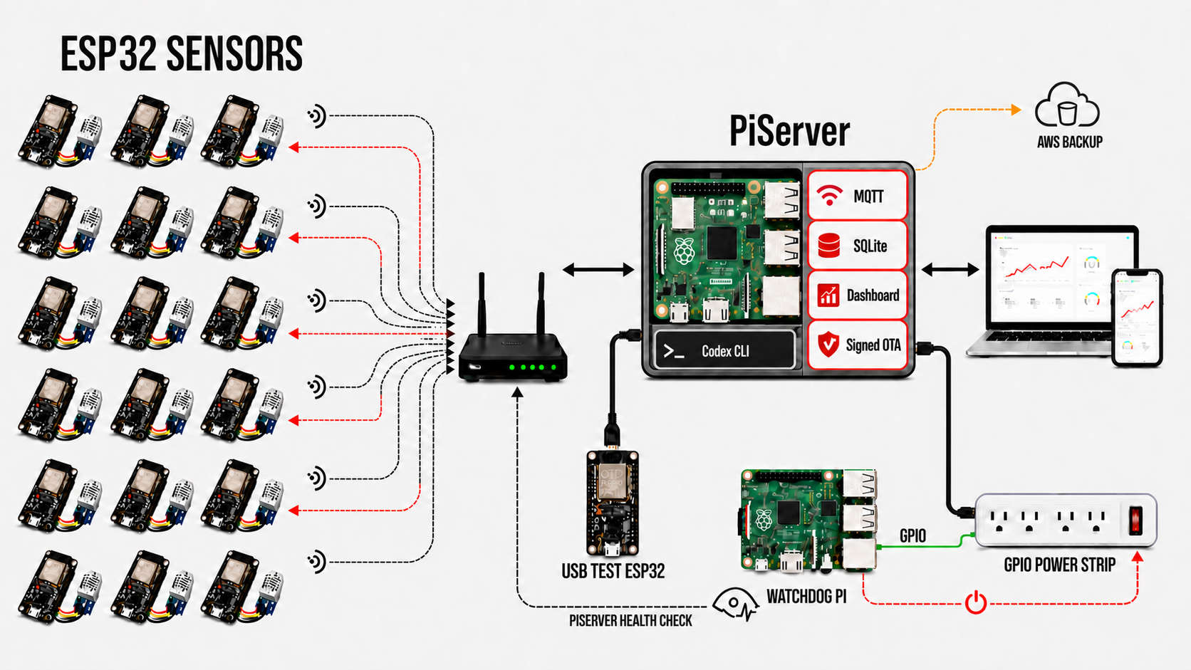
NOW
Local first. Cloud only for backup.
341,385 VALID READINGS
JUN 22 → AUG 28, 2026
27 DEVICE IDs
6
Notes:
The same sensor fleet now reports through the home router to PiServer. PiServer owns MQTT, SQLite, the dashboard, and signed OTA—and it is also where Codex CLI ran. From June 22 through August 28, 2026, the local database collected 341,385 valid readings across 27 device IDs. A USB-connected test ESP32 validates the artifact before deployment. A separate Watchdog Pi checks PiServer through the router and can recover it through a GPIO-controlled power strip. AWS remains only as an outbound backup destination.
[Sources]
- Generated architecture illustration based on the inspected current system and user corrections
- presentation_assets/current-system-esp32-to-piserver-v9.png
- Live read-only PiServer SQLite query on August 28, 2026; five invalid 1970 timestamps excluded
[/Sources]

Slide 7
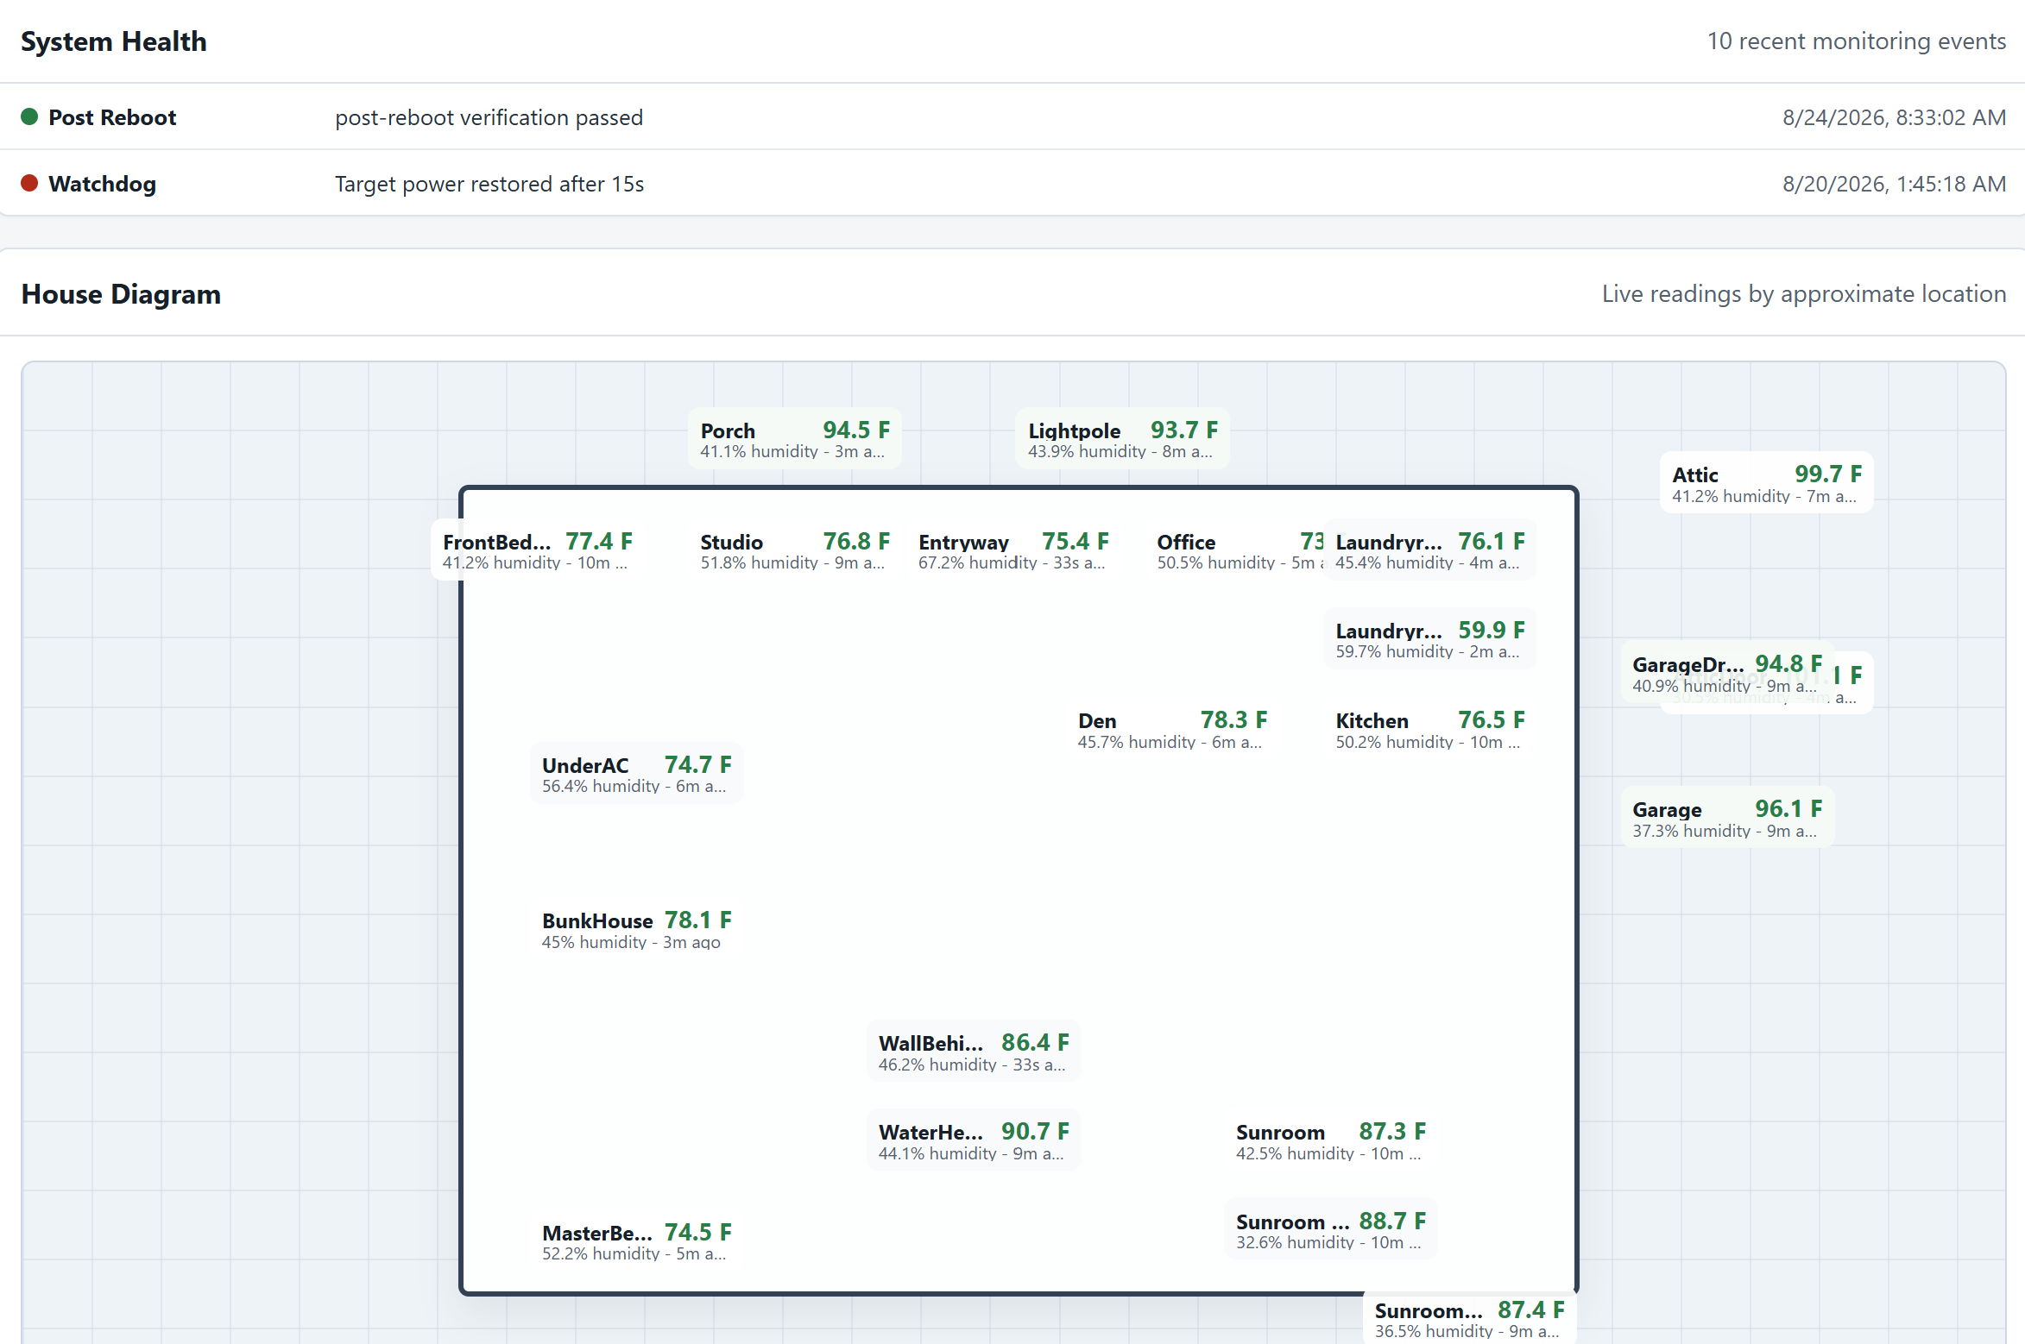
THE OUTCOME
The original idea is finally visible.
IDEA → WORKING PRODUCT
7
Notes:
This is what I wanted from the beginning: gather sensor data and see it in a dashboard. The finished view now also reports post-reboot verification and watchdog activity. The product goal stayed simple; the partnership helped make the system behind it responsible.
[Sources]
- User-provided PiServer dashboard screenshot, August 2026
- presentation_assets/dashboard-house-system-health.png
[/Sources]

Slide 8
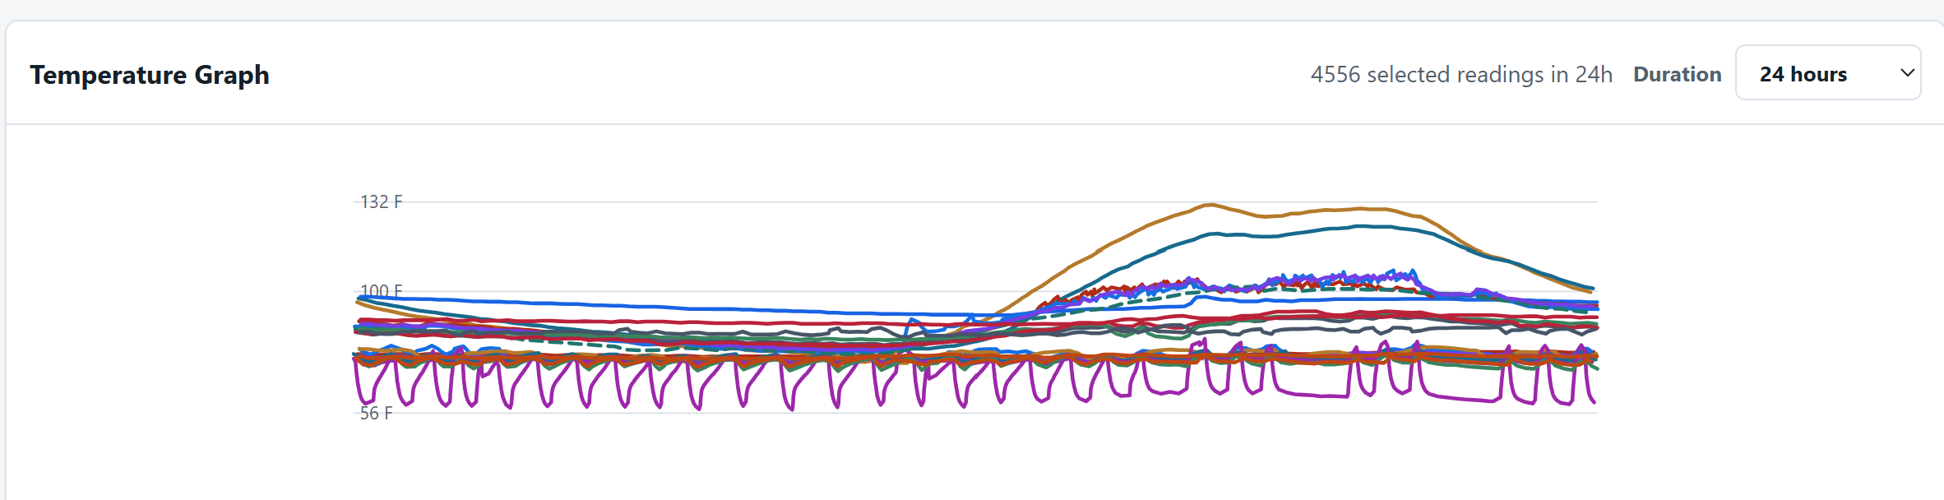
4,556
readings in 24 hours
Local changed what
the data could tell me.
Higher frequency reveals patterns, cycles, and outliers.
8
Notes:
The old cloud system forced reporting frequency to become a cost decision. Here, the dashboard shows 4,556 selected readings in twenty-four hours. That resolution makes normal cycles, outliers, and sudden changes visible. Moving local lowered operational friction and increased what I could learn from the system.
[Sources]
- User-provided PiServer dashboard screenshot, August 2026
- presentation_assets/dashboard-temperature-24h.png
[/Sources]

Slide 9
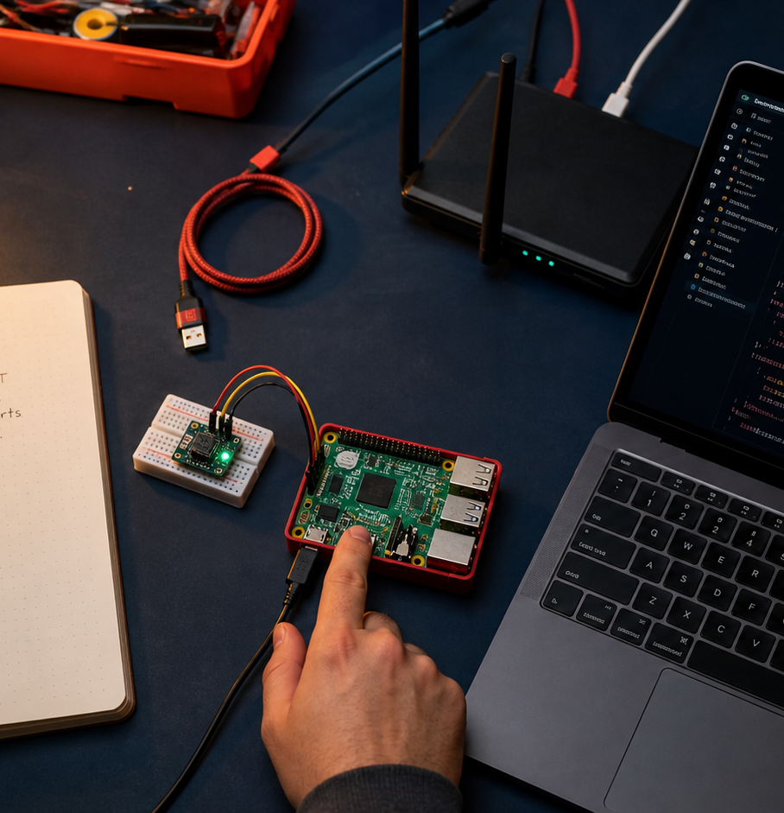
THE TURNING POINT
This isn’t really
a story about AWS
and a Raspberry Pi.
It is a story about managing an AI-assisted product-development process.
9
Notes:
Pause here and make the pivot explicit. The architecture proves the work happened. But the important change was not where the data was stored. It was that I stopped trying to personally perform every technical task and started managing the development of the product with an AI partner.
[Sources]
- Generated human-AI partnership editorial image using built-in image generation
- User-approved presentation message
- Synthesis from the inspected modernization project
[/Sources]

Slide 10
WHY THIS PARTNERSHIP WORKED
Codex joined the project where it lived.
Context connected the specification to reality.
Source code
Running services
SQLite history
Device telemetry
Git + session history
CODEX CLI
ON THE PiSERVER
10
Notes:
Codex was not working from a pasted code fragment. It ran on the Raspberry Pi where the services, database, repository, and device telemetry lived. That gave it something essential for responsible modernization: context. It could compare what the code claimed, what the documentation remembered, and what the system was actually doing.
[Sources]
- Read-only inspection of /home/scotty/IoT and running PiServer services
- Codex session and rollout records on the Pi
- presentation_assets/current-system-esp32-to-piserver-v9.png
[/Sources]

Slide 11
THE ROLE CHANGE
I managed the product.
Codex carried the technical work.
THE HUMAN ROLE
THE AI ROLE
Problem
Priorities
Physical context
Risk decisions
Approval
Development
Configuration
Testing
Documentation
Operations evidence
Responsibility stays human.
11
Notes:
I did not become the developer, infrastructure specialist, tester, technical writer, and operations engineer for every part of the system. I managed the product: the problem, desired outcome, priorities, physical reality, risk, and approval. Codex carried much of the technical execution and context between those decisions.
[Sources]
- Representative Codex session and rollout records
- IOT_MODERNIZATION_TALK_RESEARCH.md: human versus Codex evidence
[/Sources]

Slide 12
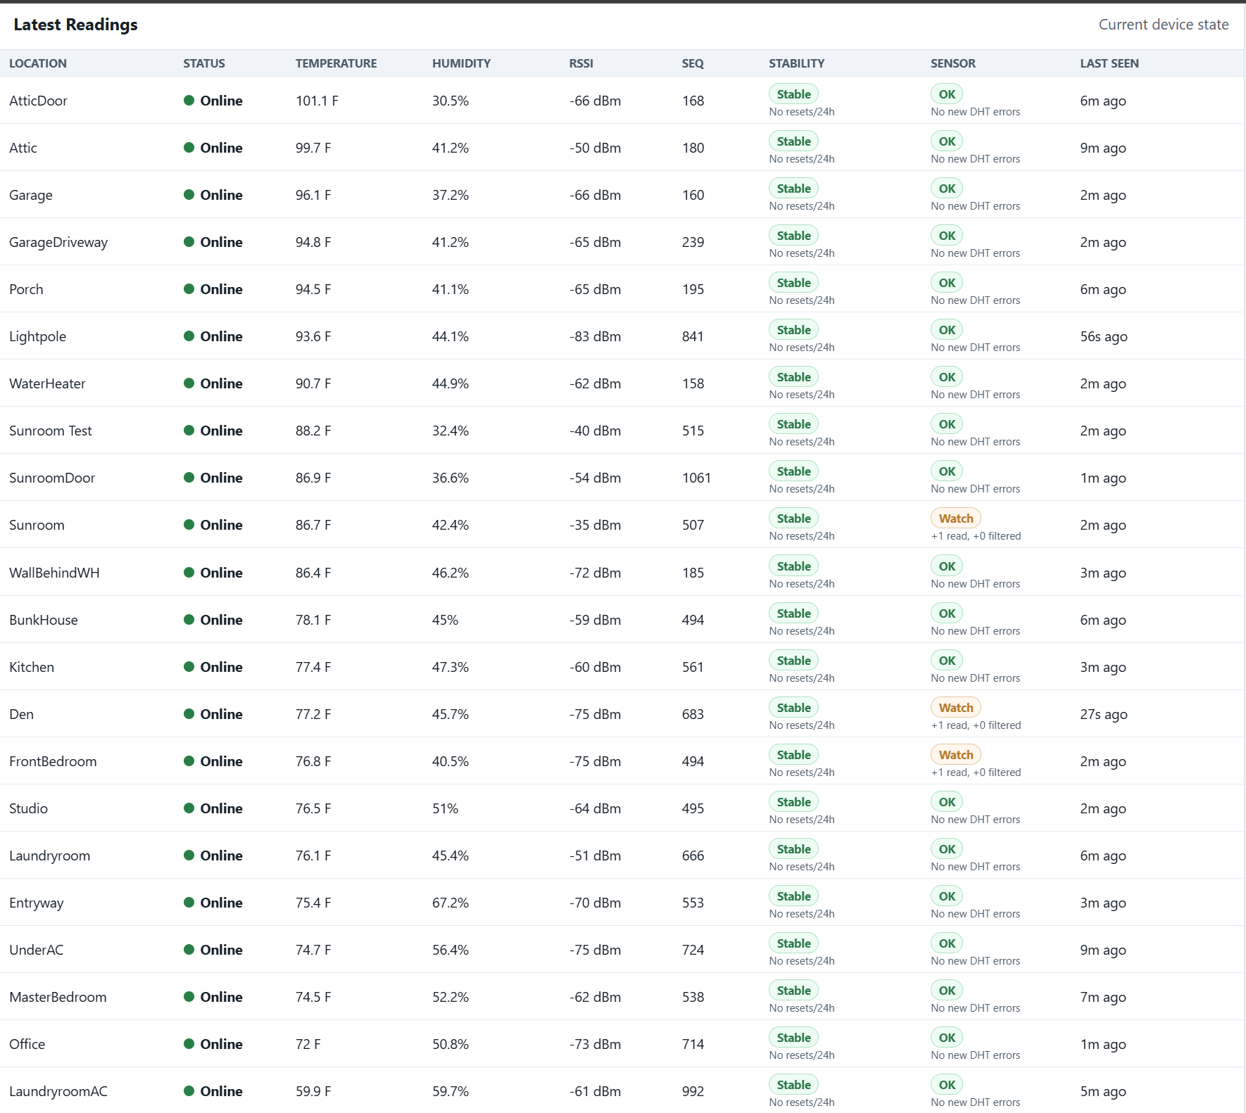
AI ADDED IDEAS
Hidden problems became visible signals.
NOT JUST
TEMPERATURE
STABILITY
SENSOR HEALTH
LAST SEEN
SIGNAL + SEQUENCE
12
Notes:
AI did more than execute a specification. It proposed ideas, compared code with telemetry, identified problems I had not named, and helped turn them into safeguards. The dashboard now tracks signal strength, sequence numbers, stability, sensor errors, and last-seen time—not just temperature and humidity.
[Sources]
- User-provided PiServer dashboard screenshot, August 2026
- presentation_assets/dashboard-latest-readings.png
- docs/decision-record.md and rollout records
[/Sources]

Slide 13
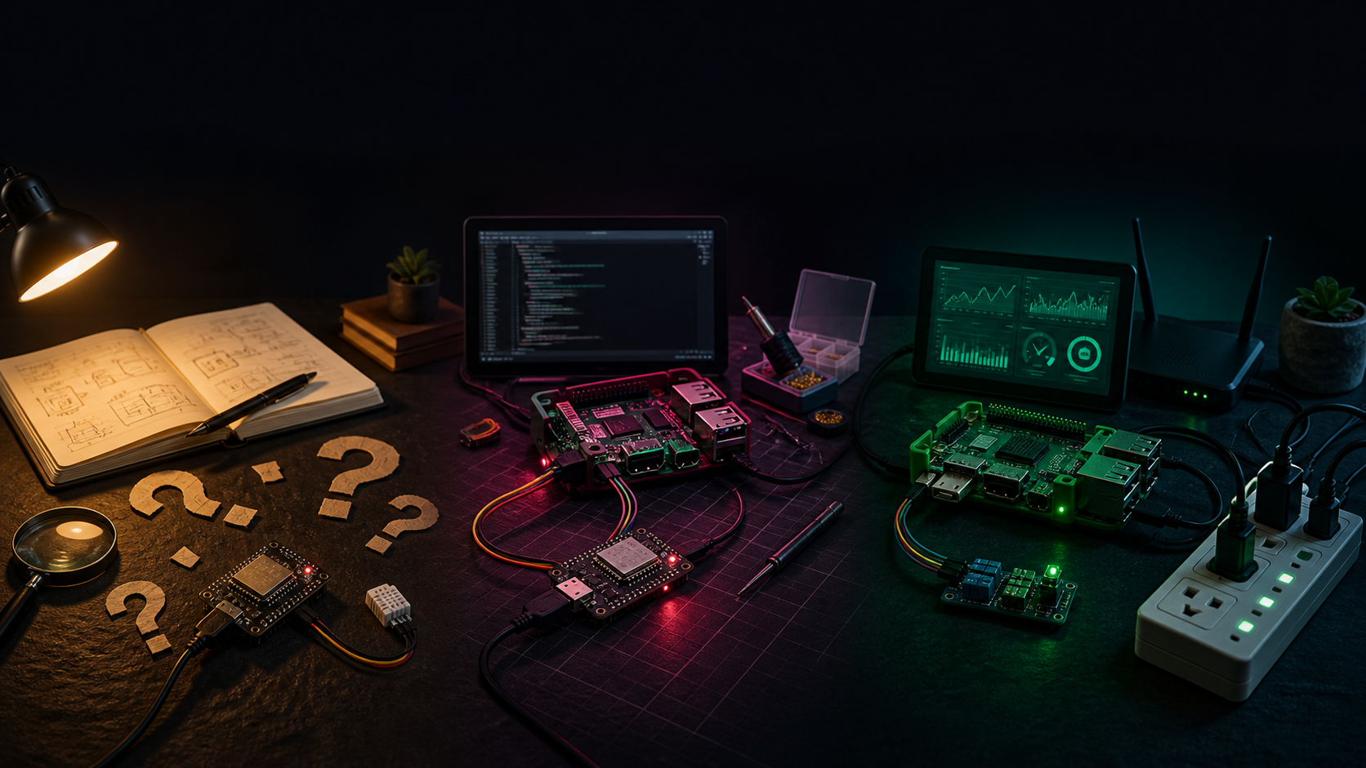
Use AI across the entire product lifecycle.
EXPLORE
BUILD
OPERATE
Learn • ask • experiment
Create • test • document
Monitor • diagnose • sustain
13
Notes:
The opportunity is larger than code generation. Use AI to learn unfamiliar domains, compare options, build experiments, configure systems, test behavior, document decisions, troubleshoot failures, monitor operations, and sustain what you created.
[Sources]
- Generated product-lifecycle editorial image using built-in image generation
- Synthesis of repository decisions, tests, documentation, telemetry analysis, and Codex rollout records
[/Sources]

Slide 14
FOR OUR TEAM
Manage the product—not every technical task.
1
Bring a problem
2
Start before you know how
3
Experiment + learn
4
Ask AI for ideas
5
Own the outcome
Define success. Provide context. Make decisions. Verify reality.
14
Notes:
Bring a problem worth solving. Start before you know every technical step. Use AI to experiment and learn. Ask it for alternatives, missing requirements, and risks—not only implementation. And remain responsible for the outcome. AI expands capability; it does not make purpose or judgment optional.
[Sources]
- User-approved team message
- Synthesis from the IoT modernization evidence
[/Sources]

Slide 15
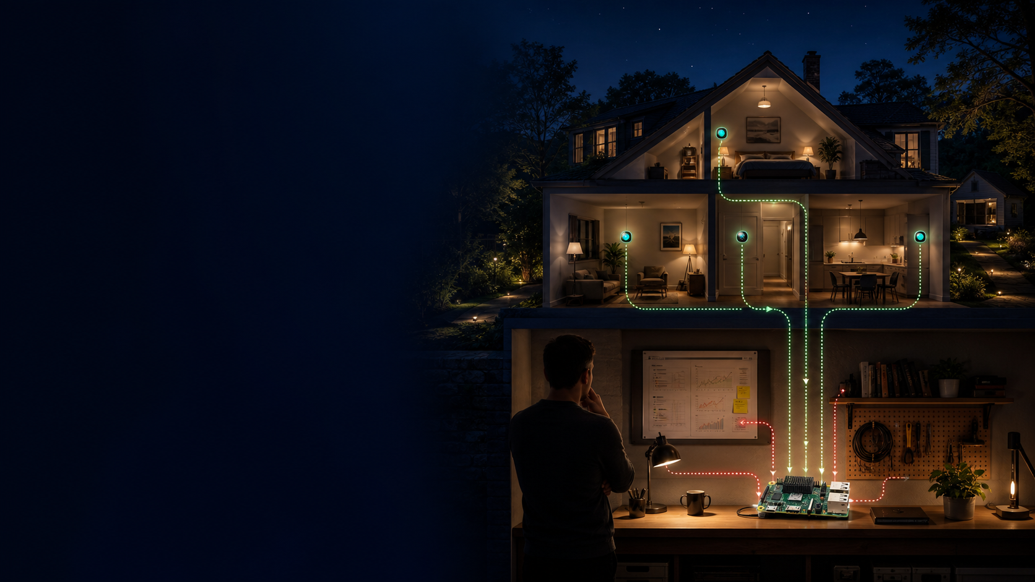
THE INVITATION
Bring the problem.
Bring your curiosity.
Manage the outcome.
Build a small experiment.
See what you learn.
Notes:
Close with an invitation, not a summary. Think of one useful problem you have postponed because you lacked the time, skills, or technical support. Describe the outcome to AI. Build a small experiment. Ask questions. Let it teach you. See what becomes possible—and keep responsibility for deciding what should become real.
[Sources]
- Generated closing editorial image using built-in image generation
- User-approved team message and closing invitation
[/Sources]

