Slide 1
PT. Timedoor Indonesia
Programmer Training
Challenge30
～ You can do it! ～
Yutaka Tokunaga

Slide 2
Bulletin board Level1
Your title must be 10 to 32 characters long
Your message must be 10 to 200 characters long
Error message
(Must be filled in
& character length)
4 type error
1.Title length
2.Title NULL
3.Body length
4.Body NULL
Title
Must be filled in
Body
Must be filled in
Submit
Title3
Hello World!! Third ********************** *******************************************
05-05-2014 14:05
Title2
Hello World!! second ********************** *******************************************
05-05-2014 13:09
Title1
Hello World!! first ********************** *******************************************
03-05-2014 11:00
※You must use VIM.
※You must use MYSQL

Slide 3
Bulletin board Level2
Your title must be 10 to 32 characters long
Your message must be 10 to 200 characters long
Title
Body
Submit
Title10
Hello World!! Third ********************** *******************************************
05-05-2014 14:05
Title2
Hello World!! second ********************** *******************************************
05-05-2014 13:09
Title1
Hello World!! first ********************** *******************************************
Attach Pagination
03-05-2014 11:00
<
1
2
3
4
5
>
※You must use VIM.
※You must use MYSQL

Slide 4
Bulletin board Level2
<
1
2
3
4
5
>
※1 page 10message
※Max 5 pager
■Case1 30message Page1
1
2
3
>
Go to page 2
No link
■Case2 100message Page5
<
3
4
5
6
7
>
Go to page 4
No link
Go to page 6
■Case3 59message Page5
<
2
3
4
5
6
>
Go to page 4
Go to page 6
No link
■Case4 59message Page6
<
2
3
4
5
6
Go to page 5
No link

Slide 5
Bulletin board Level2
Error message
(Must be filled in
& character length & character type)
Your title must be 10 to 32 characters long
Your message must be 10 to 200 characters long
Title
Body
Submit
Add
delete
Button
Title10
Hello World!! Ten ********************** *******************************************
Del
05-05-2014 14:05
Title2
Hello World!! Second ********************** *******************************************
Del
05-05-2014 14:05
Title1
Hello World!! first ********************** *******************************************
Del
05-05-2014 14:05
<
1
2
3
4
5
>

Slide 6
Bulletin board Level2
Title10
Hello World!! ten ********************** *******************************************
Different Page from index.php
Date:05-05-2014 14:05
Are you sure?
Yes
Cancel
Delete. Then back to previous page.
(If you were in page3, you have to back page3.)
(If you were in page3 and only 30message , you have to back page2.)
Don’t delete. Then back to previous page.
(If you were in page3, you have to back page3.)

Slide 7
Bulletin board Level3
Your title must be 10 to 32 characters long
Your message must be 10 to 200 characters long
Title
Body
Submit
Title10
Hello World!! Ten ********************** *******************************************
Del
Edit
05-05-2014 14:05
Title2
Hello World!! Second ********************** *******************************************
Del
Edit
05-05-2014 14:05
Title1
Hello World!! first ********************** *******************************************
Del
Edit
05-05-2014 14:05
<
1
2
3
4
5
>
Add Edit Button

Slide 8
Bulletin board Level3
Error message
(Must be filled in
& character length & character type)
Your title must be 10 to 32 characters long
Your message must be 10 to 200 characters long
Title
****************************
Body
***********************************************************************************************
Different Page from index.php
Submit
Cancel
Rewrite. Then back to previous page.
(If you were in page3, you have to back page3.)
Don’t rewite. Then back to previous page.
(If you were in page3, you have to back page3.)

Slide 9
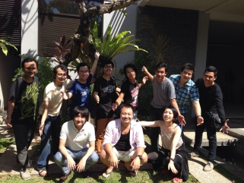
Bulletin board Level4
Add error message
Your image is only valid .jpeg, .jpg, .png, .gif
Your image is only valid 1MB or less
Title
Body
Insert image
aaa.jpg
upload
Submit
Title10
Hello World!! Ten ********************** *******************************************
Show photo
Del
Edit
05-05-2014 14:05
Title1
Hello World!! first ********************** *******************************************
Del
Edit
05-05-2014 14:05
<
1
2
3
4
5
>

Slide 10
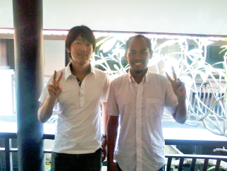
Bulletin board Level4
Title10
Hello World!! Ten ********************** *******************************************
Del
Edit
05-05-2014 14:05
Add error message
Your title must be 10 to 32 characters long
Your message must be 10 to 200 characters long
Your image is only valid .jpeg, .jpg, .png, .gif
Title
****************************
Body
***********************************************************************************************
Delete image function.
(If you chose this and upload photo at the same time, delete is priority. )
Delete image
Insert image
bbb.jpg
upload
Submit
Cancel
Rewrite. Then back to previous page.
(If you were in page3, you have to back page3.)
Don’t rewrite. Then back to previous page.
(If you were in page3, you have to back page3.)

