Slide 1
R Statistical modeling functions
BST 625
Min Lu

Slide 2


Q&A from last class why I have trouble using .Rproj
Min’s opinion: not very stable(2020/10/31). I use it for creating package, github files or shiny website, but I don’t use it for editing and organizing my files
.Rproj is not created from R software environment; it is a product of R Studio
 | R (simple and robust) | R studio (point and click, not stable)
Logo
Supported by | Nonprofit organization The R Foundation The R Development Core Team | A commercial company
Commonly used files/features | .R .RD .Rdata | .Rproj .rmd Github integration, Desktop and Server https://rstudio.com/products/shinyapps/ Rstudio Connect
Commonly used packages | {base} --- ready for your usage | {tidyverse} --- you have to library(tidyverse) to run their command
Update ----- both R and R studio grow rapidly | R-3.X.X R-4.X.X | New packages in {tidyverse}; New buttons in Rstudio desktop
Min’s advice: Install 2 versions behand: the newest version may have bugs

Slide 3
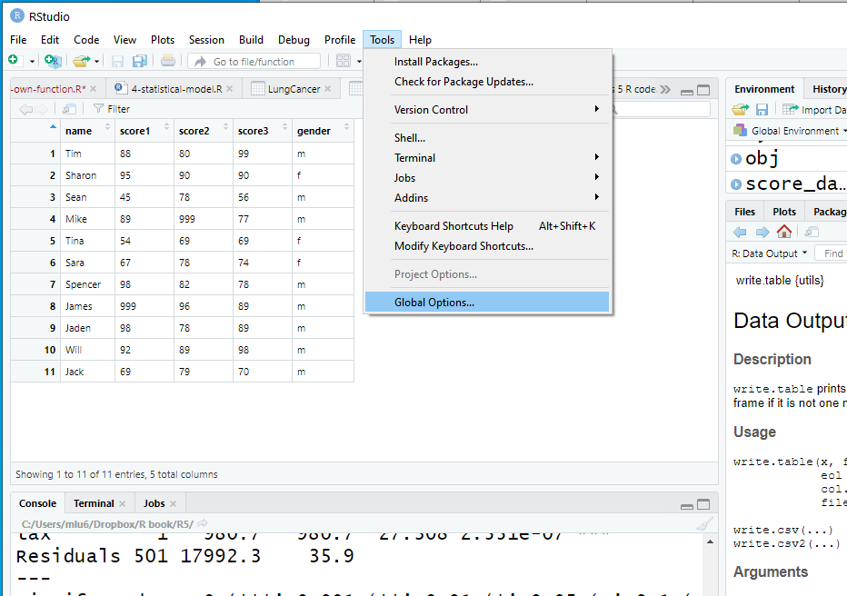
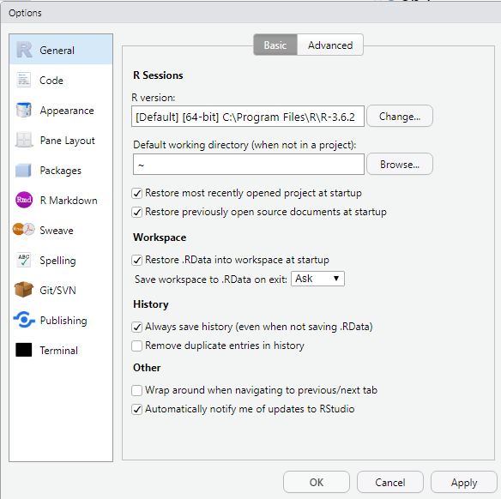
Q&A from last class
Setting default working directory
Default working directory when you open R Studio

Slide 4
Q&A from last class
From {base} ---- your object will be created as a data.frame
From {readr} ----- you have to run library(tidyverse) or library(readr)
your object will be created as a tibble
To read and write data
Set up working directory
click session -> set working directory -> choose working directory
or use command setwd("~/Dropbox/R book/R2")
Read in data
Upper right panel -> click of “Import Dataset” -> From Text
Copy the command and change the name of the object if needed
dat <- read.csv("C:/Users/mlu6/Dropbox/R book/GitR/BST625/score_data999.csv")
into you .R R script
Operation
dat[dat == 999] <- NA
Write data out
write.csv(dat, file = "score_data.csv", row.names = FALSE)
write.csv {base} --- you can choose whether to keep row names
write_csv {readr} --- you have to run library(readr)
by default, row names are not kept
For .csv file, you write out any numeric data as double and
character or factor as character
To keep integer and factor, we can use save(dat, file = “dat.RData”)

Slide 5
Statistical programming
Attitude
Skillset

Slide 6
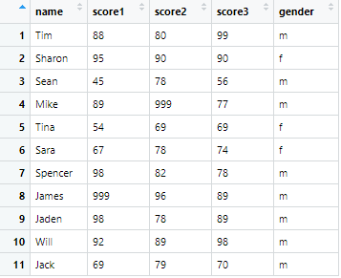
Data: rows and columns
{base}
Column (variable)
ncol(dat)
colnames(dat)
colSums(dat)
colMeans(dat)
cbind(dat1,dat2)
p
Usually n>p
Hight dimensional data: p>>n
n
Row (observations)
nrow(dat)
rownames(dat)
rowSums(dat)
rowMeans(dat)
rbind(dat1,dat2)

Slide 7
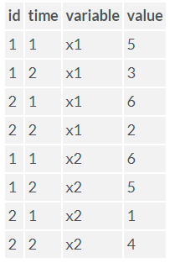
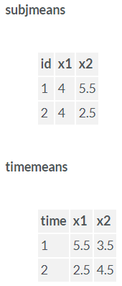
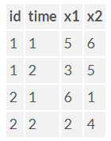
Extend R with add‐on packages
This is only an example
Topic 3: Data manipulation
1. Know how to extend R with add‐on packages
2. Understand the R ecosystem
3. Know how to find help for functions
4. Understand test statistics
5. Understand functions ‘lm’ and ‘glm’
6. Know how to Interpret results
7. Understand predicting
nonessential code or unimportant content
essential code
# install.packages("reshape")
library(reshape)
mydata <- data.frame( id = c(1, 1, 2, 2),
time = c(1, 2, 1, 2),
x1 = c(5, 3, 6, 2),
x2 = c(6, 5, 1, 4) )
mdata <- melt(mydata, id=c("id","time"))
cast(mdata, id~variable, mean)
cast(mdata, time~variable, mean)

Slide 8
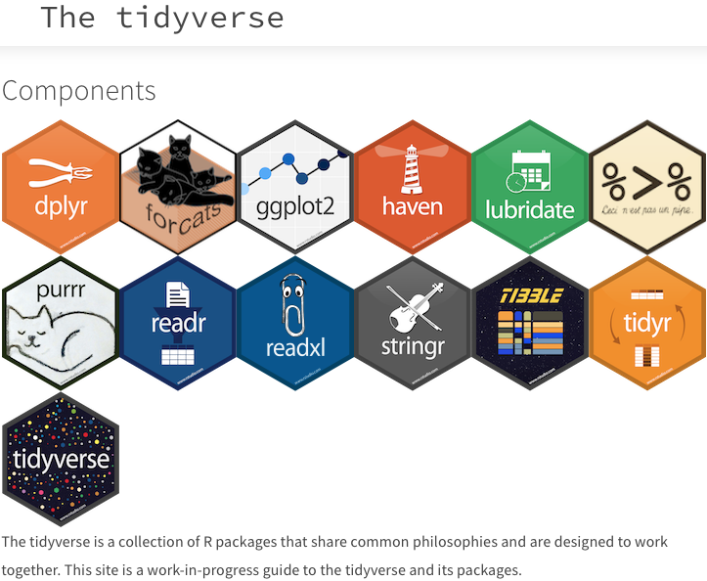
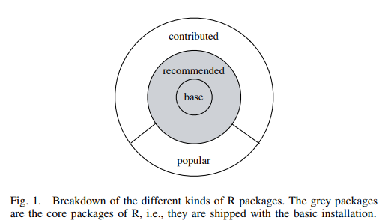
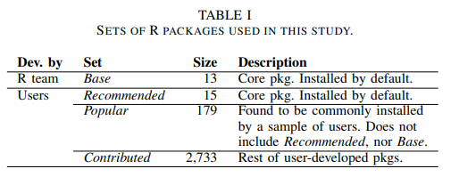
Topic 3: Data manipulation
1. Know how to extend R with add‐on packages
2. Understand the R ecosystem
3. Know how to find help for functions
4. Understand test statistics
5. Understand functions ‘lm’ and ‘glm’
6. Know how to Interpret results
7. Understand predicting
nonessential code or unimportant content
essential code
German DM, Adams B, Hassan AE. The evolution of the R software ecosystem. In2013 17th European Conference on Software Maintenance and Reengineering 2013 Mar 5 (pp. 243-252). IEEE.

Slide 9
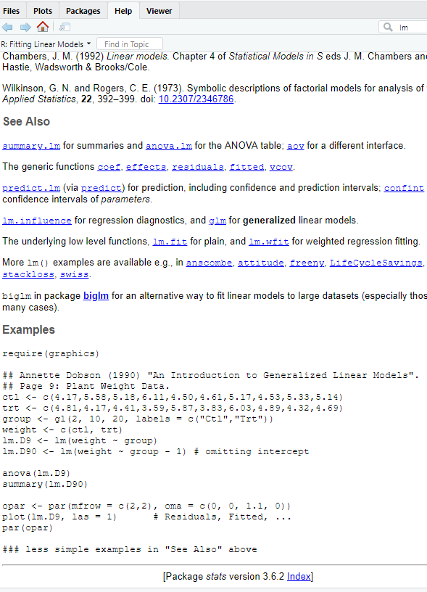
Getting Help with R
Helping Yourself
Topic 3: Data manipulation
1. Know how to extend R with add‐on packages
2. Understand the R ecosystem
3. Know how to find help for functions
4. Understand test statistics
5. Understand functions ‘lm’ and ‘glm’
6. Know how to Interpret results
7. Understand predicting
nonessential code or unimportant content
essential code
R Help: help() and ?
The help() function and ? help operator in R provide access to the documentation pages for R functions, data sets, and other objects, both for packages in the standard R distribution and for contributed packages
To get an idea even quicker, you run the examples in the bottom of the help file
You can execute these examples in the current R session via the example() command: e.g., example(lm).

Slide 10
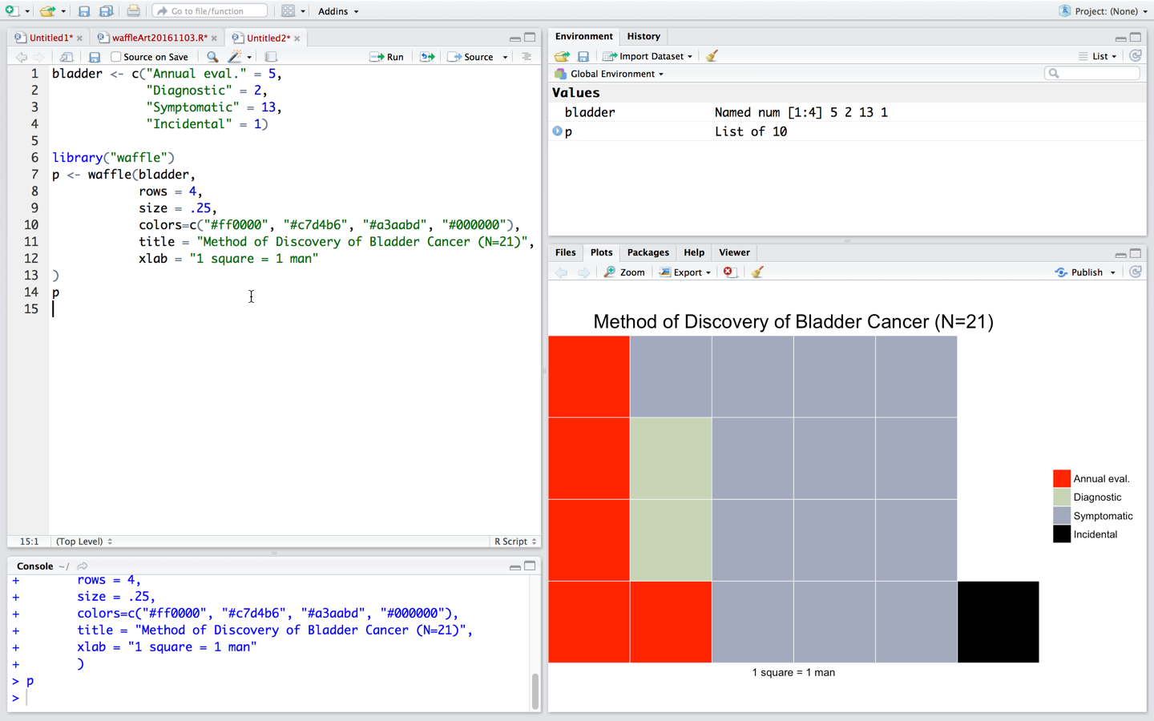
Take the “waffle” package from R2_data_visual.ppt for example
Topic 3: Data manipulation
1. Know how to extend R with add‐on packages
2. Understand the R ecosystem
3. Know how to find help for functions
4. Understand test statistics
5. Understand functions ‘lm’ and ‘glm’
6. Know how to Interpret results
7. Understand predicting
nonessential code or unimportant content
essential code

Slide 11
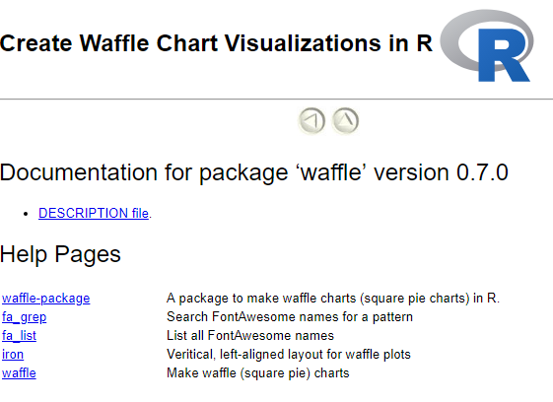
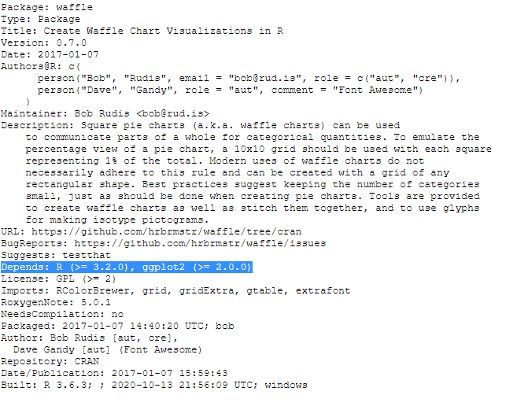
Take the “waffle” package from R2_data_visual.ppt for example
Topic 3: Data manipulation
1. Know how to extend R with add‐on packages
2. Understand the R ecosystem
3. Know how to find help for functions
4. Understand test statistics
5. Understand functions ‘lm’ and ‘glm’
6. Know how to Interpret results
7. Understand predicting
nonessential code or unimportant content
essential code

Slide 12
This is only a programming course …
Topic 3: Data manipulation
1. Know how to extend R with add‐on packages
2. Understand the R ecosystem
3. Know how to find help for functions
4. Understand test statistics
5. Understand functions ‘lm’ and ‘glm’
6. Know how to Interpret results
7. Understand predicting
nonessential code or unimportant content
essential code
Objects have names in r through attributes. Today we mainly focus on list since the output of statistics models is often a list
age <- c(10, 12, 25, 50, 55, 80)
attributes(age)
attributes(age) <- list(collectDate = "20200101", Collectedby = "Tom Hanks")
attributes(age)
class(age)
x <- data.frame(a = 1:3, pi = pi) # data frame with dimnames
attributes(x)
rownames(x) <- paste("row", 1:3, sep = ".")
attributes(x)
x$pi
x <- list(a = 1:3, pi = pi)
x$pi

Slide 13
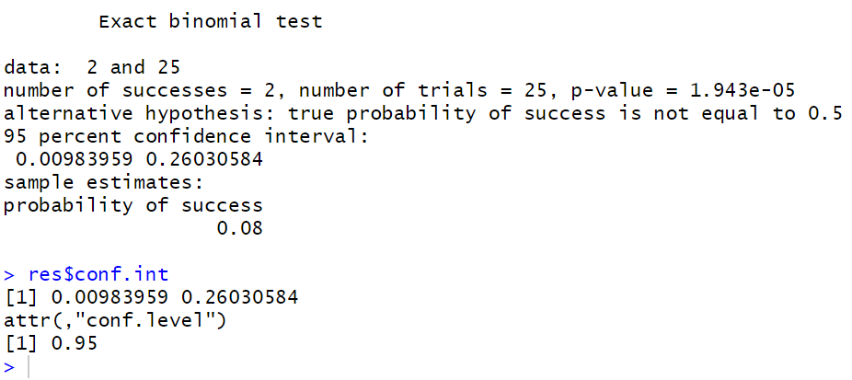
Test and Confidence Intervals
Topic 3: Data manipulation
1. Know how to extend R with add‐on packages
2. Understand the R ecosystem
3. Know how to find help for functions
4. Understand test statistics
5. Understand functions ‘lm’ and ‘glm’
6. Know how to Interpret results
7. Understand predicting
nonessential code or unimportant content
essential code
I have a coin and I want to test whether it is even or not. If it is even, I should get half chance of heads and half chance of tails. I tried 25 times and record my result as: 2 times of heads and 23 times of tails. Then I used this R function:
My hypothesis is that the coin is even. I reject my hypothesis through p values and confidence interval. Maybe one side of my coin is gold, and the other side is aluminum
res <- binom.test(x = 2, n = 25, conf.level = .95)
res
res$conf.int

Slide 14
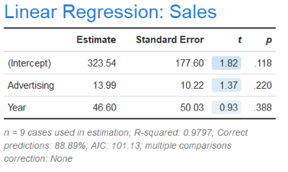
This is only a programming course …
Topic 3: Data manipulation
1. Know how to extend R with add‐on packages
2. Understand the R ecosystem
3. Know how to find help for functions
4. Understand test statistics
5. Understand functions ‘lm’ and ‘glm’
6. Know how to Interpret results
7. Understand predicting
nonessential code or unimportant content
essential code
Your job is to create a summary table for your model that looks like this:
I won’t explain too much about statistics. I only want to demonstrate that to save your result, you need more coding in R, compared with other software, but you can inspect and control a lot of things
library(mlbench)
data(BostonHousing)
help(BostonHousing)
summary(BostonHousing)
head(BostonHousing)
obj <- lm(medv ~ rm + crim + zn + tax, data = BostonHousing)
summary(obj)
mytable <- summary(obj)$coefficients
rownames(mytable) <- c("Intercept","Room number","Crime rate","Residential land","Property tax")
mytable[,1:3] <- round(mytable[,1:3],2)
mytable[,4] <- round(mytable[,4],3)
mytable
write.csv(mytable,"BostonHousingResult_medv.csv")
plot(obj)

Slide 15
R is consistent in terms of model usage
Topic 3: Data manipulation
1. Know how to extend R with add‐on packages
2. Understand the R ecosystem
3. Know how to find help for functions
4. Understand test statistics
5. Understand functions ‘lm’ and ‘glm’
6. Know how to Interpret results
7. Understand predicting
nonessential code or unimportant content
essential code
Now I am running a completely different model, but I did not made a lot of changes my code
  I only change my outcome from continuous outcome medv to binary outcome chas
  and change function from "lm" to "glm"
obj2 <- glm(chas ~ rm + crim + zn + tax, data = BostonHousing, family = binomial())
summary(obj2)
mytable2 <- summary(obj2)$coefficients
rownames(mytable2) <- c("Intercept","Room number","Crime rate","Residential land","Property tax")
mytable2[,1:3] <- round(mytable2[,1:3],2)
mytable2[,4] <- round(mytable2[,4],3)
mytable2
write.csv(mytable2,"BostonHousingResult_chas.csv")
plot(obj2)

Slide 16
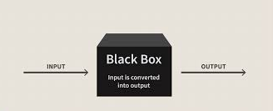
What is a model?
Usually, we have an outcome (supervised model) …
Topic 3: Data manipulation
1. Know how to extend R with add‐on packages
2. Understand the R ecosystem
3. Know how to find help for functions
4. Understand test statistics
5. Understand functions ‘lm’ and ‘glm’
6. Know how to Interpret results
7. Understand predicting
nonessential code or unimportant content
essential code
Features/
Independent variable
Outcome/
Dependent variable
A model is to
  Predict the outcome
  Infer associations between features and outcomes
If you can program a model, then this black box is transparent to you

Slide 17
Supervised model
Topic 3: Data manipulation
1. Know how to extend R with add‐on packages
2. Understand the R ecosystem
3. Know how to find help for functions
4. Understand test statistics
5. Understand functions ‘lm’ and ‘glm’
6. Know how to Interpret results
7. Understand predicting
nonessential code or unimportant content
essential code
A lot of R functions for supervised model take the following format
obj <- name(outcome ~ x1 + x2 + x3 + x4, data = train.dat)
or
obj <- name(outcome ~ ., data = train.dat) ## all the other columns in .
For prediction, we have
predict(obj, newdata = test.dat)
See examples of lm, glm, rfsrc in “4-statistical-model.R”

Slide 18
Model prediction (supervised model)
Topic 3: Data manipulation
1. Know how to extend R with add‐on packages
2. Understand the R ecosystem
3. Know how to find help for functions
4. Understand test statistics
5. Understand functions ‘lm’ and ‘glm’
6. Know how to Interpret results
7. Understand predicting
nonessential code or unimportant content
essential code
Features/
Independent variable
Outcome/
Dependent variable
If you only want to test models, then you are allowed to have a vague idea of this black box
Your knowledge about his black box mostly depends on your training from your statistics course, not your programming course

Slide 19

Thank you very much!

