Slide 1

Applying Convex Optimization to supply distribution Logistics
Chuxuan Tang

Slide 2
problem description
In this problem, the company needs to deliver all the orders in the cycle to the customers according to the requirements.
Under normal circumstances, there are many logistics suppliers in the market, and the specifications and costs of different logistics suppliers and vehicles may be different. Therefore, how to choose the right logistics suppliers to minimize the total distribution cost is a problem that enterprises need to face.
From the perspective of enterprises, the following two issues need to be considered, and these two issues affect each other:
(1) how to combine different orders
(2) Select logistics suppliers and distribution methods (partial load or vehicle)

Slide 3
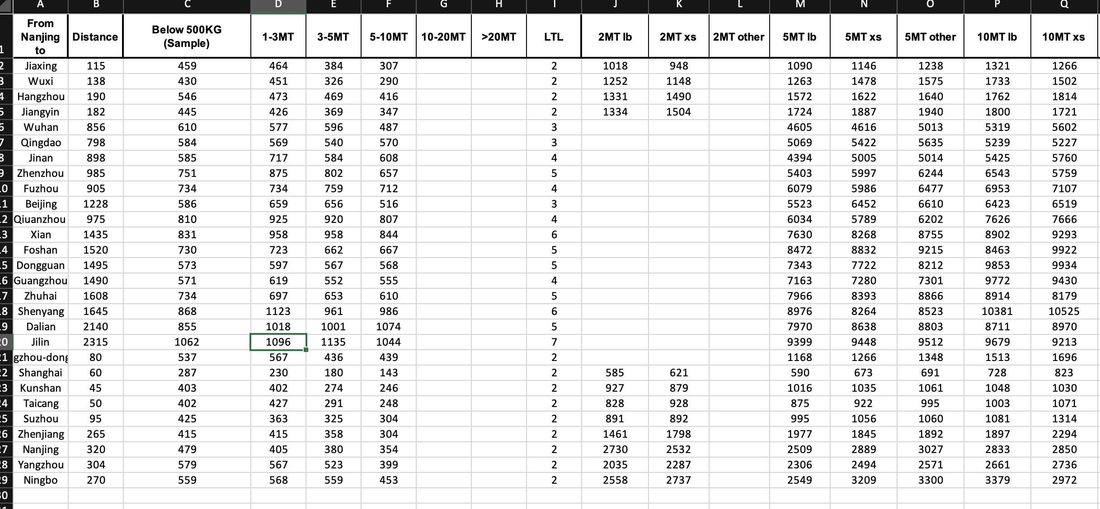
input
Order delivery case Input data Order information: start and end, weight, delivery time and other data.

Slide 4
input
Logistics provider information: information of all providers of different price of vehicles, load and other data. For example, the quotation scheme given by a logistics supplier:

Slide 5
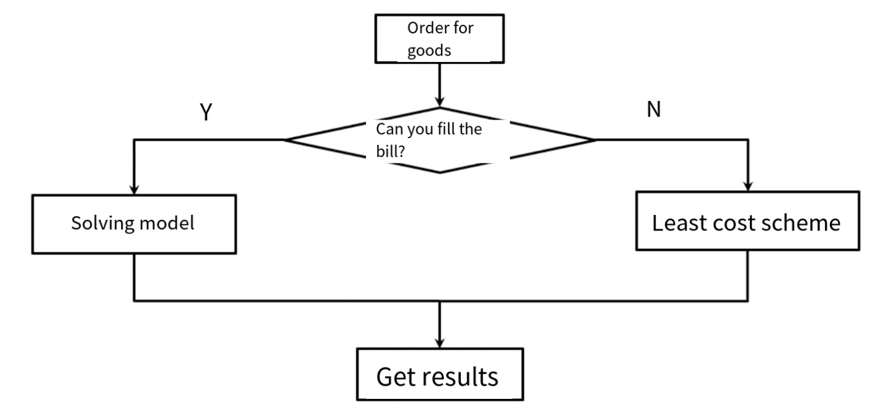
Problem Formulation
For all orders in the planning cycle, if a feasible order combination scheme is given, according to the quotation of the logistics provider, we can easily work out the distribution scheme with the lowest total cost.
For a particular order, it is easy to determine the relationship with other orders:
Share the bill

Slide 6
Problem Formulation:
For the orders within the planning period, the most difficult situation to deal with is that all orders can be filled (the same start and end point and the same delivery time), then all orders will appear in the model, greatly increasing the size of the problem and the difficulty of solving. However, orders often have different starting and ending positions and delivery times, so the number of orders that can be filled is not large. For example, there are 8 orders {A,B,C,D,E,F,G,H}, which can be divided into 6 order sets {A}, {B, H}, {C}, {D}, {E,F}, {G} according to the order information. Only collections with multiple elements can be ordered, in which case the model decides whether to order and how to ship. For orders that cannot be filled, you can directly find the most suitable delivery plan (the lowest price).

Slide 7
Pre-processing (orders that cannot be shared)
• Objective: To find the lowest cost distribution solution directly, that is, to determine which logistics provider to take which way (vehicle or partial load) distribution.
Methods: (1) Less-load transportation, find out the models that can be used, mainly considering the match of time, place and load. Select the lowest cost logistics provider.
(2) Full-load transportation, similarly, to find available vehicle types, pay attention to the need to meet the full-load rate when considering load constraints. Select the lowest cost delivery plan from the available options.

Slide 8
Pre-processing (orders that can be filled)
Objective: To identify all the orders that can be filled with a certain order, form a set of these orders, and build a mathematical model on the set.
Method: For a particular order, go through all outstanding orders and search for orders that can be filled. Whether the order can be filled depends on whether the starting position and the delivery time match. To further reduce the number of variables in the model, for each logistics provider, all the models that can be used are found, and the models that cannot be used will not appear in the variables.

Slide 9
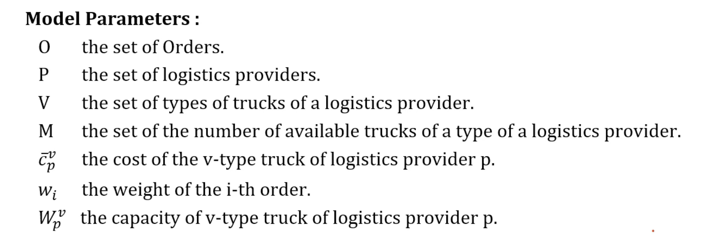
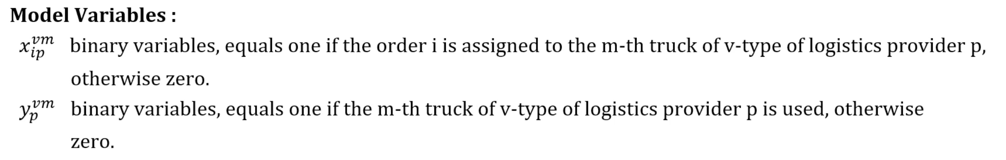
model

Slide 10
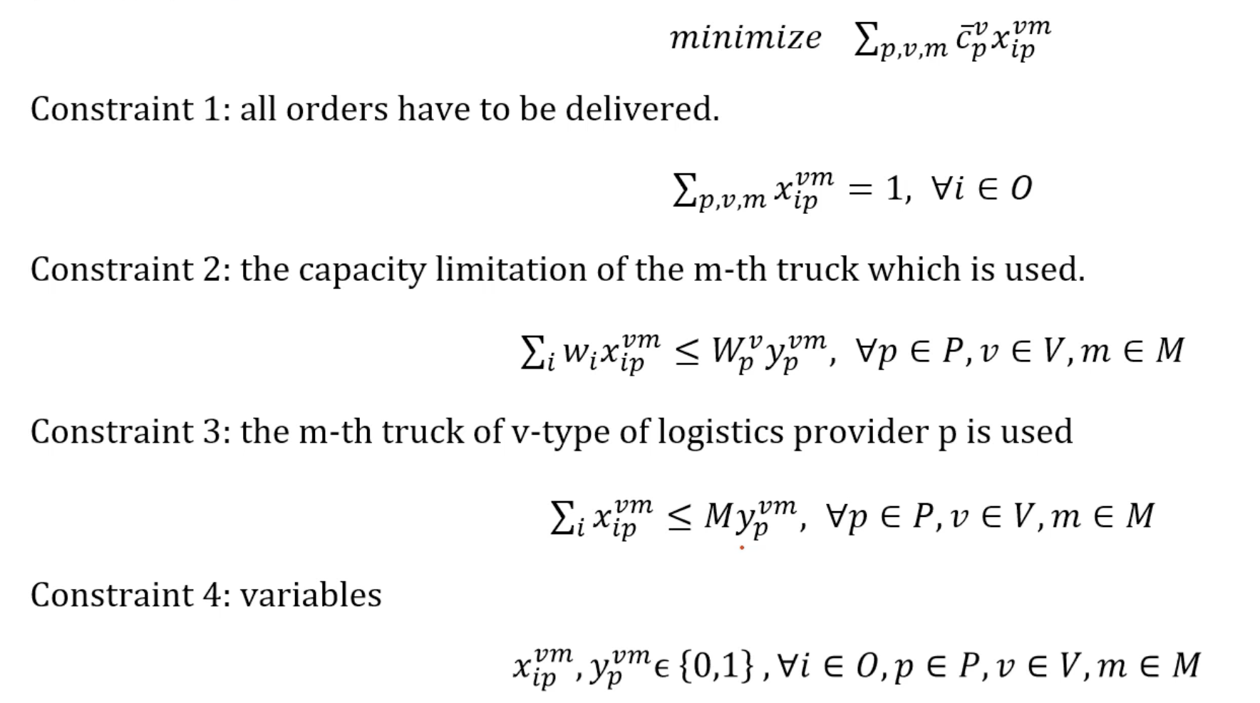
model

Slide 11
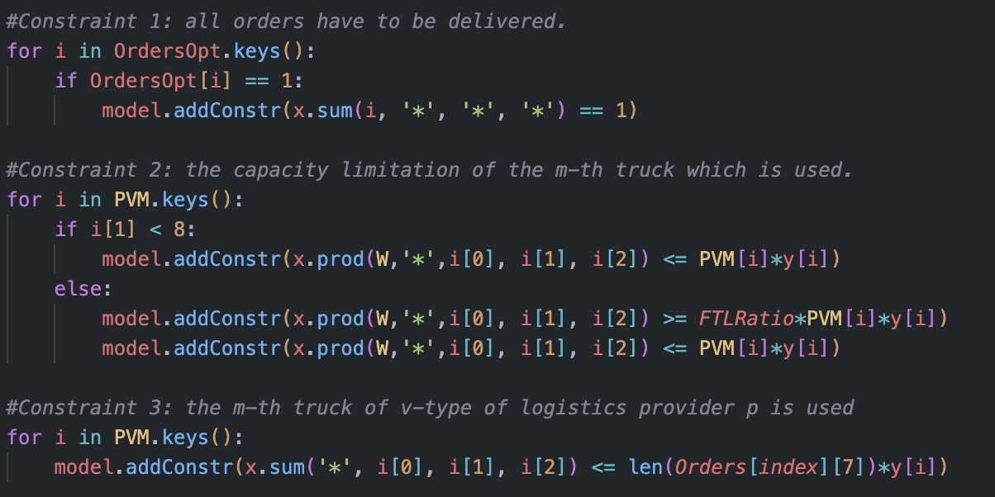
Constraint:
Each order must be assigned to a logistics provider and a vehicle type.
The payload of each vehicle must not exceed its capacity.
Each logistics provider can use each vehicle type at most once.

Slide 12
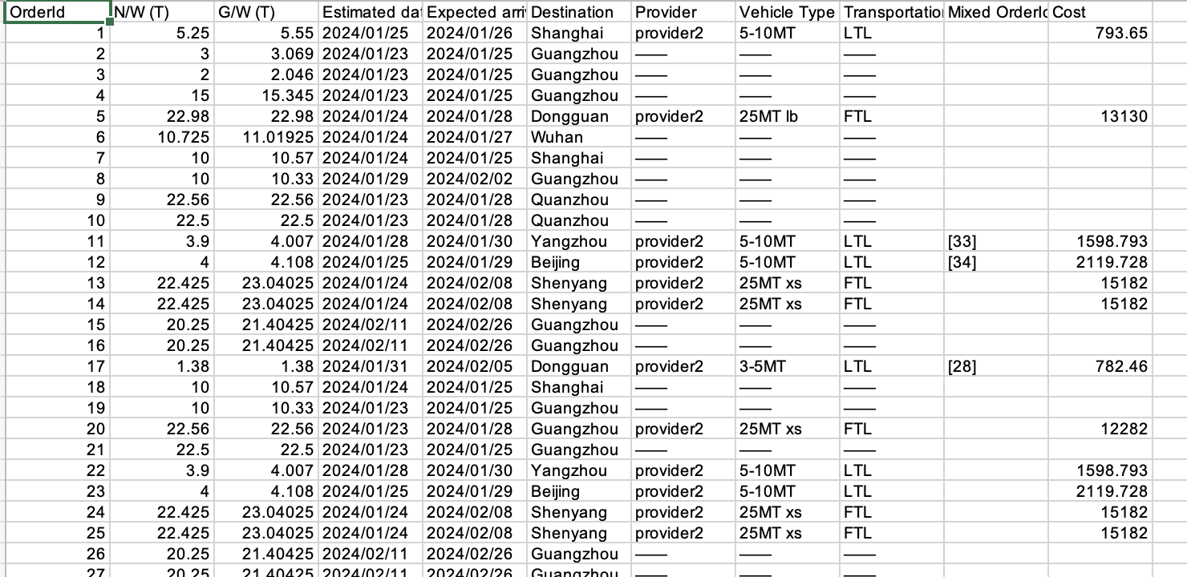
results

Slide 13
Conclusion
Divide all orders into two categories according to whether they can be filled. Find the best delivery plan directly for the orders that cannot be filled through simple processing.
For the orders that can be filled, a mathematical planning model is established, and the number of variables is further reduced by preprocessing.
Considering that the actual amount of order can not be very large, this scheme can quickly obtain the optimal solution of the problem.

Slide 14
Thank you!

