Slide 1
Portable document Format
Mike Li
Notes:
This template can be used as a starter file for presenting training materials in a group setting.
Sections
Right-click on a slide to add sections. Sections can help to organize your slides or facilitate collaboration between multiple authors.
Notes
Use the Notes section for delivery notes or to provide additional details for the audience. View these notes in Presentation View during your presentation.
Keep in mind the font size (important for accessibility, visibility, videotaping, and online production)
Coordinated colors
Pay particular attention to the graphs, charts, and text boxes.
Consider that attendees will print in black and white or grayscale. Run a test print to make sure your colors work when printed in pure black and white and grayscale.
Graphics, tables, and graphs
Keep it simple: If possible, use consistent, non-distracting styles and colors.
Label all graphs and tables.

Slide 2


Technical foundations
Adobe holds the patents to PDF
Licenses royalty-free
The PDF combines three technologies:
A subset of the PostScript description programming language, for generating the layout and graphics.
A font-embedding/replacement system to allow fonts to travel with the documents.
A structured storage system to bundle these elements and any associated content into a single file, with data compression where appropriate.

Slide 3
PDF vs. PostScript
PostScript is a page description language run in an interpreter to generate an image, a process requiring many resources.
PostScript can handle not just graphics, but also standard features of programming languages such as if and loop commands.
PDF is largely based on the PostScript but simplified to remove the flow control features like these, while graphics commands such as lineto remain.

Slide 4
PDF vs. PostScript
As a document format, PDF has several advantages over PostScript
PDF contains tokenized and interpreted results of the PostScript source code, for direct correspondence between changes to items in the PDF page description and changes to the resulting page appearance.
PDF(from version 1.4) support the graphics transparency; PostScript does not.
PostScript is an interpreted programming language with an implicit global state, so instructions accompanying the description of one page can affect the appearance of any following page. Therefore, all preceding pages in a postscript document must be processed to determine the correct appearance of a given page, whereas in each page in a PDF document is unaffected by the others.

Slide 5
Technical foundations
Why PDF?

Slide 6
Technical foundations
PDF 2.0
Adobe Extension Level 5
Include evolutionary enhancement
Refinement of the PDF language
Deprecation of features (e.g. Form Xobject)
Adobe’s XML Forms Architecture (XFA)

Slide 7
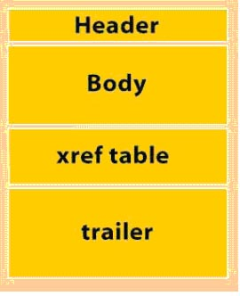
File structure
Notes:
Give a brief overview of the presentation. Describe the major focus of the presentation and why it is important.
Introduce each of the major topics.
To provide a road map for the audience, you can repeat this Overview slide throughout the presentation, highlighting the particular topic you will discuss next.

Slide 8
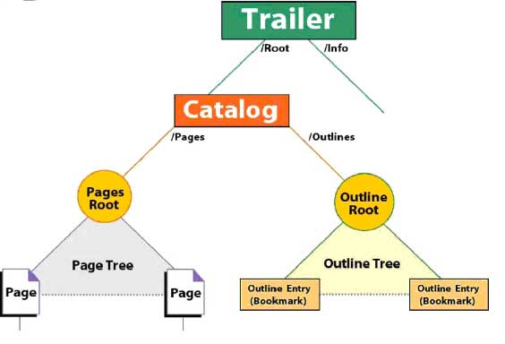
Document structure
Notes:
This is another option for an Overview slides using transitions.

Slide 9
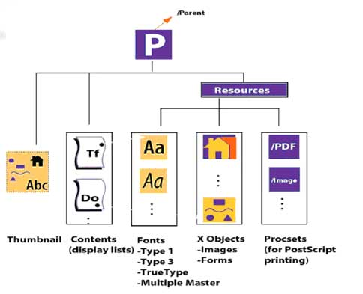
Page structure

Slide 10
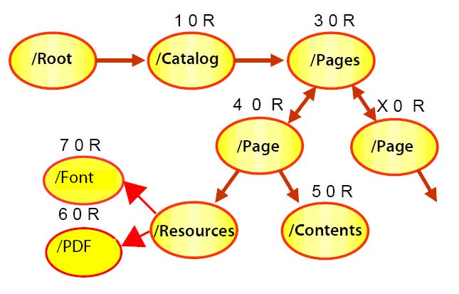
Parse

Slide 11
Technical overview
File structure
Boolean
Numbers
Strings
Names
Arrays, ordered collection of objects
Dictionaries, collection of objects indexed by Names
Streams
The null object

Slide 12
Font
Type1 and Type3 from Adobe, *.afb, *.afm, *.cff
TrueType, Apple & Microsoft
OpenType, Type1 & TrueType

Slide 13
Interactive Forms
Sometime referred as AcroForm
Root
AcroForm
Form Fields[]
Form Field
Form Field
Form Field

Slide 14
Object streams
From PDF 1.5
A kind of stream, an object stream, which contains a sequence of PDF objects.
The purpose of object streams is to allow a great number of PDF objects to be compressed, thereby substantially reducing the size of PDF files.
The objects in the stream are referred to as compressed objects.

Slide 15
Incremental update
The contents of a PDF file can be updated incrementally without rewriting the entire file.

Slide 16
Objects
Indirect Objects
7 0 obj
(Brillig)
endobj
7 : A positive integer object number
0 : A non-negative integer generation number, for incremental update.
Indirect reference
7 0 R

Slide 17
Interactive features
Annotations
Interactive forms
Digital signatures

Slide 18
Interactive forms
Interactive form, sometimes referred to as an Acroform.
PDF 1.5 introduces support for interactive forms based on the Adobe XML Forms Architecture(XFA).

Slide 19
Same Named Text Fields
38 0 obj
<</DA(/Helv 12 Tf 0 g)/FT/Tx/Kids[31 0 R 34 0 R 32 0 R]/T(Text1)/V(123)>>
Endobj
31 0 obj
<</AP<</N 42 0 R>>/F 4/MK<<>>/P 17 0 R/Parent 38 0 R/Rect[126.0 653.0 438.0 684.0]/Subtype/Widget/Type/Annot>>
Endobj
32 0 obj
<</AP<</N 41 0 R>>/DA(/Helv 12 Tf 0 g)/F 4/MK<<>>/P 17 0 R/Parent 38 0 R/Rect[121.0 555.0 451.0 588.0]/Subtype/Widget/Type/Annot>>
Endobj
34 0 obj
<</AP<</N 39 0 R>>/F 4/MK<<>>/P 17 0 R/Parent 38 0 R/Rect[138.0 468.5 450.0 499.5]/Subtype/Widget/Type/Annot>>
Endobj
36 0 obj
<</DA(/Helv 0 Tf 0 g )/DR<</Encoding<</PDFDocEncoding 40 0 R>>/Font<</Helv 35 0 R/ZaDb 43 0 R>>>>/Fields[38 0 R]>>
Endobj
16 0 obj
<</AcroForm 36 0 R/Metadata 2 0 R/Names 23 0 R/Outlines 6 0 R/Pages 7 0 R/SpiderInfo 13 0 R/Type/Catalog>>
endobj

Slide 20
Same named checkbox
42 0 obj
<</DA(/ZaDb 0 Tf 0 g)/FT/Btn/Kids[37 0 R 38 0 R]/T(Check BoxABCD)>>
Endobj
37 0 obj
<</AP<</D<</Off 50 0 R/Yes 51 0 R>>/N<</Off 48 0 R/Yes 49 0 R>>>>/AS/Off/F 4/MK<</BC[0.0]/BG[1.0]>>/P 15 0 R/Parent 42 0 R/Rect[113.25 597.749 234.001 701.25]/Subtype/Widget/Type/Annot>>
Endobj
38 0 obj
<</AP<</D<</Off 46 0 R/Yes 47 0 R>>/N<</Off 43 0 R/Yes 44 0 R>>>>/AS/Off/DA(/ZaDb 0 Tf 0 g)/F 4/MK<</BC[0.0]/BG[1.0]>>/P 15 0 R/Parent 42 0 R/Rect[320.251 587.249 450.752 700.5]/Subtype/Widget/Type/Annot>>
Endobj
43 0 obj
<</BBox[0.0 0.0 130.5 113.25]/FormType 1/Length 62/Matrix[1.0 0.0 0.0 1.0 0.0 0.0]/Resources<</ProcSet[/PDF]>>/Subtype/Form/Type/XObject>>stream
1 g0 0 130.5005 113.2504 ref0.5 0.5 129.5005 112.2504 res
endstream
Endobj
44 0 obj
<</BBox[0.0 0.0 130.5 113.25]/FormType 1/Length 167/Matrix[1.0 0.0 0.0 1.0 0.0 0.0]/Resources<</Font<</ZaDb 45 0 R>>/ProcSet[/PDF/Text]>>/Subtype/Form/Type/XObject>>stream
1 g0 0 130.5005 113.2504 ref0.5 0.5 129.5005 112.2504 resq1 1 128.5005 111.2504 reWn0 gBT/ZaDb 113.4238 Tf17.2724 18.232 Td109.2269 TL0 0 Td(4) TjETQ
endstream
endobj

Slide 21
The PDF page boxes
MediaBox
CropBox
BleedBox
TrimBox
ArtBox

Slide 22
The PDF page boxes
MediaBox
The MediaBox is used to specify the width and height of the page. For the average user, this probably equals the actual page size. For prepress use, this is not the case as we prefer our pages to be defined slightly oversized so that we can see the bleed (Images or other elements touching an outer edge of a printed page need to extend beyond the edge of the paper to compensate for inaccuracies in trimming the page), the crop marks and useful information such as the file name or the date and time when the file was created. This means that PDF files used in graphic arts usually have a MediaBox which is larger then the trimmed page size. The MediaBox is the largest page box in a PDF. The other page boxes can equal the size of the MediaBox but they cannot be larger.

Slide 23
The PDF page boxes
CropBox
The CropBox defines the region to which the page contents are to be clipped. Acrobat uses this size for screen display and printing. For prepress use, the CropBox is pretty irrelevant. The GWG industry association recommends not to use the CropBox at all.

Slide 24
The PDF page boxes
BleedBox
The BleedBox determines the region to which the page contents needs to be clipped when output in a production environment. Usually the BleedBox is 3 to 5 millimetres larger than the TrimBox. It is nice to know the size of the BleedBox but it isn’t that important in graphic arts. Most prepress systems allow you to define the amount of bleed yourself and ignore the BleedBox. By default the BleedBox equals the CropBox.

Slide 25
The PDF page boxes
TrimBox
The TrimBox defines the intended dimensions of the finished page. Contrary to the CropBox, the TrimBox is very important because it defines the actual page size. The imposition programs and workflows that I know all use the TrimBox as the basis for positioning pages on a press sheet. By default the TrimBox equals the CropBox. When creating PDFs that are PDF/X-1a or PDF/X-3 compliant it is a requirement that the MediaBox, TrimBox and BleedBox are properly defined in the PDF.

Slide 26
The PDF page boxes
ArtBox
The ArtBox is a bit of a special case. It can define a region within a page that is of special interest. It is rarely used by applications. One way in which it can be used is to handle ads: on a PDF of a page on which there is an advertisement, the ArtBox can define the size of that ad. This allows you to place that PDF on another page but only use the ad from that PDF.

Slide 27
Text Terminology
Font vs. Typeface
A typeface is the visual appearance of the letters, and the font is the implementation which create them. Simply, “Times New Roman” is Typeface, “TimeNewRoman.otf” is a font

Slide 28
Text Terminology
Glyph vs. Character
A glyph is a specific visual form of a character.
Font file vs. Font program

Slide 29
Simple Fonts
Single-byte character code, index into a table of 256 glyphs.
Each glyph has a single set of metrics, including a horizontal displacement or width, support only horizontal writing mode.
Font descriptor, containing font-wide metrics and other attributes of the font. Among those attributes is an optional font file stream containing the font program.

Slide 30
Simple Fonts
Type 1 Fonts
A Type 1 font program is a stylized Postscript program that describes glyph shapes
Hint information
Standard Type 1 Fonts (Standard 14 Fonts)
Must be avariable to the consumer application.
Deprecated from PDF1.5

Slide 31
Simple Fonts
TrueType
Can be embedded directly in a PDF file as a stream object.

Slide 32
Simple Fonts
Font Subsets
For Type 1 or TrueType fonts
EOODIA+Poetica

Slide 33
Simple Fonts
Type 3 Fonts
Glyphs are defined by streams of PDF graphics operators.
No hinting mechanism.

Slide 34
Simple Fonts
Character Encoding
A font’s encoding is the association between character codes and glyph descriptions.
Except for Type 3 fonts, every font program has a built-in encoding.
Predefined encodings: MacRomanEncoding,MacExpertEncoding, or WinAnsiEncoding

Slide 35
Composite Fonts
Type 0 font
Type 0 font is known as the root font, and its associated CIDFont is called its descendant.

Slide 36
Composite Fonts
CID-keyed Fonts
CID – Character identifier
The CID numbers are used to index and access the glyph descriptions in the font.
CMap – Character Map
CMap file specifies the correspondence between character codes and the CID numbers used to identify glyphs. It is equivalent to the concept of an encoding in simple font.

Slide 37
Font
Type 0
Type 1
Type 3
TrueType
CIDFont
CIDFont0 based on Type 1 font technology
CIDFont2 based on TrueType font technology

Slide 38
CMaps
A Cmap specifies the mapping from character codes to character selectors.
In PDF, the character selectors are always CIDs in CIDFont.
A Cmap serves a function analogous to the Encoding dictionary for a simple font.

Slide 39
CMaps
To Unicode CMaps
Writing mode – Horizontal or Vertical

Slide 40
Mapping Character codes to Unicode Values
If a font’s characters are identified according to a standard character set:
Standard named encoding
Standard character name
CIDs in well-known collection
If a font is not defined in one of these ways:
ToUnicode CMap
ActualText entry for a structure element or marked content sequence

Slide 41
ToUnicode CMaps
14 0 obj
<<
/Type /Font
/Subtype /Type0
/BaseFont /Ryumin−Light
/Encoding /Identity−H
/DescendantFonts [ 15 0 R ]
/ToUnicode 16 0 R
>>
15 0 obj
<<
/Type /Font
/Subtype /CIDFontType2 /BaseFont /Ryumin−Light
/CIDSystemInfo 17 0 R /FontDescriptor 18 0 R /CIDToGIDMap /Identity
>>

Slide 42
ToUnicode CMaps
16 0 obj<< /Length 433 >>stream/CIDInit /ProcSet findresource begin12 dict begin
begincmap/CIDSystemInfo<< /Registry ( Adobe )/Ordering ( UCS )/Supplement 0>> def
/CMapName /Adobe−Identity−UCS def/CMapType 2 def
1 begincodespacerange
< 0000 >< FFFF >
endcodespacerange
2 beginbfrange
< 0000 >< 005E >< 0020 >
< 005F >< 0061 >[ < 00660066 > < 00660069 > < 00660066006C > ]
endbfrange
1 beginbfchar
<3A51><D840DC3E>
Endbfchar
Endcmap
…
endobj
Define the source character code range to be the 2-byte character codes from <00 00> to <FF FF>
<00 00> to <00 5E> are mapped to the Unicode values
U+0020 to U+007E
Character code | Ligature
<00 5F> | ff <0066 0066>
<00 60> | fi <0066 0069>
<00 61> | ffl <0066 0066 006C>

Slide 43

ToUnicode CMaps
16 0 obj<< /Length 433 >>stream/CIDInit /ProcSet findresource begin12 dict begin
begincmap/CIDSystemInfo<< /Registry ( Adobe )/Ordering ( UCS )/Supplement 0>> def
/CMapName /Adobe−Identity−UCS def/CMapType 2 def
1 begincodespacerange
< 0000 >< FFFF >
endcodespacerange
2 beginbfrange
< 0000 >< 005E >< 0020 >
< 005F >< 0061 >[ < 00660066 > < 00660069 > < 00660066006C > ]
endbfrange
1 beginbfchar
<3A51><D840DC3E>
Endbfchar
Endcmap
…
endobj
HTML Entity (decimal) | &#131134;
HTML Entity (hex) | &#x2003e;
UTF-8 (hex) | 0xF0 0xA0 0x80 0xBE (f0a080be)
UTF-8 (binary) | 11110000:10100000:10000000:10111110
UTF-16 (hex) | 0xD840 0xDC3E (d840dc3e)
UTF-16 (decimal) | 55,360 56,382
UTF-32 (hex) | 0x0002003E (2003e)
UTF-32 (decimal) | 131,134
C/C++/Java source code | "\uD840\uDC3E"

Slide 44
Graphics

Slide 45
Color Spaces
Color specification
Device color representation (grayscale, RGB, CMYK)
Human visual perception (CIE-based)
Color rendering
Device dependent
Some combination of color conversion, gamma correction, halftoning, and scan conversion.

Slide 46
Color spaces
Color Space Families
Device color spaces
DeviceGray, DeviceRGB, DeviceCMYK
CIE-based color spaces
CalGray, CalRBG, Lab, ICCBased
Special color spaces
Pattern, Indexed, Separation, DeviceN

Slide 47
Encryption
Encryption applies to all strings and streams in the document’s PDF file, but not to other object types.

Slide 48
Encryption
Owner password, user password
Opening the document with owner password allow full access to the document.
Opening the document with the correct user password allows additional operations to be performed according to the user access permission specified in the document’s encryption dictionary.

Slide 49
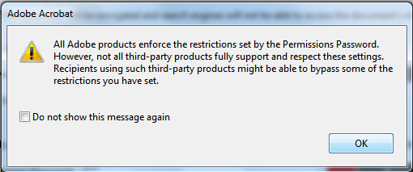
Encryption
Is the user password really helpful?

Slide 50
PDF ISO Standards
PDF/X | PDF/A | PDF/E
ISO 15930 since 2001 | ISO 19005 since 2005 | ISO 24517 since 1993/2008
“Prepress digital data exchange using PDF” | “PDF Archive” | “PDF Engineering”
ISO-standard for the printing history | Standardized long-term archiving with PDF | Construction diagrams with moving 3D models where required
PDF | PDF/VT | PDF/UA
ISO 32000 since 2008 | ISO 16612 since 2010 | ISO 14289 since 2012
“Portable Document Format” | “PDF for Variable Data and Transaction Printing” | “PDF for Universal Access”
The ISO standard for corresponds with PDF version 1.7 | Used for variable data printing | PDF standards for universally accessible PDF documents

Slide 51
PDF/UA

Slide 52
The key facts
Make use of PDF documents without assistant from others
Reaching a specific goal easily, directly, and within a reasonable time frame
Make the same-quality use of PDF documents as people without disability

Slide 53
Terminology
UA: Universal Accessibility
AT: Assistive technology
WCAG: Web Content Accessibility Guidelines
ADA: Americans With Disabilities Act
Rehabilitation Act, Section 508
AIIM: Association for Information and Image Management

Slide 54
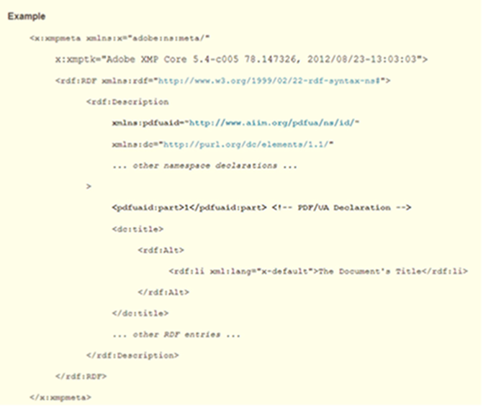
Version Identification

Slide 55
Interchange
Marked Content --- Identify sequences of graphics object.
Logical structure --- Describing the logical hierarchy for content within the document, uses the Marked Content mechanism.
Tagged PDF --- Apply semantics typing to content items identified by Logical Structure.
Accessibility support

Slide 56
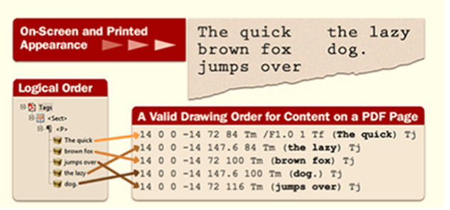
Logical reading order

Slide 57
Real Content and Artifacts
Standard Structure Types
Document, Part, Sect, Div
P, Span, TOC, List
Table, THead, Tbody, TR, TD
Figure, Annot

Slide 58
Real Content and Artifacts
Artifacts
Page layout, graphical background
Page number, header, footer
Cut marks, color bars
Image without alternate description, patterns or colored blocks
Anything is not required for understanding the content

Slide 59
Accessibility support
Natural Language Specification
Alternate Descriptions
Replacement text
Expansion of Abbr. or Acronyms

Slide 60
Navigation
Table of Contents
Where a document contains table of contents, PDF/UA confirming writers are encouraged to create Link structure elements including link annotations for each TOCI.

Slide 61
Character Encoding
What you saw in PDF viewer is a ‘Glyph’, Reading tools need a corresponding character when reading PDFs.
EXAMPLE

Slide 62
Tagged PDF
Real Content
Meaningful content
Artifact
No meaningful content

Slide 63
Real Content
Standard Structure Element
Document, Part, Section…
TOC, List, Heading…
Figure, Link…

Slide 64
Artifact
No meaningful content
Page header, footer, page number
Logo, background graphics, path…
No meaningful text (such as hyphen character’-’, Copyright…)

Slide 65
Chart
Why Chart in a document can’t be PDF in xPressoin PDF/UA?

Slide 66
Validation
Dose XPressoin need a own PDF/UA checker?
Simple and Effective

Slide 67
Validation
PDF Association
http://www.pdfa.org/
Matterhorn Protocol
PDF/UA Conformance Testing Model
Human / Machine

Slide 68
Validation
Acrobat Pro XI
PAC 2
http://www.access-for-all.ch/en/pdf-lab.html

Slide 69
PDF and Open Source
Foxit & PDFium
GhostScript

Slide 70
PDF and Open Source
Pure Java PDF Render?
Java PDF
PDF library
iText
JPDF
PDF Render
PDFBox @ Apache
IDR Solution
SunPDF
ICEPDF

Slide 71
PDF and Open Source
PDF & HTML5
pdf.js http://mozilla.github.io/pdf.js/

Slide 72
PDF and Open Source
PDF vs. OFD
OFD – Open Fixed-layout Document

