Slide 1

HTML & CSS
Instructor: 黃國峰
iLab, Multimedia Design
Internet, Image, Information, Interaction, Interesting

Slide 2
HTML(Hyper Text Markup Language)
<!DOCTYPE html>
<html>
<head>
<title>Introduce to HTML</title>
<meta name="viewport" content="width=device-width, initial-scale=1.0">
</head>
<body>
  <header id="masterHeader"> … </header>
  <article id=”mainContain">
  <img alt="tokyo buildings" src="images/tokyo.jpg" />
  </article >
  <footer> </footer>
</body>
</html>
HTML Element (Tag): http://www.w3schools.com/html/default.asp

Slide 3
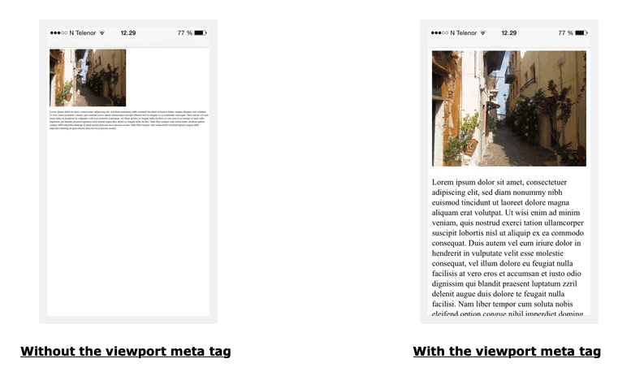

Slide 4

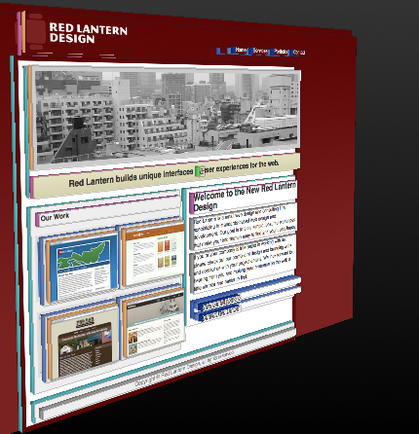
Example: Red Lantern Design
Firefox檢測器
Download Code: https://docs.google.com/file/d/0BwN5VWV_C7-5STFEZ2t0NThiWms/edit?usp=sharing

Slide 5
Html Element’s Attribute
Attributes (屬性) 描述HTML元素(或標籤)的性質或額外資訊
Attributes 定義在起始標籤(start tag)內
Attributes 的描述方式為: 屬性名稱=“屬性值”
Examples:
<a href="http://www.w3schools.com">This is a link</a>
<div id="masthead">
<h1 id="logo"><img src="images/rl_logo.png" /></h1>
</div>
<ul id="nav">
<li><a title="Red Lantern home" href="index.html">Home</a></li>
<li><a class= "disable" title="Design services" href="services.html">Services</a></li>
<li><a title="Our work" href="portfolio.html">Portfolio</a></li>
<li><a class= "disable " title="Contact Red Lantern" href="contact.html">Contact</a></li>
</ul>

Slide 6
CSS (Cascading Style Sheets)
CSS 用來定義HTML Tag的樣式， 定義方式有:
Inline - using the style attribute in HTML elements
    <p style="color: red; margin-left: 20px;">This is a paragraph.</p>
Internal - using the <style> element in the <head> section
  <head> <style type="text/css">
  body {background-color: yellow;}
  p {color: blue;}
  </style></head>
External - using an external CSS file
  <head>
  <link rel="stylesheet" type="text/css" href="mystyle.css”>
  </head>

Slide 7
Cascading
一致性: tag, class (在class名稱前加句號.)
獨特性: id (在id名稱前加sharp符號#)
#nav {
float: right;
margin: 50px 10px 0 0;
font-size: 1.4em;
}
#nav li {
display: inline;
margin: 0 0 0 20px;
}
#nav li a {
color: #fff;
text-decoration: none;
background: none;
}
#nav li a.active {
color: #ff0000;
}
<ul id="nav">
<li><a class="active” href="index.html">Home</a></li>
<li><a class="active” href="services.html">Services</a></li>
<li><a href="portfolio.html">Portfolio</a></li>
<li><a href="contact.html">Contact</a></li>
</ul>

Slide 8

HTML5 & CSS3
HTML5 第5版的HTML標準(非所有browser都支援所有功能):
New Elements: <canvas>, <video> , <audio> and so on
Support SVG (Scalable Vector Graphics)
Full CSS3 Support: Gradient color, animation, …
Local Storage
Local SQL Database
Web Applications

Slide 9
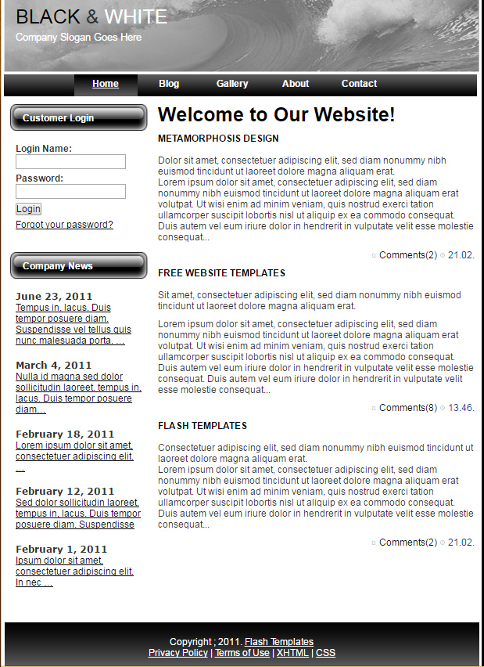
練習1
HTML/CSS 完成右列網頁

Slide 10
HTML
<body>
  <div id="main">
  <!-- header begins -->
  <div id="header">
  <div id="logo">
  <h1><a href="#" id="black">BLACK</a> &amp; <a href="#" id="white">WHITE</a></h1>
  <h2><a href="#" id="metamorph">Company Slogan Goes Here</a></h2>
  </div>
  </div>
  <!-- header ends -->
  <div id="menu">
  <ul>
  <li><a href="#" title="">Home</a></li>
  <li><a href="#" title="">Blog</a></li>
  <li><a href="#" title="">Gallery</a></li>
  <li><a href="#" title="">About</a></li>
  <li><a href="#" title="">Contact</a></li>
  </ul>
  </div>
  …
</body>

