Slide 1



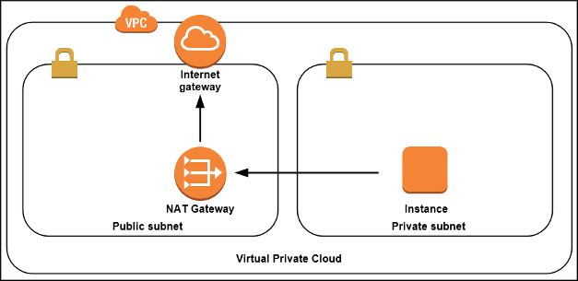




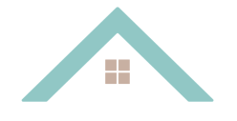
SECURITY GROUP
SECURITY GROUP
USERS
INTERNET GATEAWAY
EC2 INSTANCE
AMAZON RDS
BACKEND
DATABASE
FRONTEND
SUBNET PRIVADA
SUBNET PRIVADA
BUCKET

