Slide 2
Bioinformatics Lab
Spring Quarter 2017
UCSD
Week 3
Instructor:
Arturo Medrano
l1medranosoto@ucsd.edu
Instructional Assistant:
Hanbin Lu
hal213@ucsd.edu

Slide 3
Quiz From Week 2 Session 2
What is the G+C content of E. coli K12 MG1655? Write a script to give me the answer. You already wrote a function that reads the genomic sequence in one string, therefore calculating the G+C content is easy. Count the number of Gs and Cs, and divide that number by the length of the genome.
Tip 1: Create first a tiny “genome” with 10 bp, say 3 Cs, 3 Gs, 2 As and 2 Ts, then run your script and it should return G+C=0.6. Then you can run it in the whole genome.
Tip 2: You can do this for any program you write. For example, to test the function that calculates the CU frequencies of a gene, just design a “gene” of 10 codons you choose. Run your function on that “gene” and then compare the vector of frequencies you calculate with the numbers you know are correct. After that you can calculate the CU of all genes with confidence.
I need to see your script running and return the G+C content to give you credit for this question.

Slide 4
Assessing Translatability
Spring Quarter 2017
UCSD
Mini Project
Understand the biological context
Define the problem
Build a hypothesis
Design and implement a bioinformatic strategy (model).
Test your model and hypothesis

Slide 5
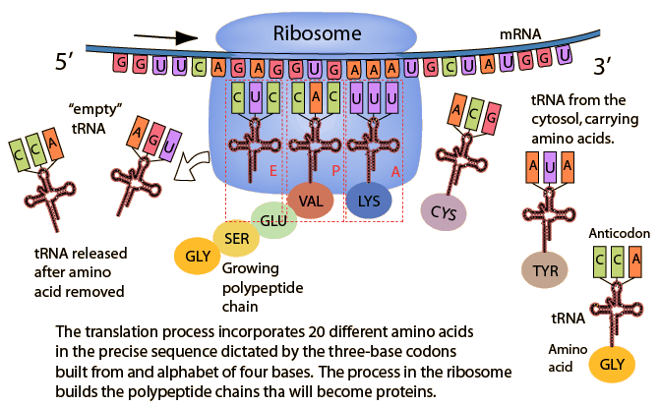
Protein Translation in a Nutshell
Codon preferences are not random, most genes follow similar patterns (Genome Hypothesis)¹
Depending on the availability of charged tRNAs the translation process will go faster or slower.^{2,3,4}
If codons correspond to abundant tRNAS, translation will be more efficient.^{2,3,4}
¹ 1980, NAR 8(1):r49-r62
² 1981, JMB 151(3):389-409
³ 1982, JMB 158(4):573-597
⁴ 1984, NAR 12(7):6663-6671
Notes:
The Genome Hypothesis also suggested that the genome is the operation unit subjected to selection rather than the gene.

Slide 6
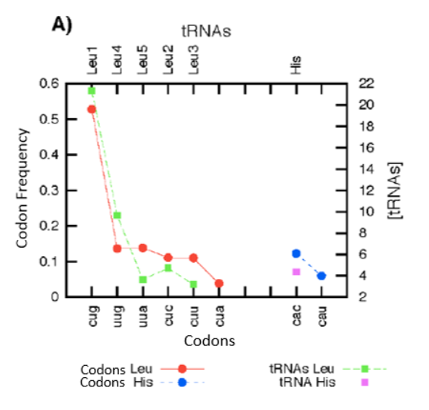
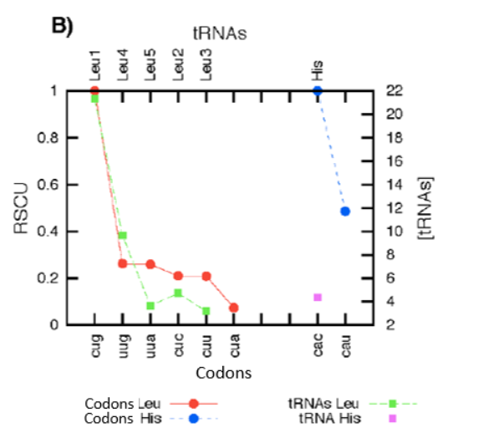
Codon usage versus tRNA concentration
Ignoring the choice of amino acid throws away valuable information relevant to translatability.

Slide 7
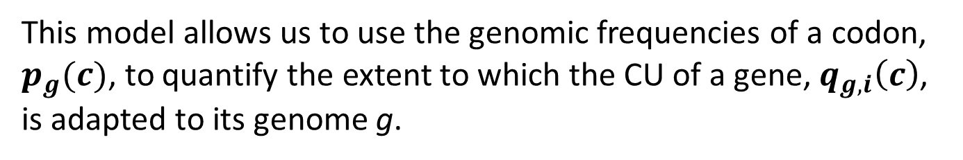
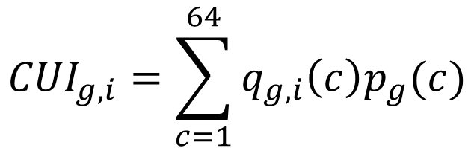
The Codon Usage Index
$${CUI}_{g,i}=\sum_{c=1}^{64}{q_{g,i}\left(c\right)p_{g}(c)}$$
This model allows us to use the genomic frequencies of a codon, $p_{g}(c)$, to quantify the extent to which the CU of a gene, $q_{g,i}\left(c\right)$, is adapted to its genome g.
The hypothesis is that the better adapted the CU of a gene to its genome, the more compatible it will be with the translational machinery of the cell.

Slide 8
Implementation
To prepare our sequences, we’ll make a slight modification to the script you developed in Exercise 3 during the first class of week 2. You downloaded the DNA sequence of the full E. coli K12 MG1655 genome and its annotation in tabular format. Your script should now:
Read the DNA sequence of the genome.
For each gene in the tab-separated annotations file, extract the DNA sequence and save it in a two column format. The first column should be the locus_tag (b-number) and the second column the DNA sequence of the gene in one string:
b0001 ATGAAACGC…TGA
b0002 ATGCGAGTG…TGA
b0003 ATGGTTAAA…TAA
…

Slide 9







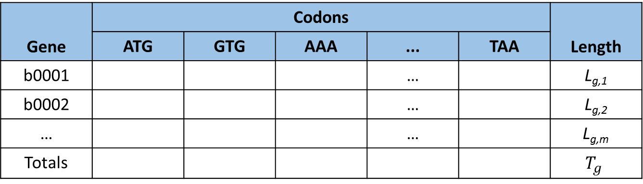









Implementation
For each gene in the genome estimate the frequencies of codons, length and keep genomic counts:
Gene | Codons |  |  |  |  | Length
 | ATG | GTG | AAA | ... | TAA
b0001 |  |  |  | … |  | L_{g,1}
b0002 |  |  |  | … |  | L_{g,2}
… |  |  |  | … |  | L_{g,m}
Totals |  |  |  |  |  | $$T_{g}$$
$$n_{g,1}\left(ATG\right)$$
$$n_{g,1}\left(GTG\right)$$
$$n_{g,1}\left(AAA\right)$$
$$n_{g,1}\left(TAA\right)$$
$$n_{g,2}\left(ATG\right)$$
$$n_{g,2}\left(GTG\right)$$
$$n_{g,2}\left(AAA\right)$$
$$n_{g,2}\left(TAA\right)$$
$$n_{g,m}\left(ATG\right)$$
$$n_{g,m}\left(GTG\right)$$
$$n_{g,m}\left(AAA\right)$$
$$n_{g,m}\left(TAA\right)$$
$$N_{g}\left(ATG\right)$$
$$N_{g}\left(GTG\right)$$
$$N_{g}\left(AAS\right)$$
$$N_{g}\left(TAA\right)$$
Order codons per amino acid and leave the stop codons at the end.
This will help to check for errors because there can be only one stop codon per gene.
Set a global counter for the 64 codons
Set local counter for 64 codons
Split the DNA sequence of a gene in sets of three nucleotides and start the counts
Save table above in a tab-separated file.
Calculate the CUI for each gene and save it to a 2-colum file (b-number and CUI)

Slide 10
Exploring Results
What is the personality and distribution of the CUI?
Scatter Plot 1: In the X-axis plot the genes in chromosomal order, in the Y-axis plot the CUI.
Scatter Plot 2: In X-axis sort the genes in ascending order based on their CUI, in the Y-axis plot the CUI.
Generate a histogram of the CUI.

Slide 11
Implications of the hypothesis
If the cell has to express all its genes when it needs them, then most genes in the genome should be adapted to the translation machinery of the cell, so that they can be expressed in adequate concentrations to perform their function.
A gene can be considered as adapted to the translation machinery of the cell if its codon usage reflects the genomic average CU.
A gene can be considered as specialized if it has similar codon preferences than highly expressed genes.¹ Do the most abundant codons in the genome correlate better or worse with tRNA concentrations?
A gene with poor CU has an excess of rare codons, this could mean:
1) the gene is foreign ²;
2) there is a strong selective pressure to have rare codons in order to regulate the level of expression; ³
3) having rare codons does not necessarily entails a significant impact on expressing its phenotype (relaxation of selective pressure). ⁴ NOTE: reference 4 convincingly refuted interpretation 2).
¹ 1987, NAR 15(3):1281-1295
² 1985, NAR 14(13):5125-5143
³ 1983, PNAS 80(3):687-691
⁴ 1986, NAR 14(9):7737-7749

Slide 12
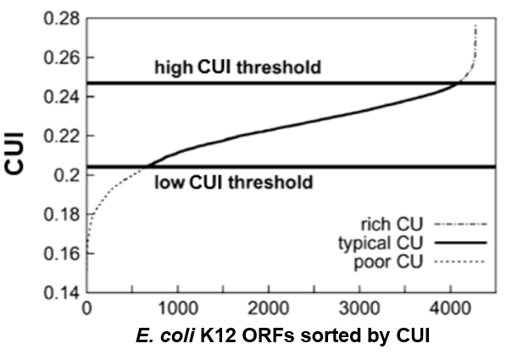
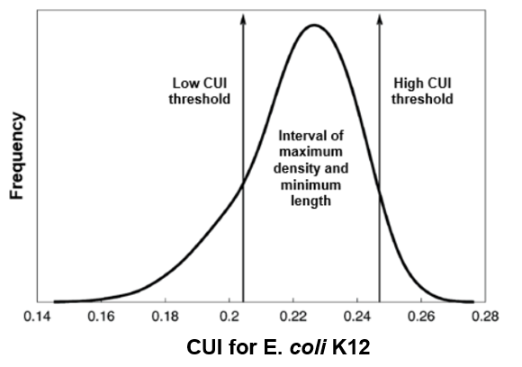
Exploring Results
How can we estimate the thresholds automatically?
This analysis makes it more appropriate to rename the index to Codon Richness Index (CRI)¹
¹ 2004, MBE 21(10):1884-94

Slide 13
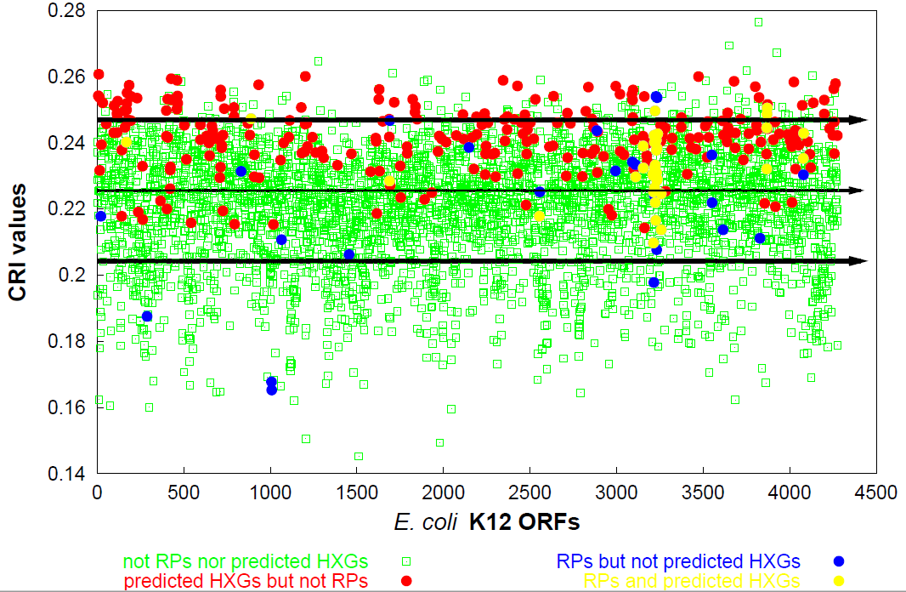
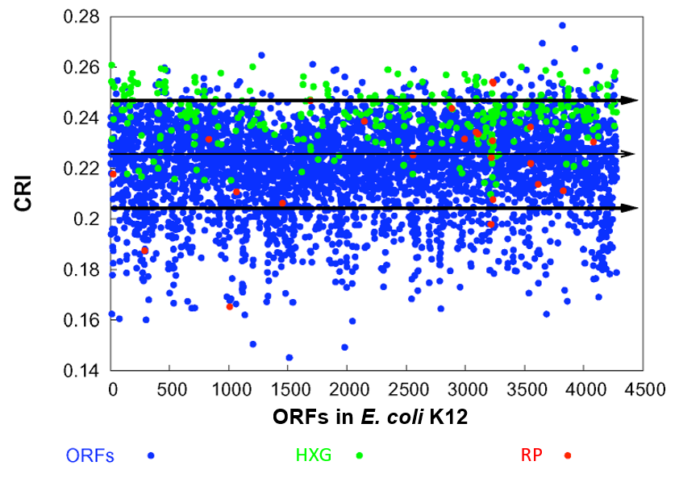
Benchmarking the model
Highly expressed genes (CXG) and ribosomal proteins (RP) tend to have typical-high to high CRI, indicating a bias towards the most abundant codons in the genome.
To what extent the CU of genes with poor, typical and rich CU correlate with tRNA concentrations?
How do such correlations compare with those of HXG and RP?

Slide 14
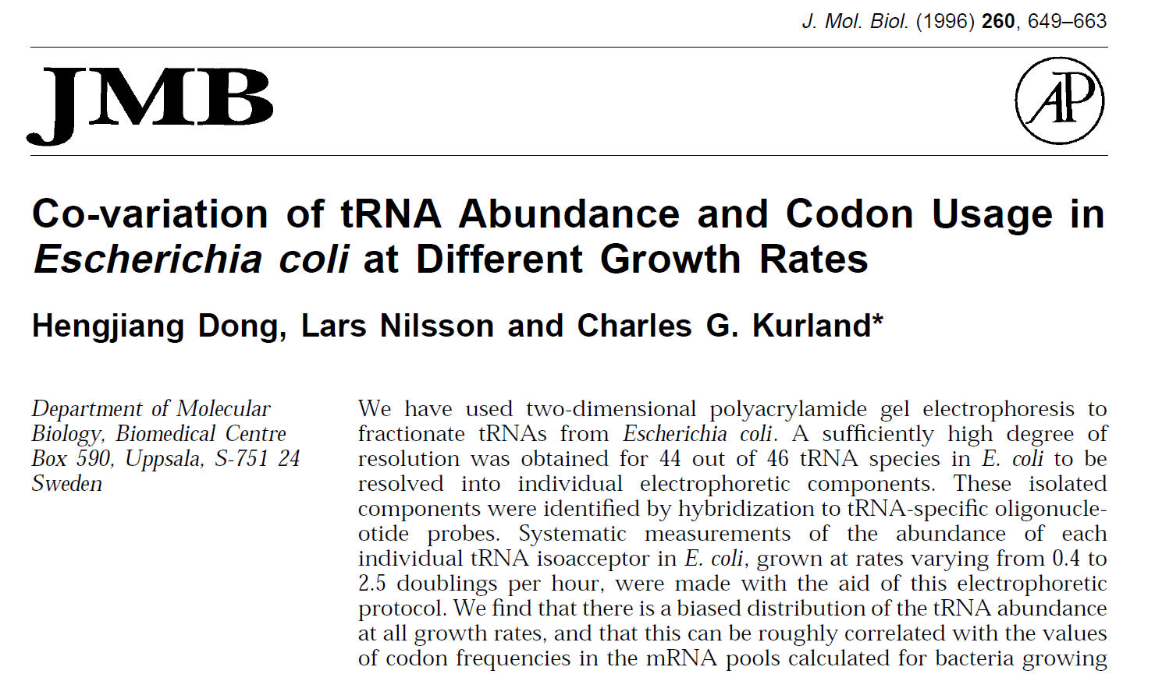
Benchmarking the model

Slide 15
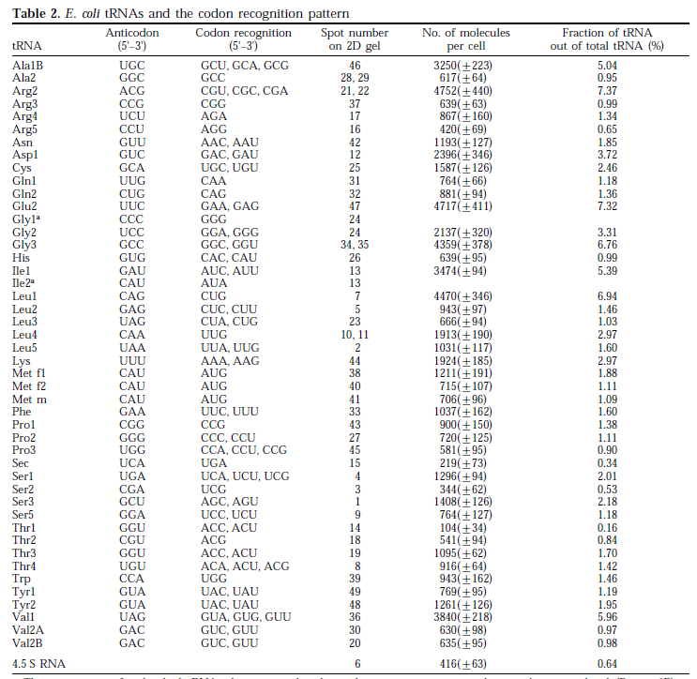
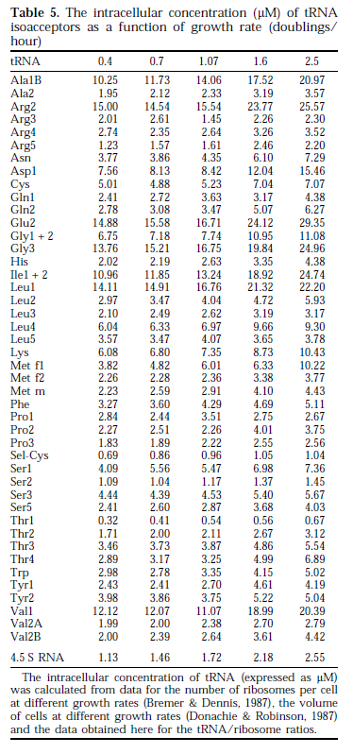
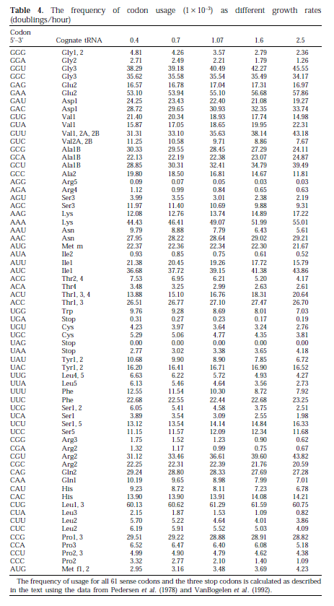
Benchmarking the model

Slide 16
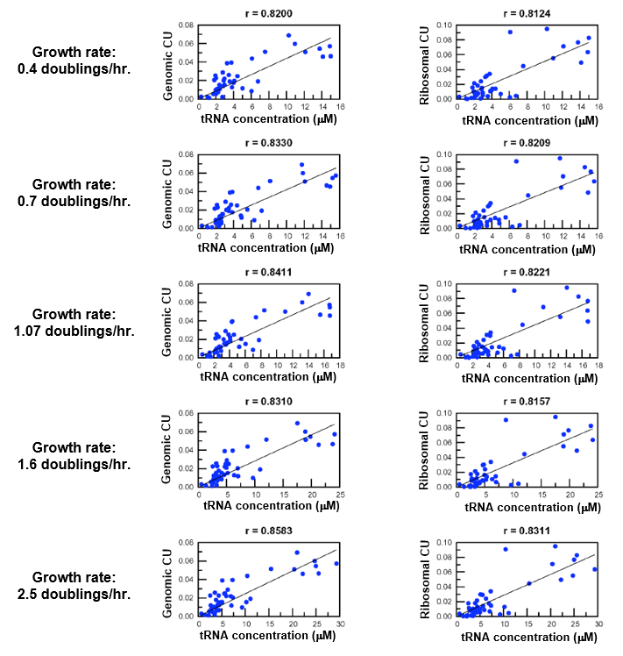
Benchmarking the model
Genomic CU correlates at similar levels with tRNA concentrations than Ribosomal CU
The correlation for Genomic CU is slightly and consistently higher than Ribosomal CU

Slide 17
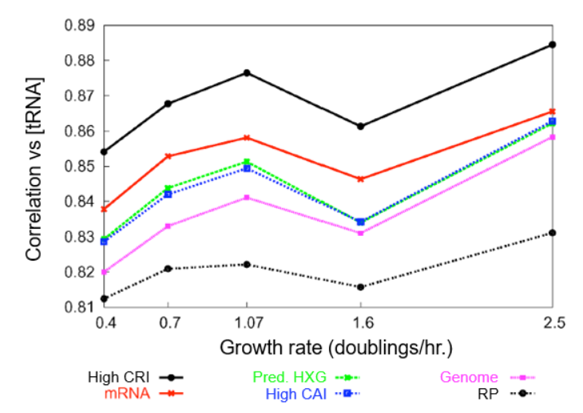
Benchmark the model
Genes with high CRI
Correlate better with tRNA content than any other set of genes in the analysis, but all correlations are significant

Slide 18
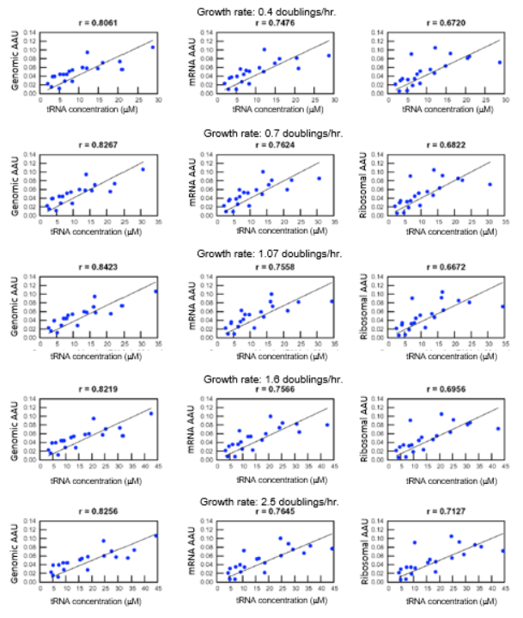
And what about amino acid usage?
Genomic AA usage also correlates better with tRNA concentrations than AAU in expressed mRNA and ribosomal proteins.

Slide 19
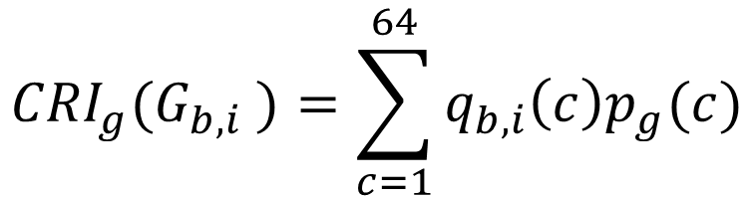
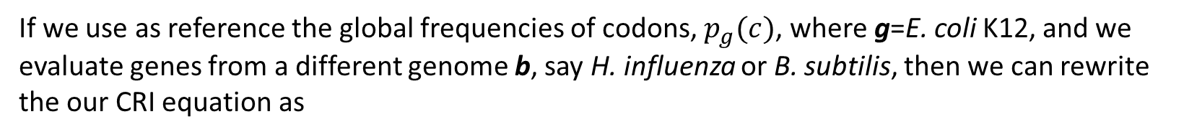
Using CRI to study HGT
If we use as reference the global frequencies of codons, $p_{g}(c)$, where g=E. coli K12, and we evaluate genes from a different genome b, say H. influenza or B. subtilis, then we can rewrite the our CRI equation as
$${CRI}_{g}(G_{b,i} )=\sum_{c=1}^{64}{q_{b,i}\left(c\right)p_{g}(c)}$$
This can be interpreted as the quantification of the CU compatibility of gene i in genome b with the codon abundances of genome g, if gene i were transferred from b to g in this moment.

Slide 20
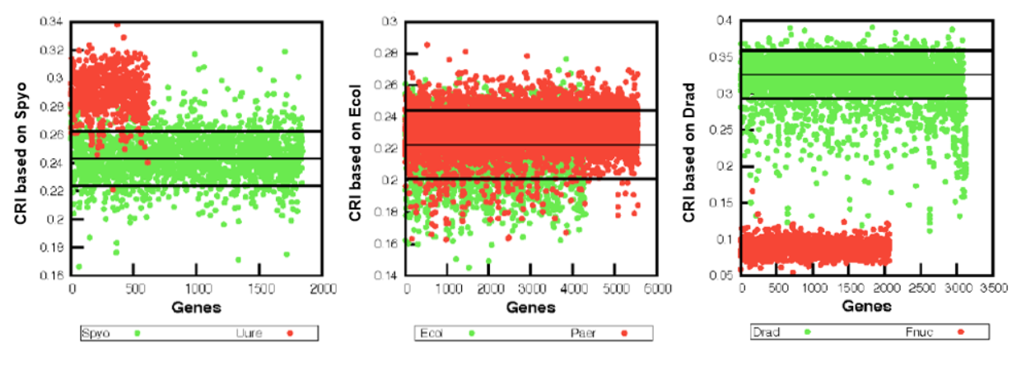
HGT potential

Slide 21
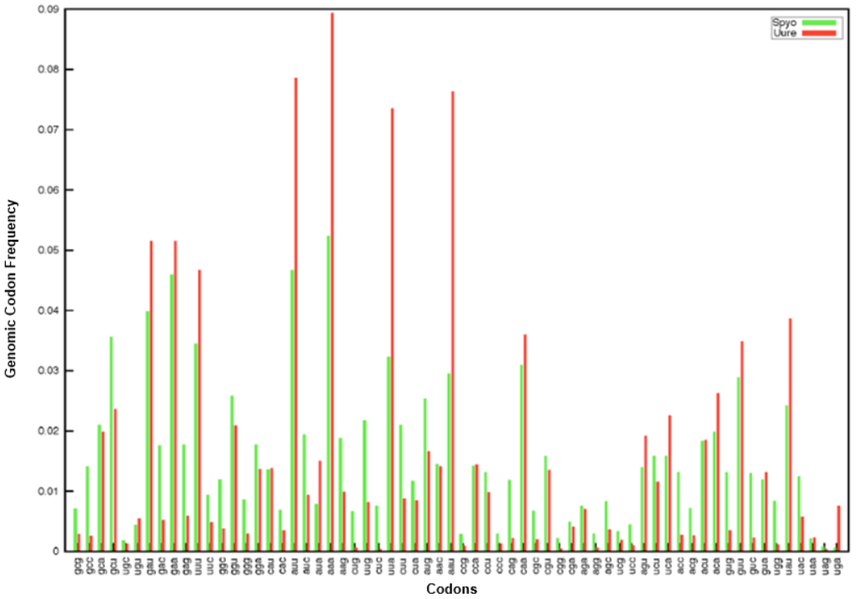

Slide 22


Biological Databases
Downloading genomes and annotations: A very powerful command to copy data from local and external servers information from externals servers is rsync. It offers a large number of options that give the user complete control over its behavior. It reduces the amount of data sent over the network by sending only differences between the source files and the existing files in the destination. It is widely used for backup and mirroring.
Support for copying links, owners, groups, and permissions.
Exclude options similar to tar.
Does not require super user privileges but also supports authentication.
Can delete files from the destination that are not in the source any more.
… and many more!
Downloading from NCBI:
Summary files: rsync://rsync.ncbi.nlm.nih.gov/genomes/refseq/assembly_summary_refseq.txt
See: ftp://ftp.ncbi.nlm.nih.gov/genomes/refseq
Genome Reports: rsync://rsync.ncbi.nlm.nih.gov/genomes/GENOME_REPORTS
See: ftp://ftp.ncbi.nlm.nih.gov/genomes

Slide 23
Biological Databases
To download the genome of E. coli K12 MG1655 type.
rsync –avz rsync://rsync.ncbi.nlm.nih.gov/genomes/all/GCF/000/005/845/GCF_000005845.2_ASM584v2/ E_coli_K12_MG1655
Write a script to download and parse the summary file. Extract the name, tax_id and ftp url to all genome directories.
Explore the different files available for each genome, access the README files, and download several genomes
For next class identify the biopython functions that parse GenBank files, and fasta files.

