Slide 1
Bioinformatics Lab
Spring Quarter 2017
UCSD
(Week 2)
Instructor:
Arturo Medrano
l1medranosoto@ucsd.edu
Instructional Assistant:
Hanbin Lu
hal213@ucsd.edu

Slide 2
Exercise 1 (Navigating directories)
Copy the folder dirtree to your account (located in ../public/data/terminal/dirtree).
Inside dirtree there are many directories, inside each directory there is another directory with the same name (e.g., 1.A.14_vs_1.A.26/ 1.A.14_vs_1.A.26/), and inside the second directory there is a file named report.tbl
To verify this information, inside dirtree try the command: ls */*/*.tbl
The results in report.tbl are sorted in descending order.
For each directory in dirtree extract the top GSAT Z-score (row 3, column 4) from file report.tbl and generate an output file with to columns (base dir and Z-score) sorted in descending order by the Z-score:
2.A.123_vs_3.E.1 67
2.A.58_vs_9.A.14 19
1.A.76_vs_9.A.14 18
2.A.102_vs_2.A.112 18
…
Note: if two rows have the same Z-score, sort those rows alphabetically based on the first column.

Slide 3


Biological Databases
NCBI: The National Center for Biotechnology Information is part of the NLM, a branch of the NIH. It houses a number of databases related to biotechnology and medicine. It’s an important resource for bioinformatics tools and services. Major databases are GenBank and PubMed.
GenBank: Sequence data repository.
PubMed: Bibliographic repository for biomedical literature.
Responsible for the development of BLAST (David Lipman and Stephen Altschul).
Useful URLs:
Main website: https://www.ncbi.nlm.nih.gov/
Blast+ suite of programs: ftp://ftp.ncbi.nlm.nih.gov/blast/executables/blast+/LATEST/
Preformatted BLAST databases: ftp://ftp.ncbi.nlm.nih.gov/blast/db/
General FTP site: ftp://ftp.ncbi.nlm.nih.gov/

Slide 4
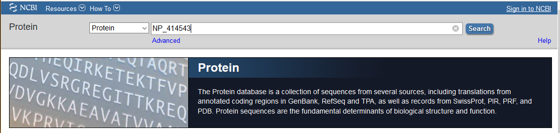
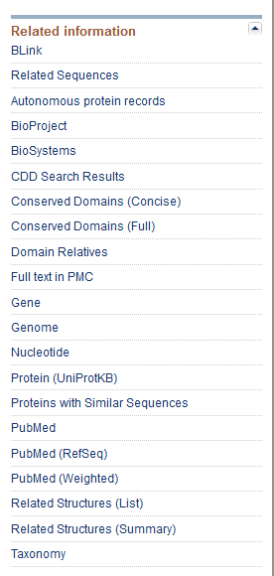
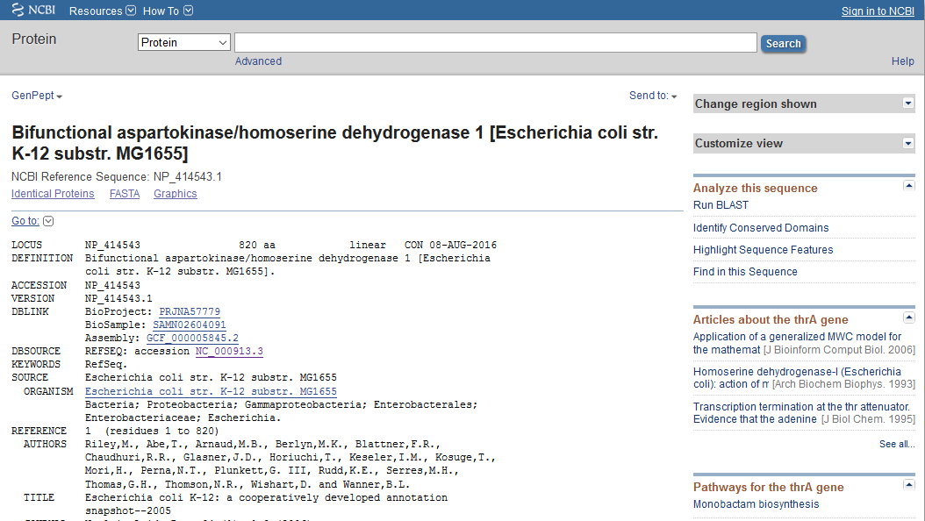
NCBI Protein DB
For accessing protein records, go to https://www.ncbi.nlm.nih.gov/protein
Type a protein accession: NP_414543

Slide 5
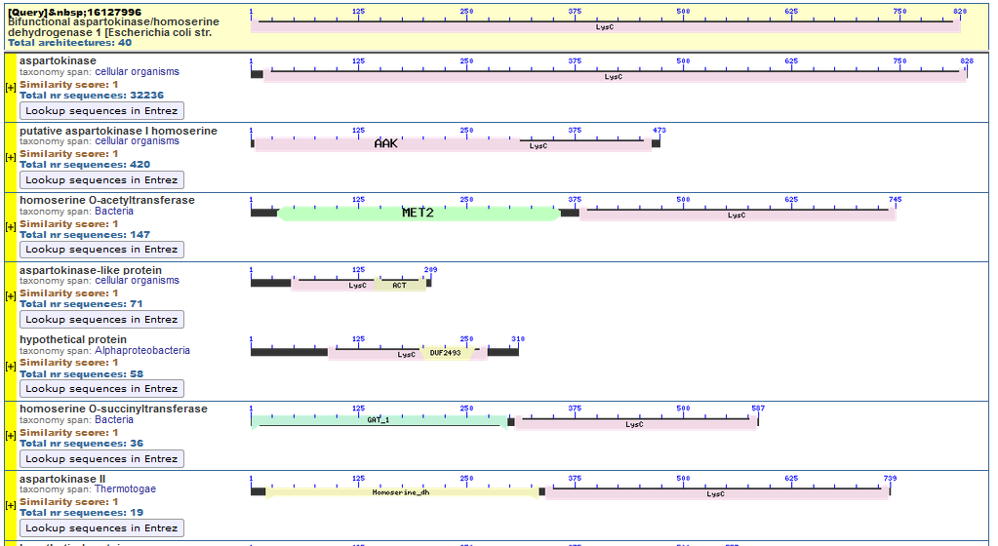
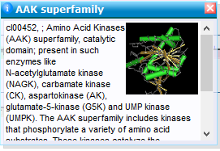
NCBI Domain Relatives

Slide 6
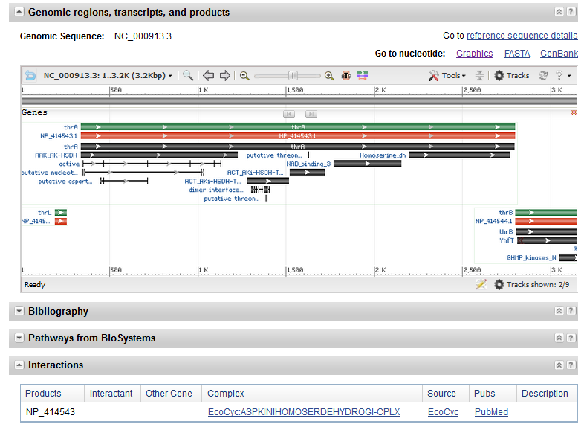
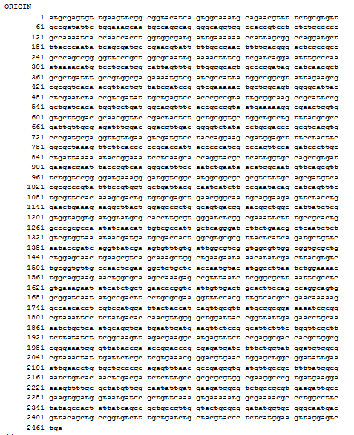
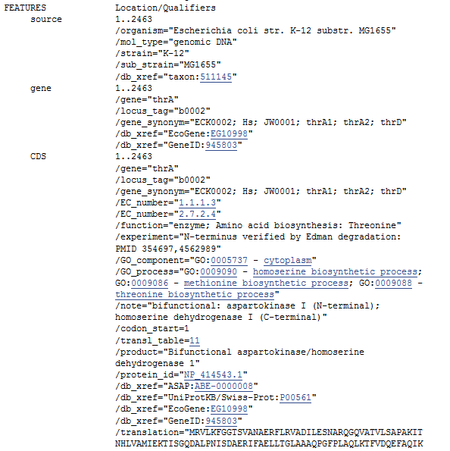
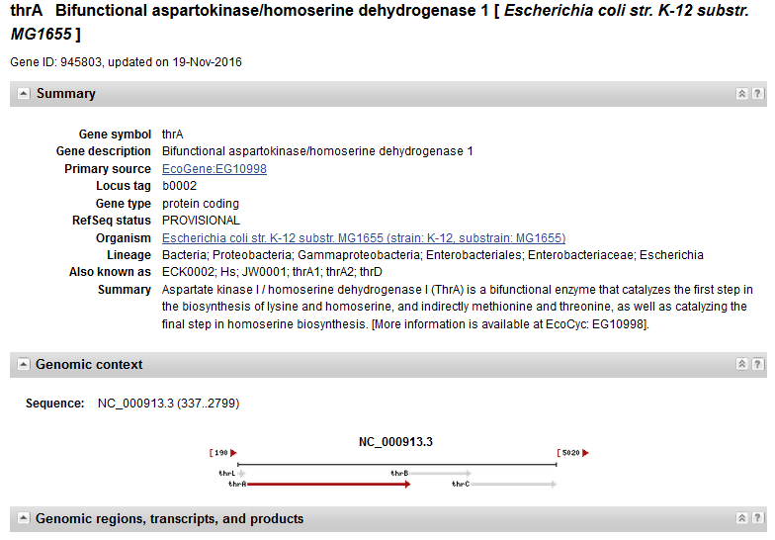
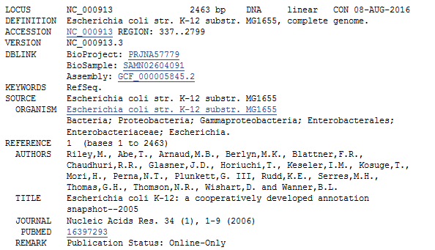
NCBI Gene DB

Slide 7
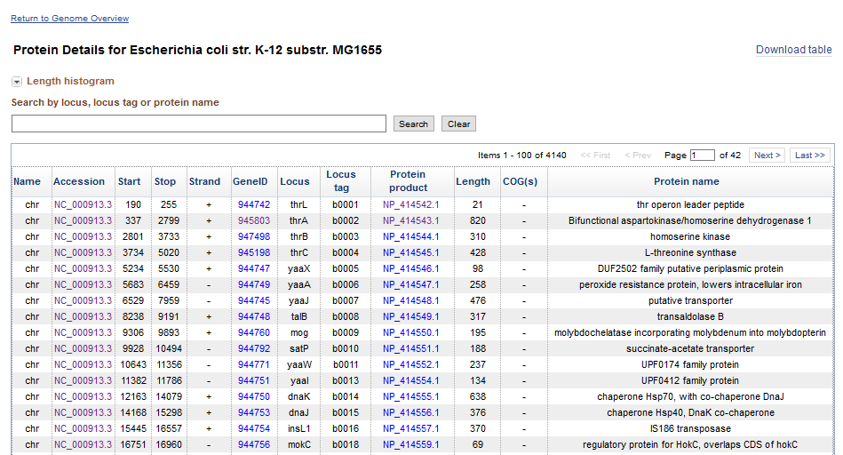
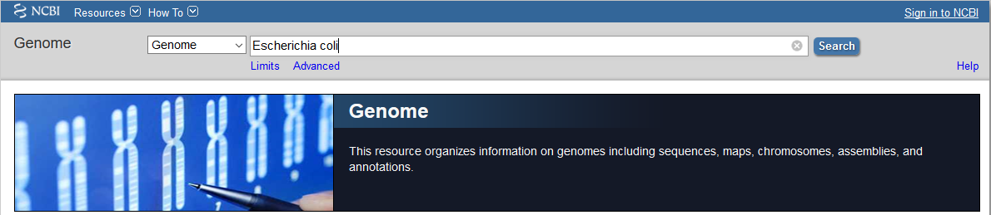
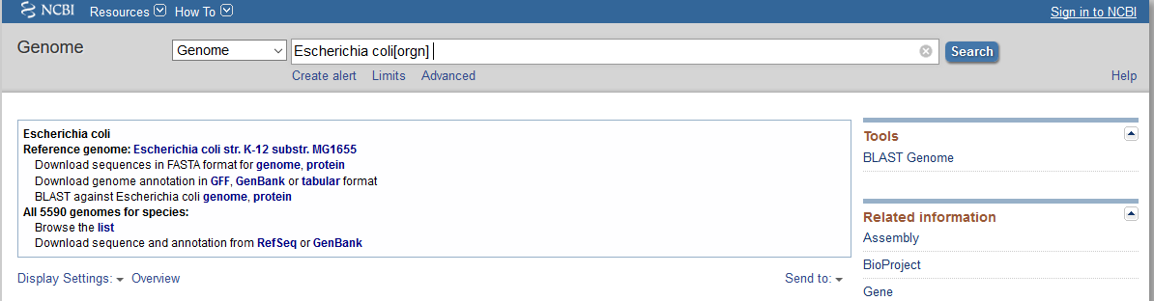
NCBI Genome DB
For manually downloading a genome, go to https://www.ncbi.nlm.nih.gov/genome
Type a genome name: Escherichia coli

Slide 8
Exercise 2 (exploring a genome)
From the NCBI Genome database, download the genome annotation in tabular format for E. coli K12 MG1655. Answer the following questions using only shell commands:
What is the name (locus) and length of the largest protein?
What is the name and length of the smallest protein?
How many proteins are in the forward strand?
How many proteins are in the reverse strand?
What is the largest protein in the forward strand?
What is the largest protein in the reverse strand?
What are the gene names (locus) of all ribosomal proteins in the genome?
cut -f 7,10 table.txt | sort -nr -k 2 | head -n 1
grep chr table.txt | cut -f 7,10 | sort -nr -k 2 | tail -1
cut -f 5 table.txt | grep ‘+’ | wc -l
cut -f 5 table.txt | grep ‘-’ | wc -l
cut -f 5,7,10 table.txt | grep ‘+’ | sort -n -k 3 | tail -1
cut -f 5,7,10 table.txt | grep ‘-’ | sort -n -k 3 | tail -1
cut -f 7,12 table.txt | grep ribosomal

Slide 9
Exercise 3 (extracting DNA sequences for analysis)
From the NCBI Genome database, download the DNA sequence of the full E. coli K12 MG1655 genome and its annotation in tabular format. Write a script that:
Reads the DNA sequence of the genome.
For each gene in the tab-separated annotations file, extract the DNA sequence and save it in a file in FASTA format.
If the protein is in the reverse strand you will have to complement the DNA sequence and reverse it, so it is displayed in the 5’ to 3’ direction in the output file.
Split each gene sequence in segments of 70 nucleotides before saving it.
This is the format that each sequence should use:
>NP_414543.1|thrA|b0002
ATGCGAGTGTTGAAGTTCGGCGGTACATCAGTGGCAAATGCAGAACGTTTTCTGCGTGTTGCCGATATTC
TGGAAAGCAATGCCAGGCAGGGGCAGGTGGCCACCGTCCTCTCTGCCCCCGCCAAAATCACCAACCACCT
GGTGGCGATGATTGAAAAAACCATTAGCGGCCAGGATGCTTTACCCAATATCAGCGATGCCGAACGTATT
TTTGCCGAACTTTTGACGGGACTCGCCGCCGCCCAGCCGGGGTTCCCGCTGGCGCAATTGAAAACTTTCG
TCGATCAGGAATTTGCCCAAATAAAACATGTC…TGA

Slide 10
Question From Week 2 Session 1
Inside the current directory, there are multiple folders containing the sequencing data and the analysis results of each sample. For example, inside sampleA folder there are 2 folders: fastq and results. fastq folder stores the files (with extension *.fastq) of sample A and results stores the analysis files for sample A. Select the command that can compress all the fastq files in the directory tree:
gzip *
gzip */*
gzip */results/*
gzip */fastaq/*fastaq
gzip

Slide 11
Question From Week 2 Session 1
Print out the locus (column 7), length (column 10), protein name (column 12) of all the ribosomal subunits in the tab-separated file Proteintable.txt. Sort them by length in descending order:
cut -f 7,10,12 Proteintable.txt | grep “ribosomal subunit”
grep “ribosomal subunit” Proteintable.txt | cut -f 7,10,12 | sort -k2nr
cut -f 7,12,10 Proteintable.txt | sort -k2n | grep “ribosomal subunit”
grep “ribosomal subunit” Proteintable.txt | sort -k2nr
sort -k10n Proteintable.txt | grep “ribosomal subunit” | cut -f 7,12,10

Slide 12
Question From Week 2 Session 1
Use the python os module to store all the names of folders inside the current directory into a list:
os.listdir()
[ name for name in os.listdir() if os.path.isfile(name) ]
[ name for name in os.listdir() if os.path.isabs(name) ]
[ name for name in os.listdir() if os.path.isdir(name) ]
[ name for name in os.path.isfile(name) if os.listdir() ]

Slide 13
Assessing Translatability
Spring Quarter 2017
UCSD
Mini Project
Understand the biological context
Define the problem
Build a hypothesis
Design and implement a bioinformatic strategy (model).
Test your model and hypothesis

Slide 14
Protein Translation in a Nutshell
The process in which ribosomes create proteins following transcription of DNA to mRNA.
mRNA is decoded by a ribosome to produce a polypeptide. The polypeptide then folds into an active protein and performs its function in the cell.
The ribosome decodes the mRNA by binding of complementary tRNA anticodons to mRNA codons.
The tRNA carries specific amino acids that are chained together into a polypeptide as the mRNA passes through and is read by the ribosome.

Slide 15
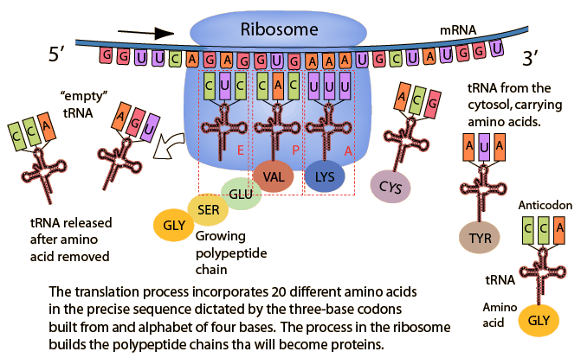
Protein Translation in a Nutshell
Depending on the availability of charged tRNAs the translation process will go faster or slower.
If codons correspond to abundant charged tRNAS, translation will be more efficient.

Slide 16
Evolutionary Implications and hypothesis
If the cell has to express all its genes when it needs them, then most genes in the genome should be adapted to the translation machinery of the cell, so that they can be expressed in adequate concentrations to perform their function.
Genes that are required in great quantities (highly expressed) for essential processes are under selective pressure to have a stronger bias toward using optimal codons.
The same may also be true for genes not required in high concentrations, but must be translated quickly to respond effectively to changes in the environment.
Genes required in relatively low concentrations can deviate from the “optimal” bias, as the selective pressure towards optimality would not be strong.

Slide 17
Bioinformatic Methods to Study CU
The most famous method, known as the Codon Adaptation Index (CAI)¹, quantifies the extent to which proteins use the same codon preferences as a reference set of highly expressed proteins (i.e., ribosomal proteins). Underlying assumptions:
Every gene with a similar codon preferences than ribosomal proteins will be highly expressed.
We don’t need to know the concentration of charged tRNAs, it is enough to know a set of highly expressed genes and their codon usage.
¹ 1987, NAR 15:1281-1295

Slide 18
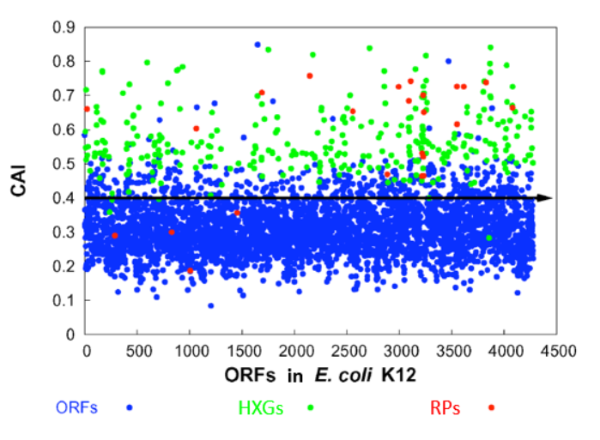
The Codon Adaptation Index

Slide 19
Bioinformatic Methods to Study CU
Weaknesses of the CAI:
The CAI ignores the possibility that the optimal codon for one amino acid can be present in much less frequency than a suboptimal codon for another amino acid that could still perform the same function in the protein.
Therefore, the CAI implicitly assumes that the choice of amino acid in a protein is essentially not related to the efficiency of translation, but to the molecular function of the protein.
Is this true??? We need to compare the frequencies of codons for different amino acids to the concentration of tRNAs in the cell.
¹ 1987, NAR 15:1281-1295

Slide 20
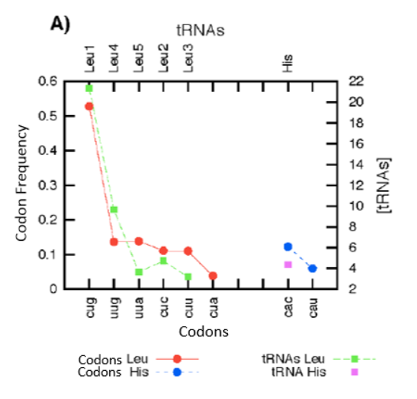
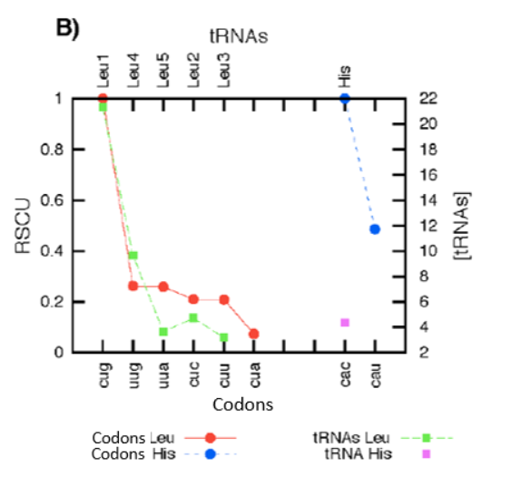
Codon usage versus tRNA concentration

Slide 21


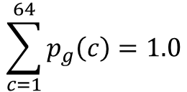
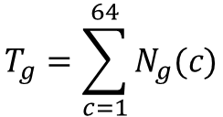

Modelling Codon Usage
Hypothesis: If the genome has evolved to have most of its genes translated at adequate rates when it needs them, then the genomic frequencies of codons should be an adequate reference of translatability.
That is, genes that use codons in similar frequencies than the genome have good chances of being translated and expressed at adequate levels to perform their function.
Probability or Global Relative Frequency of a Codon in a Genome
$$\sum_{c=1}^{64}{p_{g}\left(c\right)=1.0}$$
$p_{g}$(c)$=\frac{N_{g}(c)}{T_{g}}$
and
$$p_{g}\left(c\right)$$
Probability of codon c in genome g
$$N_{g}\left(c\right)$$
Number of occurrences of codon c in genome g
$$T_{g}=\sum_{c=1}^{64}{N_{g}(c)}$$
Total number of codons in genome g

Slide 22

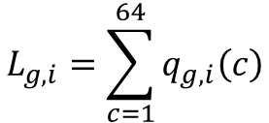
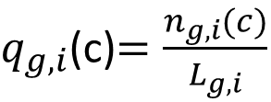
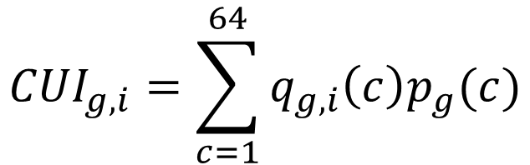
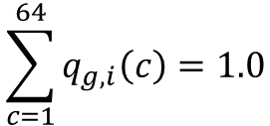

Modelling Codon Usage
Relative frequency of a codon inside a gene
$$\sum_{c=1}^{64}{q_{g,i}\left(c\right)=1.0}$$
$q_{g,i}$(c)$=\frac{n_{g,i}(c)}{L_{g,i}}$
and
$$q_{g,i}\left(c\right)$$
Relative frequency of codon c in gene i of genome g
$$n_{g,i}\left(c\right)$$
Number of times codon c is present in gene i of genome g
$$L_{g,i}=\sum_{c=1}^{64}{q_{g,i}\left(c\right)}$$
Total number of codons in gene i of genome g
Note 2:
The CUI for all genes in the genome can be calculated as a matrix product. The genes matrix (4000+ rows, 64 columns) and the genomic probabilities matrix (64 rows, 1 column).
Calculate the Codon Usage Index
Note 1:
Notice that the CUI per gene can be written as the multiplication of 2 vectors of length 64.
$${CUI}_{g,i}=\sum_{c=1}^{64}{q_{g,i}\left(c\right)p_{g}(c)}$$

Slide 23
Implementation
To prepare our sequences, we’ll make a slight modification to the script you develop in Exercise 3 during last class. You downloaded the DNA sequence of the full E. coli K12 MG1655 genome and its annotation in tabular format. Your script should now:
Read the DNA sequence of the genome.
For each gene in the tab-separated annotations file, extract the DNA sequence and save it in a two column format. The first column should be the locus_tag (b-number) and the second column the DNA sequence of the gene in one string:
b0001 ATGAAACGC…TGA
b0002 ATGCGAGTG…TGA
b0003 ATGGTTAAA…TAA
…

Slide 24







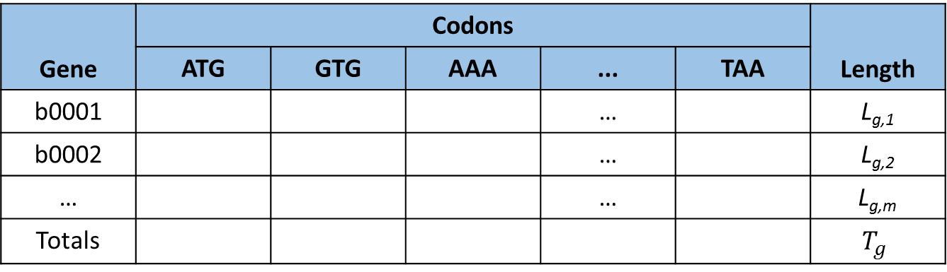









Implementation
For each gene in the genome estimate the frequencies of codons, length and keep genomic counts:
Gene | Codons |  |  |  |  | Length
 | ATG | GTG | AAA | ... | TAA
b0001 |  |  |  | … |  | L_{g,1}
b0002 |  |  |  | … |  | L_{g,2}
… |  |  |  | … |  | L_{g,m}
Totals |  |  |  |  |  | $$T_{g}$$
$$n_{g,1}\left(ATG\right)$$
$$n_{g,1}\left(GTG\right)$$
$$n_{g,1}\left(AAA\right)$$
$$n_{g,1}\left(TAA\right)$$
$$n_{g,2}\left(ATG\right)$$
$$n_{g,2}\left(GTG\right)$$
$$n_{g,2}\left(AAA\right)$$
$$n_{g,2}\left(TAA\right)$$
$$n_{g,m}\left(ATG\right)$$
$$n_{g,m}\left(GTG\right)$$
$$n_{g,m}\left(AAA\right)$$
$$n_{g,m}\left(TAA\right)$$
$$N_{g}\left(ATG\right)$$
$$N_{g}\left(GTG\right)$$
$$N_{g}\left(AAS\right)$$
$$N_{g}\left(TAA\right)$$
Order codons per amino acid and leave the stop codons at the end.
This will help to check for errors because there can be only one stop codon per gene.
Set a global counter for the 64 codons
Set local counter for 64 codons
Split the DNA sequence of a gene in sets of three nucleotides and start the counts
Save table above in a tab-separated file.
Calculate the CUI for each gene and save it to a 2-colum file (b-number and CUI)

Slide 25
Exploring Results
Plot the CUI
Scatter Plot 1: In the X-axis plot the genes in chromosomal order, in the Y-axis plot the CUI
Scatter Plot 2: Sort the CUI in ascending order.
Generate a histogram of the CUI.
Generate versions of Plot 1 and 2 where you plot the ribosomal proteins as red dots.
To this point, we just designed our model and implemented it. We will discuss it and test it next week… remember, all models are imperfect representations of our world, we need to find out how well the underlying assumptions match reality.

