Slide 1
Bioinformatics Lab
Spring Quarter 2017
UCSD
Week 6 Session 1
Instructor:
Arturo Medrano
l1medranosoto@ucsd.edu
Instructional Assistant:
Hanbin Lu
hal213@ucsd.edu

Slide 2
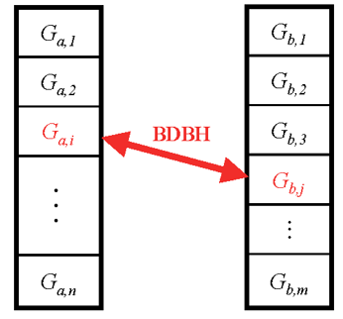
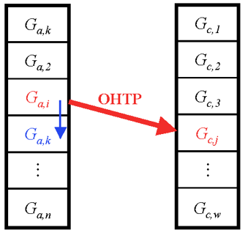

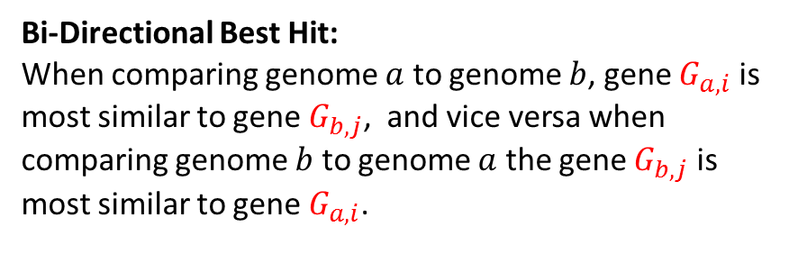



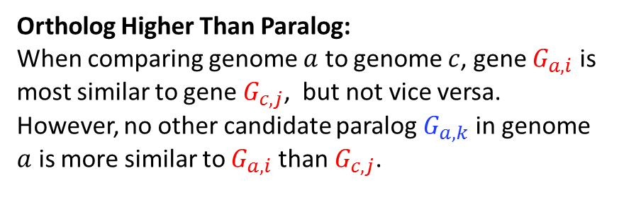
Working definitions of Orthology
Bi-Directional Best Hit:
When comparing genome $a$ to genome $b$, gene $G_{a,i}$ is most similar to gene $G_{b,j}$, and vice versa when comparing genome $b$ to genome $a$ the gene $G_{b,j}$ is most similar to gene $G_{a,i}$.
Ortholog Higher Than Paralog:
When comparing genome $a$ to genome $c$, gene $G_{a,i}$ is most similar to gene $G_{c,j}$, but not vice versa. However, no other candidate paralog $G_{a,k}$ in genome $a$ is more similar to $G_{a,i}$ than $G_{c,j}$.
Genome $a$
Genome $b$
Genome $a$
Genome $c$
2

Slide 3
Creating a blast database
The blast suit of programs includes the command makeblastdb that allows the definition of custom databases. Assuming that all fasta proteins in E. coli K12 are stored in file E_coli_K12.faa we can create a database with the command:
makeblastdb -in E_coli_K12.faa -dbtype prot –input_type fasta -parse_seqids -hash_index -out ./blastdb/ecoli -title “ecoli 04/27/2017”
If the file is compressed, we don’t need to decompress it:
zcat E.coli_K12.faa.gz | makeblastdb –input_type fasta –dbtype prot -parse_seqids -hash_index -out ./blastdb/ecoli -title “ecoli 04/27/2017” -in -
To use the database we need to:
Set the environment variable $BLASTDB: export BLASTDB=/path/to/blastdb
Or specify explicitly the path to the database when we run blast.
3

Slide 4
Running blast
There are multiple commands, but we’ll start with:
blastp -query E_coli_K12.faa -out blast.out -db ecoli -evalue 0.01 -outfmt ‘6 qseqid sseqid evalue pident …’
zcat E_coli_K12.faa.gz | blastp -out blast.out -db ecoli -evalue 0.01 -outfmt ‘6 qseqid sseqid evalue pident …’ -query -
There are many more useful options for -outfmt options 6, 7, 10:
qlen, slen, nident, qcovs, qstart, qend, sstart, send, bitscore, etc.
To extract the sequence of a protein:
blastdbcmd -db ecoli –entry NP_517767 –target_only –out NP_517767.faa
See option –entry_batch,
4

Slide 5
Exercise 1
Run blast of the whole proteome E. coli K12 vs A. tumefaciens and vice versa:
Generate blast databases for both genomes and put them in the same directory
Run blast giving the full proteome of one genome against the blast database of the other genome.
Produce a tabulated file where you store:
qseqid, sseqid, qlen, slen, bitscore, evalue, pident, nident, length, qcovs, qstart, qend, sstart, send
Calculate the extra field scov (subject coverage) as length/slen*100
Generate tables in your database to store this information. For each query genome generate a table with the name:
‘blast’ + ‘_’ + genome_id
Fill the blast tables with the blast output.
5

Slide 6
Exercise 1
blast_1
pid_1 | pid_2 | evalue | bitscore | identity | alnlen | qcovs | scov | qlen | slen | …
NP_XX | WP_XX | 4.2e-25 | 153.8 | 0.3 | 150 | 0.42 | 0.6 | 358 | 250 | …
NP_YY | WP_YY | 7.2e-200 | 333.4 | 0.8 | 300 | 0.9 | 0.8 | 334 | 375 | …
NP_ZZ | WP_ZZ | 2.3e-5 | 87.3 | 0.24 | 50 | 0.25 | 0.4 | 200 | 125 | …
6

Slide 7
Exercise 2
Identify orthologs between the two genomes using the definitions:
Reciprocal Best Hit or Bidirectional Best Hit
For each genome generate a table with the orthologs:
‘homology’ + ‘_’ + genome_id
7

Slide 8
Exercise 2
homology_1
gid_1 | gid_2 | type | method
1 | 3 | orthology | OHTP
1 | 300 | orthology | BDBH
2 | 1200 | homology | Topblast
50 | 3125 | xenology | Phylogeny
334 | 825 | paralogy | blast
(just an example, we have not seen this method yet)
8

Slide 9
Some questions we are ready to answer
What is the set of genes shared between E. coli and A. tumefaciens?
What genes are unique to each of both genomes?
What are the predominant functions of the genes shared?
What are the functions of the genes not shared?
What transport systems are shared and which are not?
What metabolic pathways are share and which are not?
What about transcriptional regulators?
How many proteins are syntenic?
9

Slide 10
Criteria to infer orthologs
At least 60% of the smaller protein should be covered in the alignment.
We need to use the bit score as criterion of significance because the E-value is not reliable as the databases are so small.
Pay attention to the top blast hits because there can be very similar or identical values, in which case on query protein can have more than one reciprocal best hit.
10

Slide 11
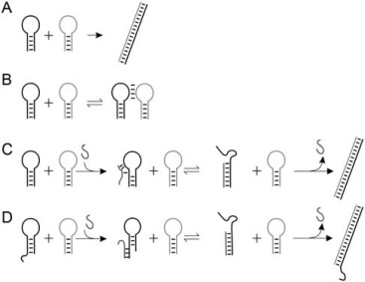
What is a gene?
A segment of DNA that contains the instructions to make proteins and different types of RNA. Genes are responsible for the physical and inheritable characteristics or phenotype of an organism.
The entire DNA sequence that is necessary for the synthesis of a functional polypeptide (or RNA molecule). Therefore, a gene includes more than then the nucleotides encoding the proteins. This includes transcription factors binding sites, promoters, etc.
Transcription termination
Promotor
CDS
TFBS
11

Slide 12
What is an operon?
Genes encoding enzymes involved in related functions often are located next to each other in bacterial chromosomes. These genes comprise a single polycistronic transcription unit referred to as operon.
Genes are transcribed from a single promotor region.
Genes are co-regulated and co-expressed.
mRNA
mRNA
12

Slide 13
Advantages of identifying all operons
It’s possible to functionally relate different proteins.
It’s possible to infer members of regulons.
It’s possible to infer co-expression.
If a transporter and enzymes are present in the operon, it would be possible to infer the substrate of the transporter.
We could approach questions about the evolution of operons.
etc.
How can we infer the set of operons in the genome?
13

Slide 14
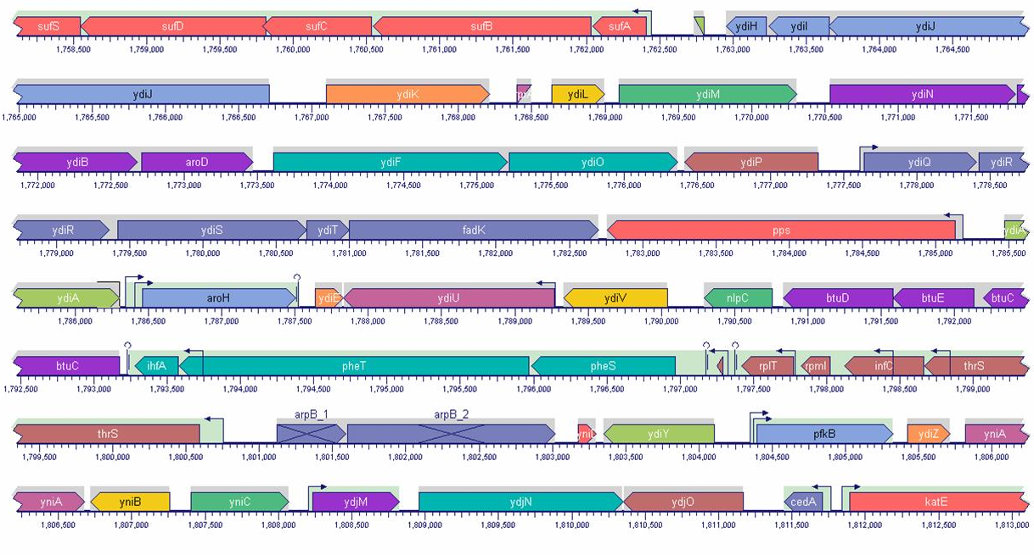
14

Slide 15
What variables are relevant to the task?
A single promoter for all genes?
Not really as there can be internal promoters.
They need to be co-expressed at similar levels?
Not necessarily. For example, if there are Rho independent transcription terminators with different specificities in intermediate genes, that would produce different expression levels for the genes in the operon. Not to mention the possible presence of regulatory regions in the genes.
What about protein function?
Functional descriptions can vary significantly within operons making it difficult to create associations, but it is definitely worth exploring.
For most genomes there are few functional annotations.
What about the intergenic distance between genes?
Is there a noticeable difference in intergenic distance between adjacent genes in known operons versus adjacent genes not in the same operon? (the feasibility test)
15

Slide 16
What data can we use?
Positive Control (distances within operons):
Sets of genes with experimental evidence indicating they are co-transcribed in the same polycistronic mRNA.
Published evidence in the literature.
RegulonDB (curated database on transcriptional regulation).
Negative Control (distances between different documented transcription units):
If there are two known, but different adjacent, transcription units in the same strand, then the distance between their borders can be taken as examples of distances between genes that do not belong to the same operon.
2000, PNAS 97(12): 6652-57
d₁
d₂
16

Slide 17
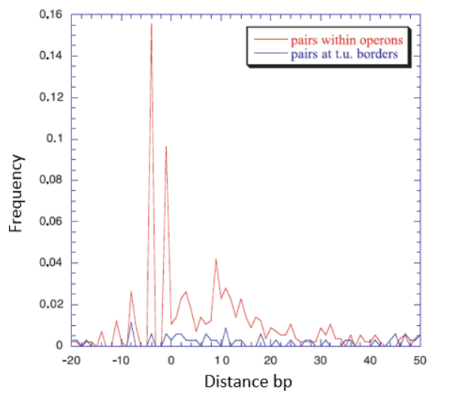
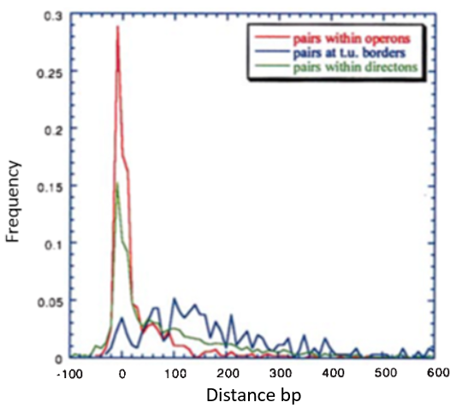
How predictive can intergenic distances be?
2000, PNAS 97(12): 6652-57
17

Slide 18
Creating a predictive model
First we need to generate a hypothesis:
The Intergenic distance between adjacent genes in the same strand can be used to infer membership to the same operon.
Define the main assumptions (implicit and explicit):
Intergenic distance is the most important variable in the identification of operons.
We create the model by assuming we know everything; that includes the properties we want to predict.
18

Slide 19






Log-Likelihood model
Distances between adjacent genes
Same directon
Operon
Not operon
$$LL\left(dist\right):$$
Log-likelihood of the distance between 2 adjacent genes in in the same strand.
$$N_{op}\left(dist\right):$$
Number of pairs of genes in operons at a specific distance.
$$N_{nop}\left(dist\right):$$
Number of pairs of genes not in operons at a specific distance.
The interpretation of LL is not intuitive.
We still need to find a critical value of LL to discriminate operons from other transcription units.
$${TN}_{op}:$$
Total number of adjacent pairs of genes in operons
$${TN}_{nop}:$$
Total number of adjacent pairs of genes NOT in operons
2000, PNAS 97(12): 6652-57
19

Slide 20
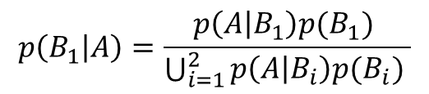

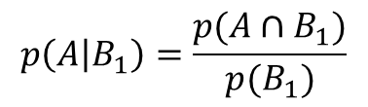
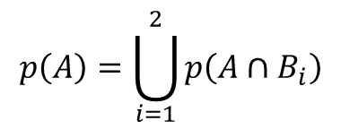

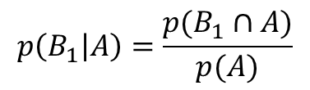
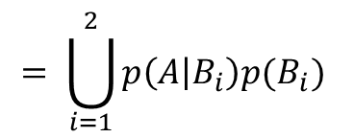
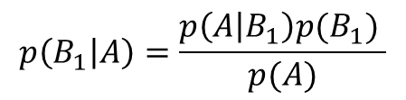





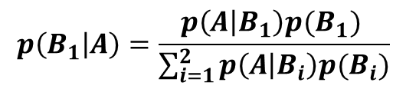

The Bayes Theorem
$$p\left(B_{1} | A\right)=\frac{p(B_{1}∩A)}{p(A)}$$
$$p\left(A | B_{1}\right)=\frac{p(A∩B_{1})}{p(B_{1})}$$
B₁
B₂
A
$$p(B_{1}∩A)=p(A∩B_{1})$$
$$p(A∩B_{1})=p\left(A | B_{1}\right)p(B_{1})$$
$$p\left(A\right)=\bigcup_{i=1}^{2}{p\left(A∩B_{i}\right)}$$
$$= \bigcup_{i=1}^{2}{p\left(A | B_{i}\right)p(B_{i}) }$$
$$p\left(B_{1} | A\right)=\frac{p\left(A | B_{1}\right)p(B_{1}) }{\bigcup_{i=1}^{2}{p\left(A | B_{i}\right)p(B_{i}) }}$$
$$p\left(B_{1} | A\right)=\frac{p\left(A | B_{1}\right)p(B_{1}) }{p(A)}$$
$p\left(B_{1} | A\right)$:
Posterior probability of $B_{1}$ given $A$
$$p\left(B_{1} | A\right)=\frac{p\left(A | B_{1}\right)p(B_{1}) }{\sum_{i=1}^{2}{p\left(A | B_{i}\right)p(B_{i})}}$$
$p\left(A | B_{1}\right)$:
Likelihood of $A$ given $B_{1}$
$$p\left(B_{1}\right):$$
Prior probability of $B_{1}$
20

Slide 21

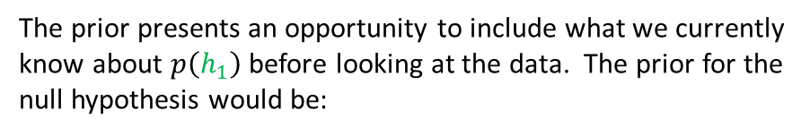

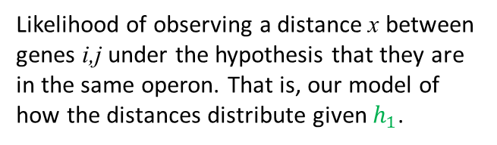




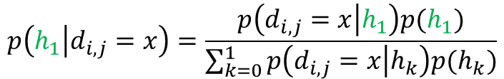




Creating our inference model
Distances between adjacent genes i, j
The competing hypotheses
$$h_{1}={OP}_{i,j}$$
Adjacent genes i,j are in the same operon
Same directon
$$h_{0}={NOP}_{i,j}$$
Adjacent genes i,j are NOT in the same operon.
Operon
Not operon
$$h_{1}$$
RegulonDB
$$h_{0}$$
What we want to know:
TP
TN
$$p(h_{1}|d_{i,j}=x)$$
Posterior probability that genes i and j are in the same operons given that they have intergenic distance x.
Applying the Bayes theorem:
Now back to reality: we don’t know the operon partition! Therefore we must work with samples and assume they are representative of the genomic distribution of distances in operons. We’ll take this sample from RegulonDB.
$$p\left(h_{1} | d_{i,j}=x\right)=\frac{p\left(d_{i,j}=x | h_{1}\right)p(h_{1})}{\sum_{k=0}^{1}{p\left(d_{i,j}=x | h_{k}\right)p(h_{k})}}$$
$p\left(d_{i,j}=x | h_{1}\right)$:
Likelihood of observing a distance x between genes i,j under the hypothesis that they are in the same operon. That is, our model of how the distances distribute given $h_{1}$.
What about the prior $p\left(h_{1}\right)$?
The prior presents an opportunity to include what we currently know about $p\left(h_{1}\right)$ before looking at the data. The prior for the null hypothesis would be:
$$p\left(h_{1}\right):$$
Prior probability of $h_{1}$
$p\left(h_{0}\right)=1−p(h_{1}$)
21

Slide 22
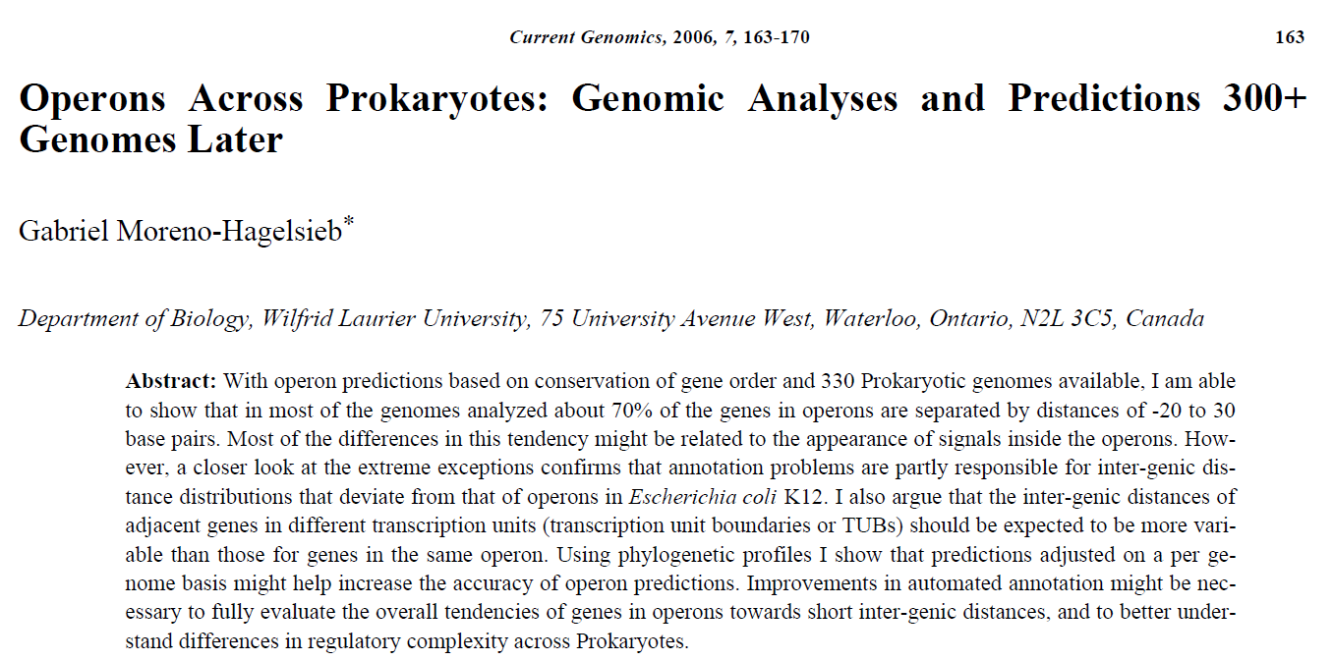
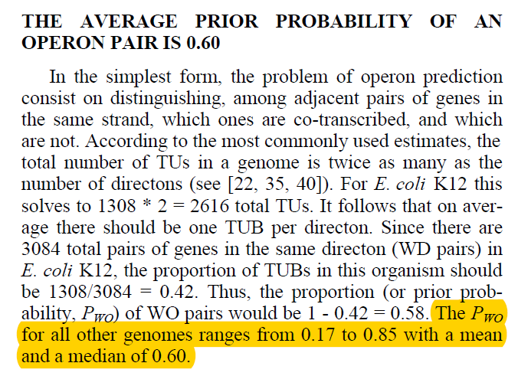
Obtaining the prior for h₁
22

Slide 23
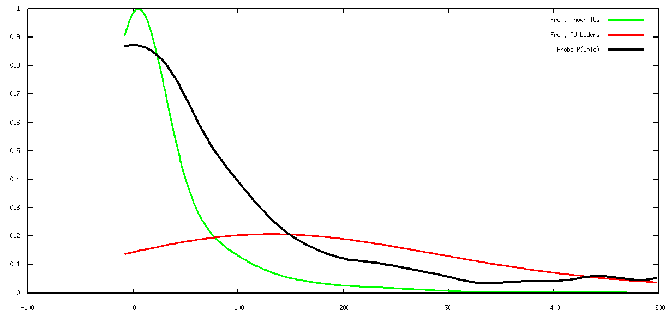
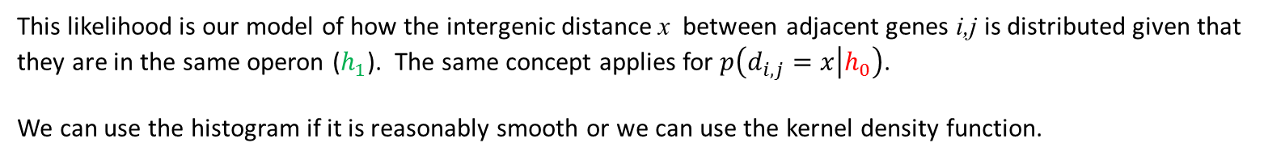




The inference model
$p\left(d_{i,j}=x | h_{1}\right)$:
This likelihood is our model of how the intergenic distance x between adjacent genes i,j is distributed given that they are in the same operon ($h_{1}$). The same concept applies for $p\left(d_{i,j}=x | h_{0}\right)$.
We can use the histogram if it is reasonably smooth or we can use the kernel density function.
$$p\left(d_{i,j}=x | h_{1}\right)$$
$$p\left(d_{i,j}=x | h_{0}\right)$$
$$p(h_{1}|d_{i,j}=x)$$
Posterior
Density
Distance (bp)
23

Slide 24
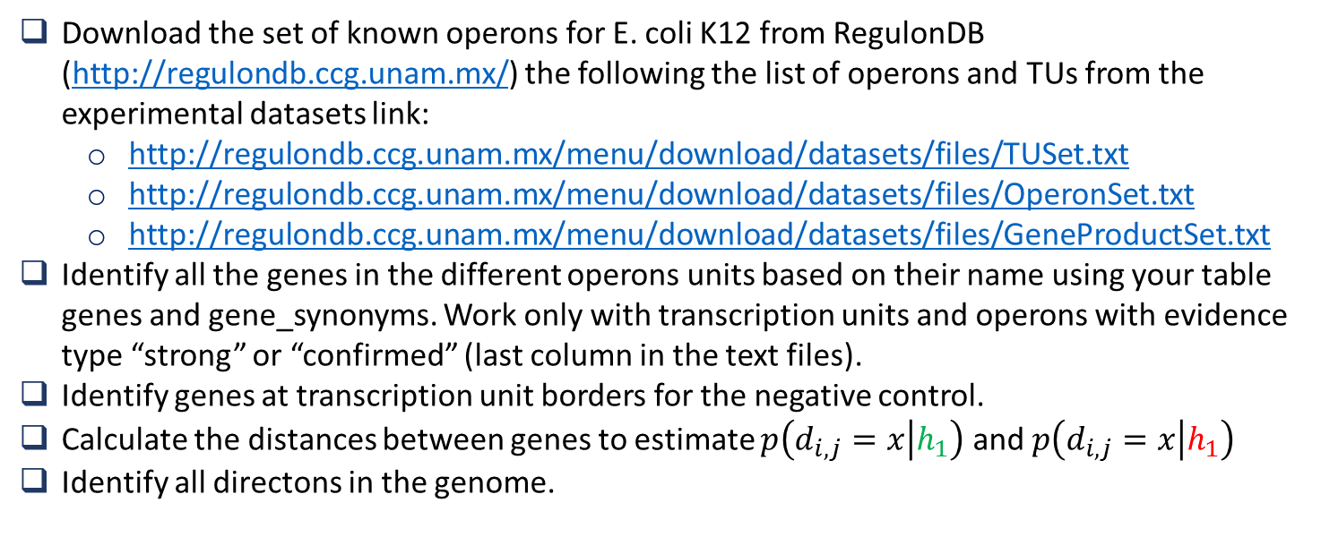
Implementing the model
Download the set of known operons for E. coli K12 from RegulonDB (http://regulondb.ccg.unam.mx/) the following the list of operons and TUs from the experimental datasets link:
http://regulondb.ccg.unam.mx/menu/download/datasets/files/TUSet.txt
http://regulondb.ccg.unam.mx/menu/download/datasets/files/OperonSet.txt
http://regulondb.ccg.unam.mx/menu/download/datasets/files/GeneProductSet.txt
Identify all the genes in the different operons units based on their name using your table genes and gene_synonyms. Work only with transcription units and operons with evidence type “strong” or “confirmed” (last column in the text files).
Identify genes at transcription unit borders for the negative control.
Calculate the distances between genes to estimate $p\left(d_{i,j}=x | h_{1}\right)$ and $p\left(d_{i,j}=x | h_{1}\right)$
Identify all directons in the genome.
24

