Slide 1
Bioinformatics Lab
Spring Quarter 2017
UCSD
Week 7 Session 2
Instructor:
Arturo Medrano
l1medranosoto@ucsd.edu
Instructional Assistant:
Hanbin Lu
hal213@ucsd.edu

Slide 2
Benchmarking our inference model
To this point we have estimated the probability that two adjacent genes in the same strand belong to the same operon.
However, we still don’t know how good our model is to discriminate between genes in the same operon and genes at transcription unit boundaries.
Therefore, we need to use the posterior probability to classify our inferences into genes that belong to the same operon, and those that do not.
But what probability threshold should we use?
There are several strategies to measure the statistical performance of binary classification tests.
2

Slide 3
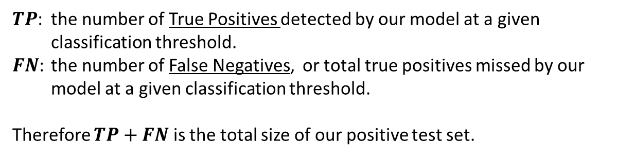

Sensitivity
Also known as the true positive rate, hit rate, recall or probability of detection.
It measures the fraction of correct inferences detected by our model. In our case, the fraction of pairs of genes in the positive control set that were correctly classified as belonging to the same operon.
This can be seen as the extent to which our method did not miss true positives (implying that false positives are few).
A highly sensitive method rarely misses a true positive (e.g., it rarely infers that two genes are not in the same operon when the actually are).
$TP$: the number of True Positives detected by our model at a given classification threshold.
$FN$: the number of False Negatives, or total true positives missed by our model at a given classification threshold.
Therefore $TP+FN$ is the total size of our positive test set.
$$Sensitiviy=\frac{TP}{TP+FN}$$
3

Slide 4
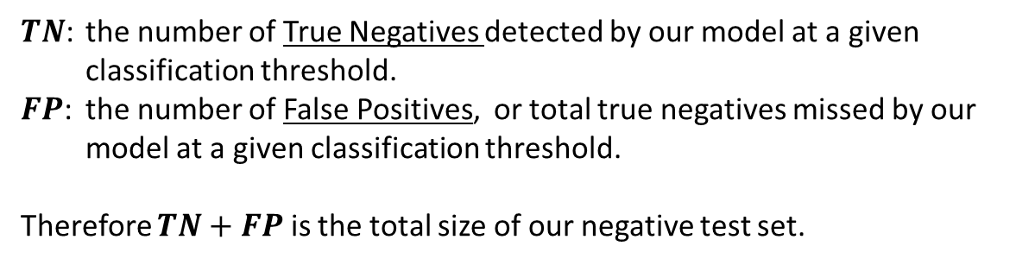

Specificity
Also known as the true negative rate.
It measures the fraction of negatives that are correctly identified as true negatives (e.g., the fraction of adjacent pairs of genes at operon borders, which were correctly inferred as not belonging to the same operon).
A highly specific method rarely confuses a true positive with a true negative (e.g., inferring that two genes are in the same operon when they the are not).
$TN$: the number of True Negatives detected by our model at a given classification threshold.
$FP$: the number of False Positives, or total true negatives missed by our model at a given classification threshold.
Therefore $TN+FP$ is the total size of our negative test set.
$$Specificity=\frac{TN}{TN+FP}$$
4

Slide 5

High Sensitivity
Posterior probability threshold
$$Sensitiviy=\frac{TP}{TP+FN}$$
Few false negatives ( )
True positives ( )
Genes at operon borders
Genes within the same operon
5

Slide 6

High Specificity
$$Specificity=\frac{TN}{TN+FP}$$
Posterior probability threshold
True negatives ( )
Few false positives ( )
Genes at operon borders
Genes within the same operon
6

Slide 7


Sensitivity vs Specificity
$$Specificity=\frac{TN}{TN+FP}$$
Posterior probability threshold
$$Sensitiviy=\frac{TP}{TP+FN}$$
High sensitivity
Low specificity
Few false negatives ( )
Many false Positives ( )
Genes at operon borders
Genes within the same operon
7

Slide 8
Sensitivity vs Specificity
$$Specificity=\frac{TN}{TN+FP}$$
Posterior probability threshold
$$Sensitiviy=\frac{TP}{TP+FN}$$
Low sensitivity
High specificity
Many false negatives ( )
Few false Positives ( )
Genes at operon borders
Genes within the same operon
8

Slide 9
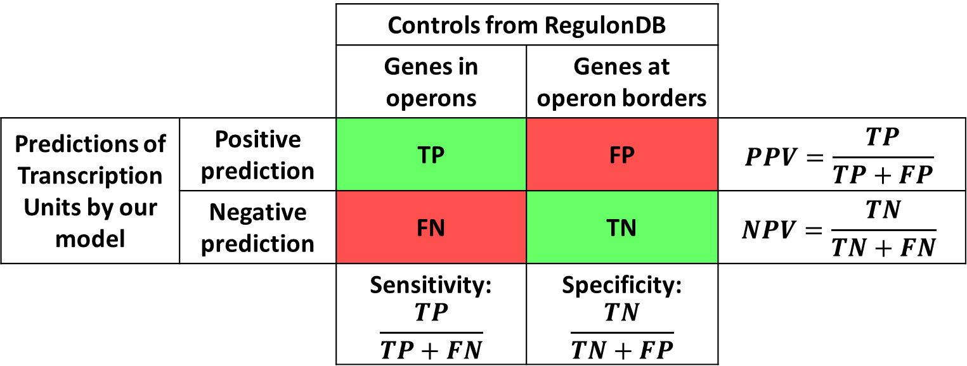
Benchmarking the model
 |  | Controls from RegulonDB
 |  | Genes in operons | Genes at operon borders
Predictions of Transcription Units by our model | Positive prediction | TP | FP | $$PPV=\frac{TP}{TP+FP}$$
 | Negative prediction | FN | TN | $$NPV=\frac{TN}{TN+FN}$$
 |  | Sensitivity: $$\frac{TP}{TP+FN}$$ | Specificity: $$\frac{TN}{TN+FP}$$
9

Slide 10









Related Calculations
$$Sensitiviy=\frac{TP}{TP+FN}$$
$$Specificity=\frac{TN}{TN+FP}$$
False Negative rate (FNr):
False Positive rate (FPr):
$$FNr=\frac{FN}{TP+FN}=1 −Sensitivity$$
$$FPr=\frac{FP}{TN+FP}=1 −Specificity$$
Likelihood ratio positive (LLp):
Likelihood ratio negative (LLn):
$$LLp=\frac{Senstivity}{1 −Specificity}=\frac{True Positive rate}{False positive rate}$$
$$LLn=\frac{1−Senstivity}{Specificity}=\frac{False negative rate}{True negative rate}$$
Positive predictive value (PPV):
Negative predictive value (NPV):
$$PPV=\frac{TP}{TP+FP}$$
(also known as Precision)
$$NPV=\frac{TN}{TN+FN}$$
Accuracy:
$$Accuracy=\frac{TP+TN}{TP+FN+TN+FP}$$
10

Slide 11
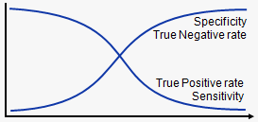


Sensitivity vs Specificity
$$Specificity=\frac{TN}{TN+FP}$$
Performance
$$Sensitiviy=\frac{TP}{TP+FN}$$
Posterior Probability threshold
11

Slide 12
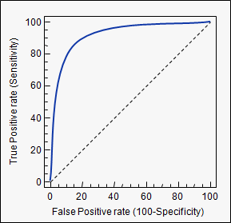


Receiver Operator Characteristic Curve
Perfect discrimination point
Illustrates the discrimination ability of a binary classifier as the decision threshold is varied.
$$TPr=\frac{TP}{TP+FN}$$
No-discrimination or chance line
$$FPr=\frac{FP}{TN+FP}$$
12

Slide 13
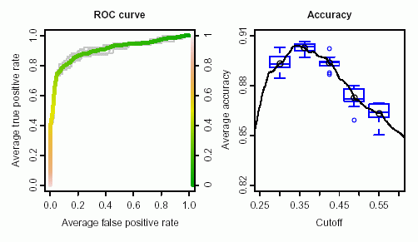
How to determine the best cutoff?
This is still very arbitrary because it depends on our goals.
Maximize the sensitivity (detect all true pairs of genes within operons) at the expense of specificity (lots of false positives)
If both are important than we can chose the value that maximizes the distance between the ROC curve and the upper left corner of the graph. Or we can estimate the average accuracy per threshold using a bootstrapping.
13

Slide 14
Create a SQL table to put your predictions
CREATE TABLE tus (
gid_1 INT (10) UNSIGNED NOT NULL,
gid_2 INT (10) UNSIGNED NOT NULL,
distance INT (10) UNSIGNED NOT NULL,
status ENUM('TP', 'TN') NOT NULL,
prob DOUBLE PRECISION NOT NULL,
KEY (gid_1),
KEY (gid_2)
) ENGINE=InnoDB;
14

Slide 15
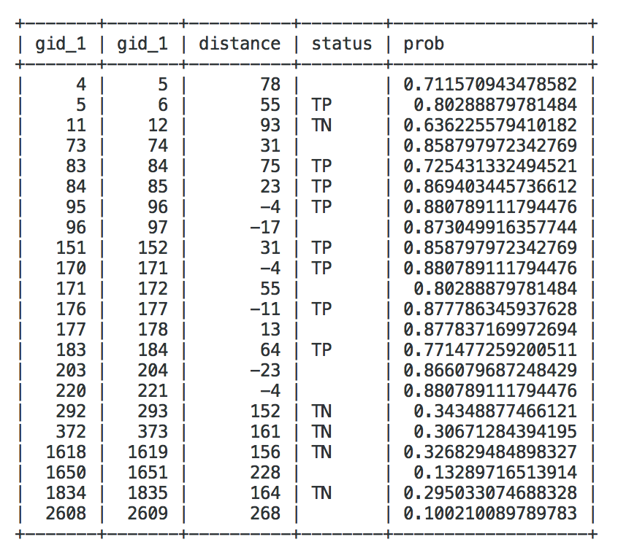
Load your predictions and tag TP and TN
With all pairs of adjacent genes in the genome and the list of TP and TN in our controls we can add the status TP and TN to our table.
For every probability threshold we define we can now estimate the Sensitivity, Specificity, Accuracy, etc.
15

Slide 16
Benchmarking the model
As starting point we will use all the gene pairs in our Positive and Negative controls.
For increments of 0.05 in the posterior probability calculate:
Sensitivity
Specificity
Positive predictive value (precision)
Accuracy.
Create the plot of Sensitivity vs Specificity in slide 11
Create the ROC curve in slide 12
Plot accuracy as in slide 13
16

