Slide 1
Bioinformatics Lab
Spring Quarter 2017
UCSD
BIMM 185
Instructor:
Arturo Medrano
l1medranosoto@ucsd.edu
Instructional Assistant:
Hanbin Lu
hal213@ucsd.edu

Slide 2
Genomic Sciences
Bioinformatics
Computer
Science
Mathematics
Analysis and
interpretation
Theories
Laws
Applications
Models
Tools
Biology
Engineering
Statistics
Physics
Biological Sciences
Data and
a priori
knowledge
Molecular
Biology
Molecular
Evolution
Experimental
Design
Biochemistry
Biostructures
Molecular
Genetics

Slide 3
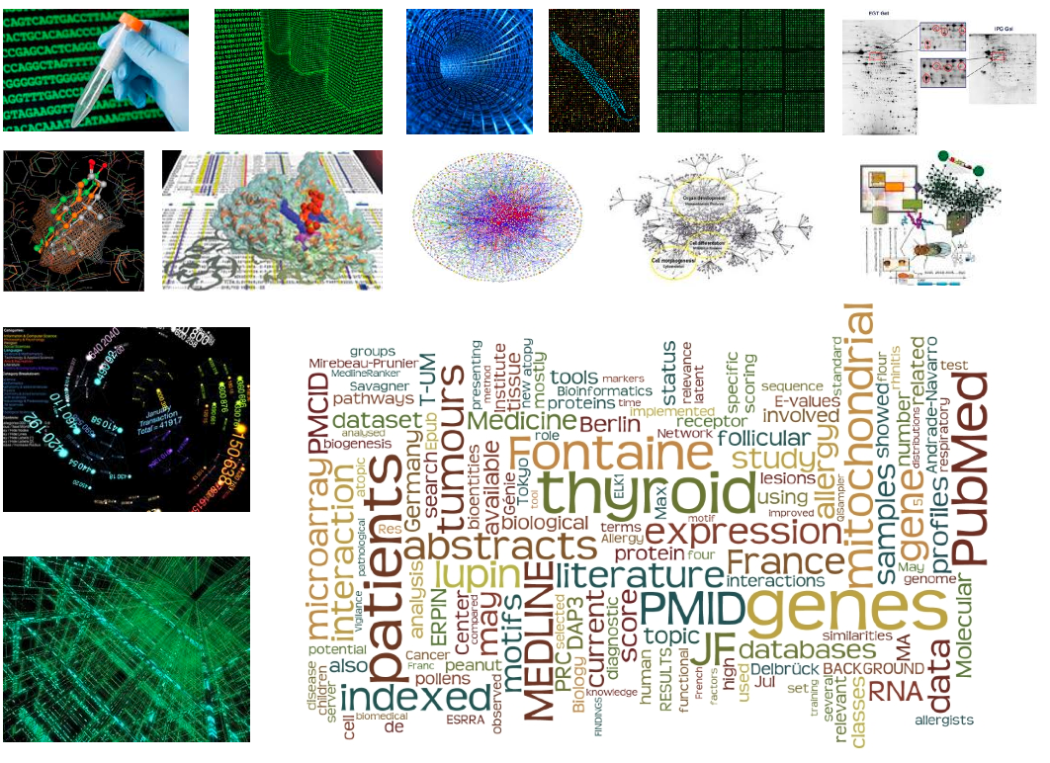

Slide 4
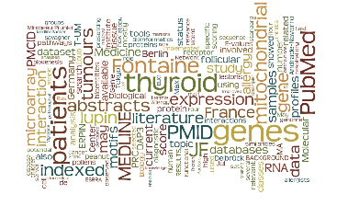
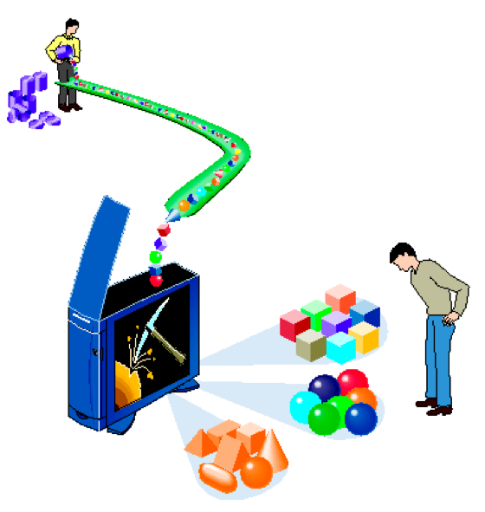
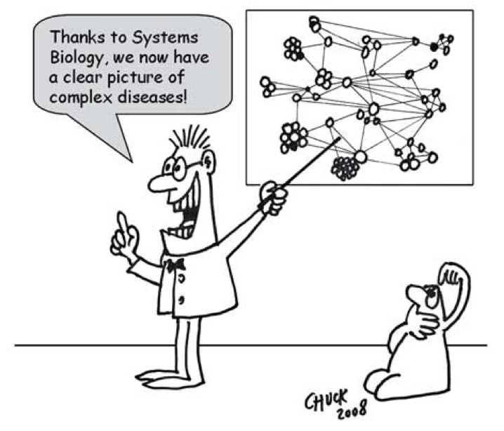
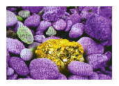
Raw Data
Data mining and knowledge Discovery are essential underpinnings of the Information age.

Slide 5
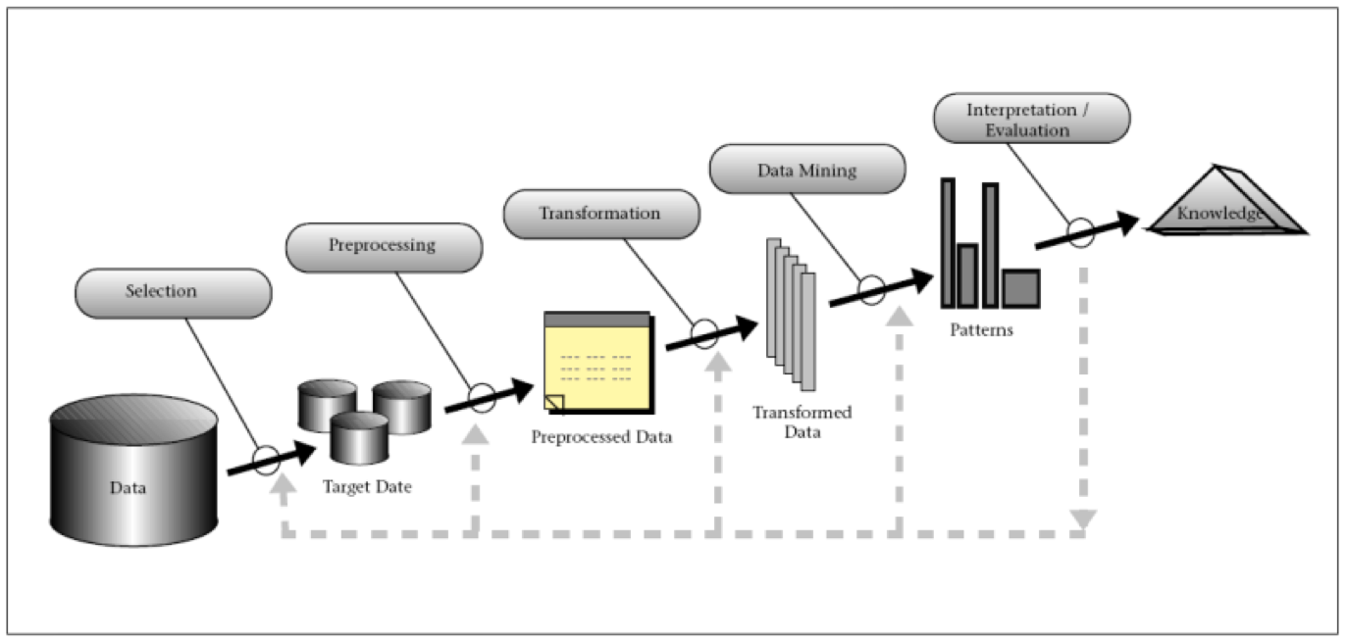
Knowledge Discovery
Throughout the process steps (i.e., variable selection, preprocessing, transformation, Data Mining and Interpretation) data processing plays a major role. Mastering the UNIX shell and a scripting language (e.g., python and perl) will greatly facilitate the bioinformatic process of knowledge discovery.

Slide 6
Two Modes of Practicing Bioinformatics
Expert user:
Understands current methodologies
Knows how to use existing tools
Designs blueprints of new strategies, models and methodologies
Developer:
Understands current methodologies
Knows how to use existing tools
Is capable of modifying/improving existing tools
Designs and implements new strategies, models and methodologies
Notes:
We will focus on the Developer mode

Slide 7
About this Course
We will focus on the Developer mode of practicing bioinformatics
Application of currently available software tools
Development of tools (pipelines, wrappers, brand new tools)
This class requires a high level of participation, engagement, and independent research
Attend classes
Complete assignments on time
Critical reflection
Keep a journal of what you learn in the lab. It will make it easier to write your reports.
Office hours will be set next week, but you can always contact me by e-mail and we can set up an appointment.
Notes:
Set the basis for understanding and using any bioinformatic tools

Slide 8
Grading
Quizzes and participation (15% )
Final Project (25%)
Weekly lab reports (60%)
No reports will be accepted after the deadline (Start of the class the following Tuesday).
No midterm and no final exams
NOTE: if for some extraordinary justifiable reason you can’t attend a lab session, you need to talk with Hanbin or me in advance. A quiz will be prepared to give you the opportunity to earn the points of the class you missed.
Notes:
Set the basis for understanding and using any bioinformatic tools

Slide 9
Connecting to the UNIX server
Open your Xterm client and connect to the servers:
ieng6-NNN.ucsd.edu (NNN are numbers between 240 to 254)
https://acms.ucsd.edu/info/vncgnome.html
Type: bm185s
You have all been assigned 10G of space in your accounts.
You can reset your password here:
http://acms.ucsd.edu/students/gpasswd.html
You can find information about your accounts/lab here:
https://sdacs.ucsd.edu/~icc/index.php
If you have any problem with the computers and your accounts, contact ETS:
https://acms.ucsd.edu/contact/index.html

Slide 10
The UNIX terminal
Basic commands (ls, cd, pwd, cat, cut, head, tail, mkdir, rm, cp, top, ps, jobs, etc.)
Using pipes. Redirecting output to a file.
Scripting
Aliases, environment variables, customizing your shell.
Resources
https://www.codecademy.com/learn/learn-the-command-line
http://linuxcommand.org/index.php
http://ryanstutorials.net/linuxtutorial/

Slide 11
The UNIX terminal
Getting help:
Many well-established programs haven an option -help or --help
sort --help
blastp -help
Accessing manual pages:
man sort
Listing files and directories:
List contents of the current directory: ls, ls ., ls -F, ls –lh, etc.
List all files that end in “.txt”: ls *.txt
List all files that contain the word “report” in the name: ls *report*
List the contents of a specific directory:
ls /some/random/dir (absolute path from the root of the system)
ls another/random/dir (path relative to the current directory)
ls ./another/random/dir (path relative to the current directory)

Slide 12
The UNIX terminal
Print the working (current) directory: pwd
Create directories:
mkdir dir (make a child directory)
mkdir –p dir1/dir2/dir3 (create a directory hierarchy)
Changing location to a different directory:
cd or cd ~ (change to home directory)
Changing to a specific directory:
cd /some/absolute/path or ls some/relative/path
cd .. (change to the parent directory)
cd - (change to the last directory where I was)
cd ~account (change to the home directory of a given account)
Deleting files and directories:
One file: rm file.txt Multiple files: rm *.txt
One dir and its contents: rm –r dir Everything in current dir: rm –r *

Slide 13
The UNIX terminal
Moving files and directories:
mv file.txt destination/dir (move file to a new directory)
mv dir another/dir (move one directory to another directory)
mv file_name.txt new_file_name.txt (change the name of a file)
mv dir_name new_dir_name (change the name of a directory)
Redirection:
Save the output of a command to a new file:
ls –l > new_file.txt
Append the output to the end of an existing file:
ls –l >> existing_file.txt

Slide 14
The UNIX terminal
Working with files
Print to screen all the contents of a file: cat some_file.txt
Concatenate the contents of several files:
cat file1.txt file2.txt file3.txt > concatenated_file.txt
Show the contents of a file page by page: less large_file.txt or more large_file.txt
Show the first 20 lines of a file: head -20 long_file.txt
Show the last 20 lines of a file: tail -20 long_file.txt
Count the number of lines, characters, words in a file:
wc –l file.txt (count lines)
wc –m file.txt (count characters)
wc –w file.txt (count words)
Cut columns in a file:
cut –f 2 file.txt (cut the 2nd column in a tab-separated file)
cut –f 1,3,5 –d ‘,’ file.txt (cut columns 1, 3, & 5 in a comma-separated file)

Slide 15
The UNIX terminal
Working with files … cont.
Sort the contents of a file:
sort file.txt (respects case) sort –f file.txt (ignoresq case)
sort –fr file.txt (reverse the result of sorting alphabetically and ignoring case)
sort –n file.txt (sort numerically) sort –nr file.txt (reverse numeric order)
Check the functionality of option –u and -k
Get the unique entries in a sorted file: uniq sorted_file.txt or sort –u unsorted_file.txt
Get the unique entries in a sorted file and report counts for repeated entries:
uniq –c sorted_file.txt
Get all the lines in a file that contain a given string: grep string file.txt
Same, but color the string that matches: grep –-color=always string file.txt
Using pipe (|) to pass the output of one program as input to another:
Concatenate two files, sort numerically, get the unique entries, and count repeated entries:
cat file1.txt file2.txt | sort -n | unique -c
Get the number of lines where a given string is present in a file:
grep string file.txt | wc –l
Get the number of sequences in FASTA format within a file:
grep ‘>’ file.txt | wc –l

Slide 16
The UNIX terminal
Environment variables:
Show all the shell variables in my environment: printenv
See the contents of the $PATH variable: echo $PATH
Add a directory to the contents of the of the variable $PATH:
export PATH=my/path:$PATH or export PATH=$PATH:/my/path
Use the value of a variable:
Define variable export MYPATH=/my/favorite/dir
Use it: cd $MYPATH or ls $MYPATH
Creating and using aliases:
Show all existing aliases in my shell: alias
Create a new alias:
alias mygrep=‘grep –color=always’ Use it: mygrep string file.txt
alias h=history Use it: h
alias ..=‘cd ..’ Use it: ..
Find out the location of a program in your shell:
which python or which blastp or which wc
NOTE:
You can add Shell variables and aliases to your configuration scripts to customize your environment:
~/.bash_profile
~/.bash_login
~/.profile

Slide 17
The UNIX terminal
Editing files:
In a comma separated file, replace all commas with tabs:
perl –pe ‘s/,/\t/g;’ file.csv > file.tsv
s/a/b/g; means Substitute every occurrence (globally) of string (or regular expression) a with string b
s/a/b/; means Substitute the first occurrence of string (or regular expression) a with string b
In all comma-separated files in this directory, replace commas with tabs, keep a backup copy of each original file, and attach an extension .bkp to each backup copy:
perl -i.bkp –pe ‘s/,/\t/g;’ *.csv

Slide 18
Scripting Challenge 1
Read file TCDB.faa with protein sequences in fasta format. Parse the headers and extract the IDs, such that you reformat the file in two columns where the first column is the ID and the second column the sequence in a single string, that is:
>gnl|TC-DB|1002048004|2.A.4.5.2 CDF zinc transporter 2 [Russula atropurpurea]
MHFGLNDRPEQVASA
TTYNDPYNIAHGLKTD
SSRMDVNKWPVGGA
Will be printed as:
2.A.4.5.2-1002048004 MHFGLNDRPEQVASATTYNDPYNIAHGLKTDSSRMDVNKWPVGGA

Slide 19
Scripting Challenge 2
Assume that file RS.txt.bz2 contains pairs of proteins (columns 1 and 2) that you predict are involved in physical interactions by the methods shown in column 3 with a given probability of interaction (column 4).
Hypothetical scenario: A collaborator wants to test your predictions in the laboratory and will attempt to co-express, co-purify, co-crystallize, and solve the 3D structure of the binary hetero-complexes you predicted. However, he can only test your best predictions.
For the first 2000 different reference proteins in column 1, extract all their inferred binding partners (column 2), and report for each reference protein a) the candidate binding partner with the highest probability of interaction, and b) the total number of candidate binding partners for that reference protein.
If we sort the resulting list of 2000 proteins by the probability column, we will be able to tell our collaborator which candidate interacting partners to take to the lab first.
In class we sorted by the number of interacting partners to easily compare top results.
If we plot the number of interacting partners vs the average (or top) probability of the interacting partners, we could try to answer the question of whether proteins that are involved in more interactions tend to be predicted with higher probability. Of course this is hypothetical as inference methods could overpredict or underpredict interactions, be biased, etc. But you get the idea….

Slide 20
Resources
Awk
http://www.grymoire.com/Unix/Awk.html
https://www.tutorialspoint.com/awk/
Perl
https://perlmaven.com/perl-tutorial
https://www.tutorialspoint.com/perl/
Python
https://www.learnpython.org/
https://www.tutorialspoint.com/python/
https://www.codecademy.com/learn/python

